Slide 1
Data exchange in the energy sector
Andries De Brouwer, Policy Officer DG ENER, Unit B4
September 2026

Slide 2
What I will cover today
Commission digitalisation and AI agenda for energy — from policy context to data exchange provisions
Part
Section
What I will cover
Slides
Core question
1
Policy context
Strategic Roadmap for Digitalisation and AI in Energy
4
Why is the EU acting?
2
AI in grids
Flagship action 4 and AI.grids as a practical use case for European grid AI models
5-6
What can AI do for grids?
3
Data bottleneck
Primary and secondary use of energy data; why access, quality and interoperability matter
8
Where is the gap?
4
Legal proposal
Article 18a data exchange provisions: operational exchange and secure reuse for research and innovation
9–12
What changes?
5

Slide 3
Introduction and context
Strategic Roadmap for Digitalisation and AI in the Energy Sector

Slide 4
Background - Roadmap
Flagship actions
Strategic Roadmap for Digitalisation and AI in the energy sector
Strategy for EU open digital ecosystems
Cloud and AI Development Act
Pillar I
Energy for AI
Chips Act 2.0
Pillar II
Digitalisation and AI for the energy system
Pillar III
Data for AI and the energy system
Securing the energy-AI nexus: trust, talent and global cooperation
Implementation
#1 A model tripartite agreement on data centres
#2 An EU rating scheme for data centres
#3 Key performance indicators for smart grids and smart meter rollout
#4 AI models across the energy value chain
#5 Simplified cross-border energy data exchange
#6 AI safety and cybersecurity of critical devices
#7 Tracking of digitalisation progress and improve energy data availability
European Tech
Sovereignty Package
Competitiveness Compass
Digital Decade policy programme
Communication on strengthening the EU’s economic security
Affordable Energy Action Plan
Joint Communication on an international digital strategy for the EU
AI Continent action plan
ApplyAI strategy

Slide 5
Flagship 4: Development of AI models across the energy value chain (1)
Objective: Build sovereign, secure AI models for the energy sector, trained on European data and developed by EU firms
Lead use cases:
  development of AI foundation models for grid management and planning
  digital portals with genAI at national level that accelerate permit review procedures for renewable, storage and grid projects; .
Follow-up use cases: renewables, nuclear safety, buildings etc
R&I funding: Horizon Europe 2026-27 earmarked about EUR 100 million for smart grids, EUR 75 million for AI technologies and about EUR 190 million for digital solutions in renewables, buildings and energy efficiency.

Slide 6
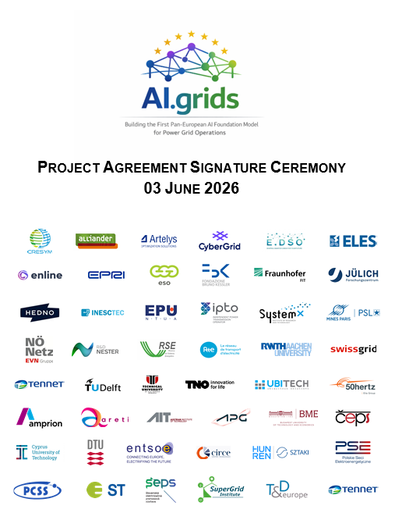
AI.grids: a Pan-European AI Foundation Model for Power Grids
What it is
Launched December 2025; 50+ organisations (TSOs, DSOs, research, tech)
First general-purpose AI foundation model for power system operations
Trained on diverse grid datasets: topology, time-series measurements, documentation
Coordinated by CRESYM; outputs shared with all European system operators
Applications (14 use cases consolidated)
The data challenge
Renewable generation forecasting & congestion management
Dynamic security assessment & flexibility management
Asset monitoring & AI-assisted operator decision support
Success depends on large-scale, high-quality datasets from system operators
Current EU law does not sufficiently incentivise sharing of operational & system data
A robust secondary-use framework is needed: governance, cybersecurity & trusted environments
AI.grids is not just a tool — it is a system-wide digital intelligence layer and critical infrastructure for European power grids.

Slide 7
Data Exchange

Slide 8
Strategic Roadmap - Pillar III – Data for AI and the energy system
Enabling smart energy services and AI through trusted, interoperable cross-border data exchange
Core problem: No coherent EU framework for energy data exchange — rules are fragmented, implemented inconsistently across Member States, creating barriers to cross-border smart energy services and AI development.
PRIMARY USE OF ENERGY DATA
Operational exchange: metering, billing, flexibility, grid operation
Rules exist but implemented inconsistently across Member States
Barriers to cross-border services (e.g. EV charging, demand response)
Priority: harmonised cross-border data interoperability & national data hubs
SECONDARY USE OF ENERGY DATA
Reuse and pooling for research, analytics, AI model training
No sector-specific EU framework exists today
Grid operators cautious; AI models rely on simplified or synthetic data
Priority: trust frameworks, data pooling, regulatory sandboxes
EU action to build upon:
Projects EDDIE, Enershare, Data Cellar,.. + INSIEME
Joint recommendation D4E – STF - CoW
EU action to build upon:
Project AI.Grids
HORIZON (2027): Large-Scale piloting of next-generation AI-driven digital platforms for a more affordable, secure and sustainable European energy system (IA) – Apply AI EUR 15 million
FLAGSHIP ACTION 5
EU framework for simplified cross-border energy data exchange — assessment 2026, development from 2027. Aims to reduce fragmentation, enable smart energy services at scale and support sovereign EU AI models.

Slide 9
Legal proposal to revise Electricity Regulation
EUCO mandate: Reduce system costs by improving grid productivity, including via network charges and use of innovative technologies
Smart Charges and taxation (Incentives)
Make cost-reflective, system-friendly charges the norm by incentivising:
a) Efficient grid operation (TSOs/DSOs)
b) Flexible consumption (users)
Increase transparency & performance monitoring, Enable targeted support
Electricity taxed less than natural gas
Smart Infrastructure (Enablers)
Smart meters:
a) ≥50% rollout by 2030, 75% by 2033
b) Enable demand response & dynamic pricing
Smart grids:
a) Smart Grid Indicators (ACER → NRAs)
b) Promote grid-enhancing technologies
Smart Data (Boosters)
Enable real-time, cross-system data exchange (TSO–DSO) to improve grid optimisation (flexibility, RES integration, congestion management)
Create a secure EU grid data exchange framework for data-driven innovation (incl. AI solutions)
Support scaling from pilots to EU-wide deployment
→ Lower peak demand → Less grid investment → Lower system costs → Lower bills
VdL SoU 2026: Moving AI from the screen to the real economy and society. (..) In our energy grids. Smart grids. We have world-class industries that sit on the highest-quality data. These data are a precious European treasure. They are what can power tailor-made industrial AI models.

Slide 10
Article 18a(4): Grid data exchange for smarter grid operation
Primary use of energy data: data is exchanged and used for the direct, original operational purpose of running the electricity system.
TSOs and DSOs must manage and exchange grid data so smart grids and data-driven tools can improve system operation.
⚡
Who?
▦
What data?
↔
How?
⌁
For what?
• Transmission system operators
• Distribution system operators
Electricity grid data:
Network topology and assets
Connection and capacity
real-time operational dataflows,
Voltage and congestion
Outages, dispatch and forecasts
• Cooperation and data-sharing agreements
• Harmonised use of grid data
• Compliance with Data Act Chapter III B2B
• To enable the development, deployment and effective use of smart electricity grids
• To develop and operate state-of-the arts digital data-driven solutions to support the monitoring, optimisation and coordination
• Integration of demand response, RES and flexibility
🛡
Safeguards / considerations
✕
What this is not
↗
Why now?
Impact
• Personal data only where anonymised data are not sufficient
• Use must support system operation
• Not a new central EU platform or data hub
• Not replacing existing cooperation — making it more explicit and future-proof
• More renewables and electrification
• More distributed flexibility
• More congestion and system complexity
• Need to improve grid productivity
• higher grid observability
• better congestion management
• more efficient use of existing grids
• lower system stress over time
Takeaway: Article 18a(4) turns grid data exchange into an operational obligation for smarter grids
with clear purpose, safeguards and system-efficiency rationale.
Draft visual explainer — Article 18a(4)

Slide 11
Article 18a(5) + 61(5b): secure framework for grid data reuse
Secondary use of energy data: reuse of that data beyond its original operational purpose, namely in a voluntary framework for research and innovation public-interest purposes
Grid operators, jointly facilitated by ENTSO-E and the EU DSO Entity, establish a voluntary secure electricity grid data exchange framework to develop digital solutions, including AI models, as a public European good
⚡
Who?
▦
↔
How?
⌁
For what purpose?
↔
Implementing act
What is used?
TSOs and DSOs
ENTSO-E + EU DSO Entity
Commission opinion / oversight
Electricity grid data
Expertise and digital resources
Secure processing environments
Coordinated arrangement
Voluntary participation
Governance, access and IP rules
Results available to all EU grid operators
Develop, test, integrate and deploy state-of-the-art digital solutions for grid operation and optimisation
Data models, formats and ontologies
Interfaces and interoperability
Secure processing environments
Liability, cybersecurity, risk mitigation and incident reporting
🛡
Safeguards / considerations
✕
What this is not
↗
Why now?
Impact
Confidentiality and security requirements
Compliance with energy law and GDPR, Data Act and AI Act
Commission opinion on coordinated arrangement + legally binding rules in implementing act
Not mandatory participation
Not unrestricted access to all energy data
Fragmented energy data access across Europe
High transaction costs and legal uncertainty
Need to scale trustworthy innovation and European AI for grid productivity
Trusted scale-up of AI and digital tools
Lower legal uncertainty
Broader access to resulting solutions
Takeaway: Article 18a(5) + 61(5b) create a trusted EU framework for voluntary cooperation on secure data reuse so grid operators can scale digital and AI solutions under common governance and safeguards.

Slide 12
Flagship actions
Strategic Roadmap for Digitalisation and AI in the energy sector
Strategy for EU open digital ecosystems
Cloud and AI Development Act
Pillar I
Energy for AI
Chips Act 2.0
Pillar II
Digitalisation and AI for the energy system
Pillar III
Data for AI and the energy system
Securing the energy-AI nexus: trust, talent and global cooperation
Implementation
#1 A model tripartite agreement on data centres
#2 An EU rating scheme for data centres
#3 Key performance indicators for smart grids and smart meter rollout
#4 AI models across the energy value chain
#5 Simplified cross-border energy data exchange
#6 AI safety and cybersecurity of critical devices
#7 Tracking of digitalisation progress and improve energy data availability
European Tech
Sovereignty Package
Competitiveness Compass
Digital Decade policy programme
Communication on strengthening the EU’s economic security
Affordable Energy Action Plan
Joint Communication on an international digital strategy for the EU
AI Continent action plan
ApplyAI strategy

