Slide 1
Fostering Grid Data Exchange
FSR Online Debate
Christine Materazzi-Wagner
28/09/2026

Slide 2
From data to decisions
→ the whole chain matters
data
models
scenarios
options
decisions
consumption
generation
congestion
etc.
all time horizons
purpose
time horizon
detail level
resolution
tools
potential future developments
historical trends versus ambitious targets
Results reflect input and algorithm
explanation of results and decision support
aim for optimised, efficient solutions reflecting targets (competition, security, sustainaibility)

Slide 3
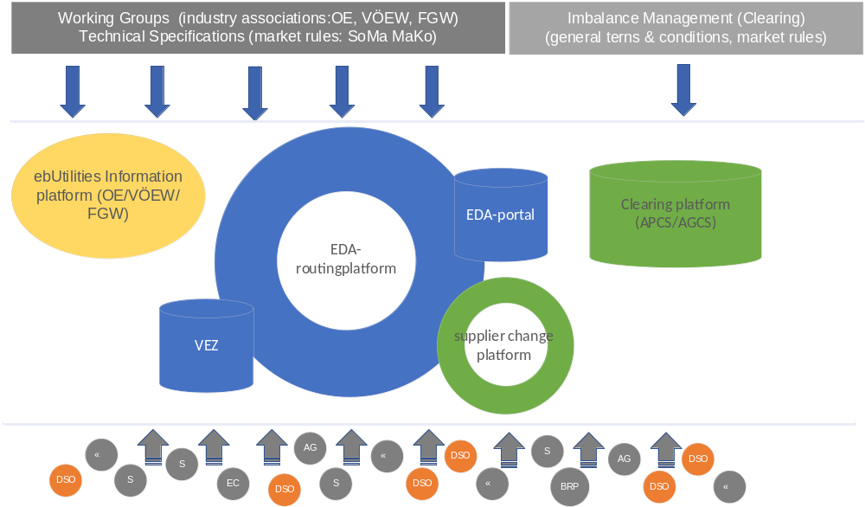
Next level data exchange in Austria
Next Level
new platforms (e.g. flexibility)
15-minutes-resolution
closer to real time
governance issues
new interfaces to control
new market roles
aggregator
peer-to-peer
self-consumption
energy sharing
DSO – Distribution System Operator; S – Supplier; EC – Energy Community; AG – Aggregator; BRP – Balancing Responsible Party
VEZ – “Verteilernetzübergreifende Energiezuteilung” (energy allocation for energy communities across the distribution grid);
EDA – “Energiewirtschaftlicher Datenaustausch” (data exchange across the energy sector)

Slide 4
Next level EU data exchange
Research and consultancy are interested to work on smart, innovative solutions.
Proper data must be the base for feasible results.
TSOs/DSOs do have the relevant data.
Electricity networks are critical infrastructure.
Hence, the challenge is to balance the benefit of proper data availability with the effort of a well functioning, secure and efficient framework (responsibilities, cost sharing etc.).

Slide 5
DI Dr. Christine MATERAZZI-WAGNER
500
Christine.Materazzi-Wagner@e-control.at

