Slide 1
Reflections on Five Implementation Aspects
FSR Online Debate
28 September 2026
Sofia Nicolai
Alessandra Porcari
Notes:
I am sofia Nicolai, research associate
Me and Ale will present the Policy Paper written together with Ellen, Lucila, Max, Alberto, Ncolò

Slide 2
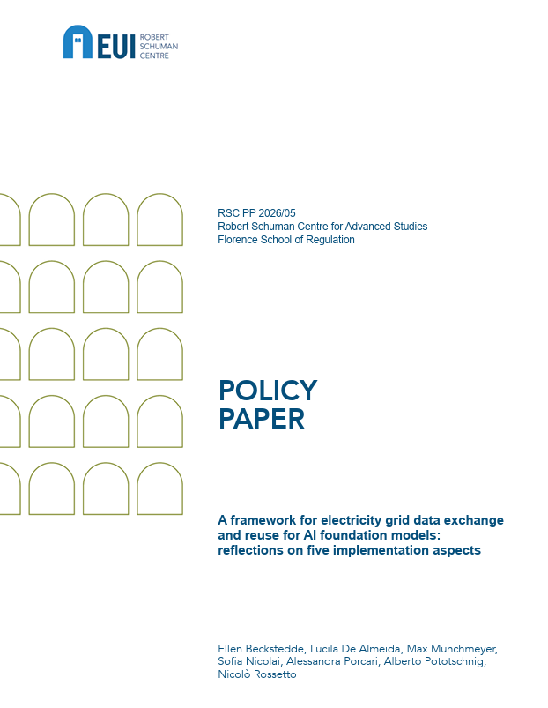
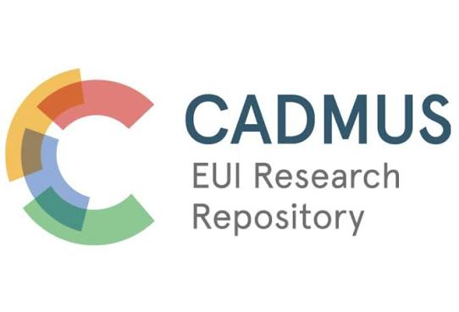
Available
Open Access here:
Notes:
The paper is titled ‘’
Which looks at the approach proposed by the European Commission and reflects on some of the implementation aspects that will have to be addressed if the reform is adopted as it is proposed.
Andries already presented the reform and the reasons underpinning it, therefore we jump right into the paper
We focus on the approach chosen by the Commission, being aware that much of the answers to the questions will also depend on the governance framework that will be deployed through the implementing acts.

Slide 3
Five implementation aspects
Who participates in the establishment of the grid data exchange framework?
Who pays for the costs associated with the framework and the development of the AI FMs?
Who owns the resulting AI FMs and their output?
Who bears liability when harm results from the use of those models? and
Which elements are to be considered when designing the implementing acts under Article 61(5b)?
Notes:
Assuming, as suggested by the reading of the Staff Working Document that accompanies the legislative proposal, that AI foundation models for electricity grids are part of the state-of-the-art technologies to which the proposal refers, this Paper explores and provides initial answers to the following practical questions: 1) who participates in the establishment of the grid data exchange framework?; 2) who pays for the costs associated with the framework and the development of the AI foundation models?; 3) who owns the resulting AI foundation models and their output?; 4) who bears responsibility when harm results from the use of those models?; and 5) which elements are to be considered when designing the implementing acts under Article 61(5b)?

Slide 4

Who participates in the establishment of the grid data exchange framework?
Voluntary framework, but the developed solutions must be made available to all TSOs and DSOs on request
Asymmetry: data are contributed by some operators, benefits flow to all → incentive to wait
Some TSOs/DSOs share grid data
All EU TSOs/DSOs can request use
Structure the charges and conditions for using the developed solutions so that they reward early and continued participation by all TSOs and DSOs, while keeping the framework voluntary
Notes:
Who participates?
Which actors should participate in the framework?
Article 18a envisages the establishment of the electricity grid data exchange framework as a voluntary initiative. Nevertheless, it imposes an obligation on TSOs and DSOs to establish such a framework. The imposition of an obligation to develop a voluntary framework raises questions about which entities are subject to such obligation, and what the obligation entails.
It is then to be determined whether the obligation is imposed on all EU TSOs and DSOs, or whether, instead, only a volunteering subset of these could be part of the group of entities working together to establish such a framework. The reading of the proposed new Article 18a seems to suggest the latter.
Main challenge identified
This setting of Article 18a is clearly characterised by a degree of asymmetry, as electricity grid data will be made available only by some TSOs and DSOs, while the state-of-the-art technologies which will eventually emerge from the use of such data to train AI foundation models will benefit all TSOs and DSOs.
In fact, Article 18a requires the TSOs and DSOs developing the electricity grid data exchange framework to “allow the use of the developed state-of-the arts solutions, by all European transmission and distribution system operators filing a request via the coordinated arrangement of ENTSOE and the EU DSO entity”.
Possible approaches
A more natural and symmetric setting would be one in which the data used to train the AI foundation models to develop state-of-the-art technologies to be used by all TSOs and DSOs were also provided by all TSOs and DSOs.
If such an outcome could not be achieved by imposing the obligation to take part in the electricity grid data exchange framework on all TSOs and DSOs, such participation could at least be strongly promoted and incentivised by appropriately structuring the charges for accessing the exchanged data and/or using the resulting state-of-the-art technologies

Slide 5
Who pays for the costs associated with the framework and the development of the AI foundation models?
High fixed and common costs
The framework as a spurious public good
Positive network externalities
Lack of mandatory participation
Difficult cost-allocation
Notes:
Who pays?
How should the framework and resulting AI foundation models be financed?
In any arrangement for the provision of a certain good or service, it is essential to identify who pays for the associated costs. In order to answer this question one needs to consider the features of the good or service delivered, including its production costs, and any other conditions that characterise the arrangement, including who is going to have access to that good or service
Main challenge identified
Some features make cost allocation difficult.
1) High fixed and common costs, incurred in the production of multiple products and/or the supply to multiple customers
2) spurious public good, once created, can be consumed by someone without such consumption preventing the consumption of the same goods by someone else, however, ‘excludable in consumption’, i.e. it is possible to exclude someone from their consumption at a reasonable cost
3) presence of positive network effects (The more system operators join the grid data exchange framework, the more grid data will be exchanged and the more valuable the exchange framework becomes
4) lack of mandatory participation
suggest the need to incentivise involvement via differentiated charging.

Slide 6
Who pays for the costs associated with the framework and the development of the AI foundation models?
Who should pay?
How much should each operator pay?
TSOs and DSOs
the primary users
Small identifiable share → by cost responsibility
Larger remainder → by ability to pay (operator size, e.g. revenues)
Network tariffs
Adjust the weights to reward early involvement in the framework
Consumers
the ultimate beneficiaries
Notes:
Possible approaches
Who should pay?
TSOs and DSOs are the primary intended users of the grid data exchange framework and of the AI foundation models for electricity grids. Both the framework and the models will benefit the system operators by improving their ability to operate the electricity system and perform their duties at a lower cost.
Therefore, according to the beneficiary-pays principle, it seems logical to ask electricity system operators, which use the AI foundation models, to finance the costs associated with the establishment of the framework and the development of AI foundation models for electricity grids. In turn, these costs will eventually be passed on to the ultimate beneficiaries of the activities carried out by the electricity system operators, namely the electricity network users.
How much should each operator pay?
As cost causality may be difficult to identify, the possibility to ‘split’ the bill among electricity system operators based on cost reflectivity is likely to be limited.
In this case, the allocation rule should minimise any distortion in the users’ behaviour and, therefore, it could make sense to resort to some type of proportional cost allocation rule or even to some hybrid approaches. For instance, any share of the costs for which cost causality can be identified could be allocated in proportion to the cost responsibility of each system operator, while the remaining share, likely to be much larger, could be allocated in proportion to other parameters, such as the ability to pay of the various system operators, which could be linked to their size
In particular, some weights could be adopted to adjust the proportional allocation of costs in order to promote early involvement in the grid data exchange framework and the development of AI foundation models by as many system operators as possible.

Slide 7
Who owns the resulting AI FMs and their output?
Contractual arrangements performing an ownership allocative function
Absence of an ownership regime for AI FMs under EU IP law
Art. 18a(5) empowers ENTSO-E and the EU DSO Entity to define intellectual property management and the means of accessing the state-of-the-art solutions
Work-for-hire arrangement
Licensing
Joint-ownership
Model
as-a-service
Notes:
EU intellectual property law does not provide a clear ownership regime for AI foundation models themselves [neither as a trade secret arrangements, considering the potential classification of high risks of AI applied into grids and the consecutive disclosure obligations]. As a result, ownership and access rights are likely to be determined through contractual mechanisms.
Article 18a(5) confers on the ENTSO-E and the EU DSO Entity the power to define – and communicate to the commission – a number of aspects, including intellectual property management and the means of accessing the developed state-of-the arts solutions.
You can find in our paper an overview of different contractual archetypes which can perform an ownership allocative function:
work-for-hire arrangements
Licensing
Joint ownership arrangement
Software-as-a-service

Slide 8
Who owns the resulting AI FMs and their output?
Alternative approaches
If the AI model is trained predominantly on grid data and financed through network tariffs → system operators’ ownership (individually or collectively through ENTSO-E and the EU DSO Entity).
If the technology developer and system operator co-shared the development costs → joint ownership
In any case: FRAND-style access obligation
Risk of vendor lock-in
AI developers as gatekeepers of a spurious public good financed through tariffs
Notes:
Our main concern is that if governance rules are not carefully designed, AI models developed using regulated grid data could become effectively controlled by private vendors, although the system operators are those providing access to data and, most likely, testing them. (We therefore see a risk of vendor lock-in.
We propose some possible approaches:
First, if an AI foundation model is trained predominantly on regulated grid data and financed through network tariffs, ownership of that model should not be with the vendor, but with the system operators themselves.
Second, As an alternative, if the development costs are co-shared with the technology developer and the system operator, joint ownership might be considered
Even where AI models remain owned or co-owned by one or more system operators, jointly or not with technology developers, they must be subject to a FRAND-style access obligation. (Fair, Reasonable and Non-Discriminatory)

Slide 9
Who is liable when harm results from the use of those models?
THE CURRENT EU FRAMEWORK
Challenging aspects
AI Act
Contains no liability rules.
Many segments: AI can be deployed across the whole energy system
AI Liability Directive
Proposal withdrawn in October 2025: fault-based claims remain national
Many functions: from direct safety functions to decision support
Revised PLD
Strict liability now covers software and AI; AI providers count as manufacturers.
Many actors: AI providers, TSOs, DSOs, energy suppliers and others
8
Notes:
Article 61(5b)(c) of the EMR, as amended according to the proposal, empowers the Commission to adopt implementing acts setting out requirements to enable the secondary use of energy data. These requirements are to address, inter alia, liability rules.
Why is this a challenging regulatory aspect?
(i) AI models may be deployed across different segments of the energy system, (ii) they may perform a range of functions, from direct safety functions to decision-supporting tasks,32 and (iii) multiple actors may be involved, including AI providers, TSOs and DSOs, energy suppliers, among others.
EU law leaves some gaps.
The AI Act does not establish liability rules.
The proposed AI Liability Directive was withdrawn in October 2025, so fault-based AI liability is largely left to the Member States. This creates the possibility of different national approaches.
The revised Product Liability Directive does cover software and AI, meaning AI developers/providers can be treated as "manufacturers" for relevant product-liability claims. But it doesn't cover every type of damage. For example, damage to an electricity network caused by an AI system malfunction may fall outside its scope and therefore have to be addressed under national liability law.

Slide 10
Who is liable when harm results from the use of those models?
Implementing acts have to set out requirements addressing liability
Strict liability
Shared fault-based
Standardised contracts
System operators, as AI “deployers” → deployment, monitoring, human oversight and over-reliance
AI providers → design, development, training and testing defects.
Liability irrespective of fault: damage from models built on reused grid data falls on the relevant system operator.
Contractual requirements (risk allocation, insurance, compensation) without a harmonised regime.
Any option must respect Art. 291 TFEU: implementing acts cannot amend or supplement the basic act. The right choice depends on the framework’s governance, and guidance from the co-legislators would be desirable.
8
Notes:
We discuss some possible ways in which the implementing acts can set out requirements addressing liability (61(5b))
Strict liability – shared fault based – standardised contracts
Probably, among these options, shared fault-based liability may be the most aligned with existing responsibilities in the electricity sector, as this is the liability regime that system operators are subjected in general at the national level. Auch approach would imply that operators remain responsible for system operation and AI providers are responsible for defects in model AI design and development.
In any case, we remark the importance of respecting the limits set out by the TFEU: implementing acts cannot amend or supplement the basic act. For this reason, given that the spectrum of policy options concerning liability is potentially broad, guidance from the co-legislators might be desirable to ensure a lawful exercise of implementing powers by the Commission.

Slide 11
Which elements are to be considered when designing the implementing acts under Article 61(5b)?
Coordinate with Art. 18a(5)
One framework
Safeguards for reuse alone may be insufficient if researchers and innovators cannot access large and sufficiently diverse datasets
Art. 18a(5)
access & availability of grid data
Art. 61(5b)
conditions for reuse
Reflect the specificities of AI
The AI Act does not apply to research, testing and development activities prior to placing a system on the market or putting it into service
Coherence, not duplication
The accumulation of compliance, certification and reporting obligations across different legal instruments could create complexity and costs for participants in data-sharing arrangements
Existing EU acquis:
data · AI · cybersecurity
10
Notes:
We provide 3 considerations:
Article 61(5b) with Article 18a(5) should operate as complementary parts of a single framework. Simply allowing data reuse is not enough if researchers and innovators cannot access sufficiently large and diverse datasets. This is because The value of the reform in terms of innovation for grid management, including AI development, ultimately depends on the availability of such datasets.
AI systems go through development, testing and validation stages, and the AI Act does not apply to research, testing and development before a system is placed on the market or put into service. The implementing acts should therefore be designed around the practical needs and risks of developing AI using grid data
They should not create new, parallel obligations or requirements such as separate AI risk classifications, certification systems or incident-reporting regimes. Instead, they should clarify how existing requirements apply to electricity-grid data sharing.

