Slide 1

Lidia Tamellini, Policy Expert on EU industrial decarbonisation
FSR Online Debate "EU ETS 2026 revision: what's next?"
22 June 2026

Slide 2
INTRODUCTION
Climate crisis is getting worse (also in the EU)
  … and it doesn’t care about politics and economics
ETS plays critical role
  Long term and predictable signal for business case for deep industrial transformation
  Use of revenues
  Making polluters pay
  Signal to international partners
    Carbon pricing is expanding fast

Slide 3
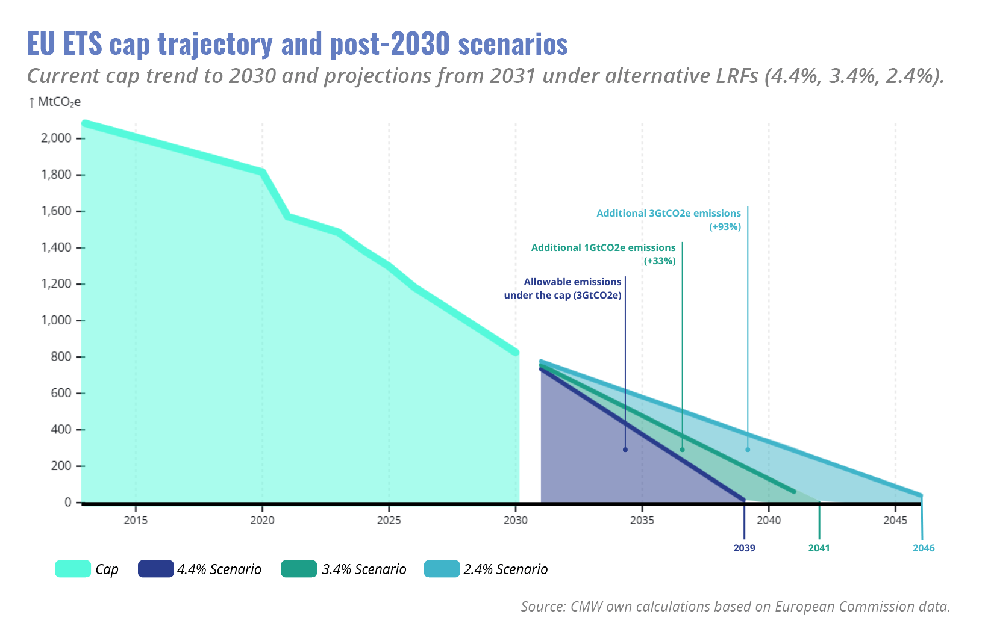
Want a new cap? Make it carbon budget neutral
The ETS doesn’t need any additional supply until 2036
Small changes to LFR have massive impacts on carbon budget (2.4% → 3 billion extra tonnes of CO2e)

Slide 4
Want a new cap? Make it carbon budget neutral
If more “emissions space” is needed, that’s an argument for scope extension
Waste incineration should be included
Aviation
  Two-thirds of carbon emissions from private jets are not covered
    All departing and arriving private jets must be covered with a multiplier of four (+€1.2B/yr by 2030)
  Include all EEA flights (departing and returning) to generate an extra €19 billion annually by 2030

Slide 5
Freebies have prevented investments: eliminate them once and for all
Free allocation is a wasteful failure - it must be phased out.
2008-2021: €200 billion of free allocation
  Windfall profits are still an issue
  90% of industrial emissions are free
  Since 2021: 97% of total EU EI industry pollutions
Court of Auditors: FA hampers industrial decarbonisation

Slide 6
Freebies have prevented investments: eliminate them once and for all
Make any residual freebies conditional on climate investments
Strict investment conditionality:
  Investments into real, additional and meaningful decarbonisation.
  Investments of similar values, similarly to what has been proposed in the Temporary Decarbonisation Fund
Opposing conditionality shows lack of commitment

Slide 7
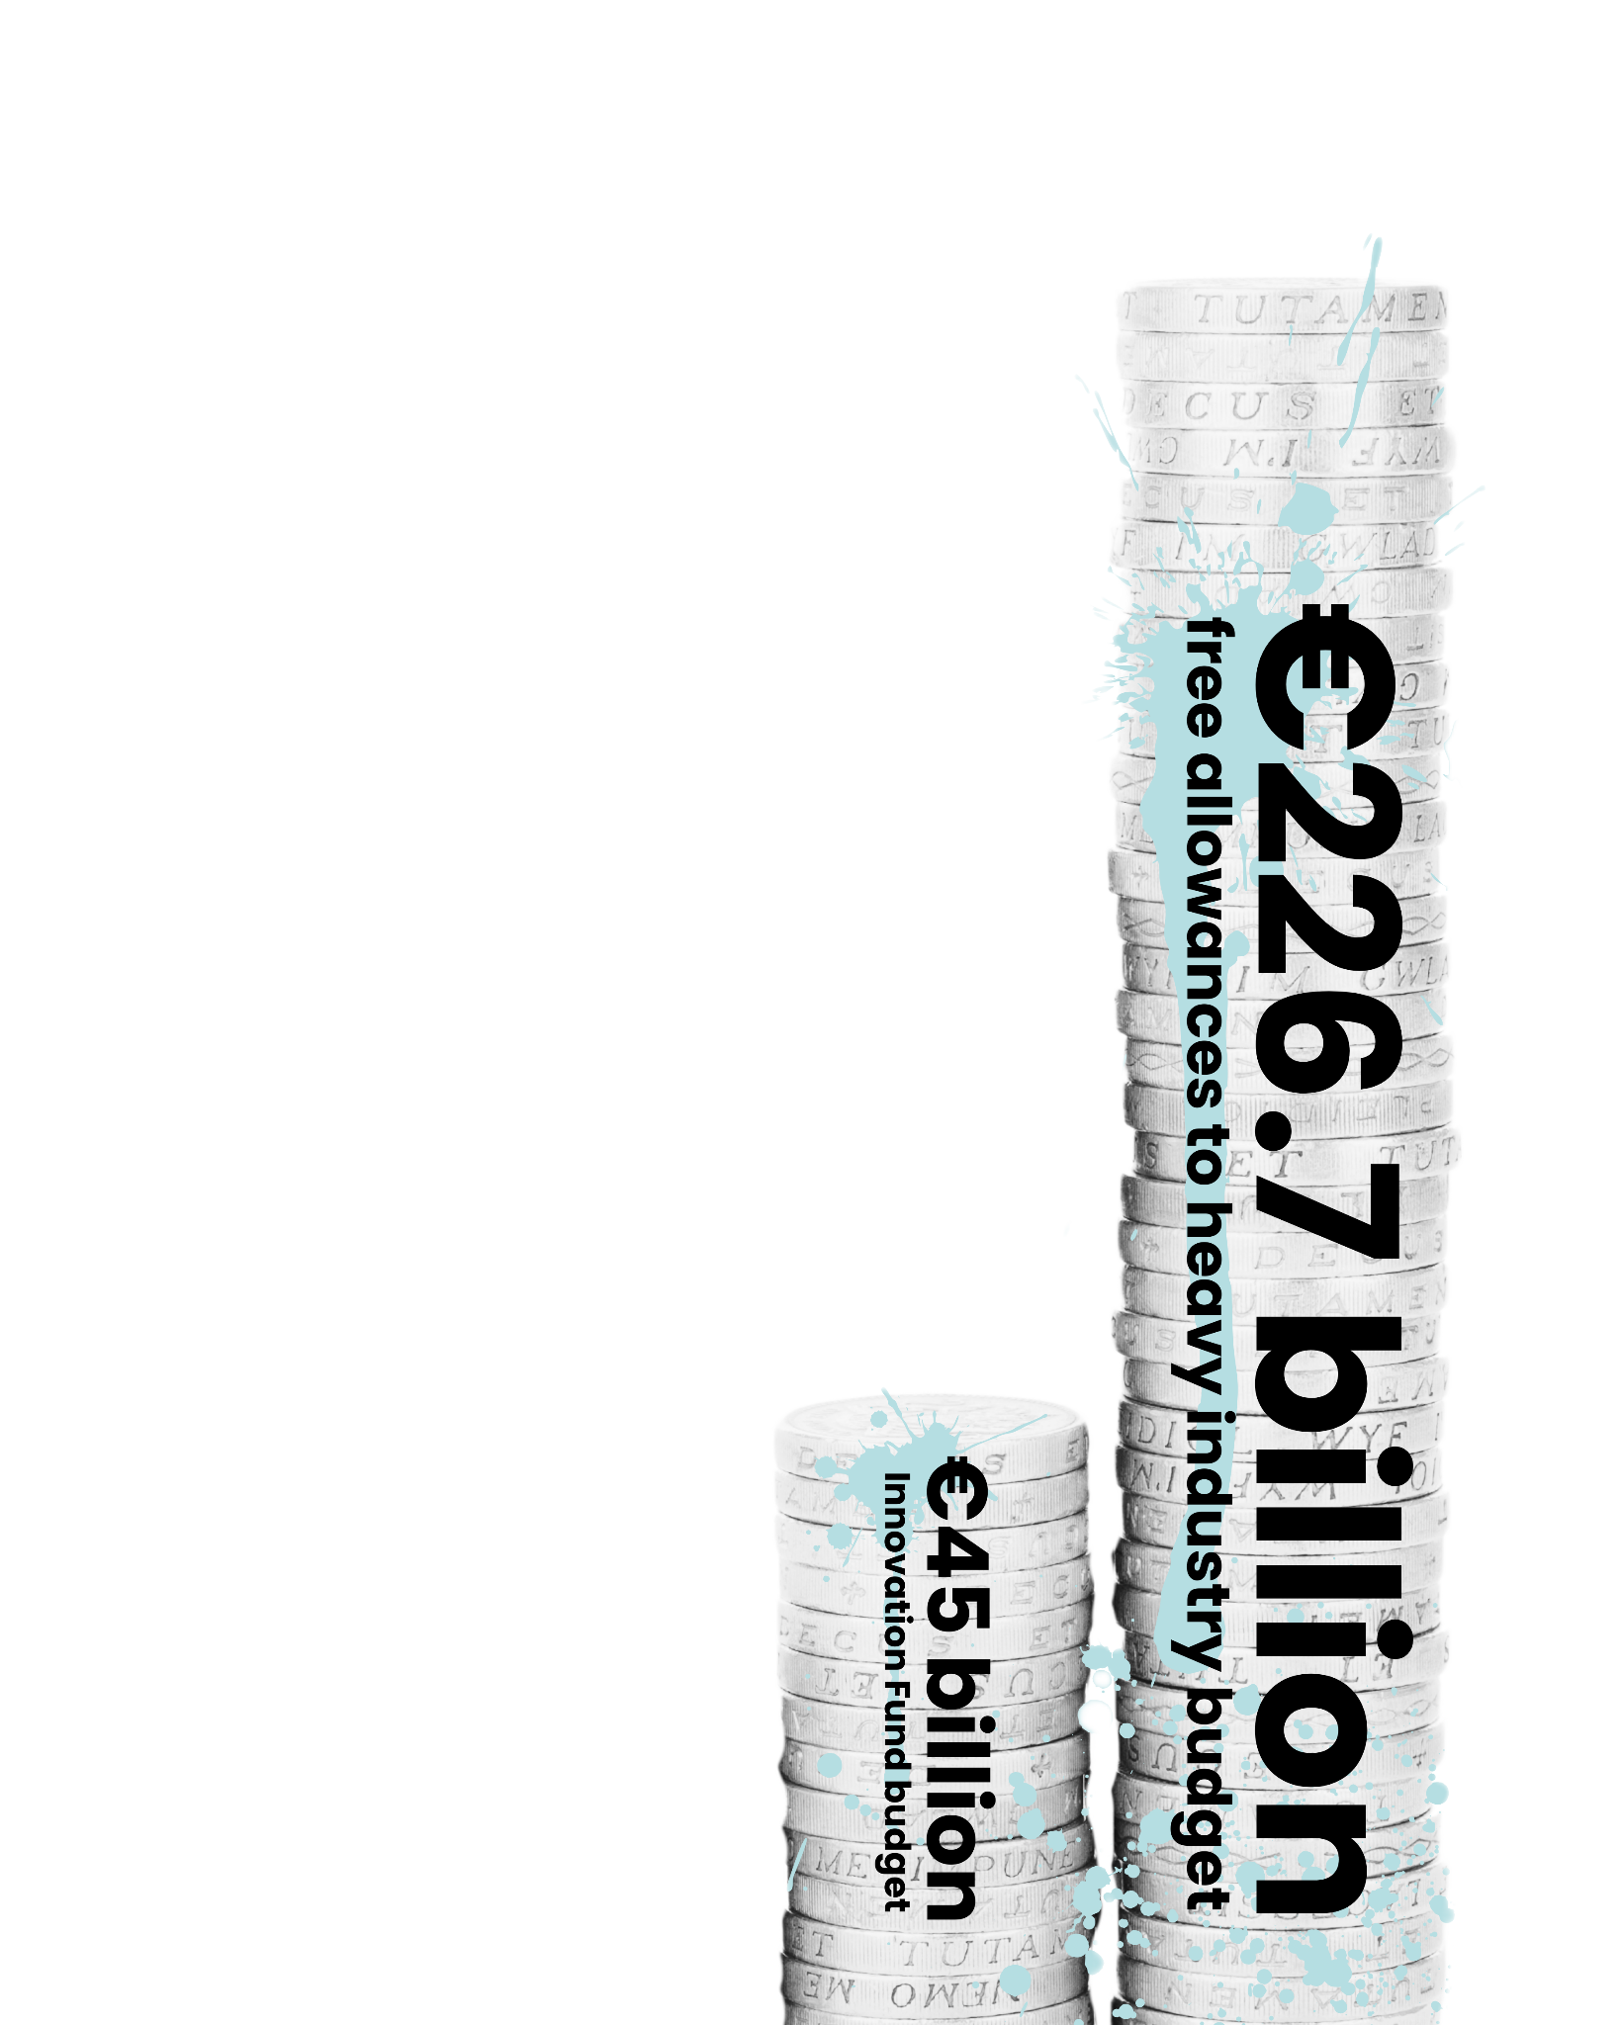
Use revenues wisely: kick out fossil fuels subsidies
Too many revenues are being wasted
List of funding priorities is outdated and needs a fundamental overhaul
  Prioritise emission reductions
  International finance commitments
  ‘People first’ approach
  Also fund industry, but not only
  Top-up SCF with ETS1 revenues

Slide 8
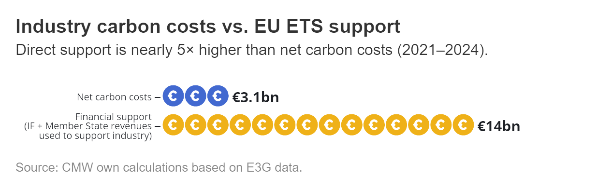

Slide 9
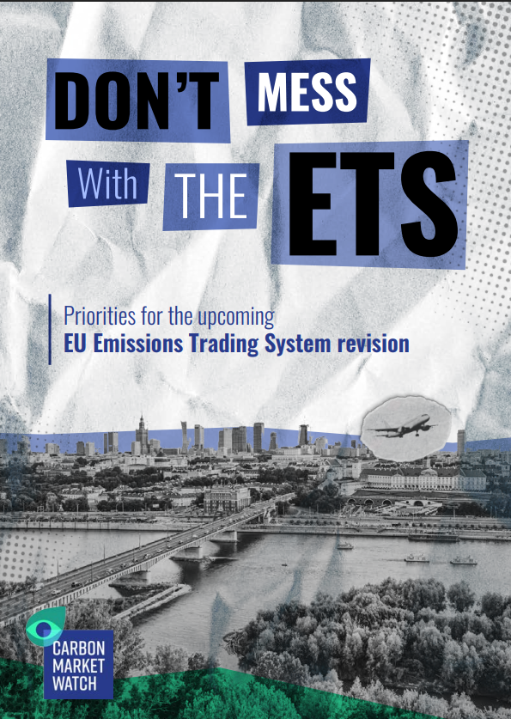
Stay the course.
Don’t mess with the ETS
Lidia Tamellini
lidia.tamellini@carbonmarketwatch.org
www.carbonmarketwatch.org
@CarbonMrktWatch

