Slide 2









Project Team
Simone Borghesi,
Director
Alessia Casamassima,
Research associate
Jacopo Cammeo,
Research associate
Lea Heinrich,
Project associate
Marie Raude,
Research associate
Simon Quemin, Data monitoring advisor
Albert Ferrari, Training course collaborator

Slide 3
2027 Executive training on EU ETS and International Carbon Markets
First edition: 8-9 February 2027, Residential at EUI in Florence (Italy)
Day 1: the EU ETS's design, functioning, impacts, and new developments in light of the 2026 reform.
Day 2: the international picture focusing on CBAM, Article 6, voluntary markets, credits, and removals.
Learn directly from EU policymakers, industry practitioners, leading academics, carbon-market specialists.

Slide 4
EU ETS 2026 revision: what’s next?
Online debate,
23/06/2026
Panelists interventions
Audience Q&A
Welcome and Introduction
Topic presentation

Slide 5
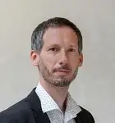
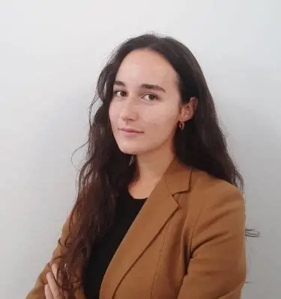
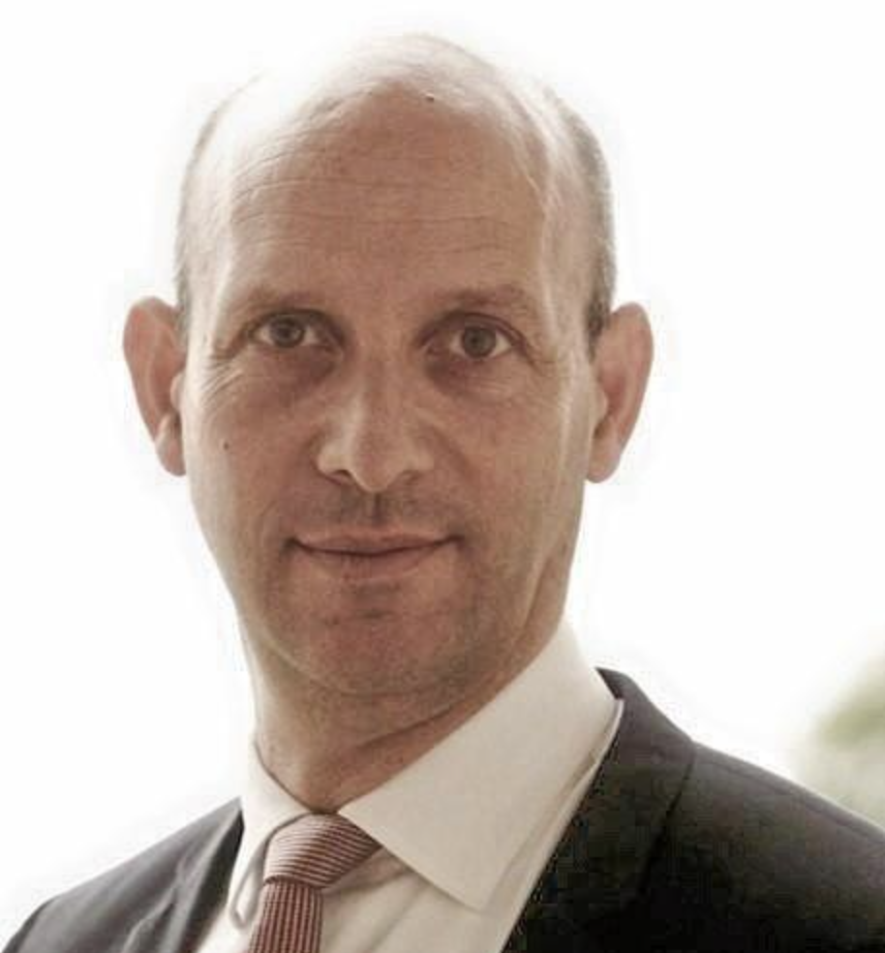
Panel of the online debate
Michael Pahle (Head of WG Climate & Energy Policy, Potsdam Institute for Climate Impact Research)
Lidia Tamellini (Policy Officer, Carbon Market Watch)
Daniele Agostini (Head of Energy and Climate Policies, ENEL)

Slide 6
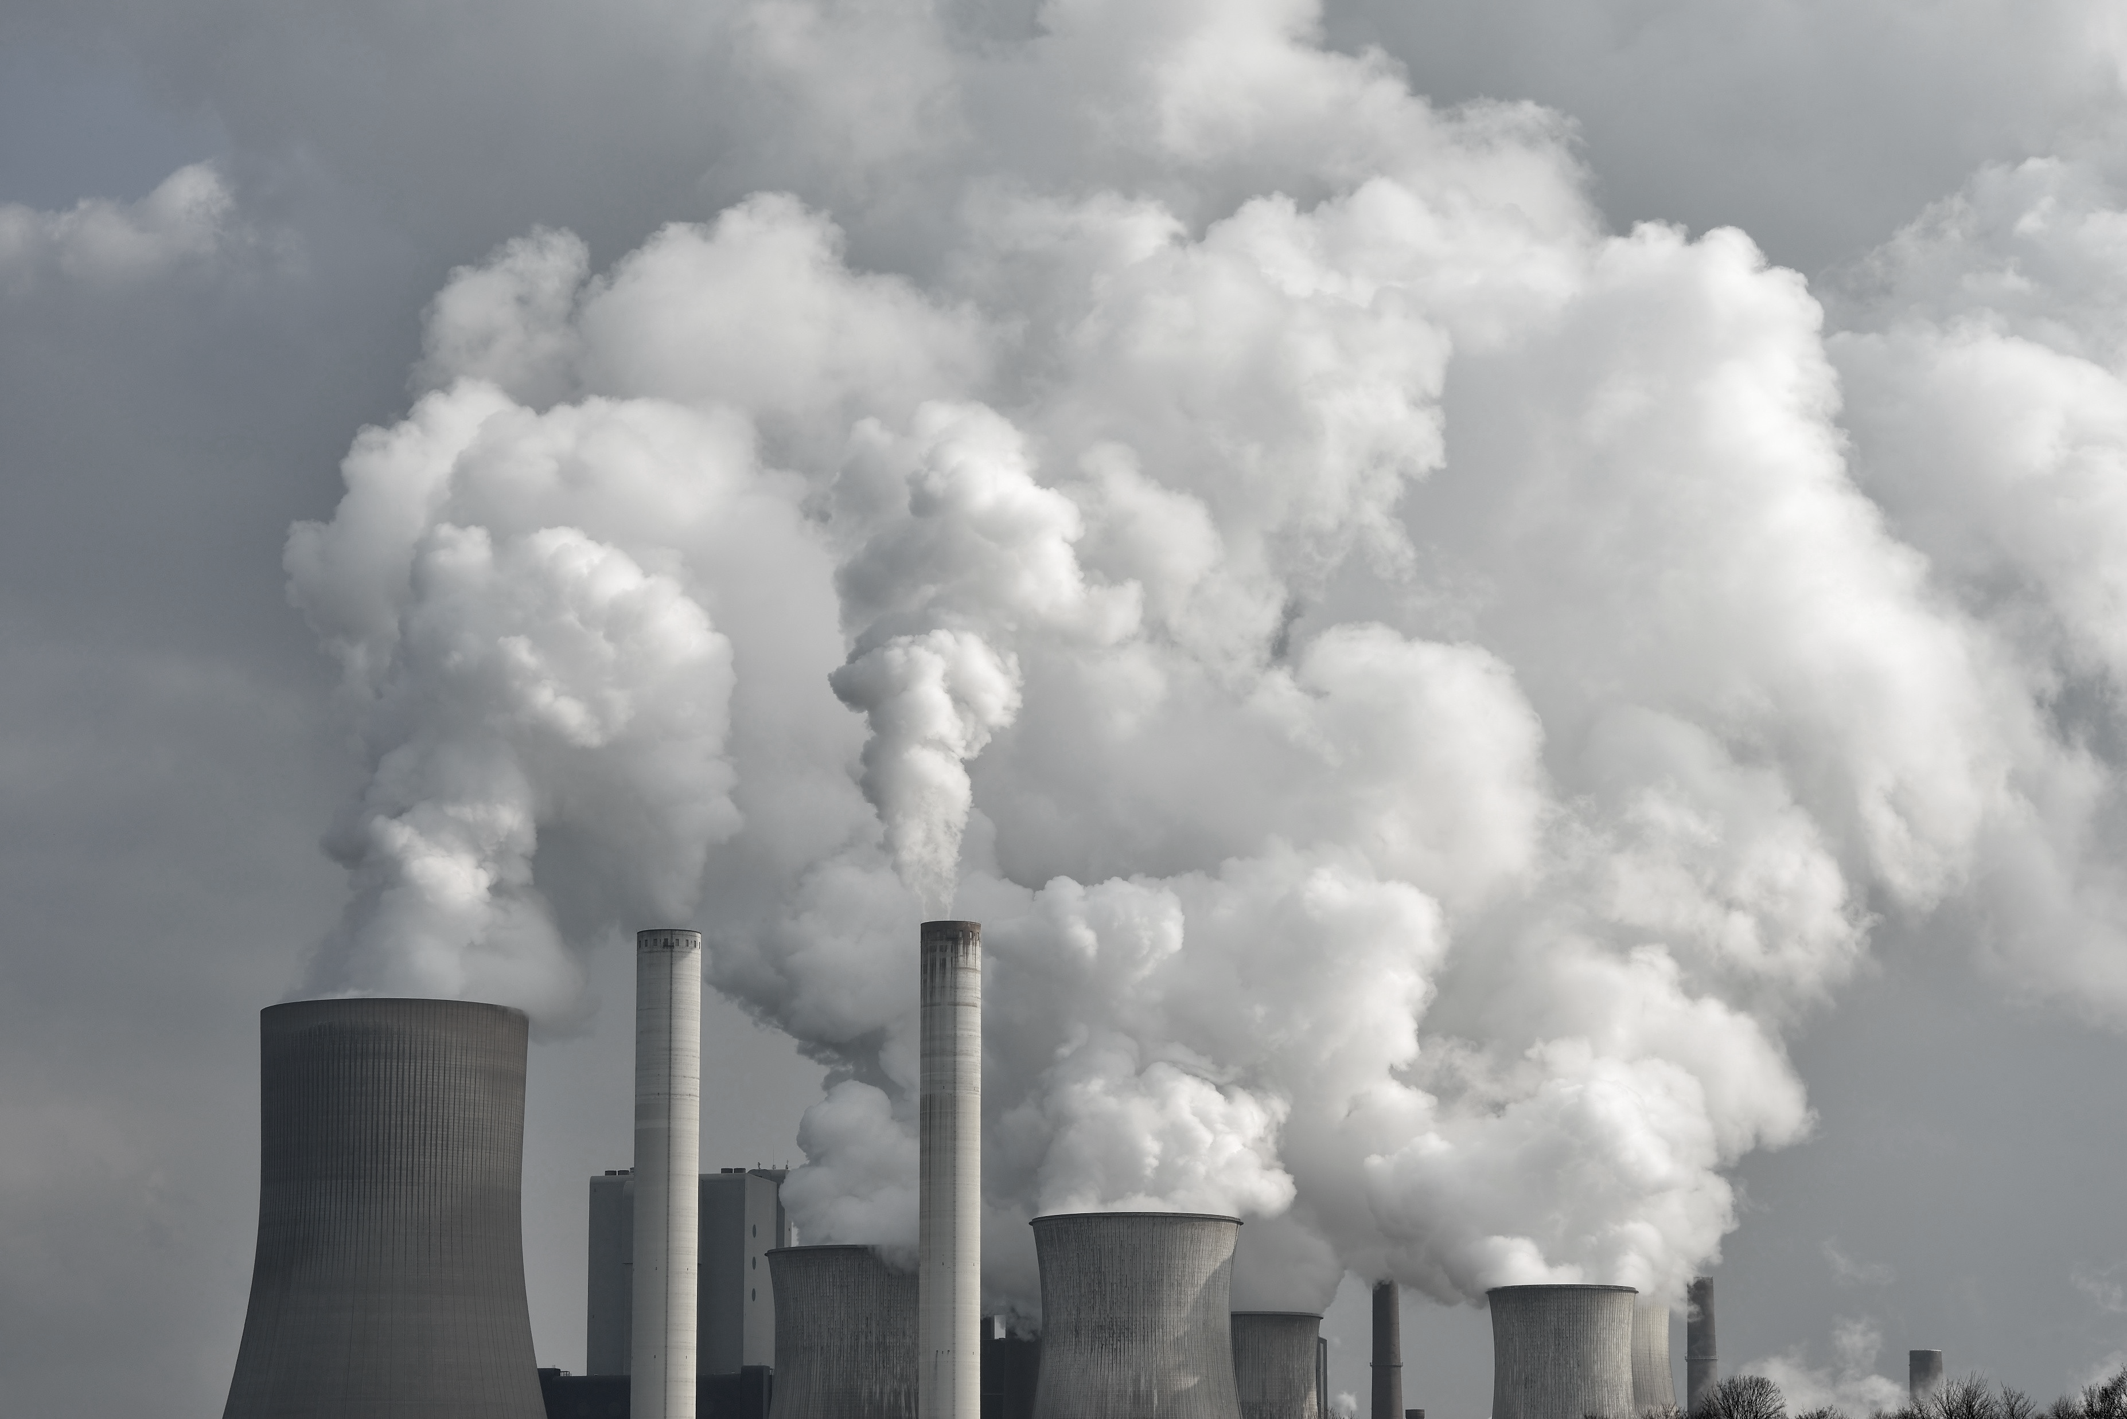
Where we stand
A cornerstone under pressure
Main concerns on EU ETS1 and EU ETS2.
Why 2026 EU ETS review is decisive.
EU ETS1: key climate policy tool.
  Contributed to a reduction of 50% of GHG from 2005-2025
  Over the period, total revenues exceeded €250 billion
High carbon costs => competitiveness loss
High energy prices => distributional aspects
New 2040 climate target (net –90% vs 1990)
It will shape the system for 2031-2040

Slide 7
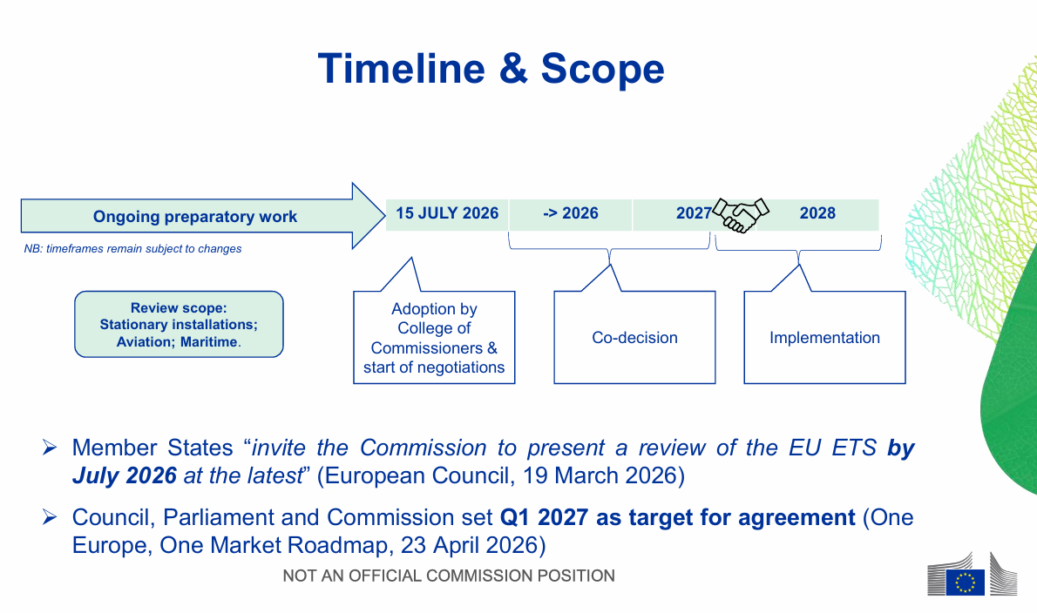
Potential timeline
High-level stakeholder roundtable on the EU ETS review on 12 May 2026
Source: Directorate-General for Climate Action (2026)
Notes:
On 12 May 2026, the European Commission’s hosted a high-level stakeholder roundtable on the review of the EU Emissions Trading System (EU ETS), bringing together close to 60 representatives from a wide range of industry, aviation and maritime sectors covered by the EU ETS, as well as civil society organisations and other relevant stakeholders such as auction platforms and market analysts.

Slide 8
What's on the table
Open questions
Making the system fit for 2031-2040
Scope: including waste incineration, small installations, smaller ships, non-CO₂ aviation effects.
Market Stability Reserve: recalibrating it to curb volatility and keep the market liquid as the cap shrinks.
Carbon credits and carbon removals: complementary measures, risk of crowding out domestic CO₂.
Protecting industry
Carbon leakage: CBAM and free allocation
ETS revenues and the Industrial Decarbonisation Bank
International linking to other carbon markets
Fairness and public acceptability
Revenue justice: transparency on how Member States spend revenues
Household costs: investing in the Social Climate Fund
Notes:
Carbon removals: whether (and how) to count permanent removals against residual, hard-to-abate emissions
Scope: whether to bring in new sources: waste incineration, small installations, smaller ships, non-CO₂ aviation effects
Market Stability Reserve: how to recalibrate it to curb volatility and keep the market liquid as the cap shrinks

Slide 9
Framing question
Which design choices in the 2026 revision are most critical to preserving the industrial competitiveness, fairness, and acceptability, while delivering the 2040 target?

Slide 10
Panel of the online debate
Michael Pahle (Head of WG Climate & Energy Policy, Potsdam Institute for Climate Impact Research)
Lidia Tamellini (Policy Officer, Carbon Market Watch)
Daniele Agostini (Head of Energy and Climate Policies, ENEL)

Slide 11

Website: https://lifenets.eui.eu/
Thank you!

