Slide 1
Connecting High-Speed Rail to Urban Mobility: the Île-de-France case study

Slide 2
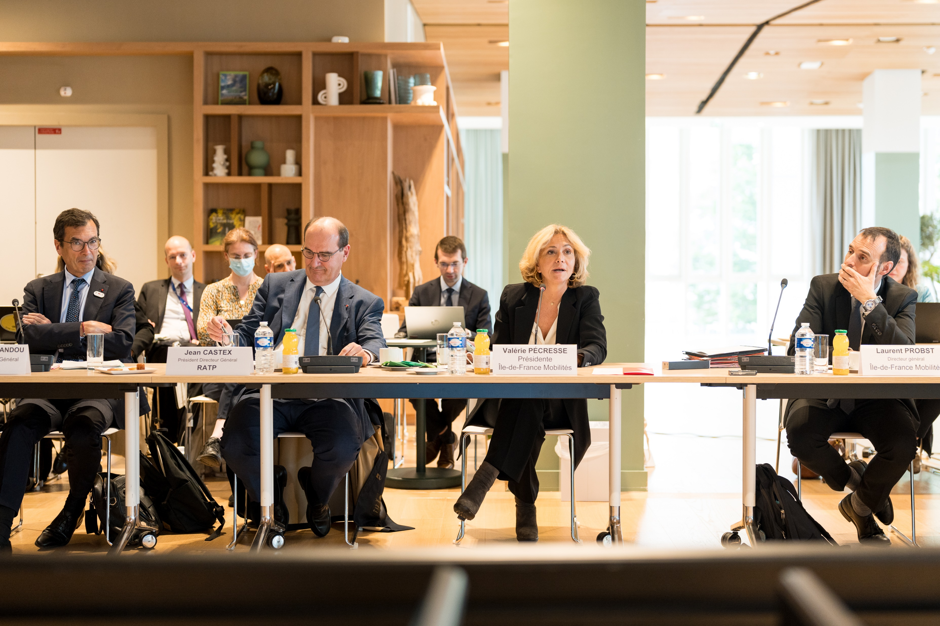
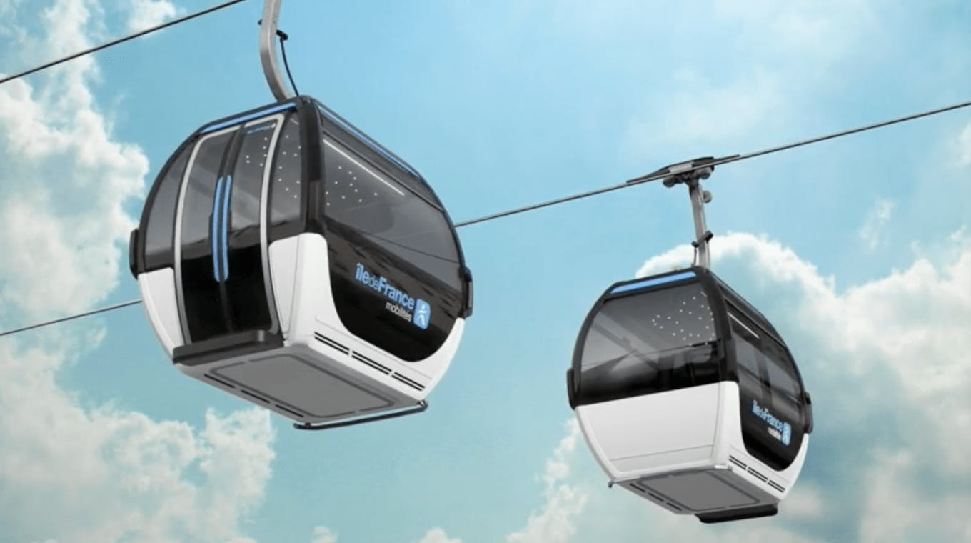
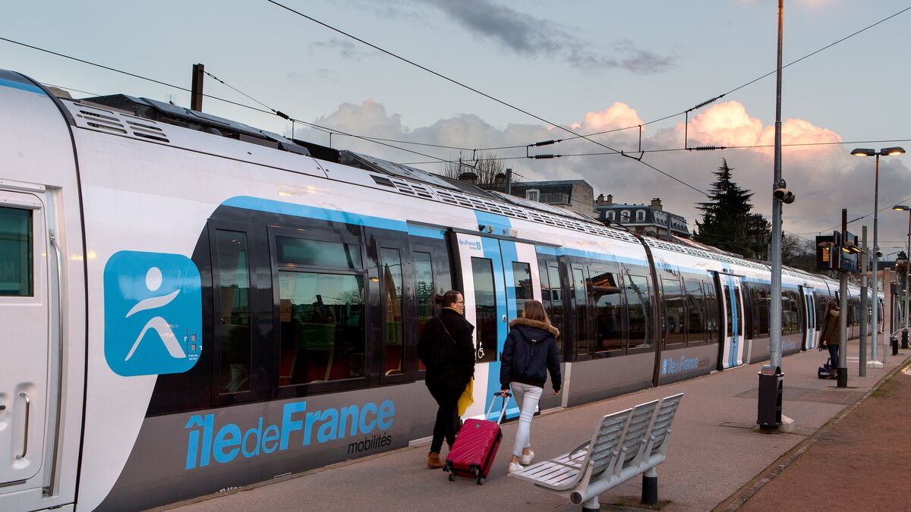
Île-de-France Mobilités, the integrated authority responsible for planning, funding and coordinating mobility across the region
Investment and innovation
Development of innovative forms of transportation
Investment programs
Public transport governance
Definition and organization of public transport
Pricing definition and user information
Contracting transport operators
Coordinating regional stakeholders while maintaining a single mobility authority
Mobility planning
Recommendations on organizing intermodal solutions
Notes:
Refaire une passe L15S. Demander à R. PICHOT version à jour

Slide 3
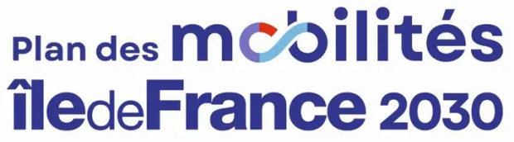

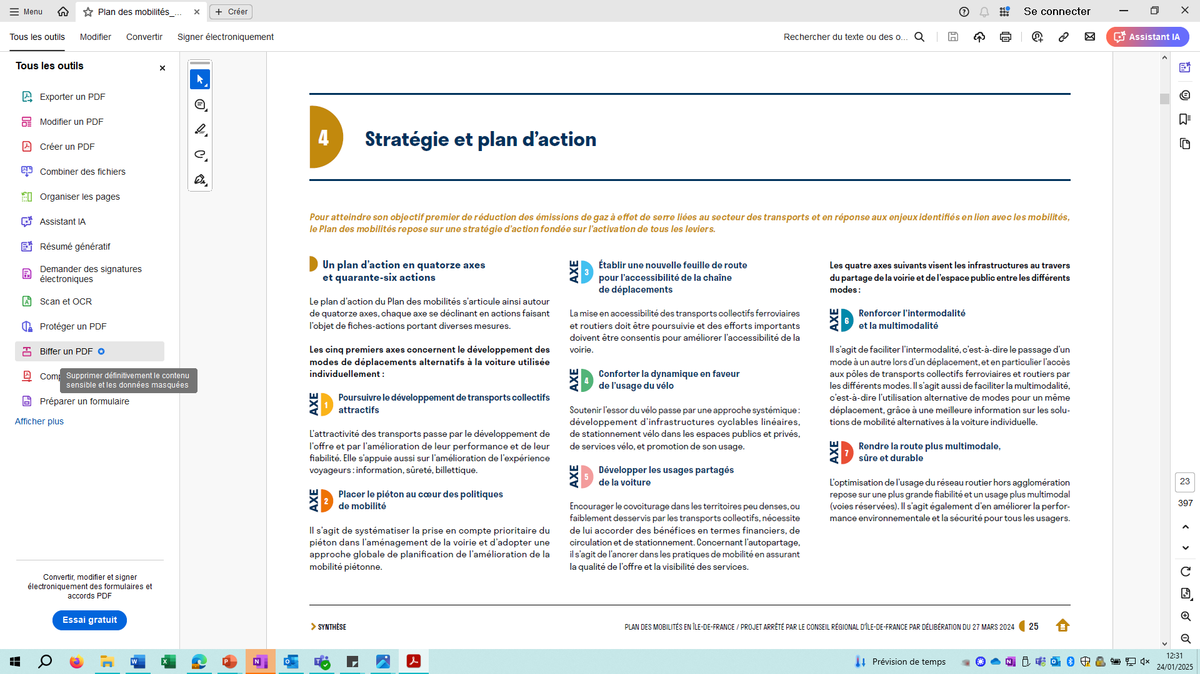



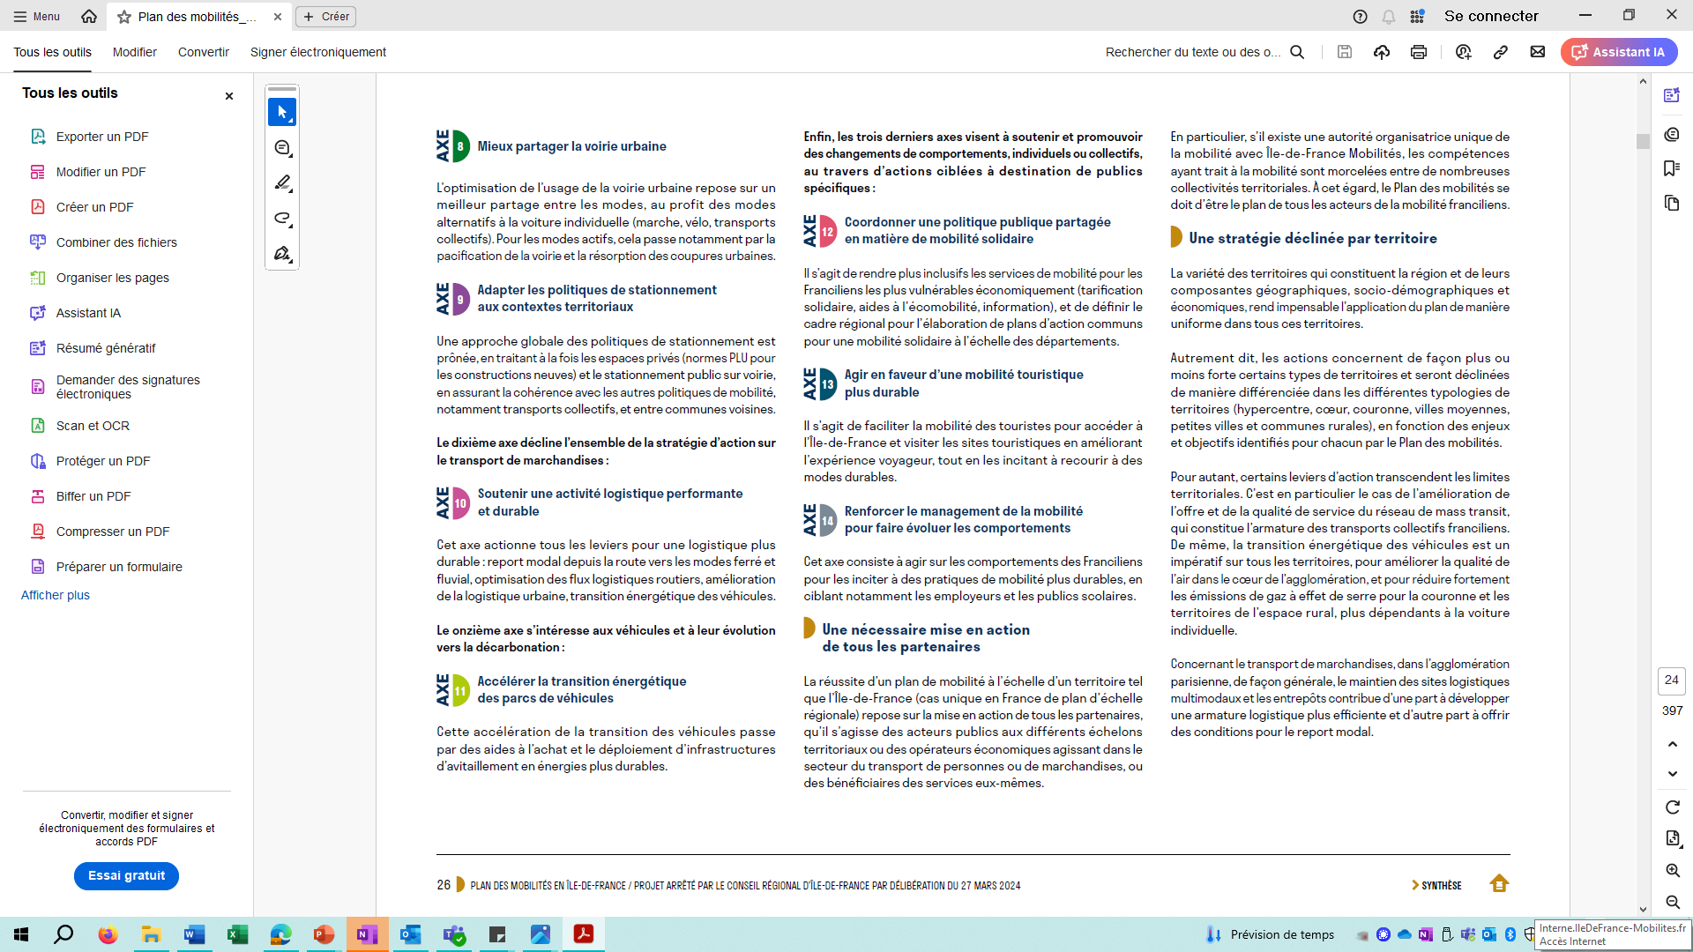



46 measures grouped in 14 lines of action to reach these objectives, following the principles of the SDRIF-E
Pursuing the development of attractive public transport
Pedestrian at the centre stage of mobility policies
A new road map for accessibility of the trip chain
Comforting the dynamic in favour of cycling
Developing shared use of cars
Facilitating intermodality and multimodality
Making roads more multimodal, safer and sustainable
Towards a better share of urban streets
Adapting parking policies to territorial contexts
Promoting performing and sustainable logistics
Acceleration of the vehicle energy transition
Promoting solidary mobility
Towards a more sustainable mobility of tourists
Strengthening mobility management to facilitate behaviour changes
Developing solutions alternative to single car occupancy
Sharing roads and public space between transport modes
Acting on logistics
Enabling evolution of vehicles
Changing behaviours

Slide 4
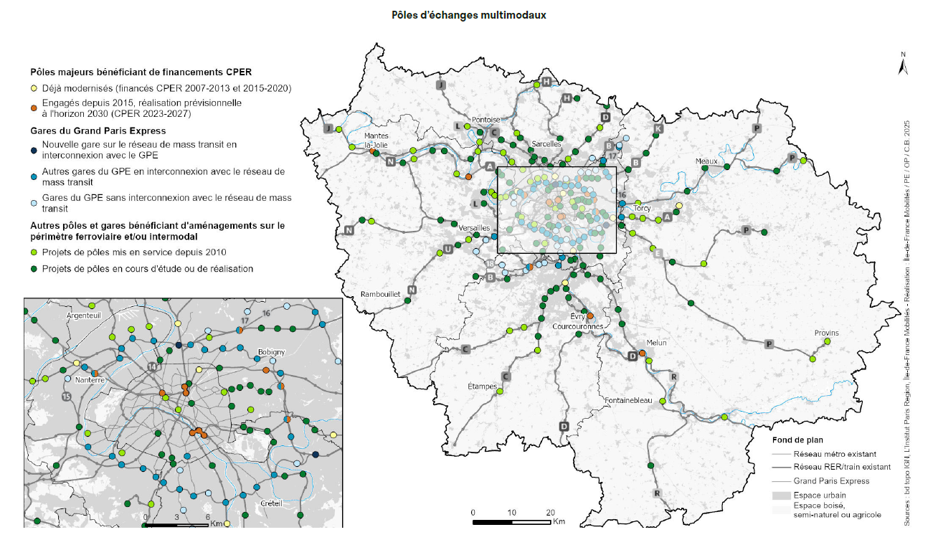
Multimodal transport hubs in Île-de-France
Objectives :
Renovate around 100 multimodal hubs within their intermodal areas
Redevelop 13 major hubs financed through the CPER programme
Reach 140,000 bicycle parking spaces near stations
Equip 100% of stations with bicycle parking
Create 10,000 additional park-and-ride spaces by 2028
Develop 100 to 150 eco-bus stations by 2030
Major hubs financed through the State–Region Planning Contract (CPER)
• Already modernised (CPER 2007–2013 and 2015–2020) • Projects underway since 2015, completion expected by 2030 (CPER 2023–2027)
Grand Paris Express stations
• New stations on the mass transit network connected to the Grand Paris Express
• Other GPE stations connected to the mass transit network
• GPE stations without connection to the mass transit network
Other hubs and stations benefiting from upgrades within the railway and/or intermodal perimeter
• Hub projects delivered since 2010
• Hub projects under study or under construction
Background map
Existing metro network
Existing RER / rail network
Grand Paris Express network
Urban areas, forest, natural or agricultural areas

Slide 5
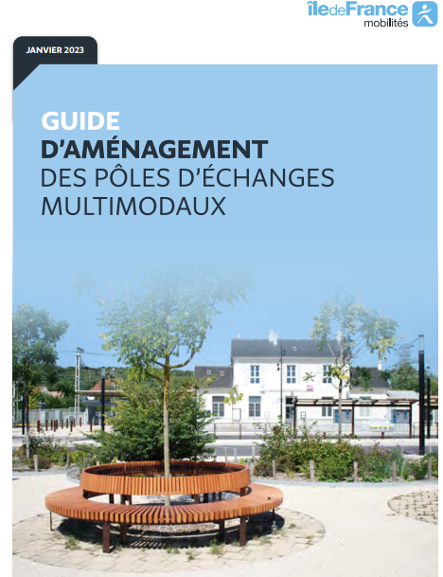
Multimodal Transport Hubs: Key Enablers of Intermodality
1. Governance and coordination
Île-de-France Mobilités coordinates hub projects with infrastructure managers, transport operators and local authorities
A hub steering committee (“comité de pôle”) ensures coordination between stakeholders
Projects integrate both rail infrastructure constraints and public space planning
2. Planning process
Multimodal hub projects follow a structured process:
Diagnostic phase : analysis of passenger flows and mobility needs
Scenario development : definition of intermodal layouts and services
Reference masterplan : agreement between stakeholders on the final design
Engineering studies and implementation
3. Intermodal facilities developed
Typical intermodal improvements include:
Eco-bus stations and bus terminals
Bicycle parking and cycling facilities
Park-and-ride infrastructure
Pedestrian forecourts and accessible pathways
Passenger information systems

Slide 6
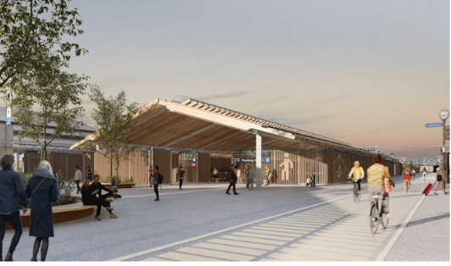
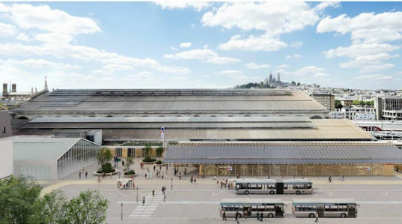
Gare du Nord – Horizon 2024: A Major Multimodal Hub Redevelopment
Improving access to the station
New pedestrian and cycling access
1,200 secure bicycle parking spaces
Rebalancing public space in favour of active mobility
Strengthening intermodal connections
Eco-bus station serving around 100,000 daily passengers
Improved connections between regional, metro and bus networks
Enhancing passenger experience
Integrated passenger information systems
Improved circulation between station levels
Crédits : architecte AREP / graphiste Jeudi Wang
Crédits : architecte AREP / graphiste Jeudi Wang

Slide 7


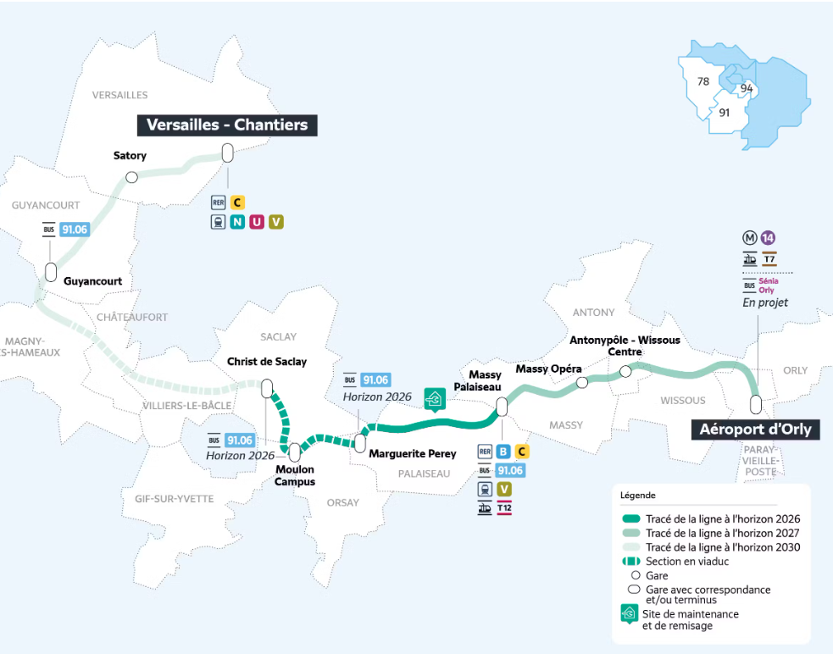
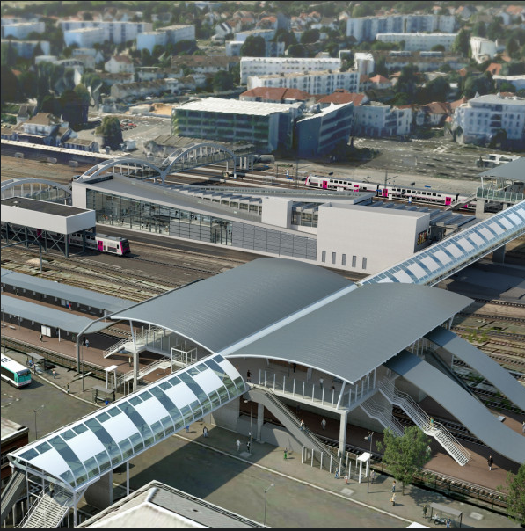

Massy–Palaiseau: A New Multimodal Hub Connecting High-Speed Rail and Urban Mobility
Massy – Palaiseau : a strategic multimodal hub
Massy TGV station on the national high-speed rail network
RER B and RER C regional rail connections
Major bus interchange serving the surrounding area
Future connection with Grand Paris Express Line 18
The Grand Paris Express will create 200 kilometres of new automatic metro lines and 68 stations.
The future Line 18 will further strengthen Massy–Palaiseau as a key multimodal hub linking high-speed rail, regional rail and Orly Airport.

Slide 8
Thank you for your attention! For more information Francoise.guaspare@iledefrance-europe.eu

