Slide 1
Phytosanitary Measures and International Trade
Emilia Lamonaca (UniFG)
Work performed in collaboration with
Fabio Santeramo (EUI)

Slide 2
Plant health in the EU
International trade and climate change raise risks of disease spread (IPCC, 2024)
EU major importer of specialised F&Vs, with increasing trends (EC, 2025)
Complex regulatory framework (EU Plant Health Law; EU Reg. 2016/2031)
Need to prioritise actions on crops / pests / importer

Slide 3
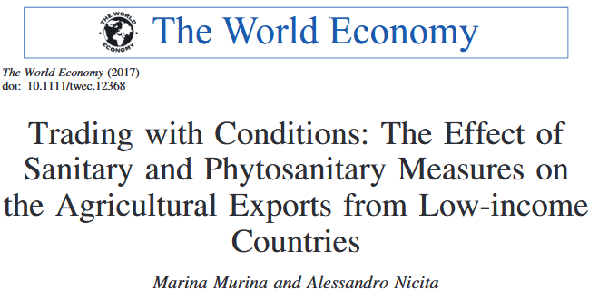
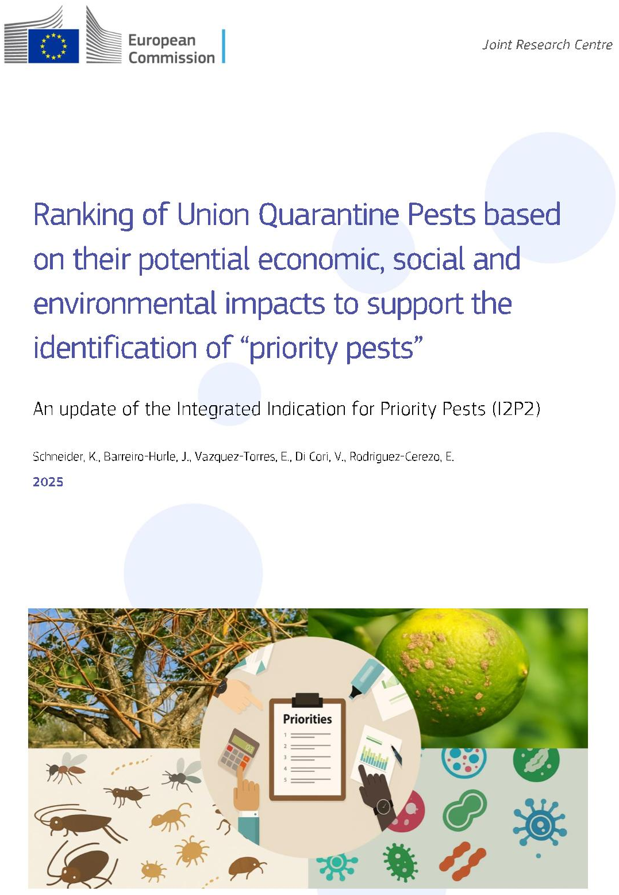
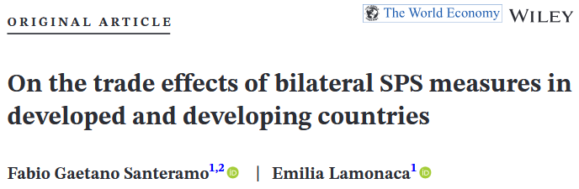
EU production and pest risks
Quarantine pests, not established in the EU, threaten F&Vs markets
(Schneider et al., 2025)
F&Vs production (FAOSTAT, 2024)
ESP, ITA, FRA top producers (~ 30 mln t each)
SPS measures designed to prevent plant health risks
(Murina Nicita, 2017; Santeramo Lamonaca, 2022)

Slide 4
The risk triangle A 3 dimensions index based on production, multi-host pests, imports
‘Risky’ crops and origins
Pests, hosts, and production at risk
Commodity | Intra-EU flows (mln USD) | Imports (mln USD) | Pests | Entry points | Imports (t)
Citrus | 305 | 1,306 | False codling moth, black spot of citrus Black spot of citrus | South Africa China Zimbabwe | 781,400 69,708 35,698
Mango, guava | 218 | 838 | False codling moth | Côte d’Ivoire | 31,453
Peach | 1,124 | 67 | False codling moth | South Africa | 9,594
Asparagus | 267 | 162 | Bud midge | Peru | 16,106

