Slide 1
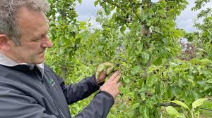
Dealing with invasive fruit pests in Belgium: an everyday struggle
Dany Bylemans
Pcfruit and KU Leuven, dany.bylemans@pcfruit.be
FSR Online Debate - The evolving EU framework for phytosanitary measures
March 3, 2026

Slide 2
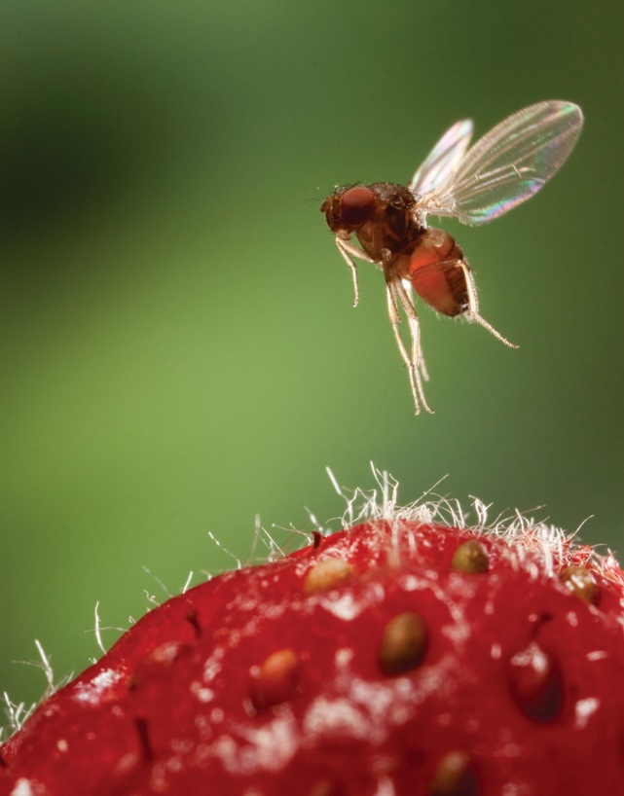
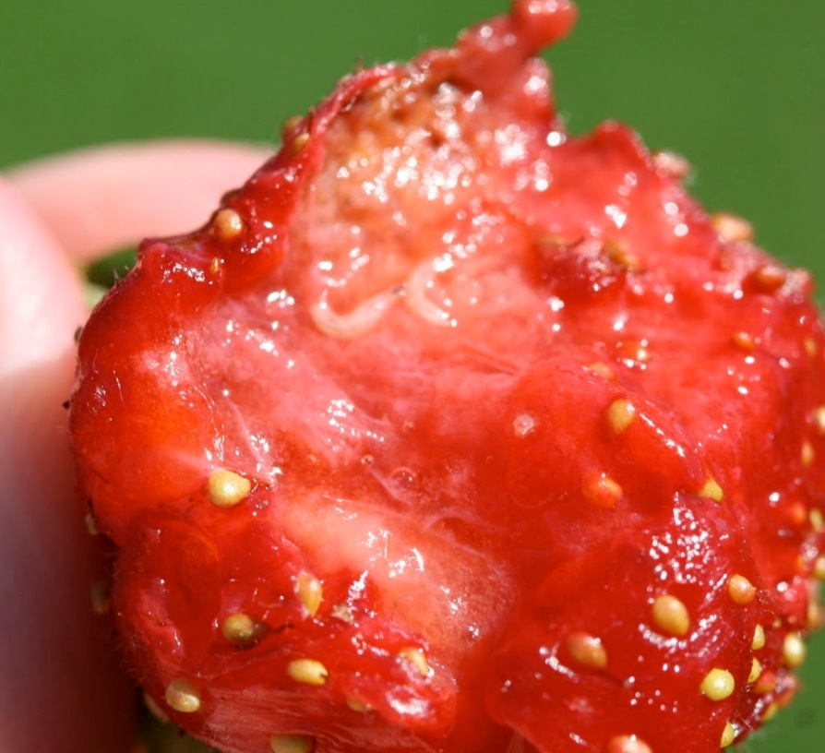
Invasive species 1: Drosophila suzukii
Sean McCann, Simon Fraser Univ., US
pcfruit
@ pcfruit
2011: First observation in Belgium
2013: Omnipresent
2014 onwards: Important economical damage (depending on weather conditions)

Slide 3
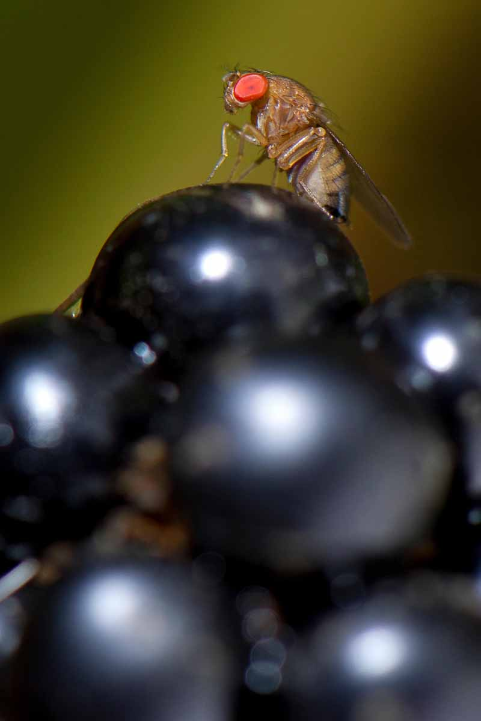
What did we try in the last 11 years … (in pcfruit)
Physical control:
Exclusion netting
Physcial deterrents
Mass trapping
Lure and kill
Sterile Insect Technology
Cold chain management
Modified atmosphere (post harvest)
Visual distraction
Biological control:
Pest phenology modelling
Predators
Parasitoids
Biological control agents
Natural insecticides
Pheromone disruption
Push & pull
Repellents
Attractants
Farm management:
Hygiene measures
Waste fruit management
Shorter picking interval
(Automatic) Monitoring
Chemical control:
Selective compounds
Broad spectrum compounds
Pest phenology models
Breeding:
Resistant varieties

Slide 4
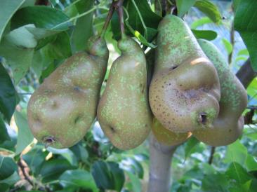
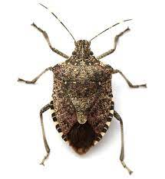
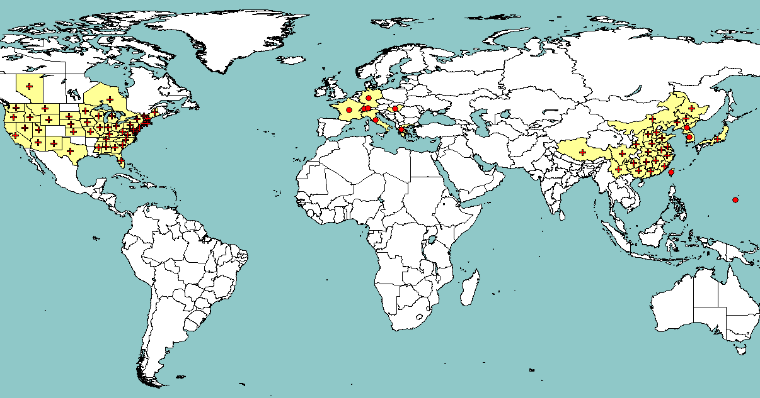
Invasive species 2: Halyomorpha halys
2017: first observation 2024: Omnipresent 2026: Important economical damage

Slide 5
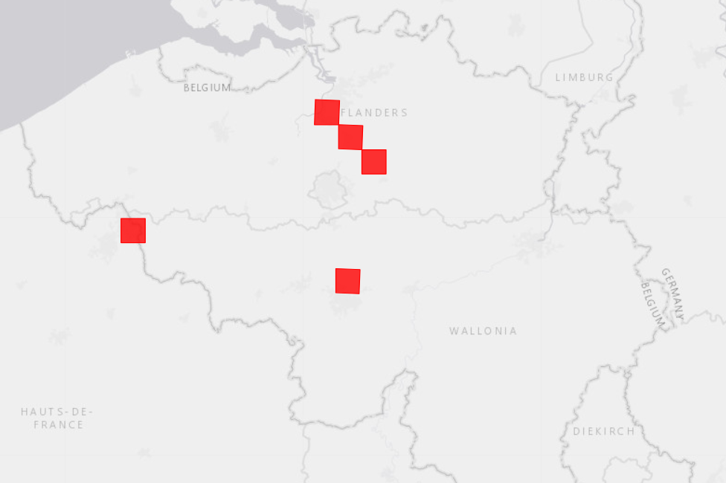
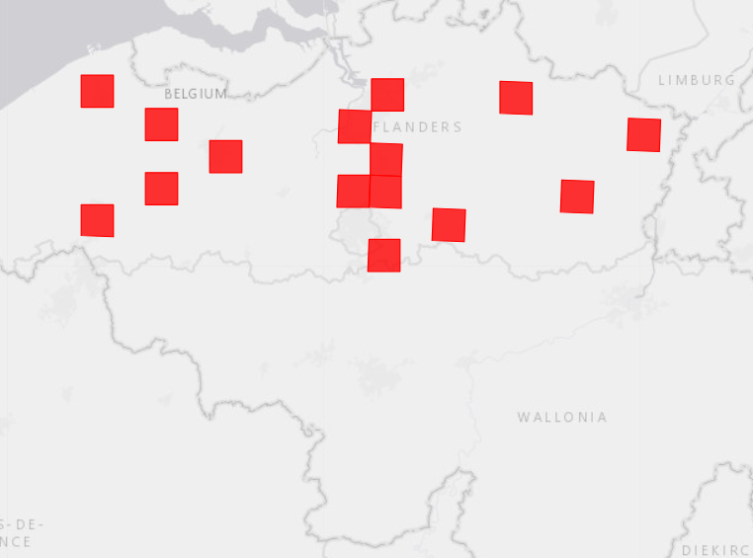
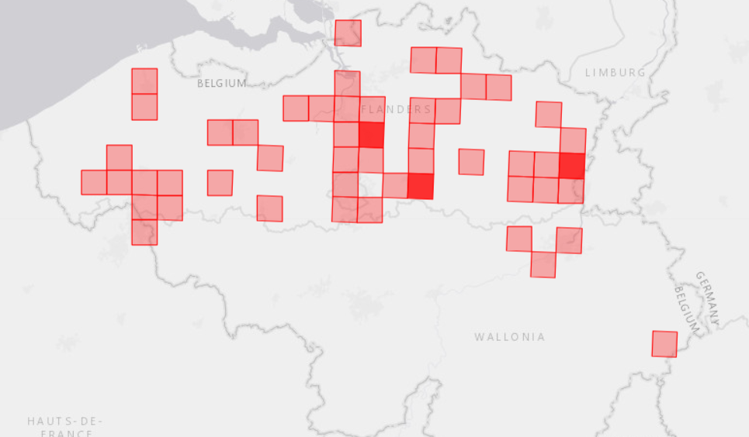
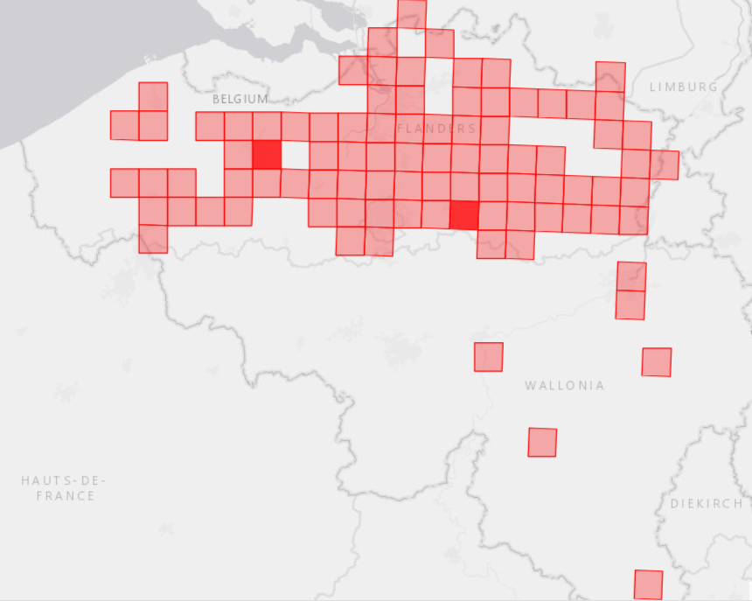
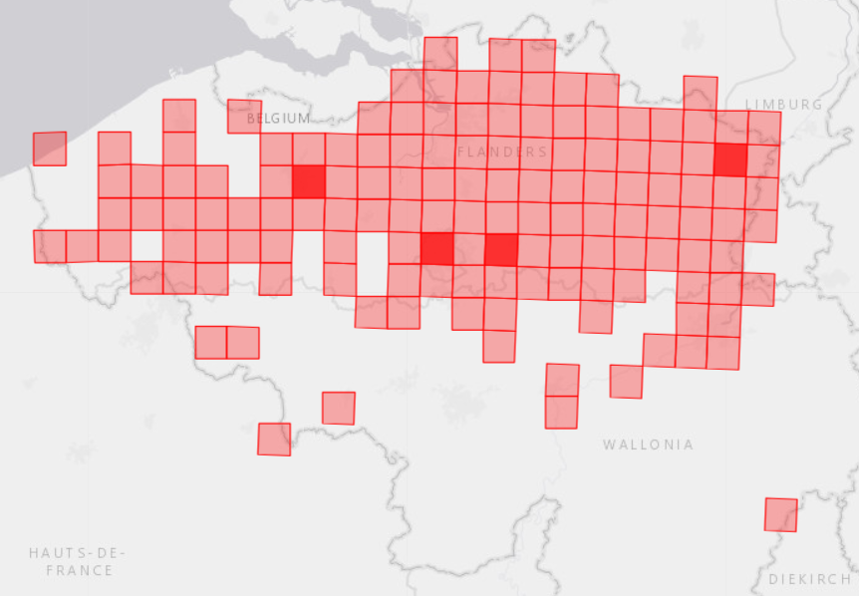
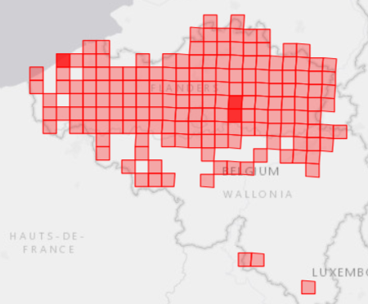
Rapid spread of H. halys in Belgium
2019
2020
2021
2022
2023
2024

Slide 6
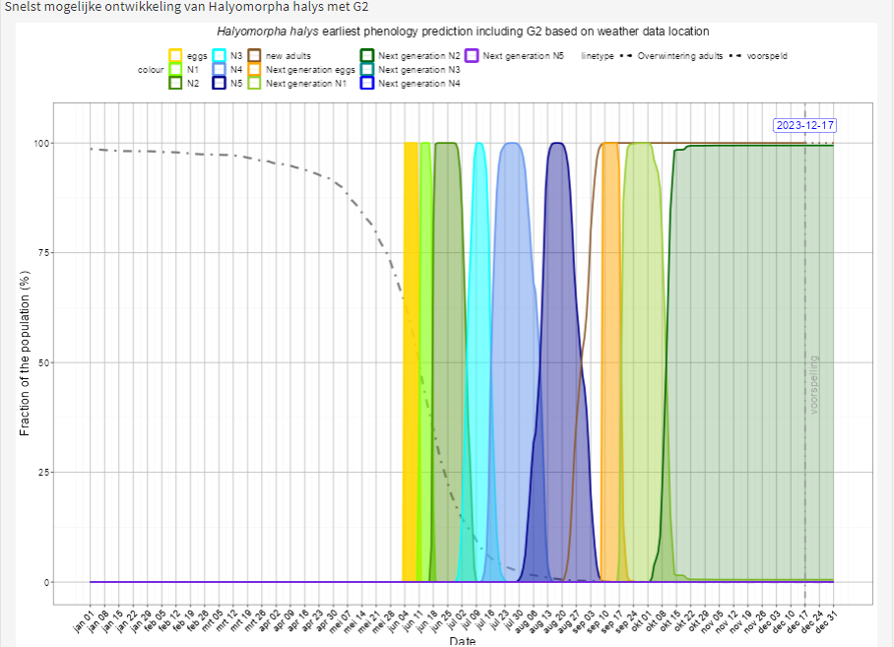
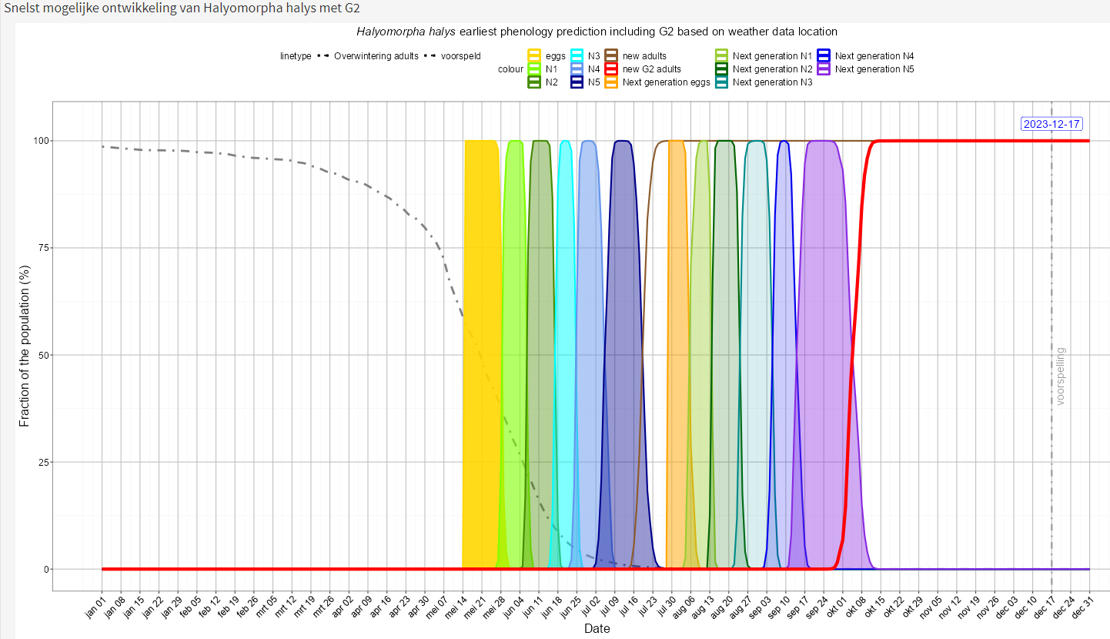
Importance of phenological modelling ! (thanks to my colleague Tim Beliën)
Current climate
Future climate
+ 2°C
N2 2nd generation
Do not survive winter ! -> Restricted population growth
Adults 2nd generation
Do survive winter !
-> Strong population growth

Slide 7

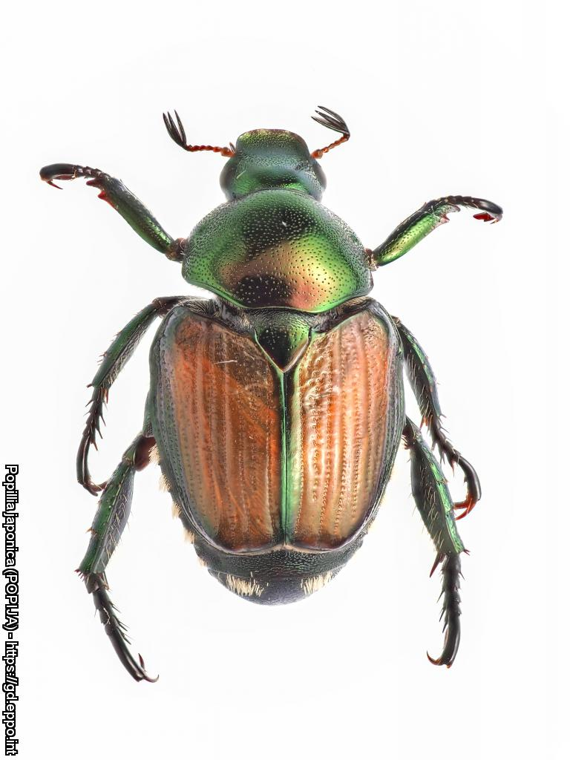
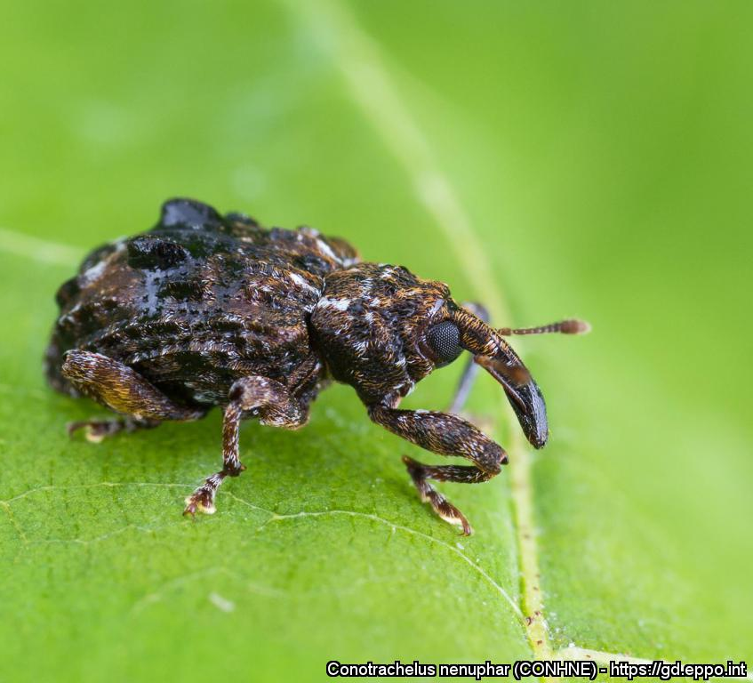
Consequences of new invasive species for Belgian fruit sector
Very disruptive for existing Integrated Pest Management practices
Until novel effective IPM strategies are established: increased use of (broader spectrum) plant protection products
Require intensive (proactive) research
Increased costs for growers - monitoring - control measures (e.g. netting : 30.000 – 50.000 euro/ha) - losses to tolerate (yield and/or quality)
Increased cost of monitoring in commercial chain
… and the next ones are already knocking on the door…
Japanese beetle
Popillia japonica
Plum curculio
Conotrachelus nenuphar

