Slide 1

Learning from the Past: Lessons for the New Common Agricultural Policy
Webinar at Florence School of Regulation
Sophie Hélaine
DG AGRI, Unit A.3 - Policy Performance

Slide 2
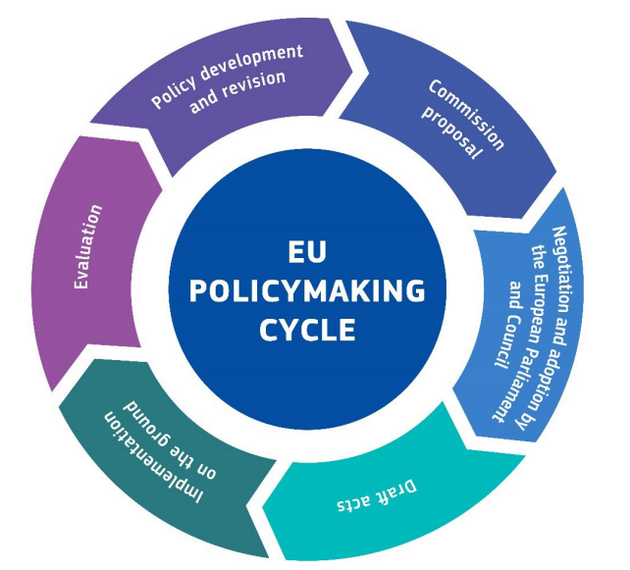
CAP within the EU policymaking cycle
Through the Better Regulation agenda the Commission is committed to ensure that EU laws are necessary, evidence-informed, proportionate, transparent, and deliver the intended results with minimal burden.
Political context is fast-paced, changing, complex and multi-layered.
Notes:
CAP part of EU policies
For all EU policies, EC is committed to ensure quality legislative proposals that are evidence-informed.
BR sets out detailed guidelines and analytical toolbox, the Commission committed to covering the whole policy cycle.
Strong toolbox & principles, internationally recognise as being among the leading by OECD. e.g. evaluate first principle.
However, political reality, especially in these times, is more complex.
In keynote: offer some points of reflection by showing on how we in AGRI and especially in Policy performance perspective, apply these principles in the Context of the CAP, analytically, practically and in the political dimension.
Although none of the elements on the cycle can be seen in isolation, also for the CAP, focus is on the left half of the stylised EU policymaking cycle in the image. And especially on evaluation within DG AGRI.

Slide 3
Increased performance orientation of the 2023-2027 CAP
An integrated strategic programming
Inreased role of Result Indicators, linked to the Annual Performance review
Focus on quantitative methods (EU Reg. 2022/1475)
Need for data:
Farm Accountancy Data Network to Farm Sustainability Data Network
Disaggregated Data on Interventions and Beneficiaries (DIB)
Catalogue of CAP interventions
Labelling of interventions by farming practices supported

Slide 4
´Continous Evaluation´ Approach within the CAP Policy Cycle
2020 | 2021 | 2022 | 2023 |  | 2024 | 2025 | 2026 | 2027 | 2028 | 2029
CAP 2014-20
Transition period
decommitment rule n+3
RDP ex post eval.
CAP 2023-27 proposal
CAP 2023-27
MSs eval. during implementing period
CAP 2028-34 proposal
CAP 2028-34
EU interim eval. + Report
EU ex-post eval. (2031)
Notes:
As acknowledged by the ECA, the difficulty to reconcile the policy cycle with the time needed to collect data will imply that DG AGRI has not respected the ‘evaluate first principle’ for the next CAP.
Even then: especially for ENV effects to materialize & to have data about them, takes time. -> rethink approach towards a “continuous evaluation” approach.
Meaning, mitigating the challenges by:
Long-term approach to data availability and evaluations for the performance assessment (DIB, FSDN, SAIO first data on pesticides published 2028, IACS data sharing, Copernicus data, Interoperability)
Collaboration with the JRC to develop methodologies
Past evaluation still relevant for new (see JRC work)
Exchange with the Research community, but also providing them tools: Classification of interventions, classification of farm practices, catalogue of cap interventions)
Rough estimate to assess the contribution of the CAP based on JRC work to estimate the effects of farm practices (supported by the CAP) on climate (GHG), soil, nutrient

Slide 5
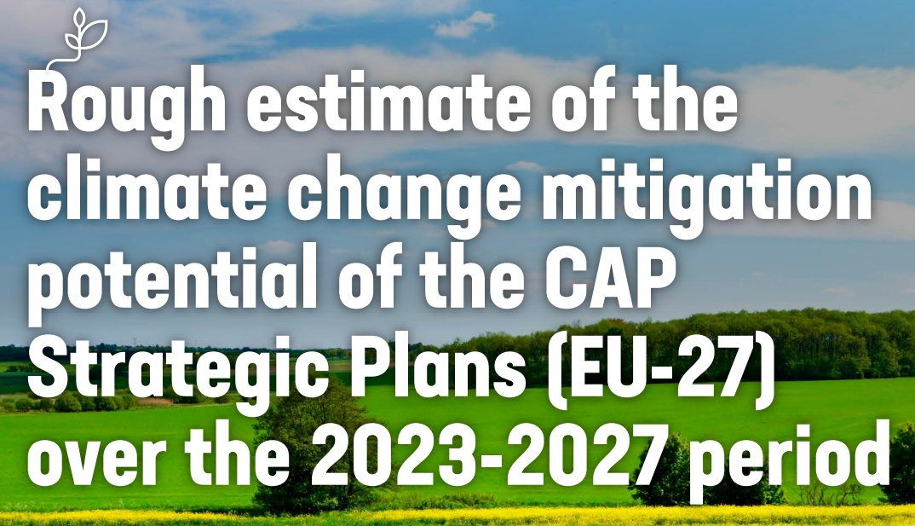
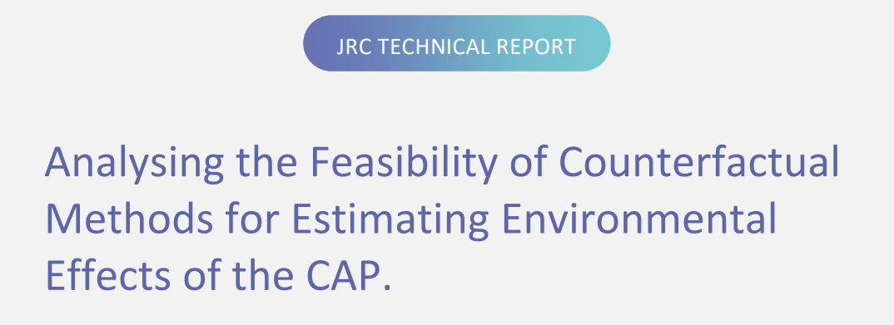
Develop new approaches
Rough estimate of the climate change mitigation potential of the CAP Strategic Plans (EU-27) over the 2023-2027 period | EU CAP NetworkJRC Publications Repository - Analysing the Feasibility of Counterfactual Methods for Estimating Environmental Effects of the CAP.
Notes:
More ambitious policy (see wide spectrum of CAP objectives) and more performance orientation means, stronger need for monitoring and evaluation to see policy is on track for objectives.
„Culture of Evaluation “: Involves the whole stakeholder community, from DG AGRI until beneficiaries.
This means investing in
people: they change, knowledge needs to be kept; people drafting policy need to structurally collaborate with people who monitor and evaluate to close the loop.
skills: analytical skills involving quantitative skills (modelling, estimations, more and more data) but also qualitive analysis form various disciplines (CAP multi-obective, env knowledge, social knowledge needed).
trust building: Between EC and MS, but also between public authorities and beneficiaries (see data sharing).
Concretely, what are we doing (examples with links)-all interconnected:
DG AGRI: re-organisation of DG in view of the current cap, see structure of Dir A, bring evaluation closer to policy drafting.
External analytical support studies: external evaluators look on policy. We gain insights & manage to cope with high work rhythm. Help us out see e.g. primary data collection which otherwise very challenging.
Evaluation Helpdesk: capacity building between MS and EC. Methodologically but also collaboration. Ad hoc support. TWG, GPW-> horizontal Task how to follow up on Evaluations
JRC: In house, collaboration on complex topics. Strong, historical collaboration. Modelling suite, but also on evaluations and monitoring. Classification of farming practices. Methodlogical advancing: counterfactual.
Research Community: we need them. Provide evidence. Strong exchange, see EAAE Agri always with delegation there. Horizon projects: see tools for Cap.
Beneficiaries: trust data sharing. But also EU CAP network.
Member States: built capacity, learn from each other, foster collaboration between departments/agencies within same MS.
EU co-legislators: interinstitutional agreement on better law making: so also they assess impacts on key amendments.
Long term process, lots of investment but we see progress over the years, away from tick the box.

Slide 6
Foster a `Culture of Evaluation´
DG AGRI
External Analytical Support Studies
Evaluation Helpdesk
Trust
People
Skills
EU Co-legislators
Joint Research Centre
Member States
Beneficiaries
Research community
Notes:
More ambitious policy (see wide spectrum of CAP objectives) and more performance orientation means, stronger need for monitoring and evaluation to see policy is on track for objectives.
„Culture of Evaluation “: Involves the whole stakeholder community, from DG AGRI until beneficiaries.
This means investing in
people: they change, knowledge needs to be kept; people drafting policy need to structurally collaborate with people who monitor and evaluate to close the loop.
skills: analytical skills involving quantitative skills (modelling, estimations, more and more data) but also qualitive analysis form various disciplines (CAP multi-obective, env knowledge, social knowledge needed).
trust building: Between EC and MS, but also between public authorities and beneficiaries (see data sharing).
Concretely, what are we doing (examples with links)-all interconnected:
DG AGRI: re-organisation of DG in view of the current cap, see structure of Dir A, bring evaluation closer to policy drafting.
External analytical support studies: external evaluators look on policy. We gain insights & manage to cope with high work rhythm. Help us out see e.g. primary data collection which otherwise very challenging.
Evaluation Helpdesk: capacity building between MS and EC. Methodologically but also collaboration. Ad hoc support. TWG, GPW-> horizontal Task how to follow up on Evaluations
JRC: In house, collaboration on complex topics. Strong, historical collaboration. Modelling suite, but also on evaluations and monitoring. Classification of farming practices. Methodlogical advancing: counterfactual.
Research Community: we need them. Provide evidence. Strong exchange, see EAAE Agri always with delegation there. Horizon projects: see tools for Cap.
Beneficiaries: trust data sharing. But also EU CAP network.
Member States: built capacity, learn from each other, foster collaboration between departments/agencies within same MS.
EU co-legislators: interinstitutional agreement on better law making: so also they assess impacts on key amendments.
Long term process, lots of investment but we see progress over the years, away from tick the box.

Slide 7
Thank you
© European Union 2024
Unless otherwise noted the reuse of this presentation is authorised under the CC BY 4.0 license. For any use or reproduction of elements that are not owned by the EU, permission may need to be sought directly from the respective right holders.

