Slide 1

“Learning from the Past: Lessons for the New Common Agricultural Policy”
Agro-economic-environmental modelling in the context of the CAP and the MFF, lessons learnt and future needs
Giampiero Genovese
Joint Research Centre (JRC) Directorate for Sustainable Resources Unit Economics of the Food System (D.4)
Seville, January 2026
https://dx.doi.org/10.2760/123978

Slide 2
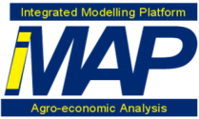

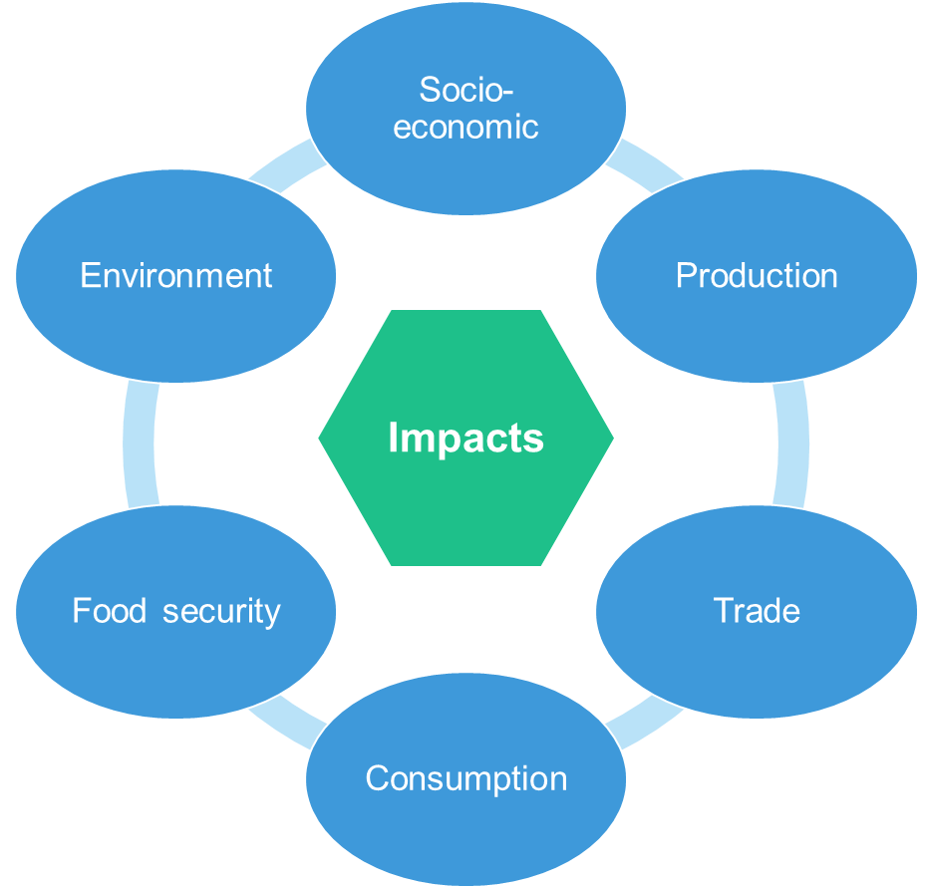
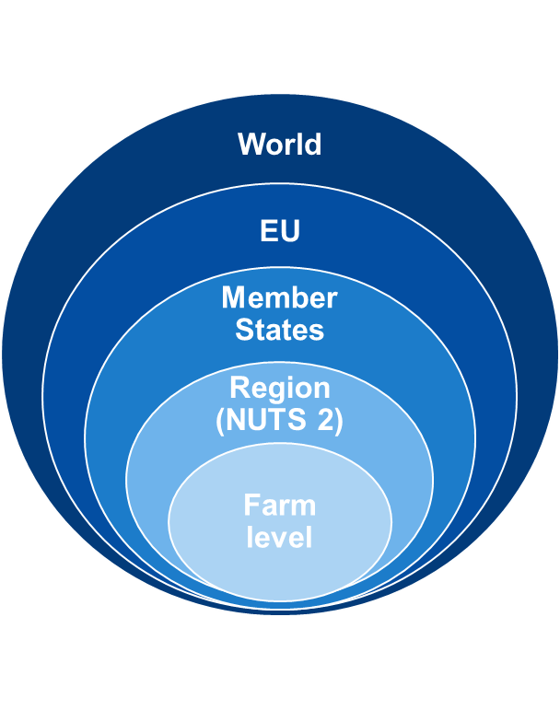




integrated Modelling Platform for Agro-economic and Resource Policy Analysis (iMAP)
iMAP models
Integrated analysis
Further model input, e.g. data from FSDN, food chain analysis, behavioral science
Model output for further analysis, e.g. health impacts, biodiversity
CGE
Baseline
Agricultural sector
Baseline
Farm level
Linkages to other models & tools, e.g.
Biophysical models, e.g. related to climate change, soil health,…
Copernicus Land Monitoring Service, for landscape features,…

Slide 3
Some of the latest studies for policy DGs based on iMAP models
AGRI
Effects of Cumulative Free Trade Agreements on the agricultural sector (AGRI, TRADE).
Model-based contribution to the simplification packages.
Model-based scenarios and analysis the context of the EU protein plan.
Scenar 2040: Multi-model analysis of three broad future pathways for the CAP.
Contribution to the annual generation of the AGRI Medium-Term Outlook for EU agricultural markets.
Stronger alignment of production standards at multilateral level (pesticides use).
SANTE
NGTs: Assessing benefits of pesticides reduction via NGTs.
Animal welfare: Impacts of additional costs related to new transport requirements.
Pesticides use: Impacts of environmental ambition of pesticides reduction.
Food waste reduction targets
CLIMA: Contributions to climate targets assessments, EcAMPA-based regarding mitigation potentials in agriculture
ENV: Bioeconomy strategy

Slide 4
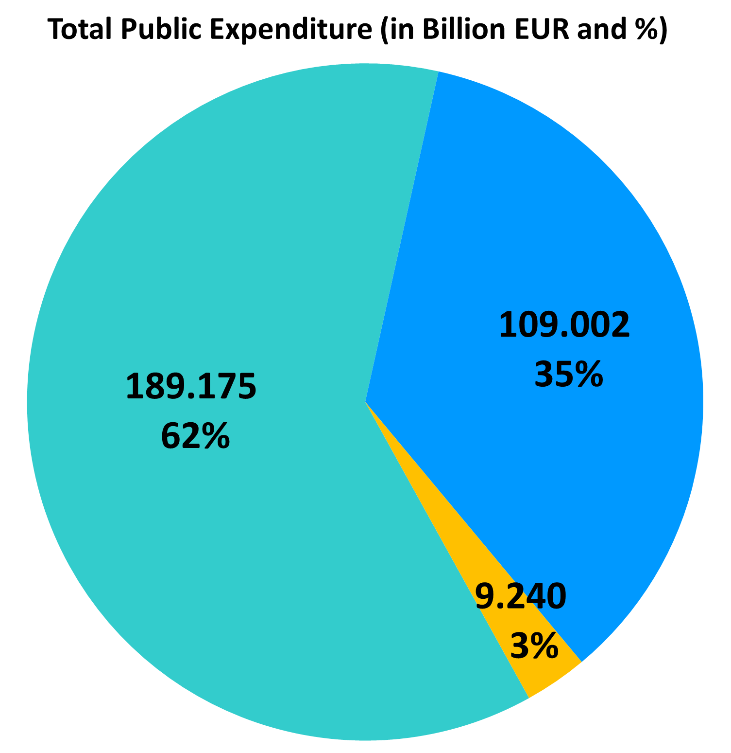
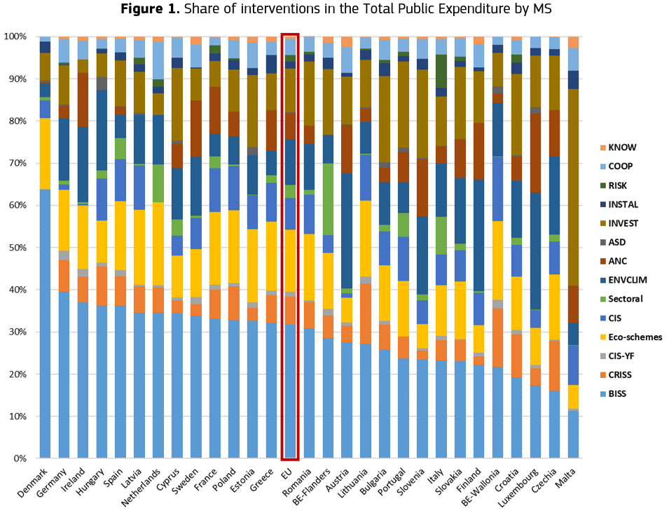
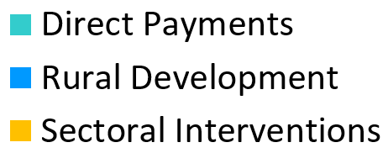
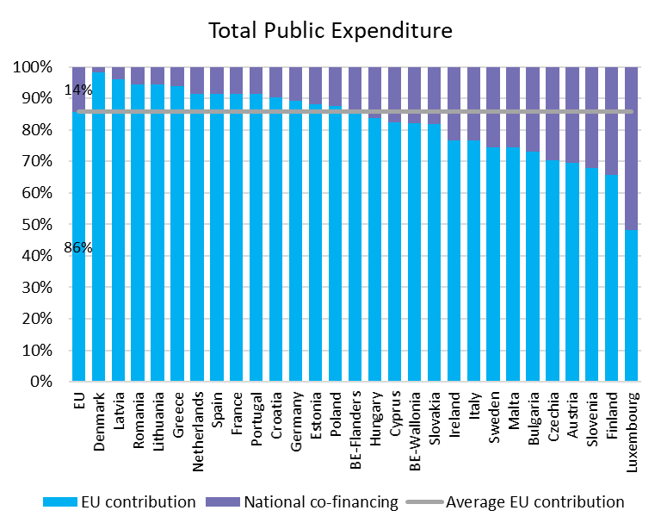
The diversity of the current CAP Baseline – Share of interventions in the Total Public Expenditure by MS
Notes:
Total public expenditure = EU contribution + mandatory co-financing by MSs
Only EU: Direct Payments + Sectoral Interventions; Mandatory co-financing: RD interventions
Pillar 1: BISS (Basic income support for sustainability), CRISS (Complementary redistributive income support for sustainability), CIS-YF (Complementary income support for young farmers), Eco-schemes, CIS (Coupled Income Support), Sectoral (Sectoral interventions),
Pillar 2: ENVCLIM (Environmental, climate-related and other management commitments), ANC (Natural or other area-specific constraints), ASD (Area-specific disadvantages resulting from certain mandatory requirements), INVEST (Investments, including investments in irrigation), INSTAL (Setting up of young farmers and new farmers and rural business start-ups), RISK (Risk management tools), COOP (Cooperation), KNOW (Knowledge exchange and dissemination of information).

Slide 5
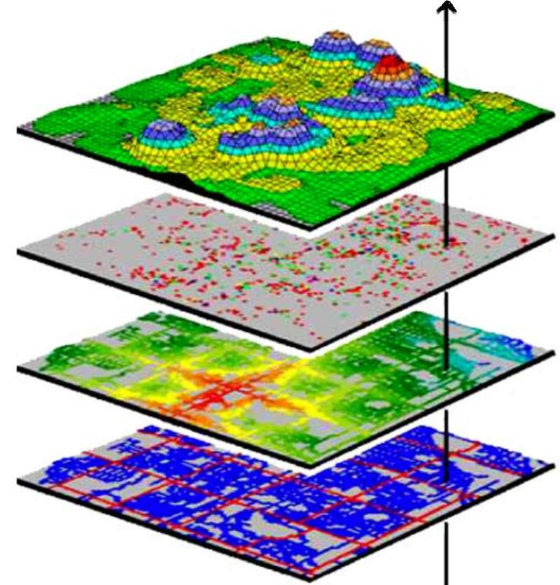
The way forward: Enhancing the analysis of iMAP models with an increased use of environmental data (building a database)
JRC is testing the integration of FADN data with geo-referenced environmental data
Soil data from ESDAC, e.g. on physical soil, chemical soil properties, soil erosion, change in organic carbon
Biodiversity data, e.g. on natural pest control, pollination services, biodiversity intactness.
Weather data, e.g. on cloud cover, precipitation, humidity, temperature, etc.
Generic approach that can be extended to new/different data
Needs to be compatible with personal data protection regulation
Geo-referenced Variables
Database
€ | € | T° | mm | %
JEODPP
Final product is a dataset of FADN data extended with environmental variables

Slide 6
Take away conclusions from the research side
Enhance modelling capacities
Expansion of individual models
Model integration at different levels
Integration between socio-economic, biophysical and environmental data/models, and other approaches
Additional models, tools and approaches to accompany and extend the analysis
Integrated analytical frameworks for policy coherence
Anticipation is a key

Slide 7
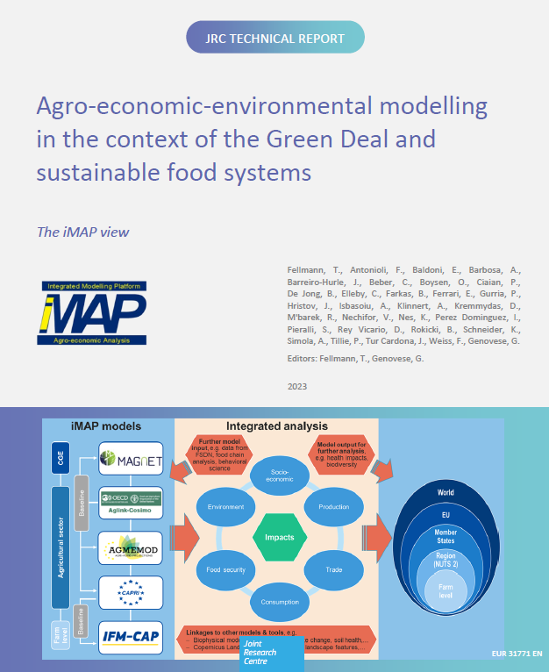
THANK YOU!
Giampiero.Genovese@ec.Europa.eu
https://dx.doi.org/10.2760/123978

