Slide 1
Learning from the past: Lessons for the new CAP 20th January 2026 Bérénice Dupeux - Ecorys

Slide 2
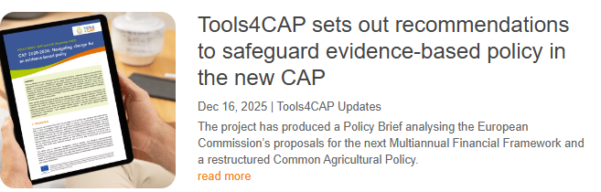
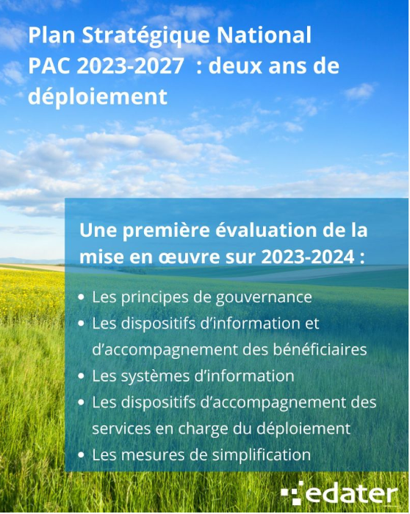
Learning from two projects

Slide 3
Doing more with less.
What do we observe regarding CSP implementation:
An attempt to do all: A multitude of complex objectives supported by weak intervention logics
No strict quality control to underpin strategic planning
Limited use of past experiences or real impact assessment, often strong path dependency
Limiting ability to undertake a cross-cutting reading of programming dynamics at the territorial level, due to a lack of a formalised framework between local/regional/state actors,
Difficulty in addressing the different dynamics between the different types of interventions
Underlying driver: lack of a predictable environment
Climate and environmental events
Change of legal framework
Policy uncertainty
Lack of capacity at the national and regional levels

Slide 4
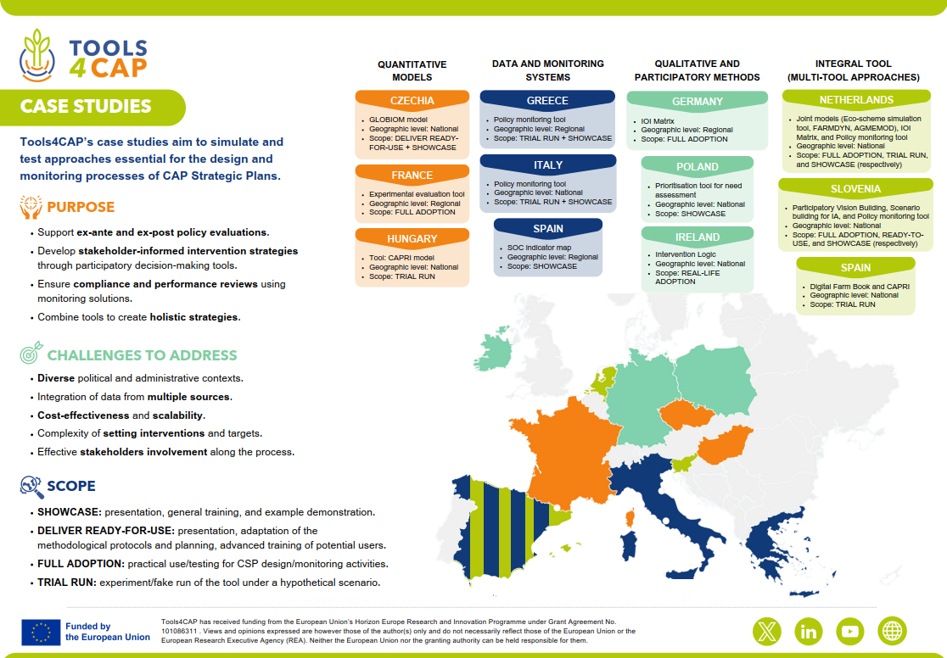

Slide 5
Adaptative evaluation and design process of the CAP
Quantitative tools:
Where complex models are adopted, long-term cooperation with research teams and continuous impact assessment are essential. For Member States, simpler partial-equilibrium or farm-level models are more feasible, provided that national research capacity and sustained ministry–research cooperation are ensured.
Qualitative tools:
These tools support evidence-based CAP decision-making by structuring reasoning, eliciting stakeholder preferences, and clarifying intervention logic. They help policymakers and stakeholders understand and communicate trade-offs, coherence, and causal pathways, when designing or adjusting their CAP Strategic Plans.
Monitoring tools:
Substantial long-term value for evidence-based CAP implementation, such as systematic tracking of policy results and environmental outcomes, but their use is currently quite limited and left to their developers.

Slide 6
Navigating change for an evidence-based policy
Challenges for the future CAP
Budgetary Uncertainty and Fragmentation: Flexible allocations, crisis provisions complicate planning.
Complexity in Co-Financing: Risk of deprioritising high-impact interventions.
Diverse Impacts of Degressivity and Capping: Variable effects, need for national impact assessments.
Ambiguity in Farm Stewardship: Risk of inconsistent standards, loss of level playing field.
Balancing Economic, Societal and Environmental objectives: risk of perpetuating existing production pattern and delaying structural change
Analytical and Administrative Capacity: High demands on Commission and Member States.
Challenges for evaluators and researchers
➔ Address budgetary data gaps, enable like-for-like comparisons across Member States and programming periods, and support comparisons during a programming period.
Researchers should develop and apply integrated methodologies, combining qualitative and quantitative approaches at multiple scales and in diverse geographical contexts, to support robust policy evaluation.
Fostering interdisciplinary and cross-country collaboration.
Notes:
One might argue that the strategic orientation of the CAP, previously driven by a set of specific objectives and corresponding interventions, has now been subsumed within a broader political discourse.
Alternatively, it could be contended that policy decisions will need to be substantiated with robust evidence to withstand heightened scrutiny. In either case, it will demand significant resources from the European Commission to ensure that Member States fulfil Union objectives and resources from Member States to address the needs of all constituencies, including rural areas, which are often less organised and less well-resourced and therefore less able to make their voices heard.
Commission may subsequently introduce impact indicators, embedding measurable and substantive impact indicators at the core of the policy design, and ensuring that they are linked to well-defined causal pathways, would strengthen both the comparability and the validity of the overall framework. S

Slide 7
Thank you

