Slide 1
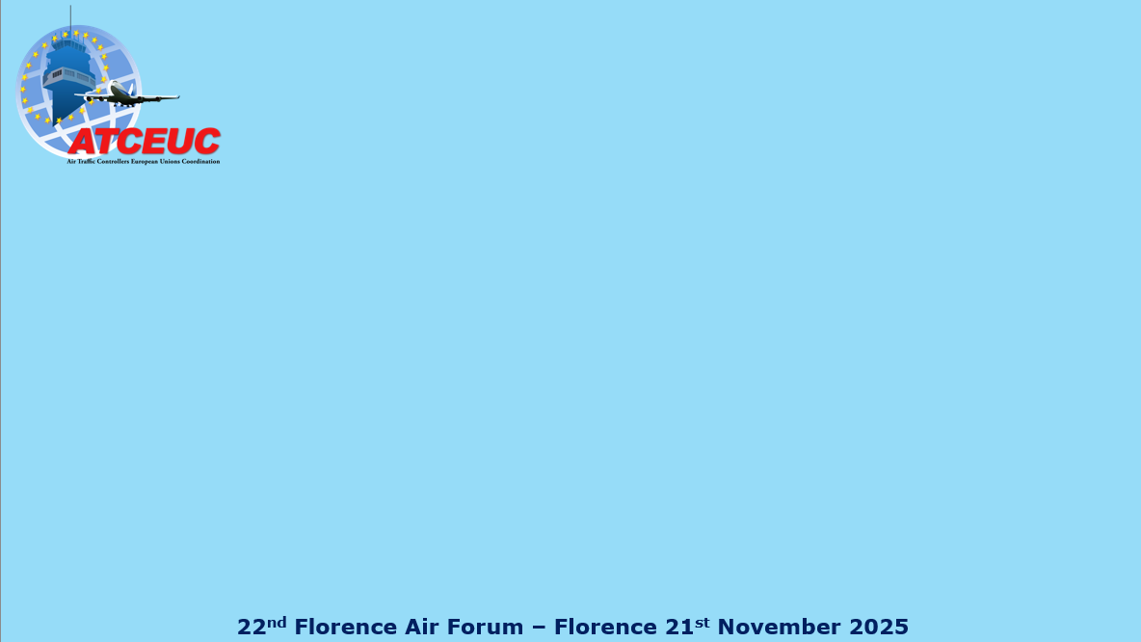
The Human Cost of Efficiency: Safety, Sovereignty, and the Future of European ATM
Giancarlo Saviantoni ATCEUC EB Officer

Slide 2
ATM’s Foundation: Sovereignty and State Mandate
The Non-Negotiable Legal Reality: The 1944 Chicago Convention is addressed exclusively to States. The provision of Air Traffic Services (ATS) is intrinsically linked to national sovereignty.
Safety Over Commerce: Article 1 establishes complete and exclusive sovereignty over airspace, meaning national defense and safety are unequivocally superior to commercial interests.
The EU's Role: The European Union (via SES/EASA) dictates performance and cost targets, but is not a contracting party and remains legally distant from assuming ultimate responsibility for service delivery.
Core Principle: ATS is a sovereign public safety mandate. The operational workforce embodies this essential public good, not a commercial metric.
Notes:
Thank you. Before we discuss performance, costs, or new technology, we must start with the legal foundation of European ATM: the sovereign responsibility of the State. The 1944 Chicago Convention gives complete and exclusive sovereignty over airspace to individual States—not to the EU. The EU, despite its regulatory power, is not a contracting party and cannot assume the ultimate legal responsibility for safety. In today's geopolitical context, we must treat ATS as a sovereign public safety mandate, applicable only at the national level. The women and men on the console are the operational expression of this State duty, not just cogs in a commercial machine

Slide 3
The True Service Model: Prioritizing Operational Well-being
Human Element as the Core: The actual objective of any new service model must be the well-being of operational staff. This is the indispensable means to ensure efficient and safe service delivery.
Fatigue is a Safety Reality: Decades of experience confirm that the fatigue of front-line personnel is a concrete operational risk, not a theoretical concept.
Essential Safety Priority: Fatigue Risk Management (FRM): Managing growing network pressure safely requires all ATS professionals to operate at peak performance, which necessitates a holistic approach to FRM.
The Path Forward: Effective FRM must include support for mental well-being and be founded on trust, collaboration, and the full involvement of operational staff and their unions.
Notes:
Now, let's talk about the real New Service Delivery Model. From my 30 years in Milan and Rome, I can tell you: the single most indispensable factor for safe, efficient delivery is the well-being of the operational staff. Everything else is secondary. The pressure on the network is exponential, and we need Air traffic controllers and ATSEPs operating at their maximum. This cannot happen without robust, holistic Fatigue Risk Management (FRM). FRM is not a soft benefit; it is an essential safety priority to uphold our sovereign obligation. A resilient ATM future means acknowledging human limitations and building policy through trust and collaboration with operational staff and their unions

Slide 4
The Tension: Performance Targets vs. Human Reality
Central Conflict: An inherent tension exists between politically adopted cost-efficiency targets and the fundamental operational realities of maintaining safety.
The Danger of RP5: A rigid, one-size-fits-all performance framework threatens to undermine the State's ability to provide safe and context-sensitive air traffic service.
Absorbing Pressure: When the logic of "profit at all costs" is prioritized, the system pressures staffing levels and working conditions. The human core is forced to absorb the costs of complexity and high living expenses.
Our Demand: We need a context-sensitive framework that recognizes the unique investment required for this sovereign safety function. We must protect the people to protect the network.
Notes:
The core conflict we face is the undeniable tension between politically adopted cost-efficiency targets and the operational reality on the ground. We are moving towards RP5 with the critical danger that a rigid, one-size-fits-all framework, driven by profit logic, will compromise the State's fundamental safety obligation. When the bottom line is prioritized over the workforce, the pressure to cut staff and compromise working conditions lands squarely on the human core of the system. We must insist on a context-sensitive framework that recognizes the unique investment required to fulfill a public safety mandate. To protect the network, we must protect the people

Slide 5
AI Integration: Legal Liability and Accountability
The Inevitable Path: Advanced Artificial Intelligence (AI) is integral to future service delivery models, but a massive obstacle remains: Legal Liability and Accountability.
The Critical Question: As AI is integrated into the operational chain, who holds the ultimate responsibility for flight safety, as required by Annex 11 of the Chicago Convention?
Risk of a Legal Vacuum: We cannot allow new technology to create a void that obscures human or institutional responsibility for the decision-making process.
ATCEUC Mandate: We demand clear legal guarantees, strong governmental supervision, and significant worker involvement to ensure that human responsibility remains unambiguous and technology supports the operator's duty of safety.

Slide 6
Protecting Fundamental Rights and Conclusion
Defense of Rights: The future of the ATM workforce must be built on the unconditional defense of workers’ fundamental rights.
Attacks on Labor: Proposals to limit the right to strike are attempts to erode the rights of professionals who perform a sovereign public safety function. This right is a national issue.
Conclusion: Preservation Over Development: The future of European ATM is ultimately about preservation:
Preserving Safety.
Preserving Accountability.
Preserving Efficiency through the protection of the workforce.
Our Commitment: ATCEUC will continue to advocate for policies that prioritize safety and ensure the voice of the operational workforce upholds the responsibilities entrusted to our States by the Chicago Convention.

Slide 7
Thank you
Giancarlo Saviantoni
g.saviantoni@atceuc.org
www.atceuc.org
secretariat@atceuc.org

