Slide 1
22 ^{nd} Florence Air Forum Organizing the future of SESAR, stakeholders’ engagement and next steps
Mariagrazia La Piscopia
Executive Director - SESAR Deployment Manager

Slide 2



The story so far: the industry engagement into SESAR
ANSPs
ANSPs
today
Despite its pilot phase and some challenges, this approach proved beneficial to the industry. They care for it. Yet a change of pace is still required to address the future transformations. The way the next phase of SESAR get organized is critical
2014
A shift to coordinated deployment required further changes, overcoming local perspectives and establishing a common approach to pursue Europe-wide benefits
2004
SESAR was established to address the urgent challenges of ATM, and managed to defragment and accelerate R&D and deployment activities

Slide 3
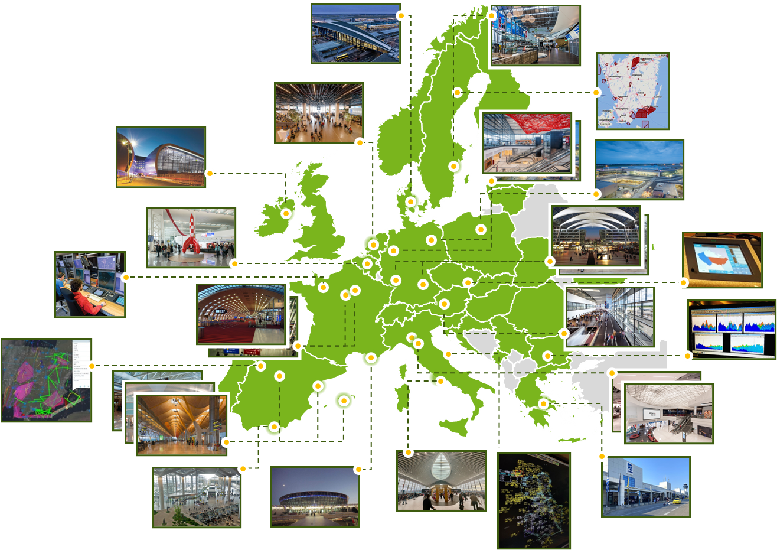
The progresses and results achieved so far
A European ATM that remains competitive, enabled industry growth, and helped to overcome market failures
Almost € 3 bln of synchronized investment, with 91% of CP1 in operations or under deployment
Over 100 organisations involved, with 319 projects completed and 37 to go
Over € 6 bln of CP1 operational benefits achieved between 2014 and 2024
Total operational benefits rising to € 20 bln in 2030, € 35 bln by 2035
Critical effect on mitigating performance degradations (e.g. avoiding ATFM delays for around 2 minutes per flight in 2024)

Slide 4
The next phase of SESAR – the lessons learned
What to protect
What to improve
Defragmentation of research and deployment to keep an EU-wide approach
CPs tool to support a coordinated / harmonized deployment with network perspective
EU funding availability, a key trigger to foster innovation, accelerate investments and overcome local considerations
A coordination function which is trusted by the investors, able to build consensus and buy-in
A modus operandi that engages stakeholders, through joint governance, joint management and joint teams.
Real Co-creation
A “hands-with” programme management approach (planning, monitoring, risk assessment and mitigation)
Closing the gap between R&D and effective deployment, going beyond TRL6
Better link to the standardisation process that facilitate large-scale adoption
Product availability
Market demand for certain solutions, in absence of mandates
The conflict between the performance scheme focus on cost-containment and the need for massive, long-term investments in ATM modernisation

