Slide 1
Organising SESAR: Stakeholder Engagement and Next Steps
An airline view
Raphael eyrolle – air France flight OPS – Airspace Program
Florence Air Forum - November 2025

Slide 2
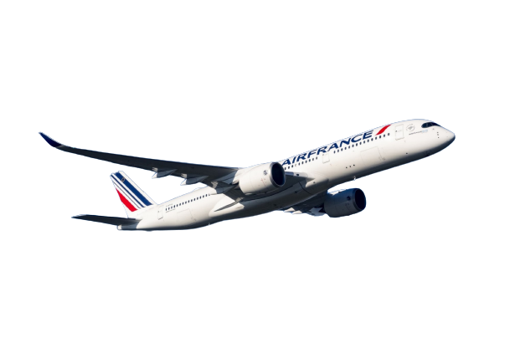
SESAR: Safeguarding the Network and Strengthening Europe’s Strategic Capability
1 — SESAR has positioned ATM as a key European strategic capability.
SESAR has positioned European ATM as a strategic capability supporting mobility, resilience, environmental efficiency and enhanced civil-military coordination.
2 — SESAR has been essential to maintaining network stability.
Recent summers showed that, without SESAR, traffic growth and geopolitical constraints would have created a significantly higher risk of network disruption and reduced connectivity.
3 — The full innovation-to-deployment cycle remains too slow.
The full R&I → industrialization → deployment → Operational use cycle remains structurally too slow, generating avoidable delays, inefficiencies and cost burdens for airlines and citizens.
We can collectively be proud of what SESAR has already delivered for Europe’s citizens and for the network.
Our responsibility now is to reinforce it and ensure the next cycle is even more effective.

Slide 3
Now: accelerate rollout, secure funding, reinforce partnership
4 — Europe must now accelerate modernization and rollout.
The priority is faster, more agile and execution-focused modernization, with reduced administrative burden and stronger EU-to-local alignment.
5 — Continued and reinforced EU financial support is indispensable.
Predictable EU financial support is indispensable to protect ATM modernization from national budget pressures and maintain cohesion. Targeted transition support could also help bridge early operational costs until outcome-based KPIs demonstrate full network benefits.
6 — Equal-partnership governance is key for buy-in.
A continuous, equal-partnership governance across R&I, deployment and operational use is essential to maintain buy-in, enhance co-creation, and overcome remaining barriers ensuring that operational reality drives decisions and that modernization delivers its full benefits. .
To organize SESAR effectively, we need continuity across R&I, industrialization, and deployment with a governance that is simpler, faster, and truly partnership-driven.

Slide 4
A successful next SESAR cycle require
“Operational Stewardship”
Strengthened involvement of operational stakeholders in SESAR decision-making processes, ensuring maturity milestones reflect real operational integration needs.
“Performance Accountability”
Outcome-driven KPIs for SESAR-funded projects, demonstrating measurable improvements in daily operations and a clear link between investment, deployment and network performance.
“Shared Value Stakeholders”
Recognition of all operational investors including airlines to support balanced decisions and sustained commitment to ATM modernisation.

Slide 5
MERCI !

