Slide 1
Delivering the Digital European Sky
Andreas Boschen Executive Director SESAR Joint Undertaking Florence, 21 November 2025

Slide 2
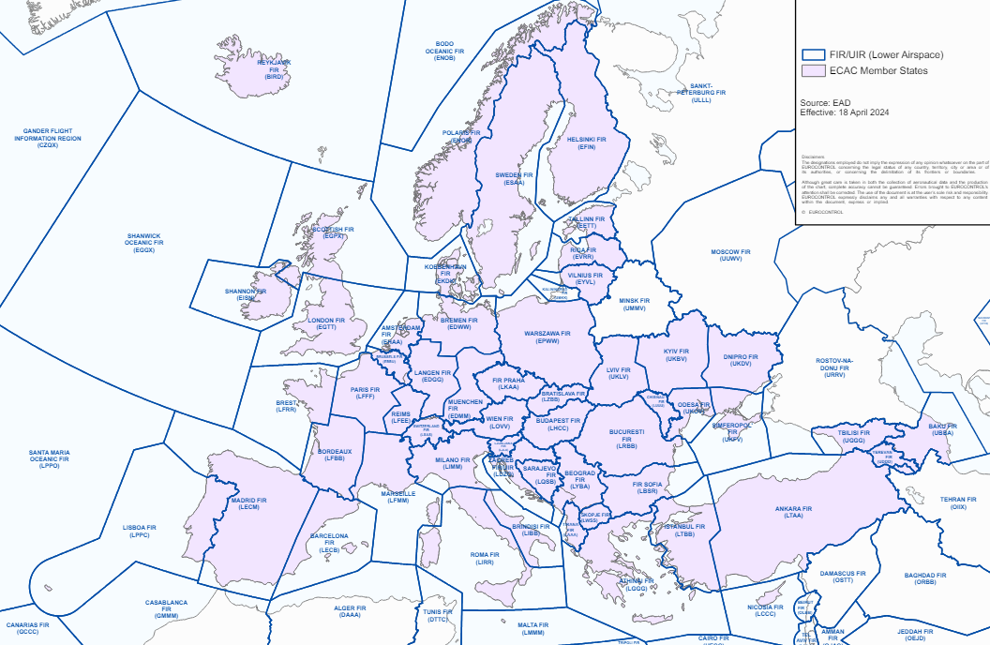
Today’s ATM operates in Europe through systems mainly built on monolithic IT architectures
FIR/UIR in the lower Airspace
68 location dependent ACCs
Fragmented local islands
Disconnected
Heterogenous application and infrastructure architecture
Different release versions
Highly customized applications (significantly different code basis)
Monolithic applications
Historical grown complex “spaghetti” code; increasingly difficult/resource intensive to maintain
Siloed data usage
Data and code integrated (no separation)
Communication bottlenecks prevent the efficient use of flight data directly from the aircrafts
Location dependent IT infrastructure
Certified at national level

Slide 3
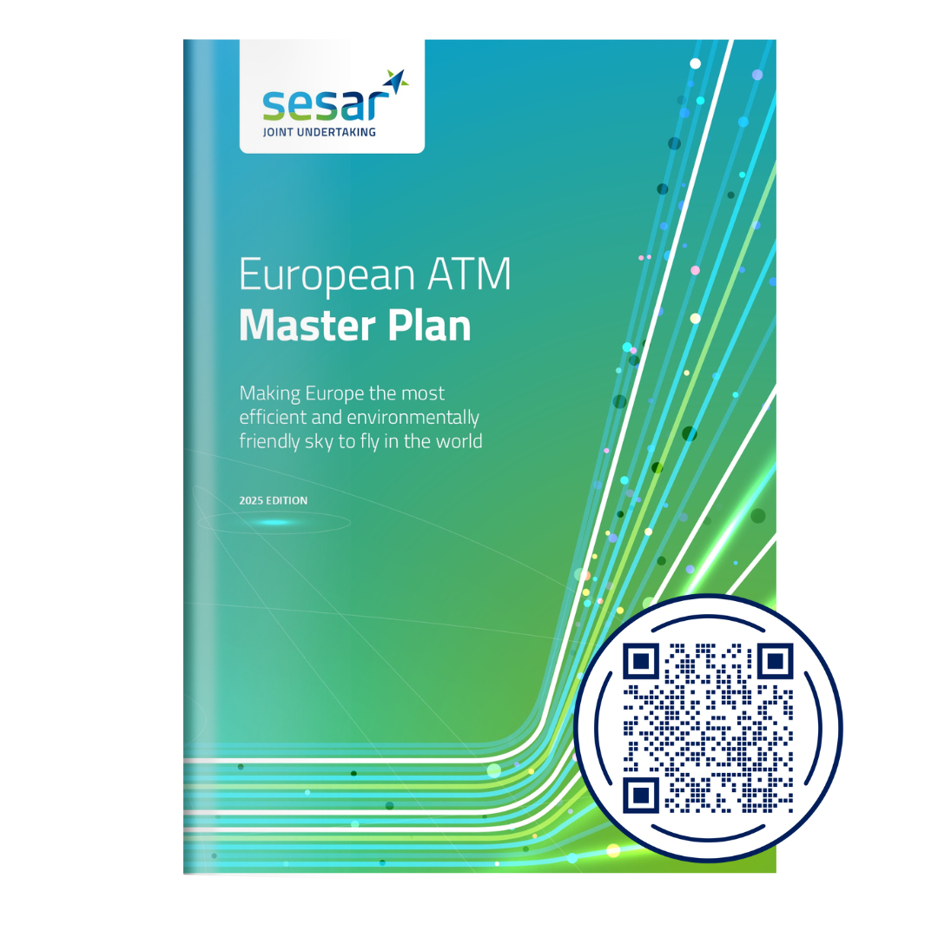
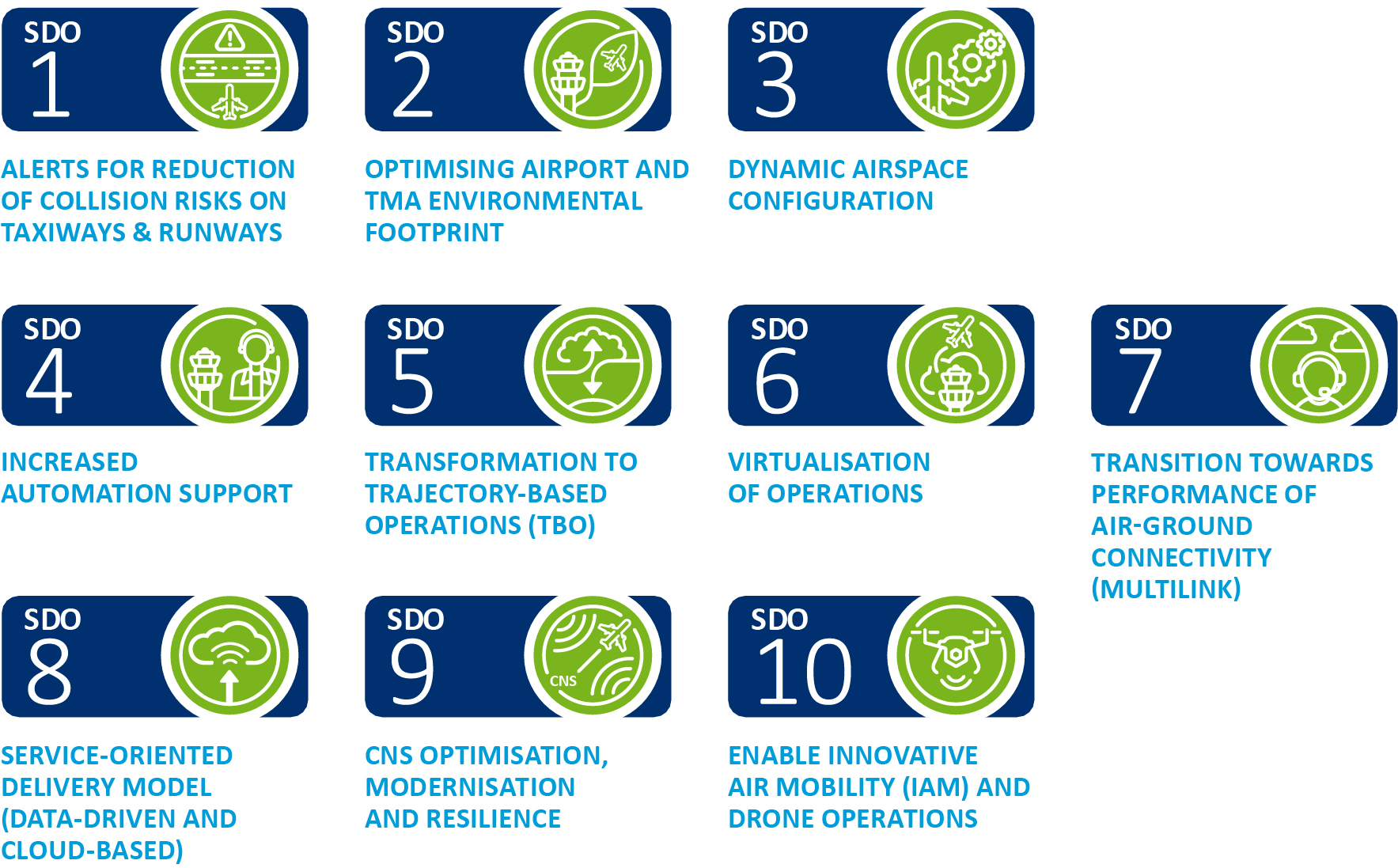

Make Europe the most efficient & environmentally-friendly sky to fly in the world by 2045
Strategic deployment objectives (SDOs)

Slide 4
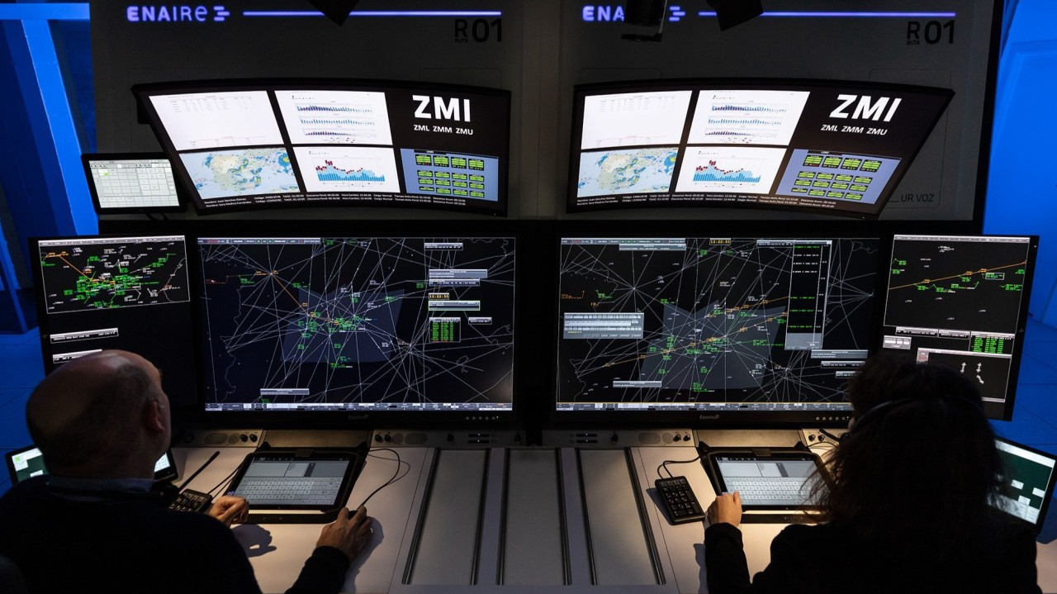
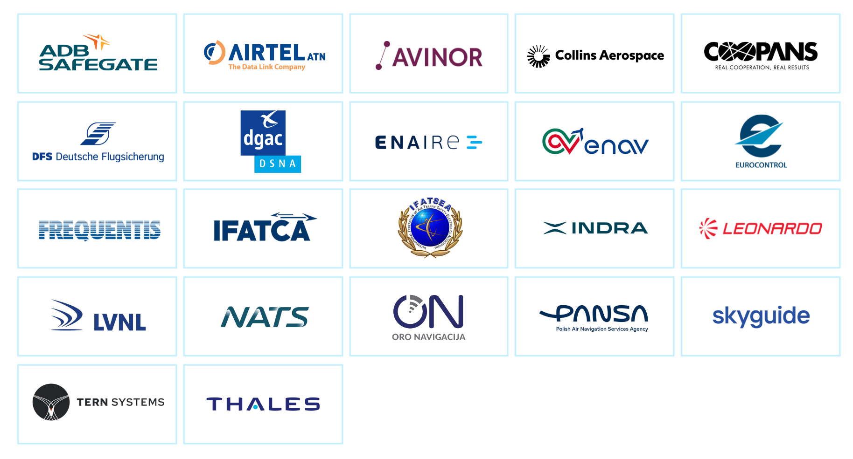

Leading industry players support the transition to a new service delivery model

Slide 5
Do we know what the new Service Delivery Model is?
Is there a momentum to push the new Service Delivery Model?
Are their alternatives?
What can everyone do to make it happen?
Are there too many cooks?

