Slide 1




TOWARD A LIVING ECOSYSTEM OF REVIEWS FOR EVALUATING THE IMPACTS OF CARBON PRICING
continuous updates and stakeholder-integrated
DATE
7TH JULY 2025
WWW.CARBONPRCING.SCIENCE

Slide 2
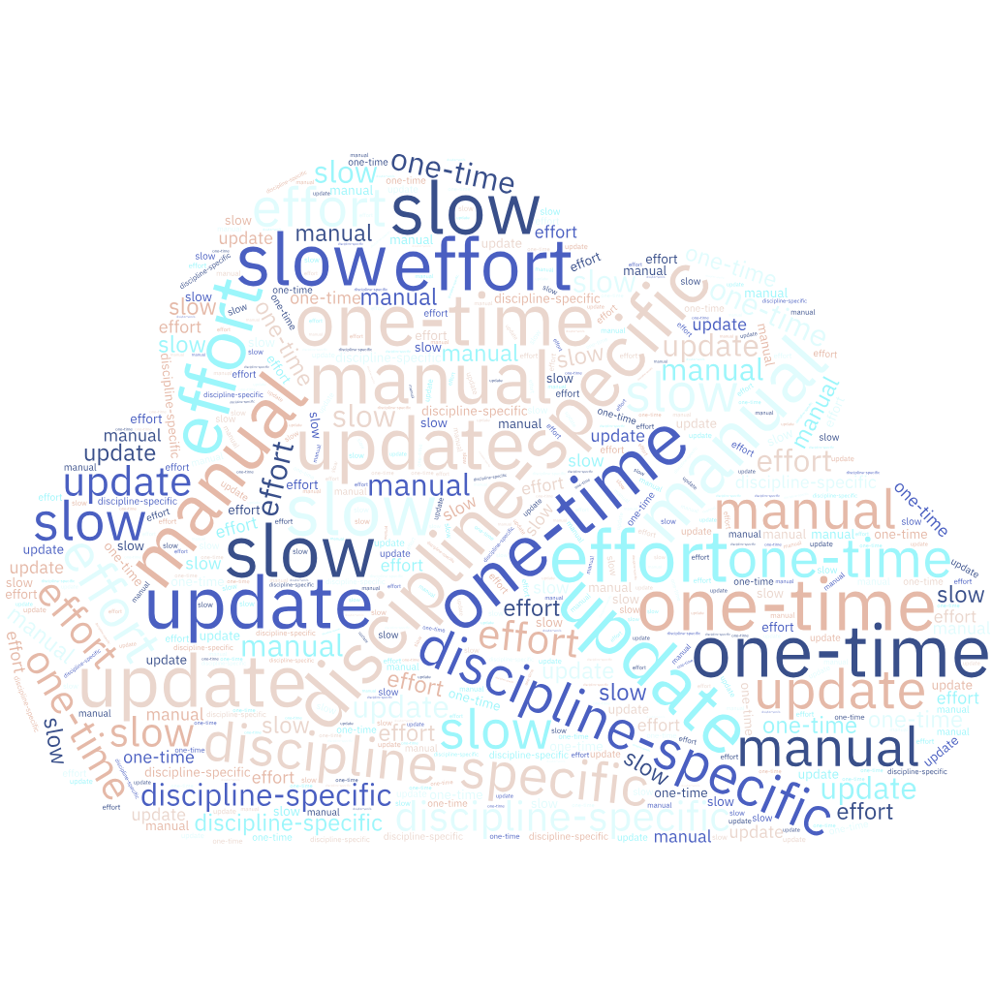
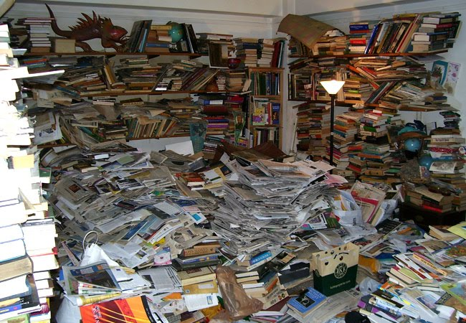
Why traditional reviews are no longer enough?

Slide 3
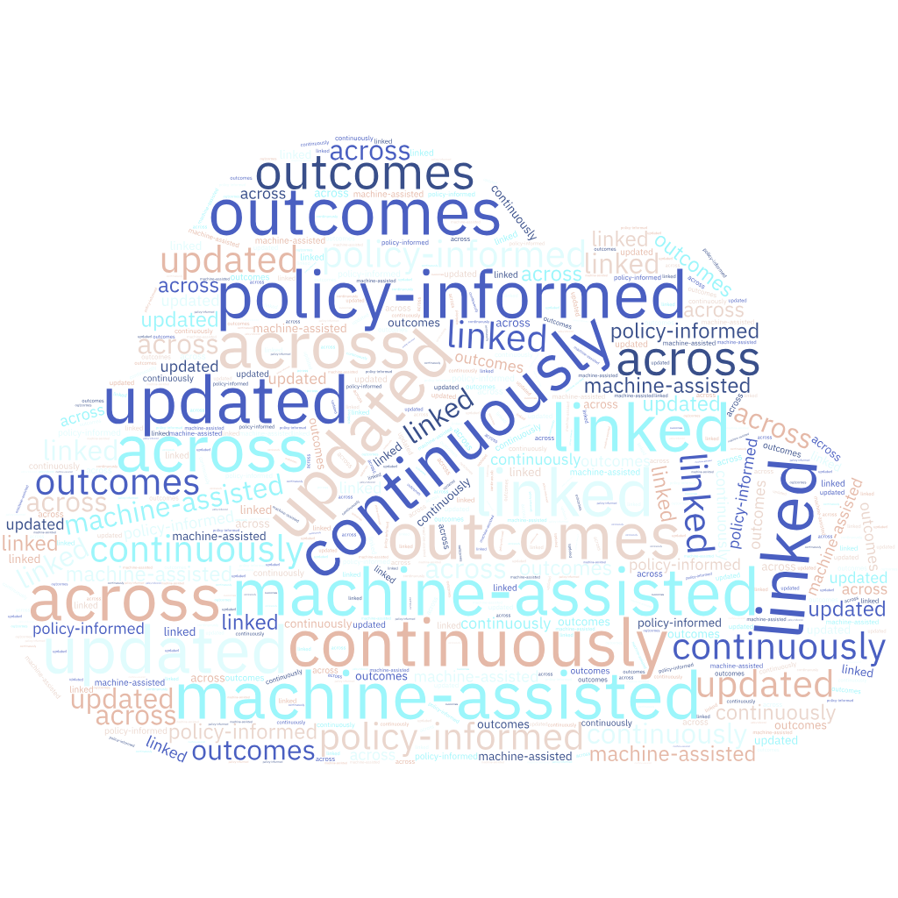
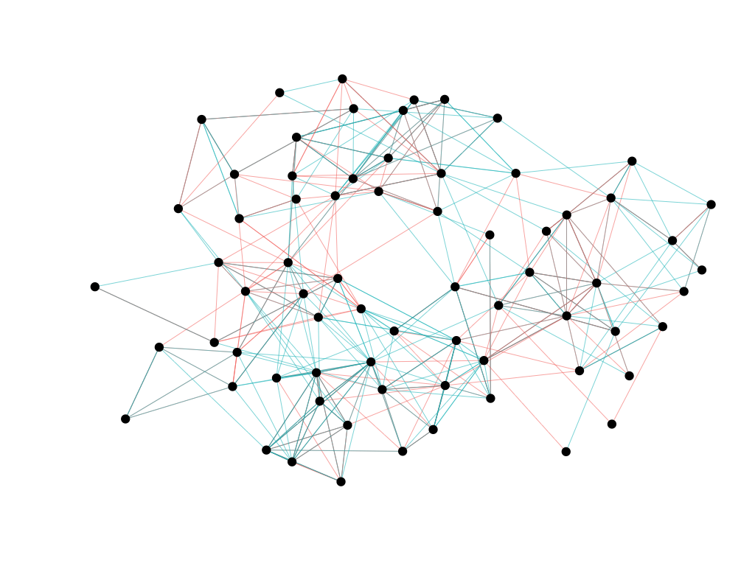
Let Evidence Evolve

Slide 4
Fragmented Knowledge in Carbon Pricing
Research papers on carbon pricing
Policymaker reports
Economic analysis
“Scattered” – “Isolated” – “Redundant”

Slide 5
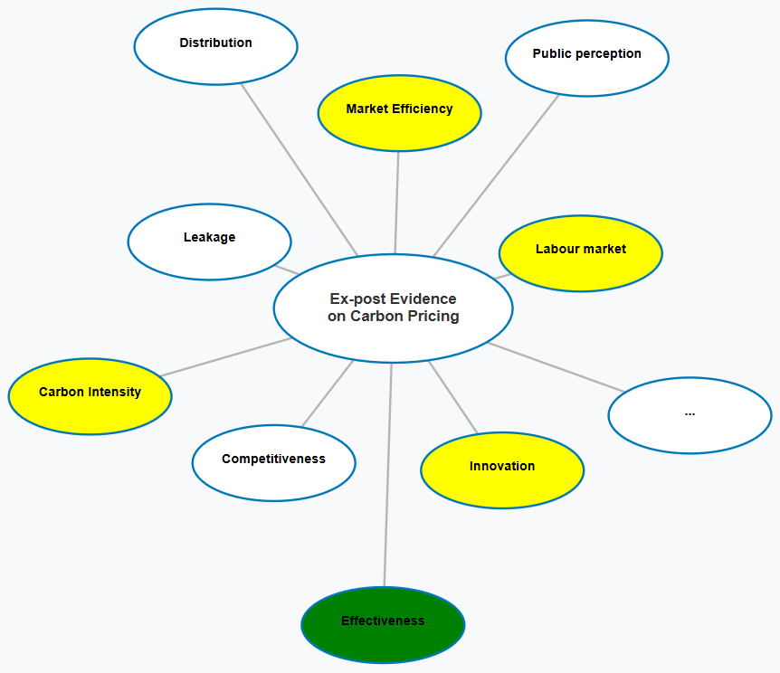
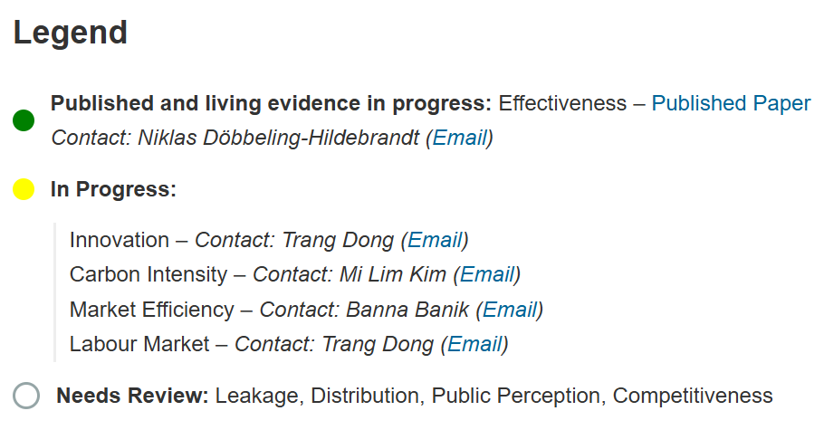
From isolated reviews to a connected, growing ecosystem

Slide 6
Horizontal and Vertical Integration
 | Effectiveness | Innovation | Intensity | Labour Market
Evidence Maps
Meta Analyses
Systematic Reviews
Primary studies

Slide 7
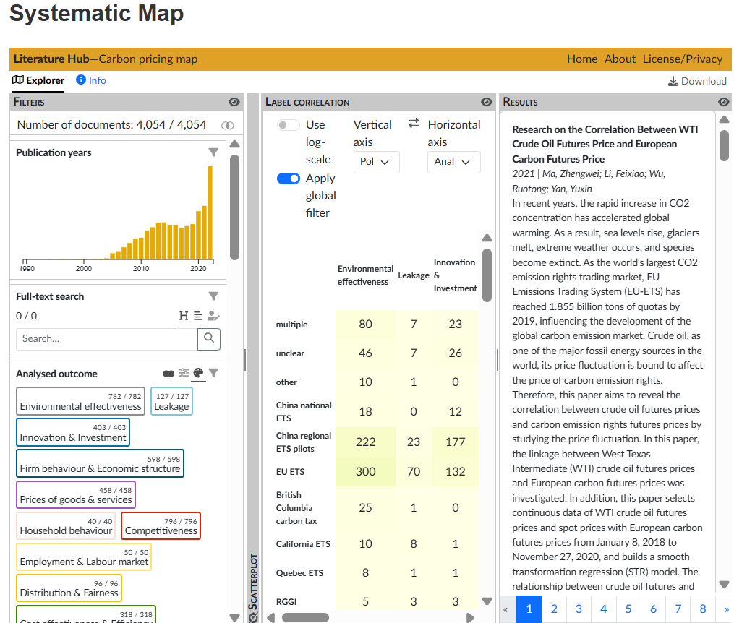
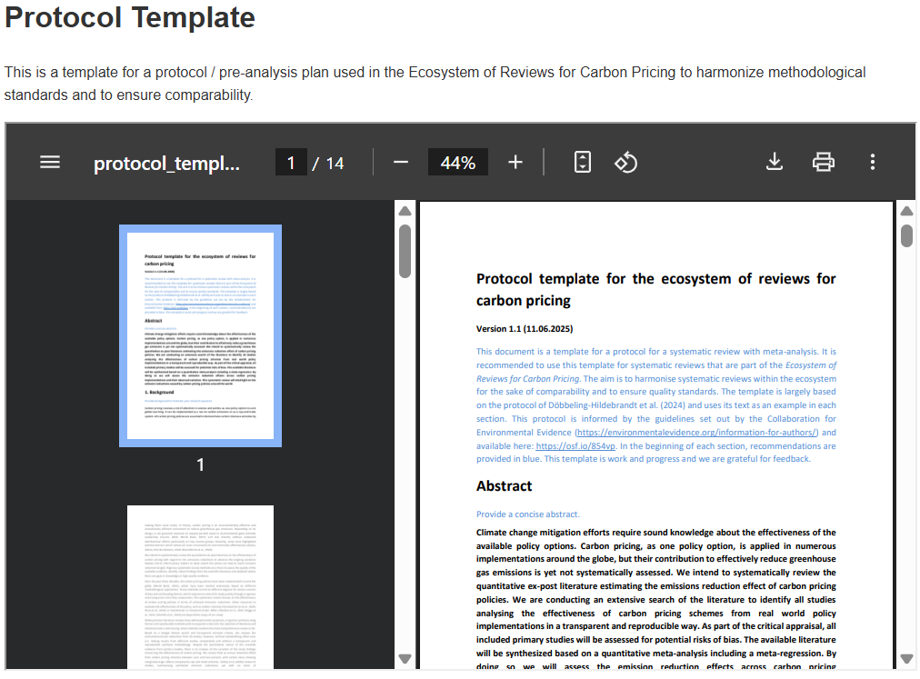
Building for Interoperability

Slide 8

From Static to Living Evidence
Traditional Reviews
Living Evidence
Machine-assisted
Stakeholder-responsive
Continuously updated
Living evidence = faster policy learning and up-to-date decisions

Slide 9
Scaling with AI: Machine Learning for Evidence Synthesis
Literature Search
Screening
Data Extraction
Synthesis
Update

Slide 10
Policy-Driven Evidence: Closing the Loop with Stakeholders
Policymakers
Raise questions, define needs
Researchers
Conduct evidence synthesis
Review System
Integrates and updates knowledge
Timely, relevant insights

Slide 11
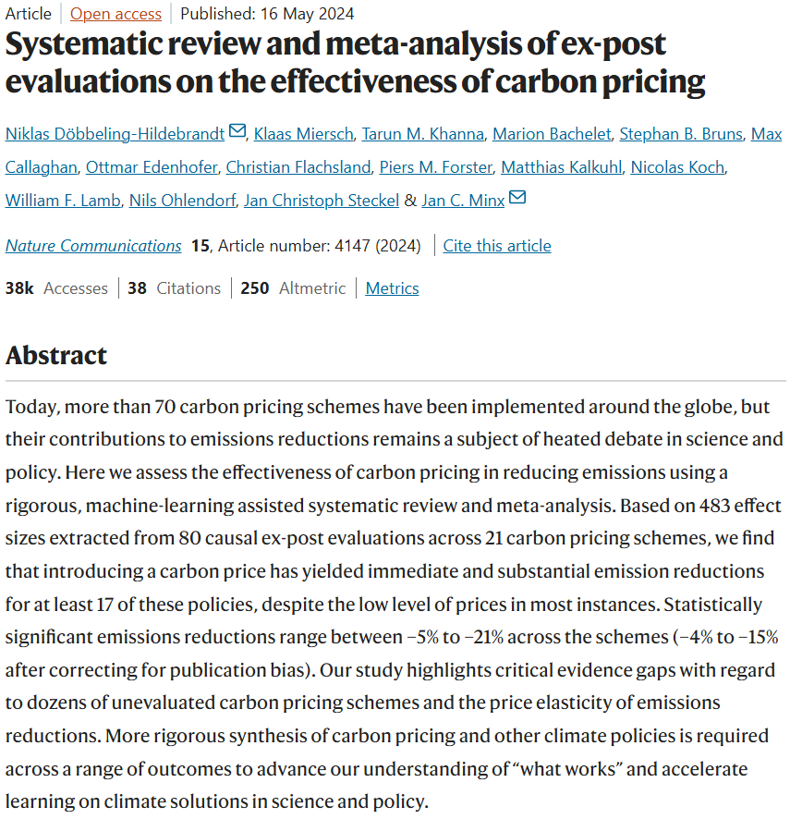
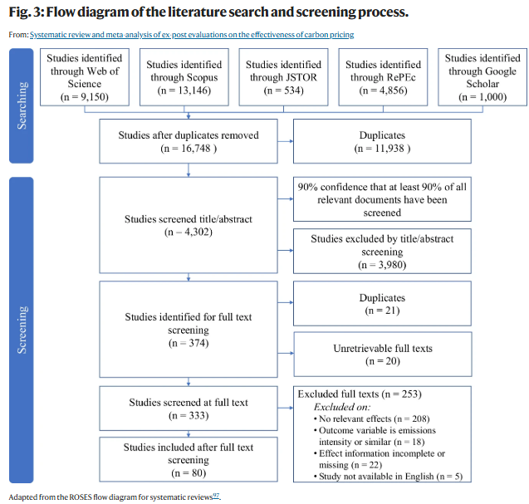
An example

Slide 12

Thank you
Thi Kieu Trang DONG
Hasselt University
trang.dong@uhasselt.be
Q&A - I’m looking forward to your thoughts.

