Slide 1
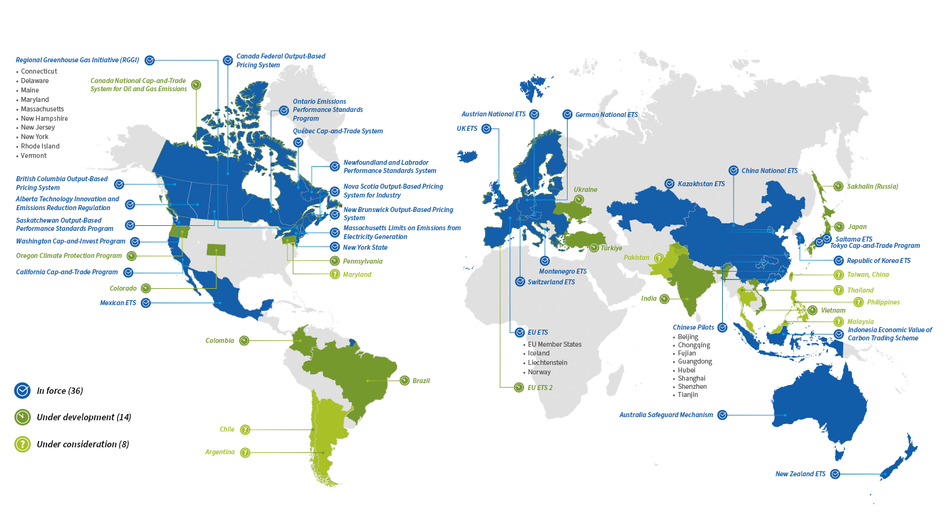

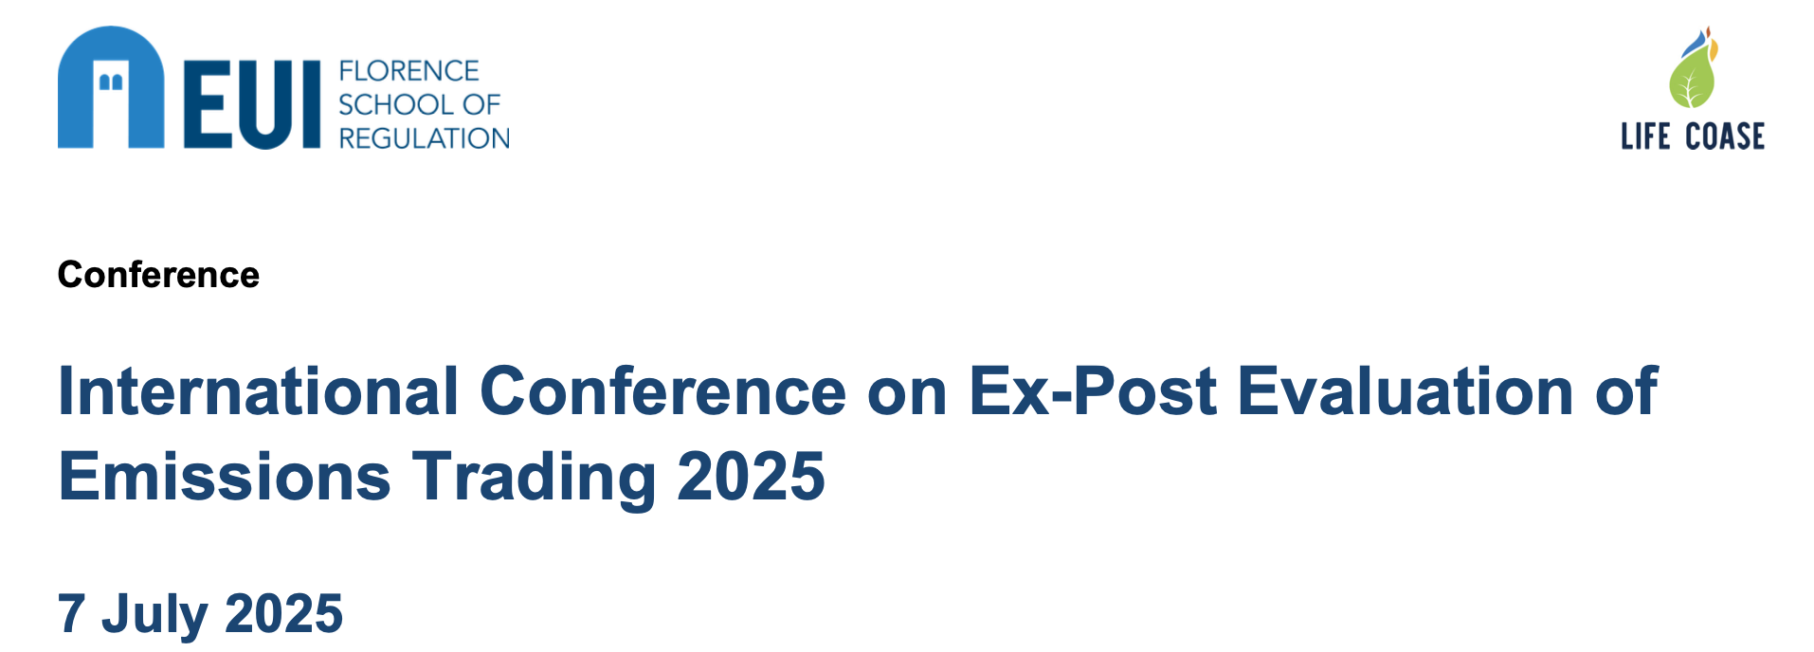
How does the EU’s ETS Phase III impact on green innovation in MENA border countries?
By 2024 there are 36 carbon trading systems in operation
Worldwide covering 18% of global emissions
by Camilla Jensen
Associate Professor
Roskilde University
DENMARK
The work presented here is supported by the Carlsberg Foundation, grant CF23-1322.

Slide 2
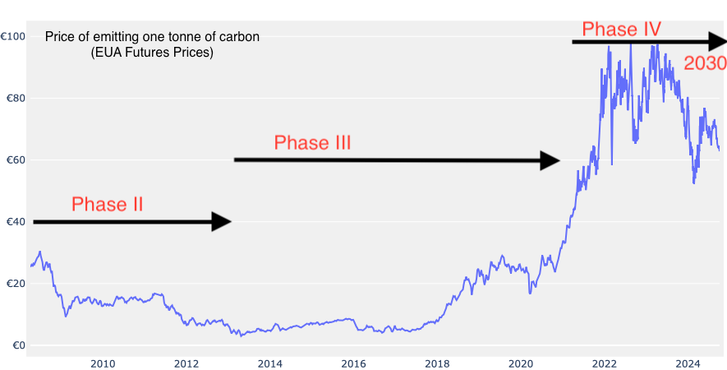
Overview of my presentation
Research Monograph work and how it relates with the research presented here today
Short intro to the European Union Emissions Trading System (EU ETS)
Background to the research: The SEM is first calibrated for Turkey (using Italy as control or counterfactual case)
About the datasets (World Bank Enterprise Surveys) – second-hand data
Summary of previous results for Turkey/Italy
Future applications: rolling out the SEM to other MENA samples (Tunisia, Morocco, Lebanon and Egypt)
Concluding remarks and Questions
Source: Sandbag CPV - https://sandbag.be/carbon-price-viewer/ and own additions.

Slide 3

Current book project (research monograph) – Carlsberg Monograph Stipend: Sustainable futures of trade. How to solve the triple crisis of inequality, security & climate?
Part I: Introduction
Ch 1 - Synthesis
Ch 2 - A brief history of the history of economic thought in international trade
Part III: Actors
Ch 7 - Multinational firms
Ch 8 - National governments
Ch 9 - The European Union
Ch 10 - The WTO
Part IV: Solutions
Ch 11 – Traditional trade policy (tariffs)
Ch 12 - Standards
Ch 13 – The EU’s ETS
Part II: Exploiting regulatory difference
Ch 3 – Labour
Ch 4 – Environment
Ch 5 – Climate
Ch 6 - Taxation
Part V: How we did it?
Ch 14 – Looking back from 2070

Slide 4
Main lessons for the international economy
Multinational firms are at the heart of the international economy today
Trade is determined by absolute, not comparative advantage
Knowledge transfer has always been more important than comparative advantage
Today comparative advantages are mostly founded in unsustainable arbitrage on regulatory difference
Solutions?
Regulate trade when dangerous (illicit trade, health, premature death, endangered species) and unwarranted (waste), collaborate in areas where the exploitation of regulatory difference (i.e. taxation, slave labour) undermines national welfare and security
In areas such as climate and environment self-management systems are desirable, since regulation in itself is not an end-game, but appealing to our better selves is
Examples of self-management systems we already know include education and waste management
I argue the ETS is not so much about carbon pricing as it is about self-management that raises the attention for firms to introduce incremental and radical innovations for energy preservation
Much more knowledge is needed about multinational firms and international trade whereby we can better regulate them to balance the needs of nation states and populations with those of firms and international organisation and management
As much as possible we should make away with efficiency-seeking types of multinational strategies and promote and develop policies for the conduit of the market-seeking types of multinational strategies (that dominated the Golden era of international investment and development i.e. 1955-1985)
Indispensable to resurrect the international public order and system for ensuring a fair and just international trading system

Slide 5
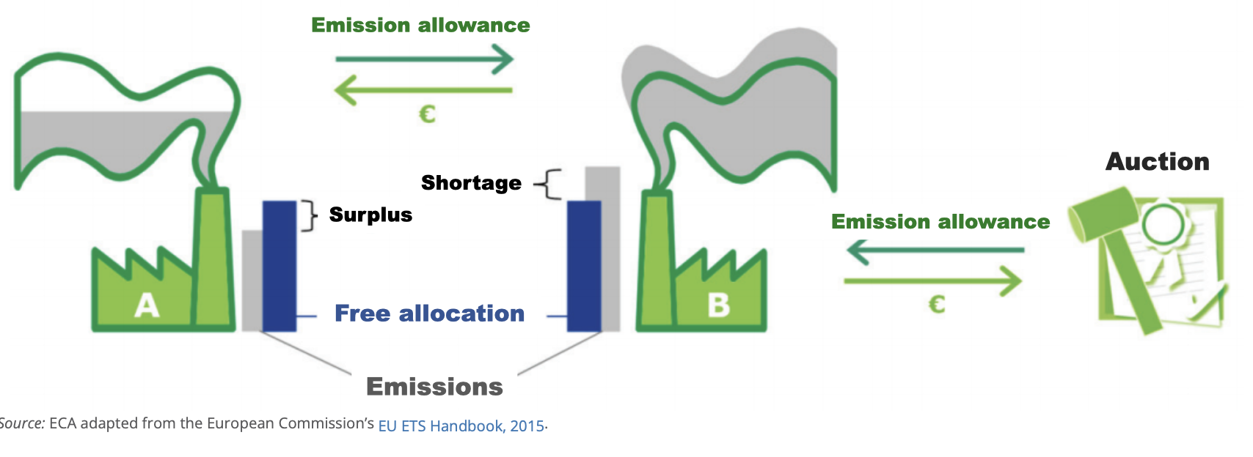
ETS: How does it work in theory and practise?
Leap: Firm introduces innovation (energy efficiency improvement) whereby it is no longer s.t. the ETS
Leak: The ETS is too costly
for the firm to remain competitive. The firm reconfigures its international activities causing carbon leakage.

Slide 6
The Emissions Trading Systems - key facts
ETS I - bring down emission in power generation and the most energy intensive industries (such as production of iron, aluminium, cement, glass, cardboard, acids etc.) by a certain % each year. Extending current rules would mean that the CAP could reach 0 by 2039 in these activities.
9,000 power plants and factories in EU-27 + Iceland, Lichtenstein and Norway covering 36% of the EU’s total GHG emissions in 2022.
The following sectors and activities are mandatory: electricity and heat, energy-intensive industry sectors, including oil refineries, steel works, and production of iron, aluminium, metals, cement, lime, glass, ceramics, pulp, paper, cardboard, acids and bulk organic chemicals, aviation & maritime.
In other sectors in some sectors, only operators above a certain size are included and where certain small installations may be excluded if governments put in alternative measures to cut their emissions.
ETS II - Transport and building sector.
Plan is to merge ETS I and II by 2030.

Slide 7
Changes with the EU Climate Law 2021
GHG emissions to be reduced with 55% by 2030 c.t. 1990 (to reach this goal the EC presented the ‘Fit for 55 package’:
  New 2030 target for ETS emissions 62% (vs. 43%) c.t. 2005
  New LRF 4.3% up from 1.7%
  ETS Revenue only to be spend on climate-related activities
  Shipping emissions included
  CBAM will replace free allocations (cement, steel and fertilisers) and remaining free allowances will be made conditional on investments in energy enhancing solutions (read: put a stop to carbon leakage..)
  Aviation will have its own CBAM called CORSIA
  Waste burning emissions to be included by 2028

Slide 8
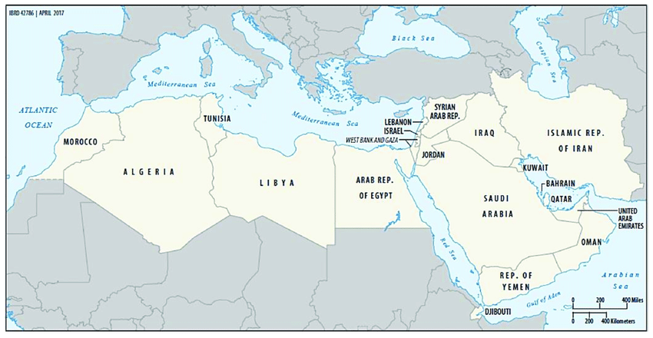
Research questions
What is the impact of the EU ETS on 3rd countries?
  Does it lead to carbon leakage? (defined as a negative trade policy spillover)
  Can there be a positive effect or positive trade policy spillover?
  What is the impact on balance for different MENA countries?
  Does the free allocations in industries at risk have an independent impact?

Slide 9
About the Enterprise Survey (ES) data
Repeated surveys for a wealth of countries, across all world regions, across all income groupings.
Only surveys with the Green Module+ can be used for the research purposes (implemented for a limited period and mostly in Europe, Central Asia and the Middle East – co-project between the World Bank ES group and the European Bank for Reconstruction and Development).
Rich data for developing latent constructs desired – i.e. capturing institutions (formal such as taxes and public standards, informal such as pressure from customers) that impact on green behaviour in organisations or firms.
The internal validity of the datasets is very high – i.e. Cronbach Alpha around 0.8 for the Turkey dataset.
Also valid for making inferences at population level – comes with survey weights (sampling is stratified on firm size and industry, not energy intensity).
Main weakness is that most observations are cross-sectional.
Some causality assumptions are not fulfilled – time series order and reverse causality.

Slide 10
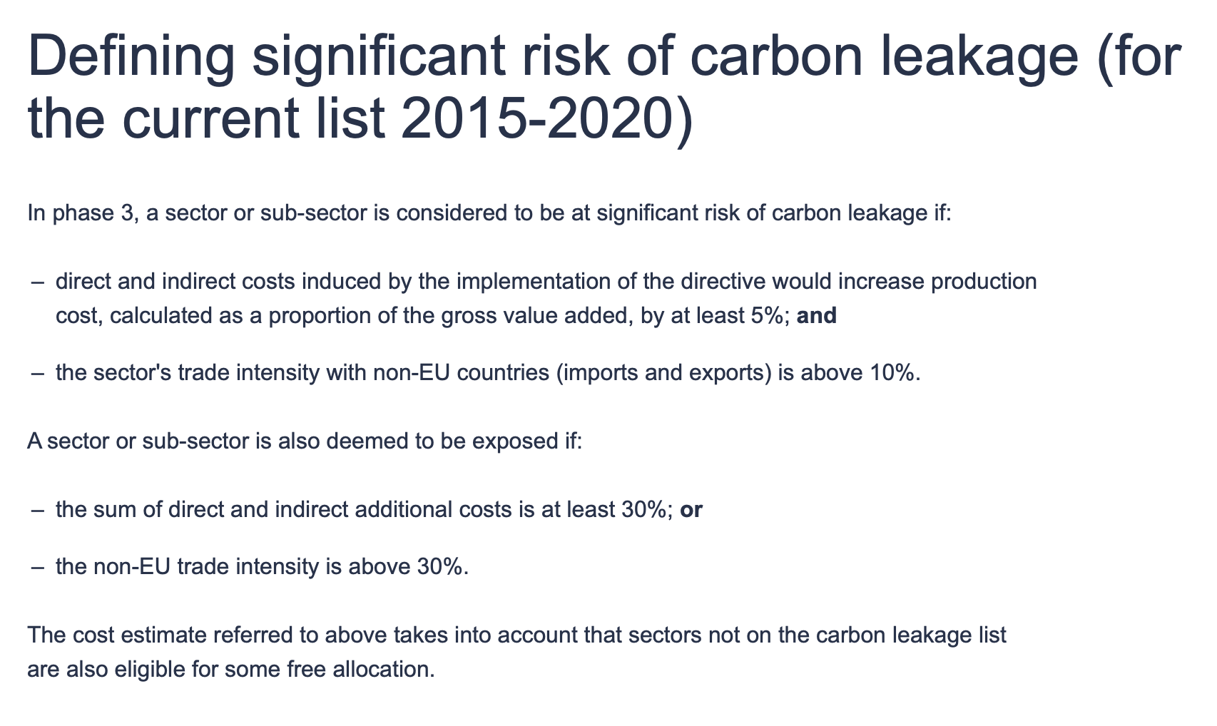
How to account for ETS and free allocations?
For 3rd countries the most correct is to code all manufacturing industries as
ETS industries. For 1st and 2nd countries this would be incorrect. Because ETS
eligibility is not based on industry classification but on energy intensity benchmarks.
NB! The EU’s System of Free Allocations (here explained for Phase 3
because it is this phase that is covered by the data used in the
present research)
Source - https://climate.ec.europa.eu/eu-action/eu-emissions-trading-system-eu-ets/free-allocation/carbon-leakage_en

Slide 11
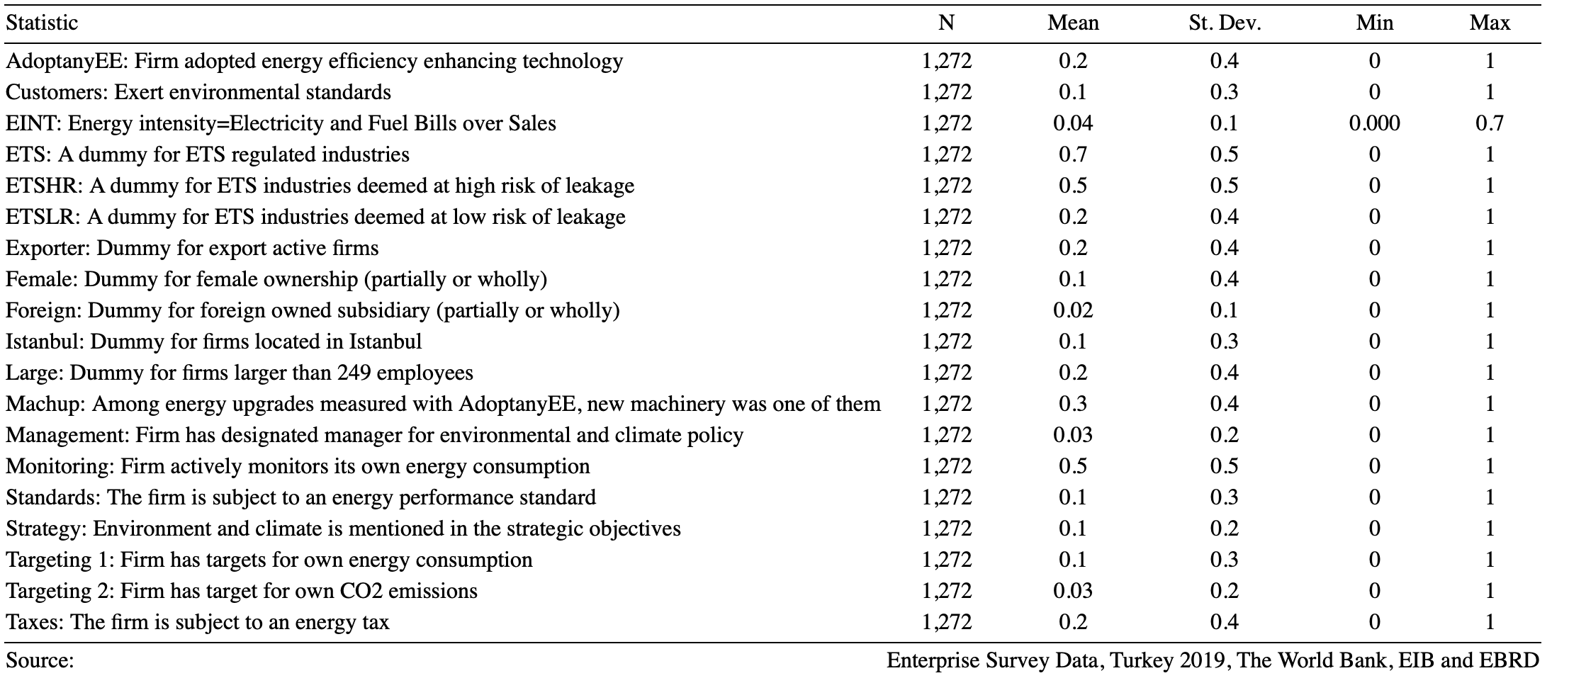
Descriptive statistics: overview of variables

Slide 12
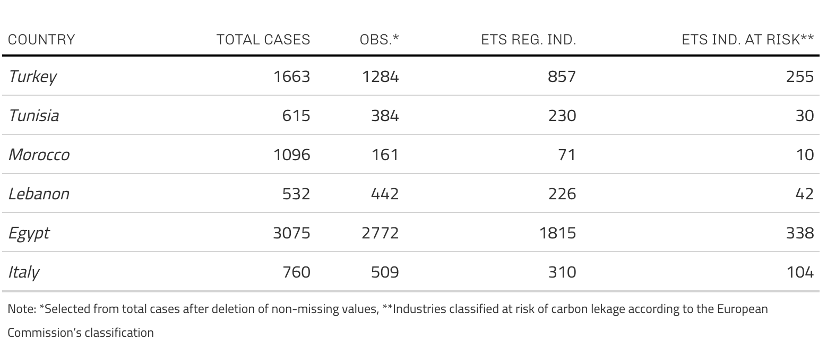
Sampled MENA countries from ES datasets

Slide 13
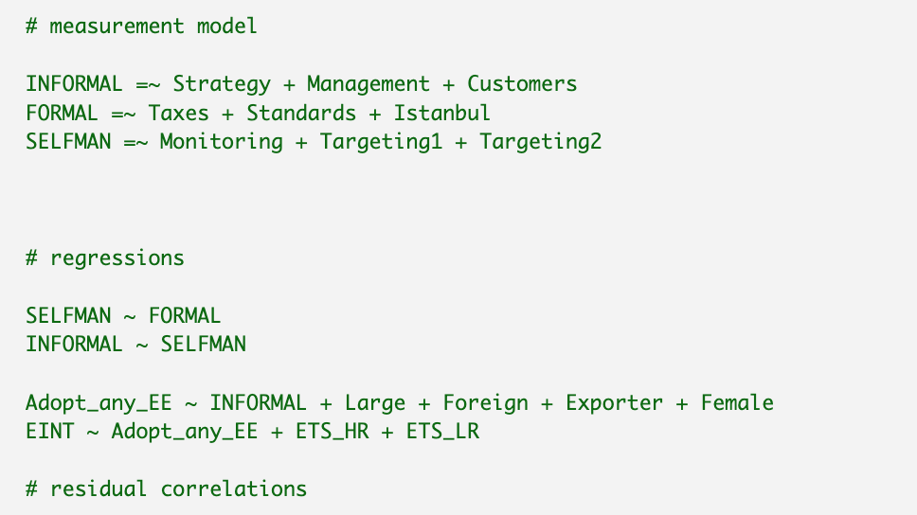

Slide 14
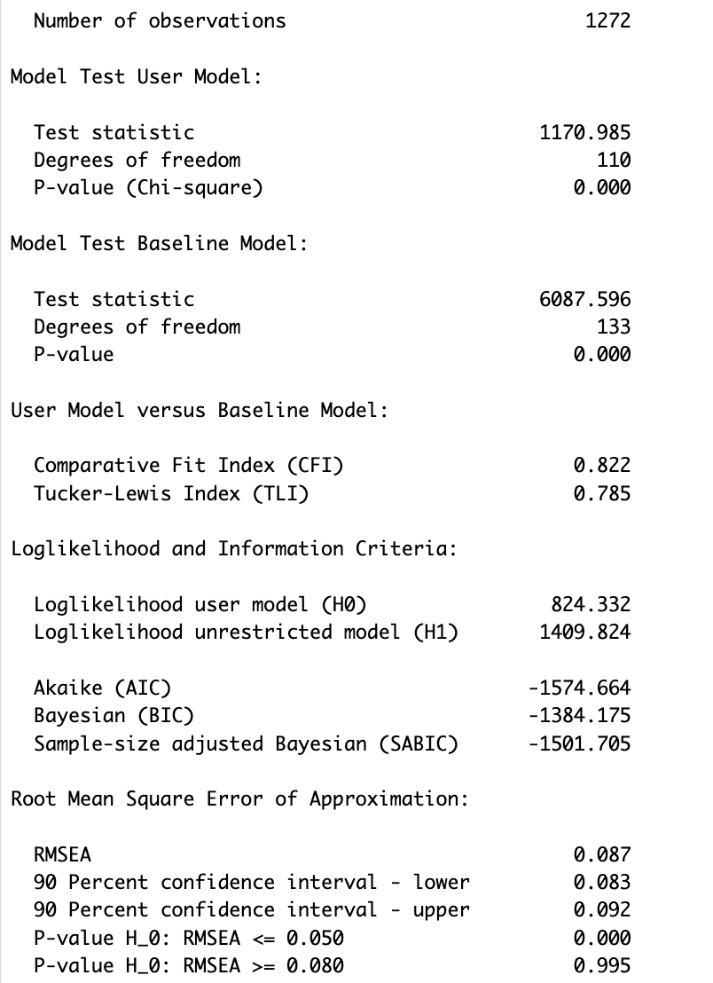
Model fit statistics (Turkey)

Slide 15
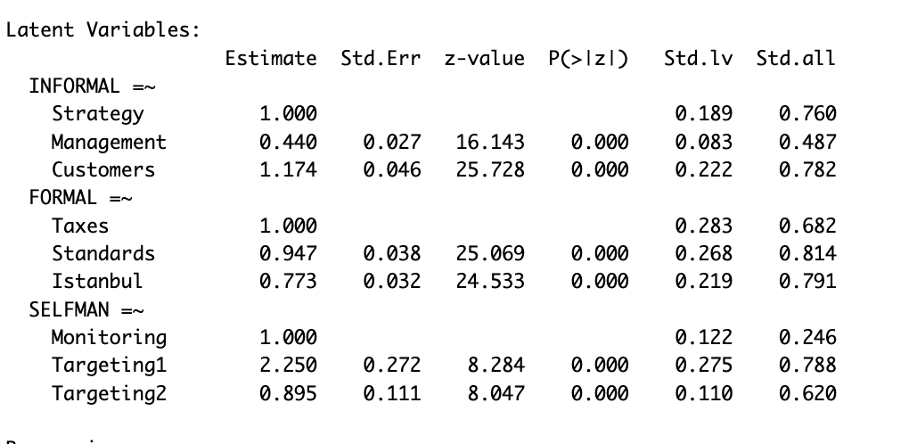
Factor loadings

Slide 16
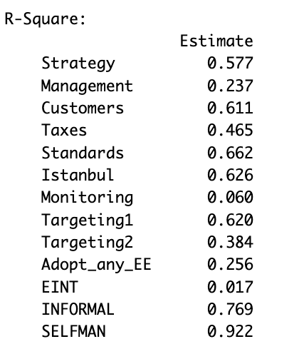
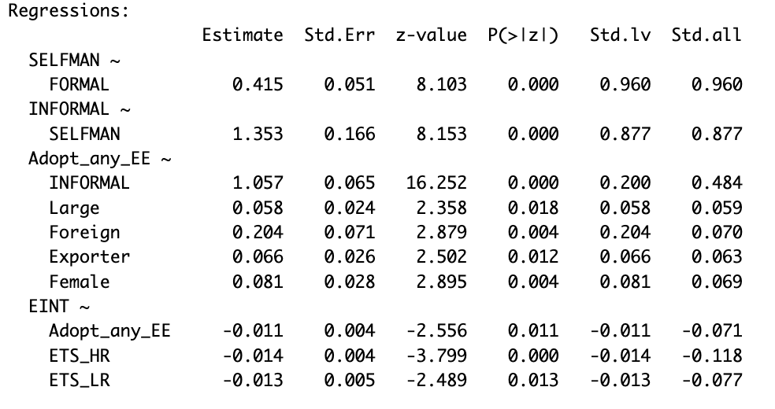
Regression results and variance explained

Slide 17
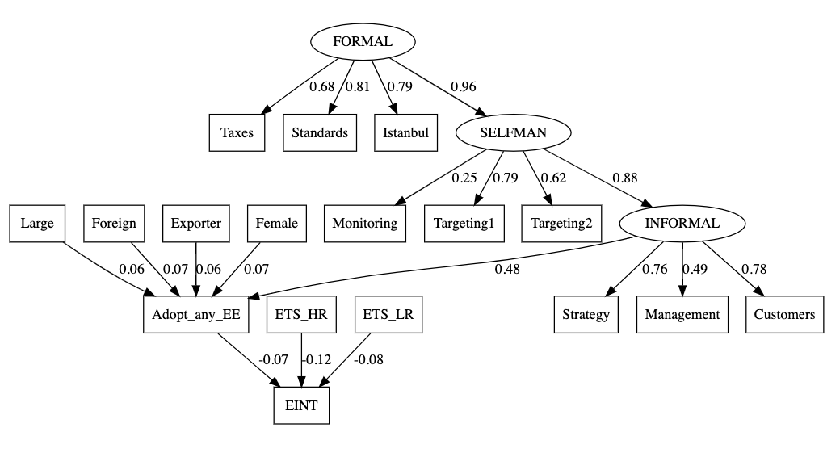
Path diagram: Turkey – standardised coefficients shown (p<0.05)
ML results (DWLS does generate better fit statistics but is computationally less efficient)

Slide 18
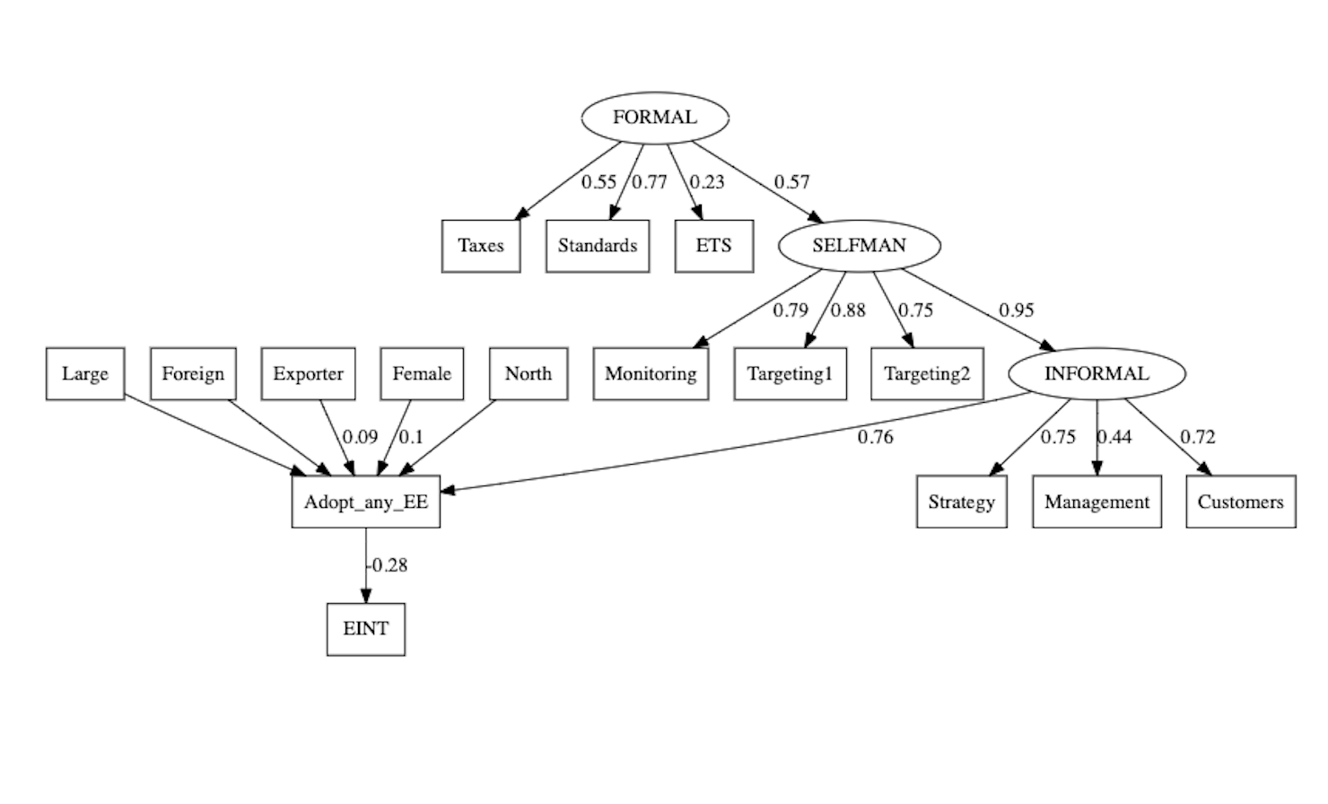
Path diagram: Italy – standardised coefficients shown (p<0.05)
ML results (DWLS does generate better fit statistics but is computationally less efficient)

Slide 19
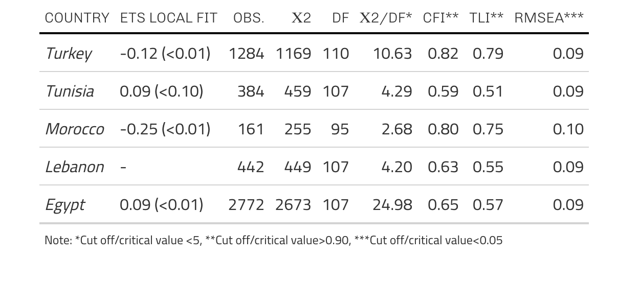
Replicating the final model for Turkey for the other MENA country samples

Slide 20
Conclusions: main results
The research demonstrates that the ‘average’ 3rd country effect may be heterogenuous
The impact of the ETS is shown to be larger than the general impact of introducing incremental innovations (energy conserving) in MENA countries
The large countries (large samples) demonstrate this well – for Turkey there is an average positive trade policy spillover, oppositely for Egypt there is an average negative trade policy spillover of carbon leakage
For the small countries (small samples) and especially Morocco and Tunisia the results are less valid and therefore inconclusive
Morocco shows a similar result to Turkey (positive trade policy spillover), but the drop-out rate is very high, whereas for Tunisia the result is similar to Egypt
The results for Lebanon are indeterminate (insignificant)

Slide 21
Discussion, perspectives, next steps..
The results demonstrate well that the impact of the ETS overall is heterogeneous both at the country and firm-level.
Extension to the research - other 3rd countries such as Ukraine, Belarus, Georgia and benchmark with data for Poland, Baltic Countries
Work on CBAM regulations - where CBAM will replace the system of free allocations to counteract carbon leakage in a more efficient way (for the ETS system to work as intended)

Slide 22
Thank you for your attention!

