Slide 1
Coherence in carbon pricing The importance of descriptive economics for policy package evaluation
Herman Vollebergh (Tilburg University and NEAA)

Slide 2
Carbon pricing and economic policy advice
Policy makers, here we come!
Example: swallow a carbon tax! But a uniform carbon tax can be welfare decreasing
In practice a variety of regulatory instruments applied, even carbon pricing instruments (see OECD, IMF, Worldbank)
Do economists really know enough to make useful policy recommendations?
Maybe less then we think, but perhaps more then others think (e.g. transition theorists)?
Relevance of production heterogeneity, status quo distortions, policy packages
Descriptive analysis is key (see Vollebergh, 2023):
have the right tools, but could be more effective in policy advice
should invest more in descriptive economics, but how?

Slide 3
I Policy packages for zero carbon and coherence
Net zero requires incentives to direct economy towards a carbon neutraity
Implies a very deep change of the economic system (e.g. Special Issue Ecological Economics: https://www.sciencedirect.com/journal/ecological-economics/special-issue/10K9PX91679 )
Examples: electricity generation, industry, but also transport, built environment, agriculture
Incentives, like regulatory instruments, are key driver of change, but…
Status quo is distorted with existing instruments (e.g. energy taxes)
Policy packages may pose concerns for coherence
Comparability issues of stringency

Slide 4
I Policy packages for zero carbon and coherence
Finding appropriate ‘kicks’ far from obvious in practice
existing policies often consist of a mix of instruments
but do not provide the right or strong enough ‘kicks’ to achieve net zero
This paper develops a descriptive tool to assess carbon pricing packages reflecting key design attributes of different regulatory instruments to facilitate coherence in policy design:
Theory based stock taking of policy instruments
Energy and emission accounting to map these to relevant market failure for correction

Slide 5
II Corrective carbon pricing in theory
What is the best regulatory system to address GHG emissions?
Choice of regulatory base:
What to regulate (‘tax base’)?
And who (which sector)?
Choice of regulatory rate: How strict?
Complications:
Pre-existing taxes and regulation (e.g. interaction with ETS).
Costs of implementing, administering, enforcing, and monitoring emissions
Conjecture: a uniform Pigovian emission tax is not necessarily optimal or even cost efficient (Smulders and Vollebergh, 2024)

Slide 6
II Corrective carbon pricing in theory
No free lunch for any ‘tax’
General equilibrium representation to get a full picture of incentives and their incidence across economy
Three possible instrument designs:
Output ‘tax’ (on q)
Input ‘tax’ (on R or X)
Emission ‘tax’ (on E)
See Smulders and Vollebergh (2024) for model

Slide 7
II Corrective carbon pricing in theory
Each tax has a different impact on emissions
$dE_{i}=d(q_{i}$ $e_{i} (x_{i}$, $a_{i}$)) = $e_{i} dq_{i}+q_{i}e_{xi}^{′} dx_{i}+q_{i}e_{ai}^{′} da_{i}$
Sources of emission reduction:
Channels: i) output reduction, ii) input reduction/substitution, iii) abatement
upstream or downstream
Different taxes use these channels in different intensity and may apply to different sectors
Three design choices to be answered:
What to tax?
Where to tax (in the value chain)?
How strict?

Slide 8
II Corrective carbon pricing in theory
What to tax?
Where to tax?
Heterogeneous sectors (cement, steel, electricity, agriculture chp, oil refineries, transport)
Upstream vs downstream sectors
PM1 Downstream emission tax acts like (small*) tax on upstream’s output (upstream-emission reduction through upstream-output reduction)
PM2 Downstream input tax acts like (bigger*) tax on upstream’s output (upstream-emission reduction through upstream-output reduction)
Which strictness?
E.g. ‘optimal’ emission tax rate can be lower (it triggers abatement which the input tax does not)
Tax | Output | Input | Emission
Emission | X | X | X
Input | X | X
Output | X

Slide 9
II Corrective carbon pricing in theory
Using expressions for changes in welfare
Derive optimal taxes (‘gross private welfare’)
Cost efficiency edge to compare welfare effect of two different taxes
Evaluate cost-effective taxes
Conditions for indirect taxes as a substitute for emission tax:
Relationship between energy and emission sufficiently strong
Use of separate abatement technology relatively expensive
Implementation cost for emission tax sufficiently higher
Other (upstream) taxes (or regulation) address emissions sufficiently
Packages can be (second best) optimal
Application differs across externality cases

Slide 10
III From theory to practice
Description is not obvious
In the Netherlands six pricing instruments (even climate pricing instrument seldom come alone) including tax on carbon, ETS, taxes on energy inputs (gas, coal, oil), downstream tax on electricity, waste tax
Pre-existing distortions are the real benchmark (not competitive economy description according to FTWE!)
Usually high implicit tax burdens on households, but …. their emissions only make up only a relatively small share of the total
Proper description, i.e. in line with theoretical considerations, helps to rationalize (complex) decision-making in the face of carbon transition (Vollebergh, Vogel, vd Werf, 2023), but how precisely?

Slide 11
GHG effective price
Policy objective
t₂₀₃₀
Observable
t₂₀₂₂
t₂₀₂₁
0
E₂₀₃₀
E₂₀₂₂
E₂₀₂₁
GHG Emissions E

Slide 12
III Corrective pricing and instrument attributes
Evaluation requires careful description of status quo:
Identification of current actions (including existing instrument attributes) and their relevance for actions involved for the transition = existing choices = revealed preferences
Identifcation of relevant attribute design characteristics = key design elements
PM Identification of relevant choice environment (‘context’) = other factors indirectly responsible or related to choice outcomes
Stock-taking starts with an inventory of relevant existing instruments (see also Module 1 IFCMA)
Use attributes to make instruments comparable (Vollebergh et al., 2023):
Focus (‘what’), Scope (‘where’), Strictness (‘how much’), Timing

Slide 13
Instrument attributes
GHG effective price
Policy objectives
t₂₀₃₀
Strictness
Observables
Timing
t₂₀₂₂
t₂₀₂₁
Focus
0
E₂₀₃₀
E₂₀₂₂
E₂₀₂₁
GHG Emissions E
Scope

Slide 14
III Mapping instruments in PE space
Map description instruments to price-quantity dimension relevant for change (see Harding et al., 2015):
Determine the GHG emissions base for X-axis (=E) using country specific (fossil fuel) energy balances and computations for non-CO₂ gases
Determine total effective carbon rates for Y-axis (=P=t) through explicit emission prices (cap-and-trade, carbon taxes) and implicit prices on energy inputs (existing excises) and outputs (excise on fossil fuel generated electricity)
How to calculate?
Six pricing instruments linked to pricing base using energy balances
Five key ‘emission sectors’ = complete GHG pricing base (= total emissions in year t)
Computation of effective rates using relevant emissions factors (‘linkage’)
Fixed for gas, oli and coal; changing for electricity, agriculture
Only fossil fuel related emissions or all (potential) GHG emissions including future emissions (due to feedstocks & dual consumption of C), bunkers and biomass

Slide 15
III Example: GHG pricing in the Netherlands in 2022
Taxes electricity, natrual gas, oil, ooal
Notes:
Explain how to get to x-as for each sector (use of energy products in sectors key)

Slide 16
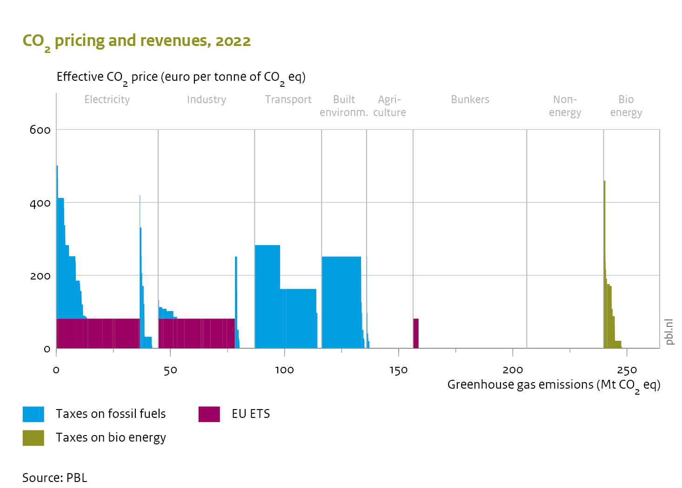
III Example: GHG pricing in the Netherlands in 2022
Fossil Fuel subsidy
Taxes electricity, natrual gas, oil, ooal
Other transport externalities
Notes:
Explain how to get to x-as for each sector (use of energy products in sectors key)

Slide 17
IV Descriptive evaluation and package evaluation
Timing:
For taxes check op indexation or other (announced) changes in tax rate over time
For tdp implicit in the running emission market price
For coherence policy package evaluation is key
Check what, where and how strict for each instrument separately as well as jointly
Instruments in a package could be complementary and/or overlap
Quantity or Tax Instruments such as ETS and energy taxes in EU are designed for complementary of carbon pricing
Existing instruments matter (a lot) for both optimality and cost effectiveness
Identification of environmental harmful subsidies (e.g. exemptions to dirty industry) in existing instruments important
Also other externalities matter (joint benefits such as air quality)

Slide 18
IV Take aways
Tansitions require not only selection of proper change agents using multiple instruments but also careful choice of what to regulate where and how strict
Instruments often overlap or come as complements (Vollebergh and Van der Werf, 2014)
So called ‘pre-existing ‘distortions’ reflect context specific compromises and should be an integral part of welfare evaluation and policy recommendations
Carbon pricing interesting example: with pre-exiting input taxes a uniform carbon emission tax not first best
Descriptive analysis helps to identify
pricing gaps (design features of policy instruments from which these gaps result)
multiple policies (overlapping or complementary)
differences in effective carbon pricing rates

Slide 19
Recent contributions
Thank you! h.r.j.Vollebergh@tilburguniversity.edu
Sen, S, & HRJ Vollebergh (2018), The effectiveness of taxing the carbon content of energy consumption, Journal of Environmental Economics and Management, Volume 92, pp 74-9
Smulders, S & HRJ Vollebergh (2024), Choosing Corrective Taxes in the Presence of other distortions, mimeo
Vollebergh, HRJ & E van der Werf (2014). The Role of Standards in Eco-innovation: Lessons for Policymakers. Review of Environmental Economics and Policy, 8(2):230{248.
Vollebergh, HRJ (2023). Evaluating policy packages for a low-carbon transitions – Principles and applications. Ecological Economics 212
Vollebergh, HRJ, E van der Werf & Vogel (2023). A descriptive framework to evaluate instrument packages for the low-carbon transition. Ecological Economics 205.
Vollebergh, HRJ & C Brink (2023), Coherence in carbon pricing - The importance of descriptive economics for policy package evaluation, mimeo
Vollebergh, HRJ, E Drissen & C Brink (2021). Klimaatverandering in de prijzen? Den Haag: PBL
Brink, C, A Trinks, HRJ Vollebergh & P Zwaneveld (2023). Afschaffing fossiele-energiesubsidies: eerder een hersenkraker dan een no-brainer. Den Haag: PBL&CPB, translation available soon

Slide 21
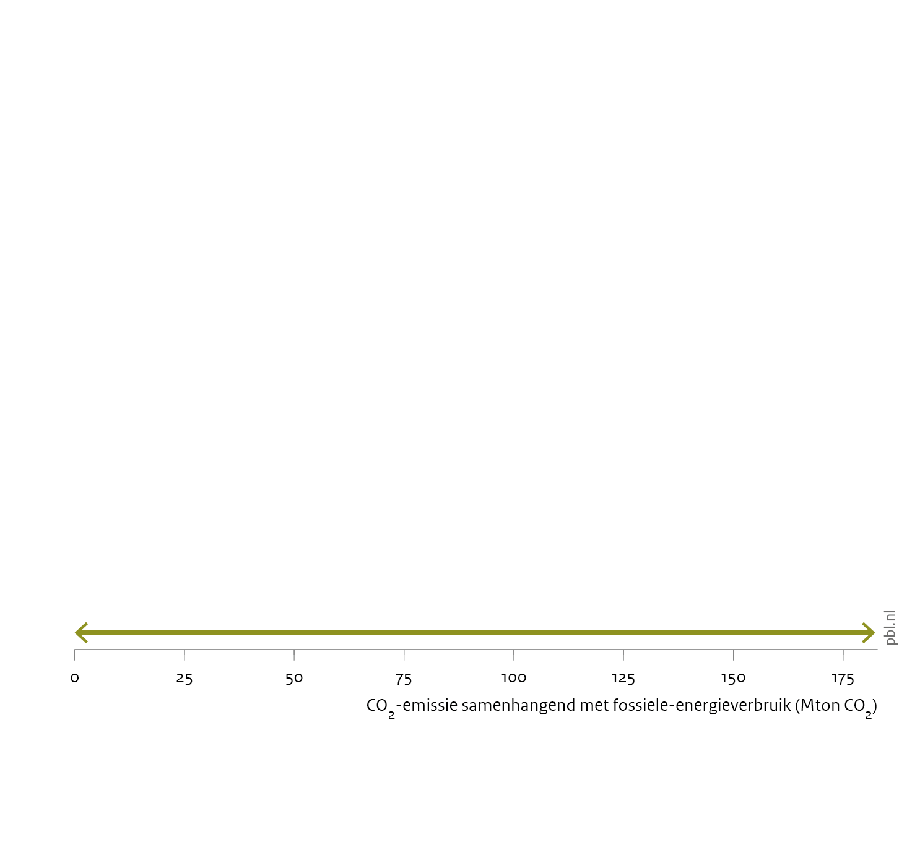
Horizontal axis: all CO₂ emissions from fossil fuel use in the Netherlands in 2021

Slide 22
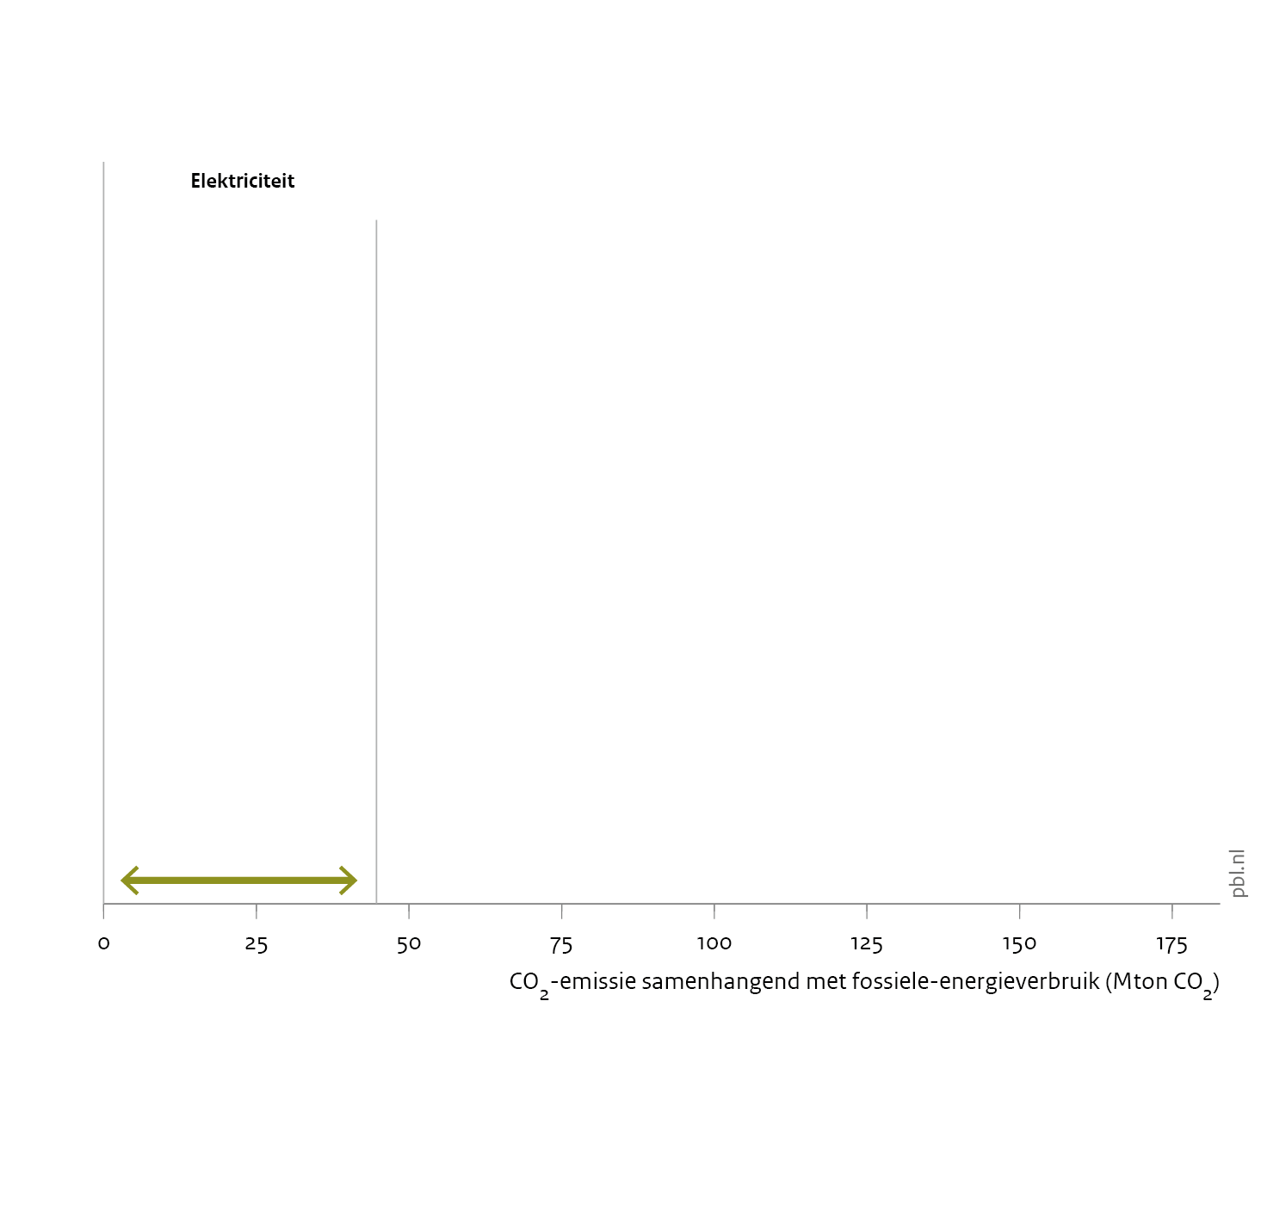
Power sector: 44.7 Mton CO₂

Slide 23
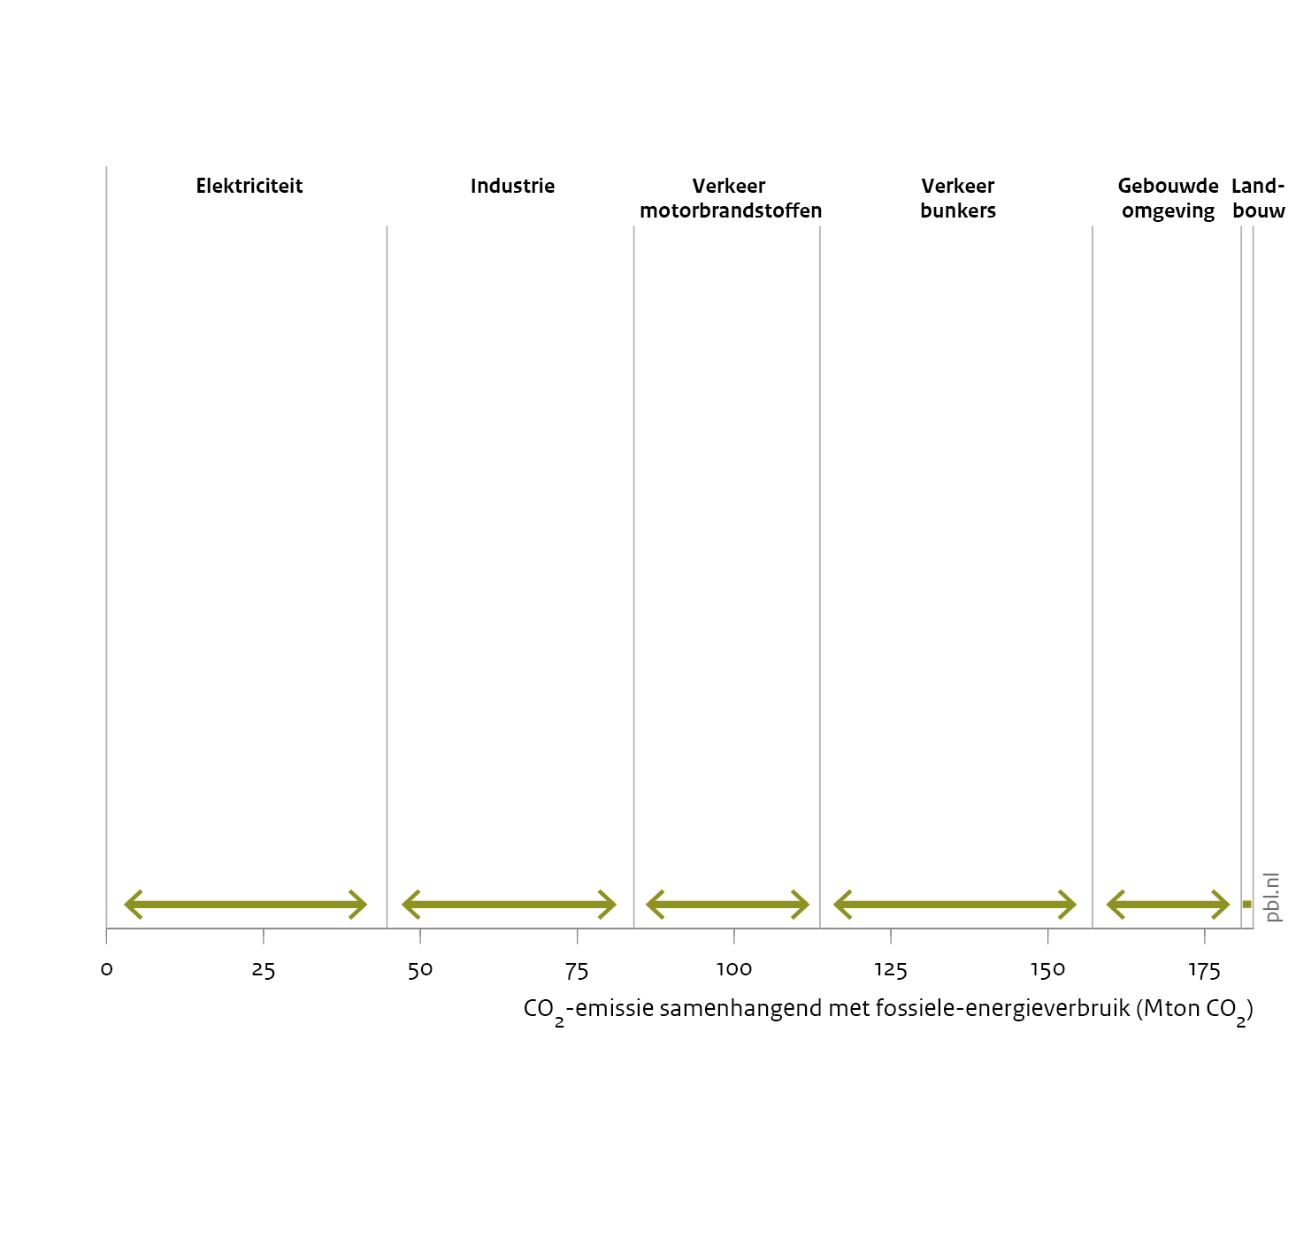
All sectors together (power sector, industry, transport sector, built environment and agriculture): 182.7 Mton CO₂

Slide 24
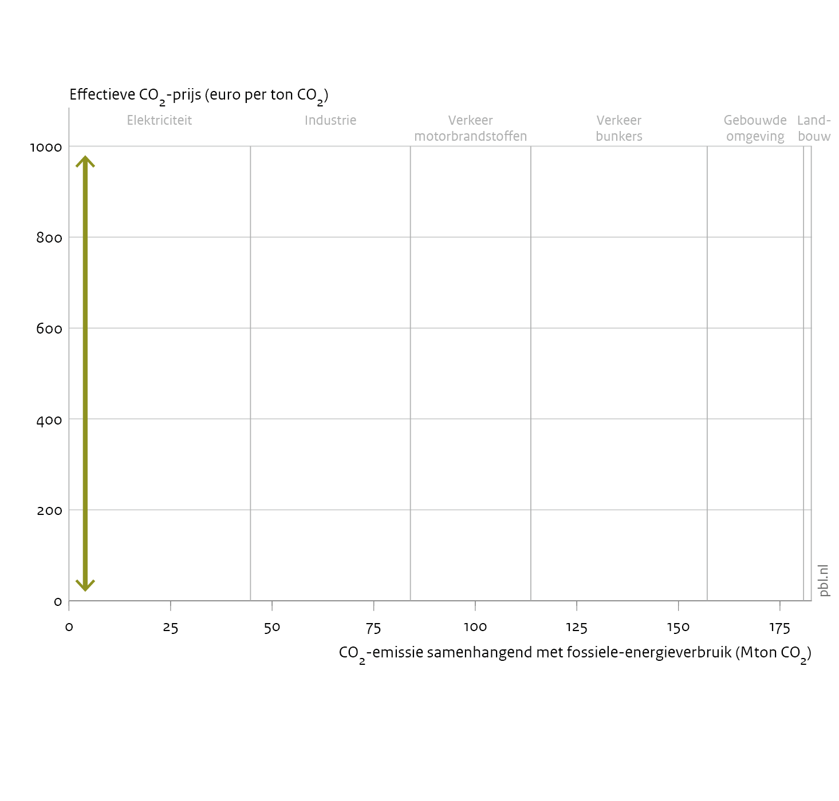
Vertical axis: effective CO₂ price.
Taxes on energy (indirect carbon pricing) are converted to a price per ton CO₂.

Slide 25
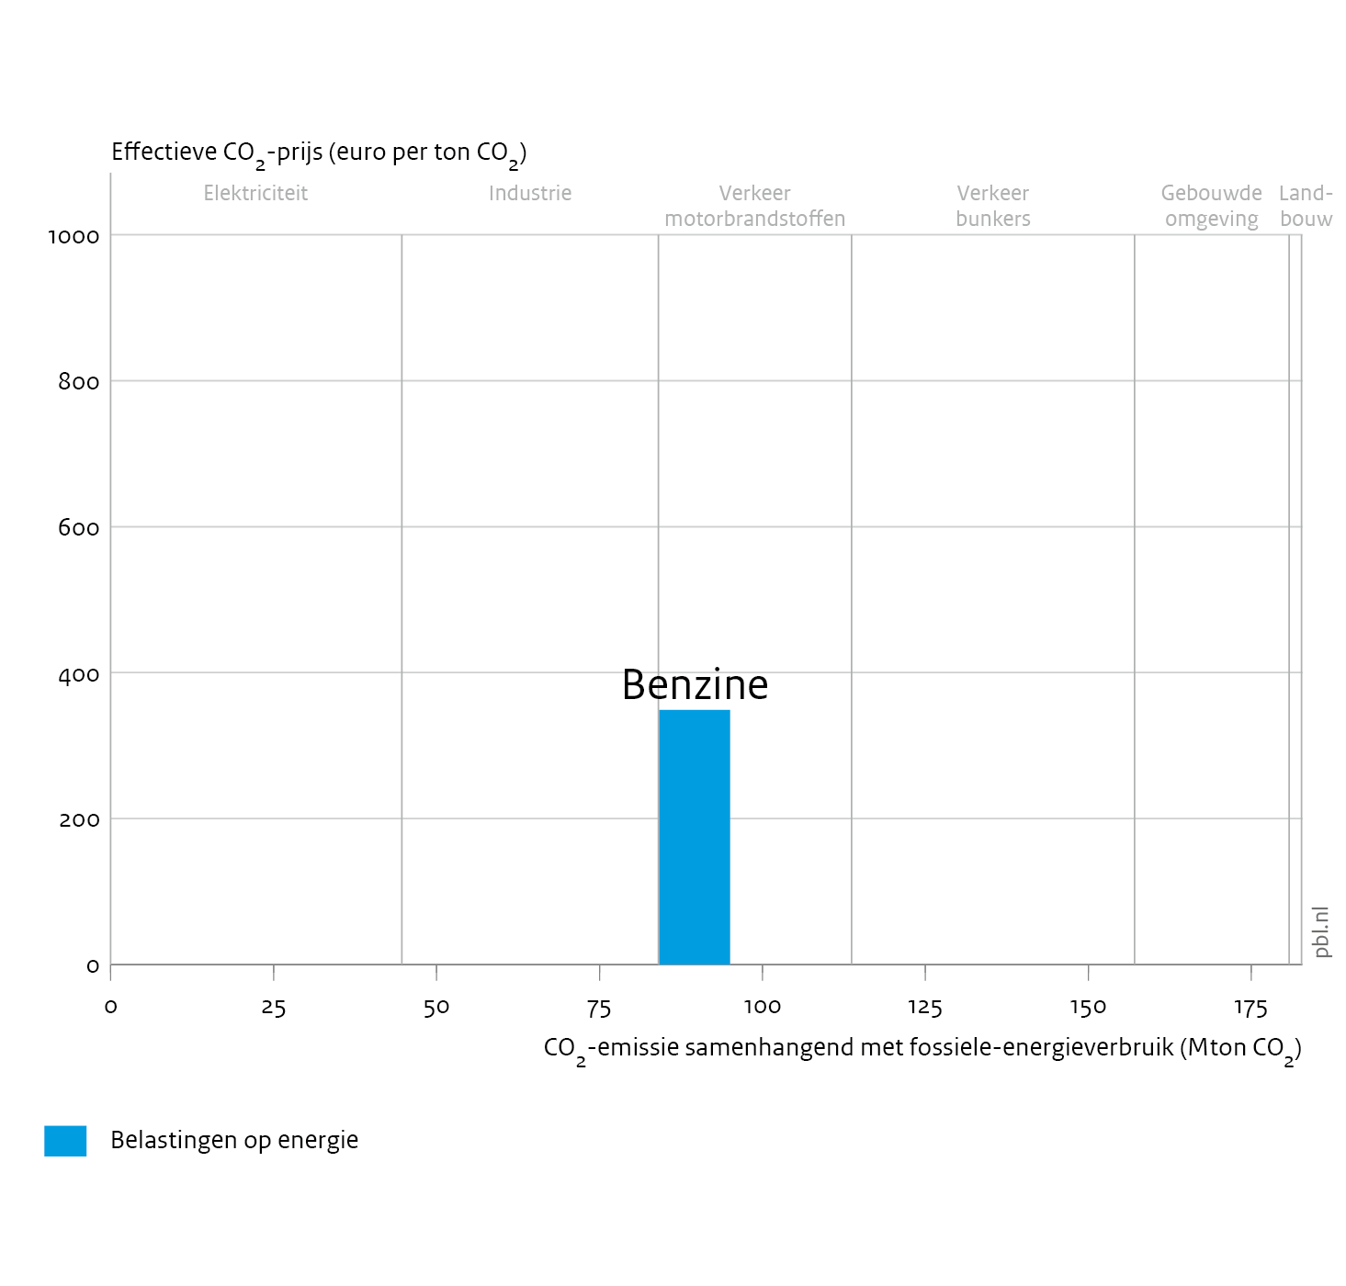
Excise duty on petrol:
focus: purchase of petrol
scope: all petrol purchased in the Netherlands, accounting for 11 Mton CO₂ emissions
strictness: € 345 per ton CO₂
time profile: tax rate indexed to inflation (not in figure)

Slide 26
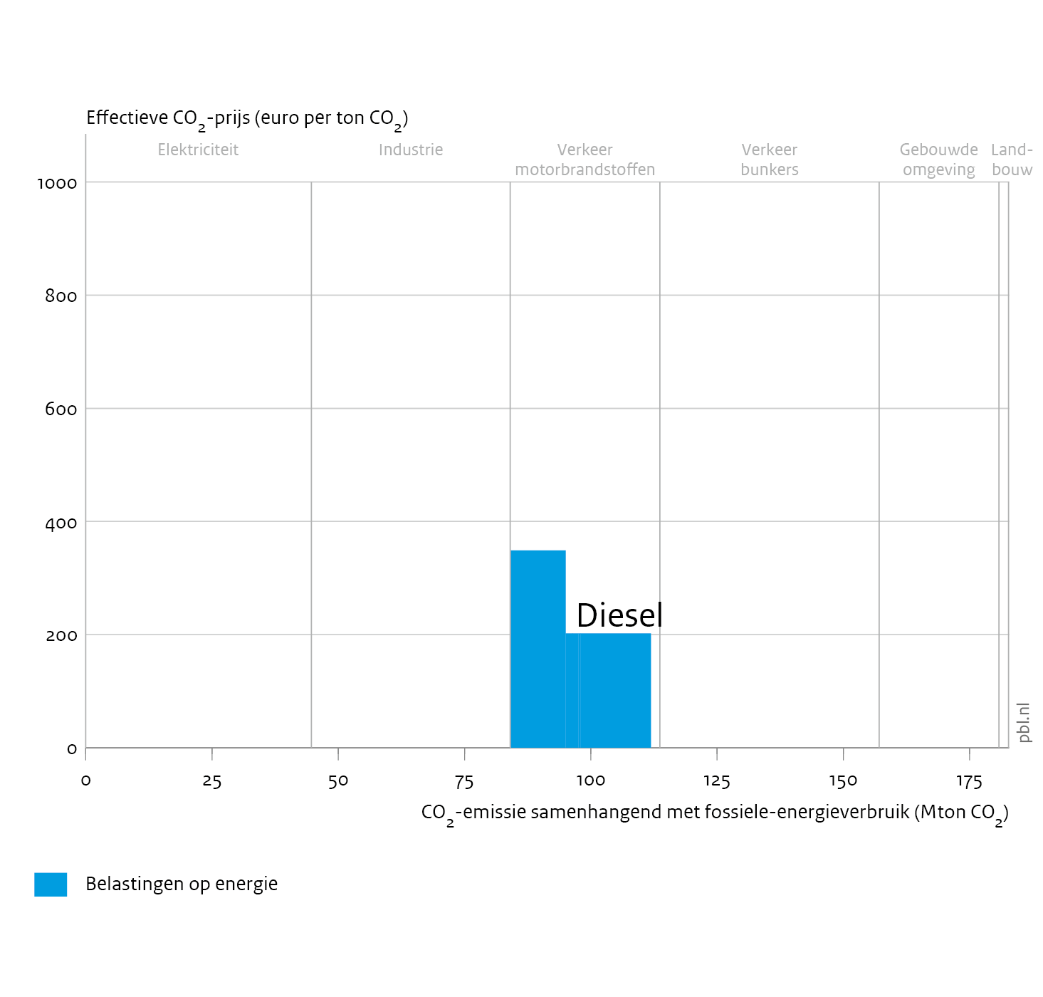
Excise duty on diesel:
focus: purchase of diesel
scope: diesel purchased by road transport in the Netherlands, accounting for 17 Mton CO₂ emissions
strictness: € 200 per ton CO₂
time profile: tax rate indexed to inflation (not in figure)

Slide 27
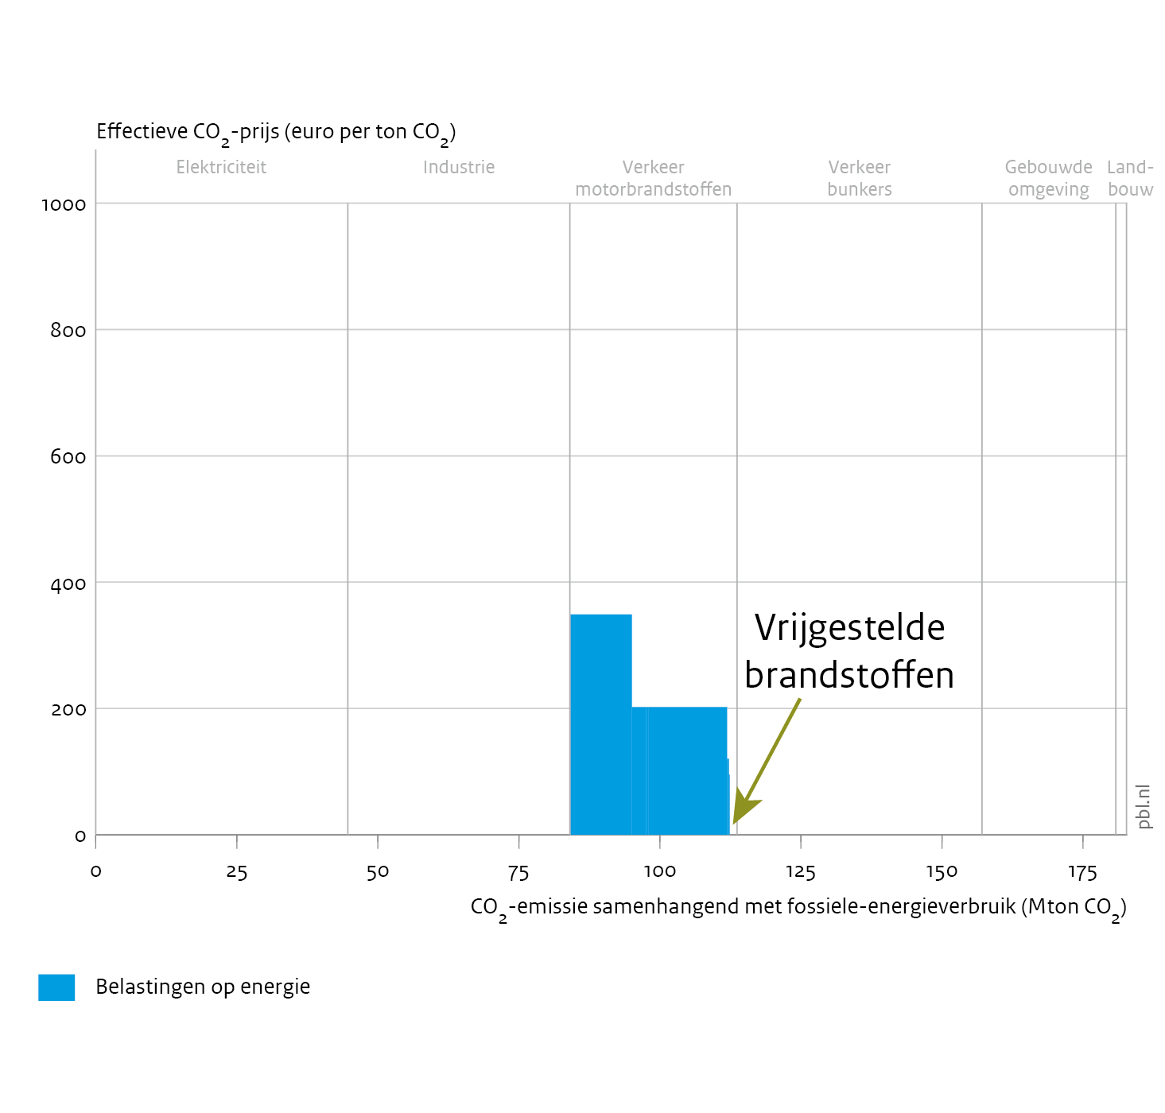
Exemption for shipping (effective CO₂ price = 0)

Slide 28
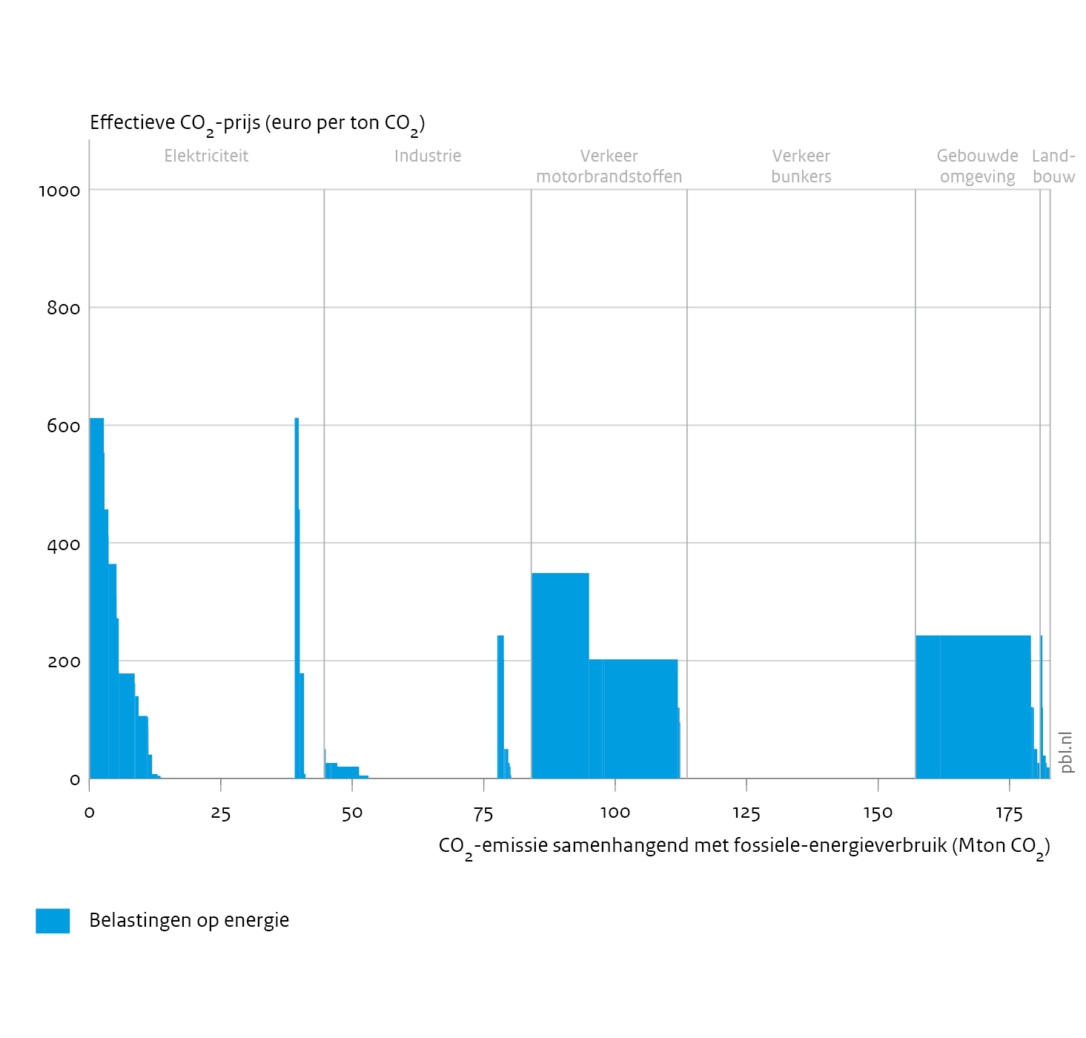
In the same way other taxes on energy
tax on electricity
tax on natural gas

Slide 29
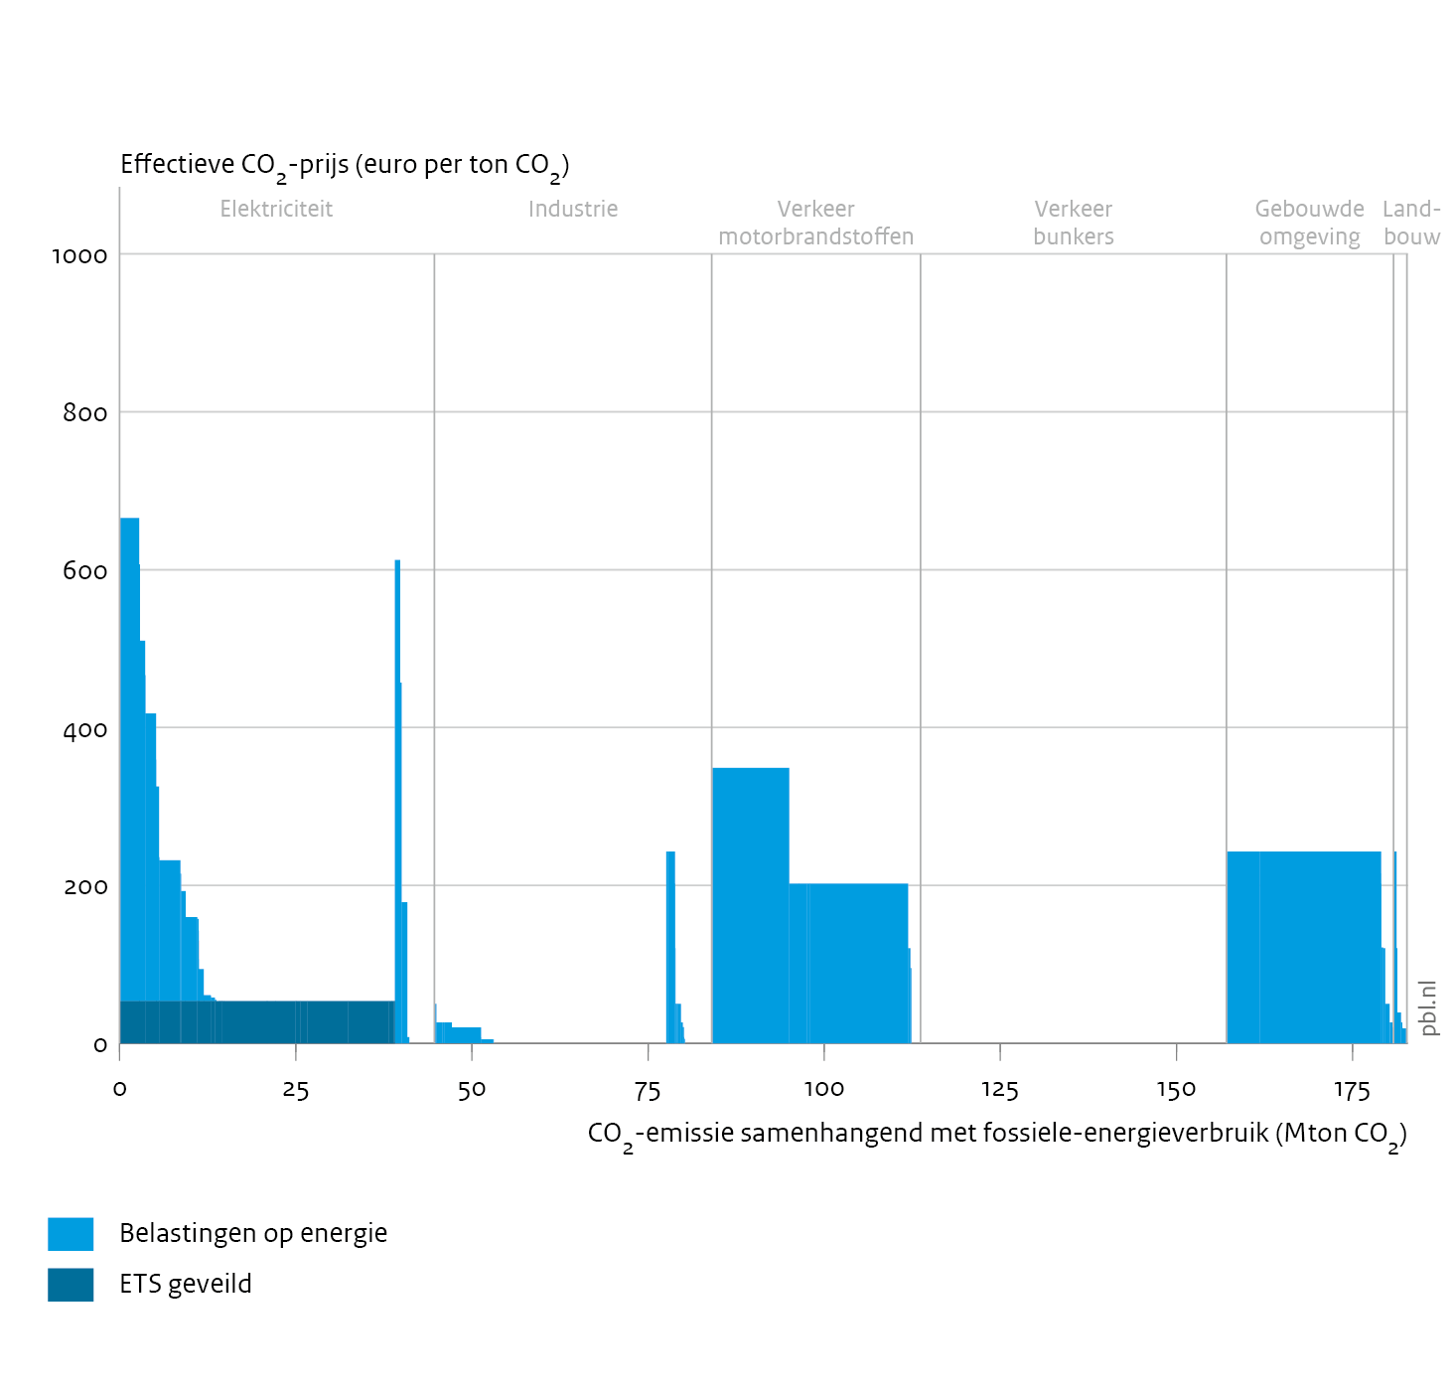
Power sector: CO₂ emissions to a large extent covered by EU ETS (direct pricing).
Average permit price in 2021: € 53 per ton CO₂.

Slide 30
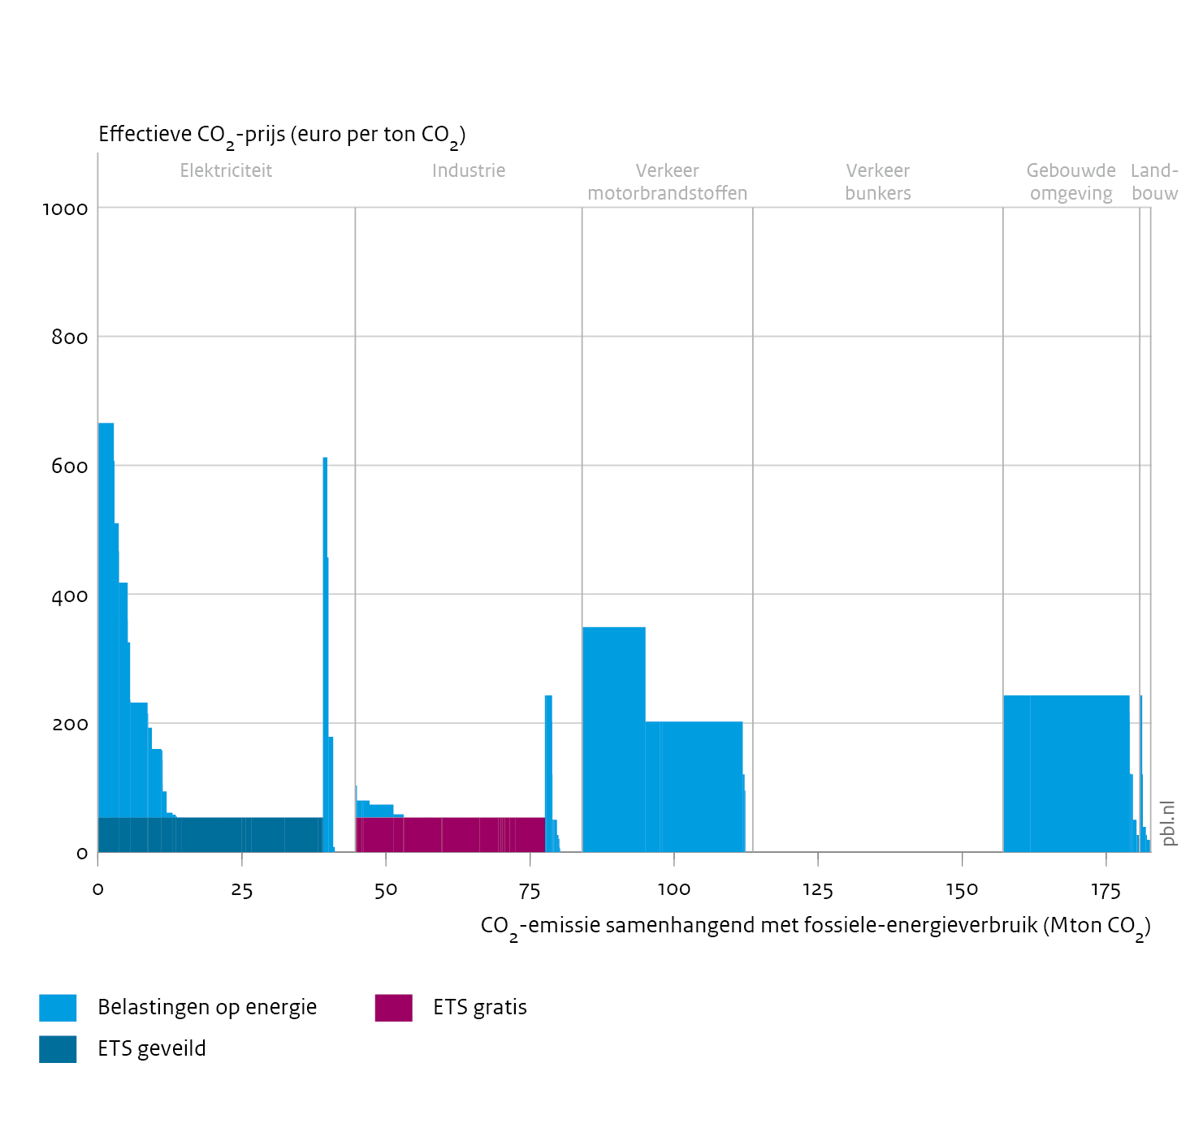
Industry: ~80% of total GHG emissions covered by EU ETS.
To a large extent energy-intensive firms get these permits for free.

Slide 31
Coherence of package of pricing instruments:
to what extent is market failure addressed?
marginal damage: € 130 per ton CO₂

Slide 32
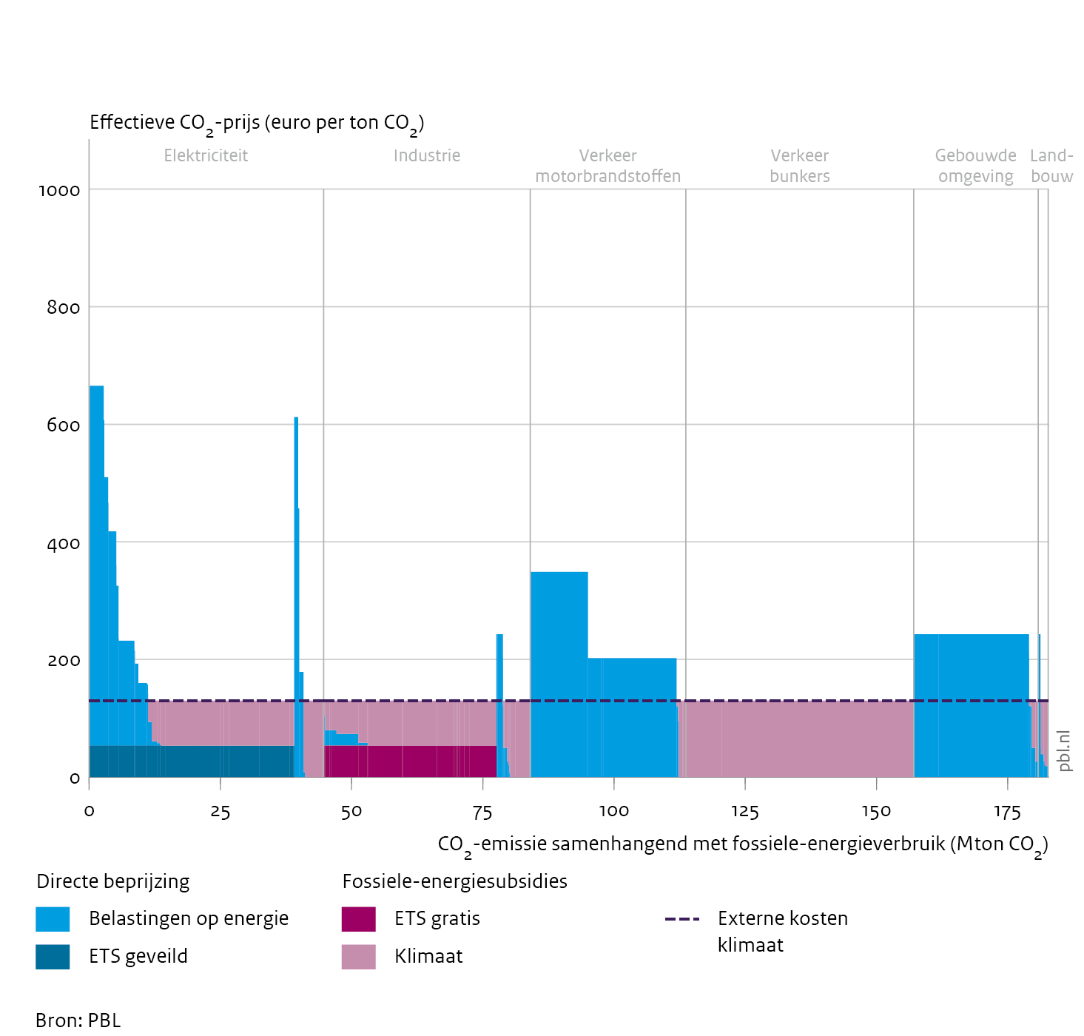
Evaluation:
significant part of emissions unpriced/underpriced (‘fossil fuel subsidies’)
uneven pricing (distribution)
tax on electricity unbalanced from carbon pricing perspective

