Slide 1
Emission Trading in a high dimensional context: to what extent carbon markets are integrated with the broader system?
Quatrosi Marco, Department of Law, University of Palermo
marco.quatrosi@unipa.it

Slide 2
Executive Summary
Introduction
Data and methodology
Results and Discussion
Final remarks

Slide 3
Background
The social cost of carbon is physiologically underestimated since it does not take into consideration biodiversity loss and long-term impact on labour productivity and economic growth (Intergovernmental Panel on Climate Change 2014; Burke et al. 2016; High-level Commission on Carbon Prices 2017)
If pricing carbon provides a reward for implementing low-carbon production processes, a (higher) carbon price might prevent development to be locked into a carbon-intensive path (Hourcade and Shukla 2013; High-level Commission on Carbon Prices 2017).
There exists a sensible difference between the optimal theoretical framework and the practical implementation of a carbon price scheme (High-level Commission on Carbon Prices 2017).
Estimates of carbon price in the 34 IPCC scenarios (430-480 ppm of CO₂ by 2100) range from US$37 to US$67 per tonne of CO₂ in 2020 whereas in 2050 would be US$127-US$305 (IPCC 2014; Tvinnereim and Mehling 2018).

Slide 4
EU ETS
The system have highlighted some criticalities that appear to be common in emission trading design (e.g. lack of long-term political commitment, adjustment mechanisms, agents’ expectations ) (e.g. Australian Carbon Mechanism) (Chevallier 2011a; Asian Development Bank 2015; Borghesi et al 2016; Perino and Willner 2016; Brouwers et al. 2016)
determinants of European Union Allowances (EUA): weather (temperature, extreme weather events) indicators, other commodity prices ( i.e., oil, gas), industrial productivity (Alberola et al 2008; Creti et al 2012; Aatola et al 2013; Koch et al. 2014).
EUAs are considered particular category of financial instruments under MiFID II Regulation (European Parliament 2014) pursuant to point (11) of Section C of Annex I of that directive. Derivatives of emission allowances are listed under point (4) of Section C of the said Annex.

Slide 5
EU ETS
few contributions have endeavoured to assess the effect of carbon price behaviour on GHGs emission production considering further ETS reforms (e.g., Market Stability Reserve) (Ellerman and Buchner 2008; Laing et al. 2014; Delarue et al. 2010; Azarova and Mier 2021).
Despite the effective decreasing trend in CO₂ over the last decade it is quite hard to trace the direct effect of the EU ETS considering the multiple factors involved (Brink and Vollebergh 2020).
The amount of emission abatement might be also influenced by unilateral policy interventions (Perino et al. 2019). In fact, uncertainty on the policy mix is likely to increase according to different scenarios of transition to a low-carbon economy (NGFS 2019).

Slide 6
EU ETS
EU ETS have been effective in abating emissions for different Phases of the scheme (Martin et al. 2016) using country-level data (Arcos-Vargas et al., 2023; McGuinness and Ellerman 2008; Ellerman and Feilhauer 2008; Dechezleprêtre et al. 2018) and sectorial data (Ellerman and Buchner 2008; Anderson and Di Maria 2011).
All the studies highlighted a contribution of EU ETS in abating emissions, despite the difficulty of measurement the counterfactual (Grosjean et al. 2016)

Slide 7
Research question
As curbing emissions is the foremost objective of the entire mechanism, the present work will try to test the effects of shocks on EUA prices might have an effect on carbon emission along with a set of multi-dimensional variables (economics, finance, climate, energy, industry)

Slide 8
Data
monthly data will be considered for a timespan of almost a decade (2008-2019)
Emissions: monthly CO₂ trends have been estimated from data on energy consumption (e.g., Gross Inland Deliveries) for the 31 Countries and 8 fuels (four primary and four secondary) from the Eurostat database following the methodology in (Eggleston et al. 2006) (e.g., Reference Approach)
Economy: Global Index of Real Economic Activities (e.g. Kilian Index) as conceived in (Kilian 2009) and adjusted following (Kilian 2019).
Finance: EURO STOXX50 index provides a synthetized measure of value for the biggest Eurozone enterprises in the stock market.
Commodity: Netherlands Title Transfer Facility (Natural Gas), Brent (Crude Oil), Nord Pool Power Market (Electricity), Rotterdam Coal Futures (Coal)
Climate: monthly averages of temperatures (i.e., min, max), rainfall (maximum rainfall), wind speed (10 mt) from the IEA Weather Energy Tracker

Slide 9
Data

Slide 10
Methodology
Hierarchical Vector Autoregressive Model (HVAR) by (W. B. Nicholson et al. 2020) dealing with high dimensional context.
Impulse-Response Function (IRF): investigate interactions in a vector autoregressive (VAR) framework
Forecast Error Variance Decomposition (FEVD): the single variables of the model will be analysed assess how much of the variance of a certain variable might be explained by the variance of carbon prices

Slide 11
Methodology
HVAR is a lasso-based VAR model embedding lag order selection into a convex regularization addressing simultaneously dimensionality and lag order selection.
Applications: forecasting (W. B. Nicholson et al. 2020); financial interconnectedness (Bagheri and Ebrahimi 2020); variable-to-variable (Impulse-Response; FEVD)
for large (even medium) set of variables the matrix of the coefficient is sparse even with regards to the true Data Generating Process (DGP) (Davis et al. 2012). Among other approaches (Davis et al. 2012), dealing with sparseness some authors have decided to implement convex penalty mechanisms (e.g., Lasso and Group Lasso) (Song and Bickel 2011)

Slide 12
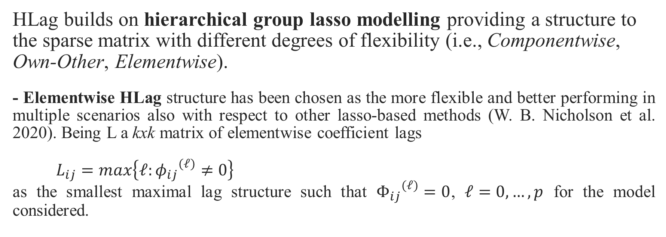
Methodology
HLag builds on hierarchical group lasso modelling providing a structure to the sparse matrix with different degrees of flexibility (i.e., Componentwise, Own-Other, Elementwise).
- Elementwise HLag structure has been chosen as the more flexible and better performing in multiple scenarios also with respect to other lasso-based methods (W. B. Nicholson et al. 2020). Being L a kxk matrix of elementwise coefficient lags
$L_{ij}=max\left\{𝓁:{φ_{ij}}^{(𝓁)}≠0\right\}$ as the smallest maximal lag structure such that ${Φ_{ij}}^{(𝓁)}=0$, $𝓁=0,…,p$ for the model considered.

Slide 13
Results-(Multiple) Stationarity tests

Slide 14
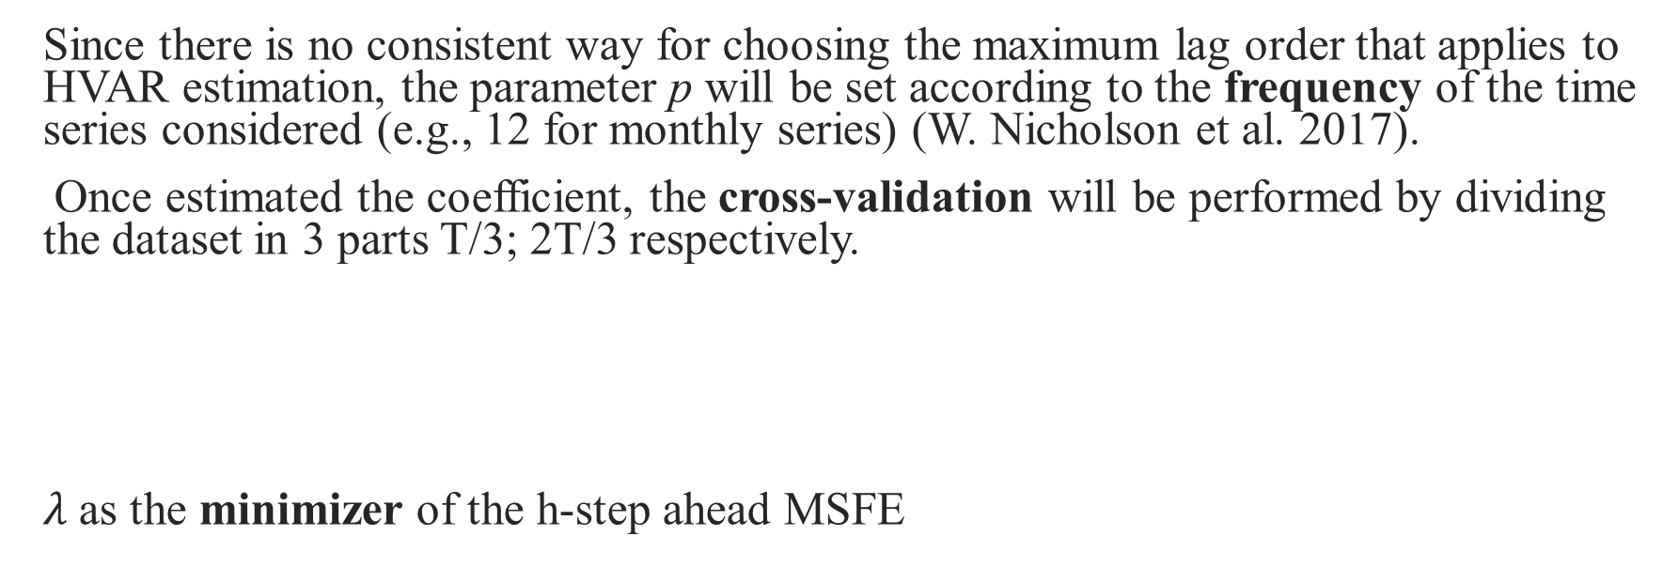
Results- Model
Since there is no consistent way for choosing the maximum lag order that applies to HVAR estimation, the parameter p will be set according to the frequency of the time series considered (e.g., 12 for monthly series) (W. Nicholson et al. 2017).
Once estimated the coefficient, the cross-validation will be performed by dividing the dataset in 3 parts T/3; 2T/3 respectively.
$λ$as the minimizer of the h-step ahead MSFE

Slide 15
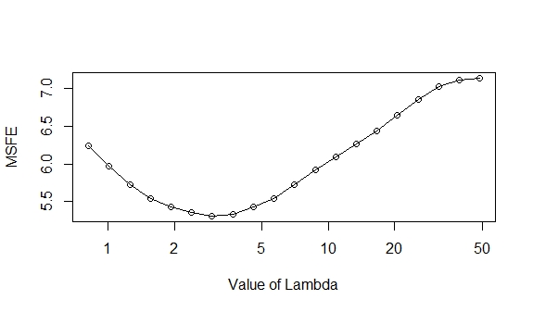
Results- Optimization

Slide 16
Results- Sparsity Matrix

Slide 17
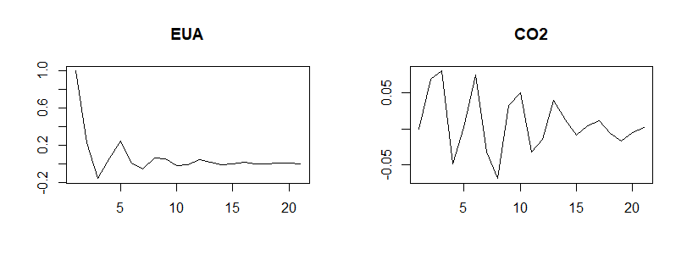
Results- Impulse-Response

Slide 18
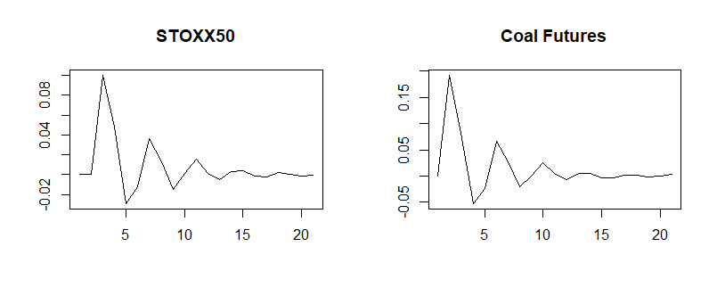
Results- Impulse-Response

Slide 19
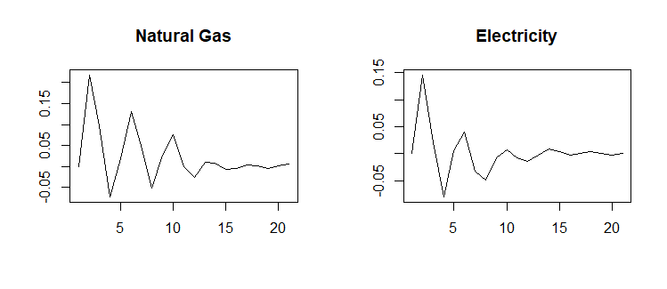
Results- Impulse-Response

Slide 20
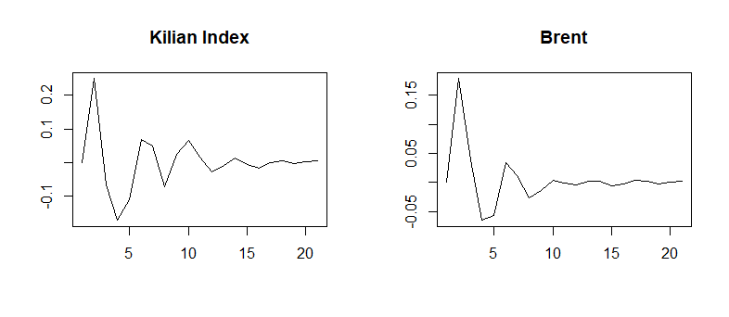
Results- Impulse-Response

Slide 21
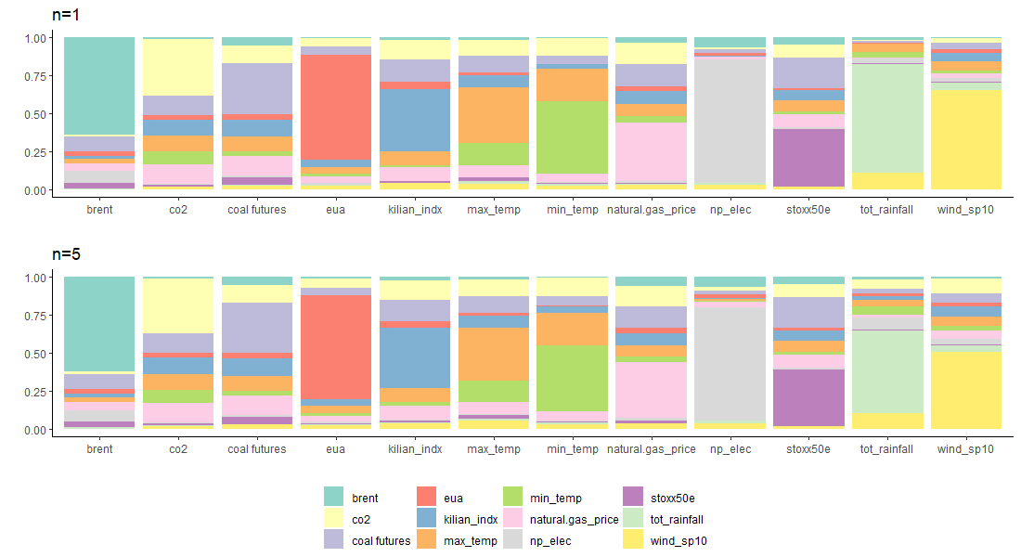
Results- FEVD

Slide 22
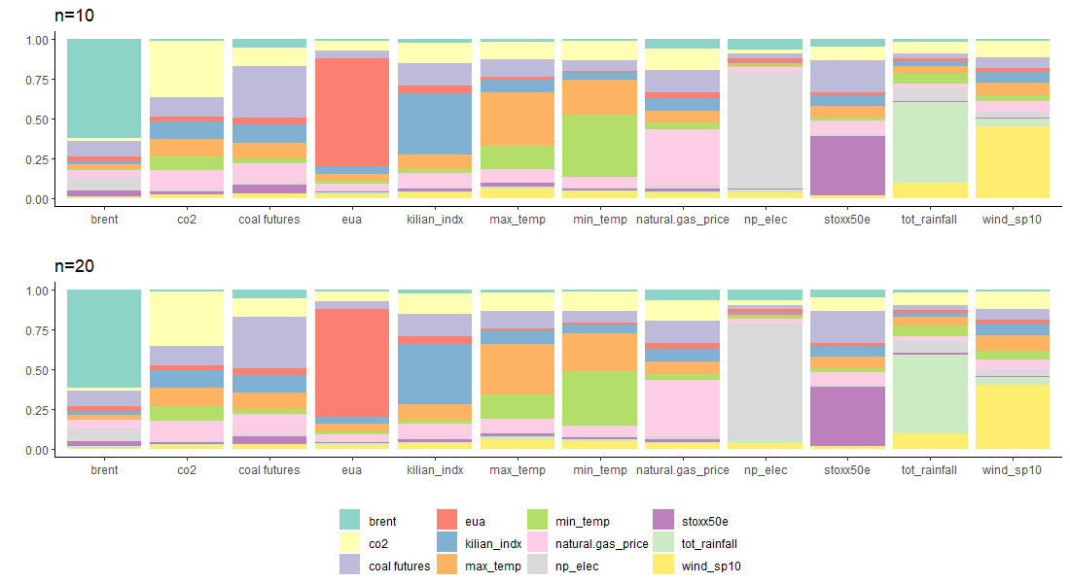
Results- FEVD

Slide 23
Discussion
IRF: a negative pattern of the response of those variables to a shock on EUA prices. Results with other model specifications confirmed if not highlighted the findings also in line with the literature. The intensity fades away as time goes by
FEVD: for CO2 emissions influences mostly come from the climate/weather set of variables along with commodity prices. Within 10%-15% of the carbon dioxide variance is explained by Kilian Index and Natural Gas and Coal price respectively.
The highest influence of EUA price ranges between 4%-5% for (Max) Temperature, natural gas price, Kilian Index.
Among other variables EUA prices appear to be influenced by Wind Speed 10mt (1,4%-1,5%). This latter finding aims at shedding further light on the analysis of the relationship of wind characteristics (e.g., speed, direction) as one further determinants of carbon prices (Chevallier 2011a).
All the findings appear consistent with the literature

Slide 24
Final Remarks
This work tries to provide ulterior insights on the effects of the emission trading scheme at EU level considering the broader system (environmental, climate, economic, financial) in a more suitable methodological framework
Despite a rather clear (downward) pattern, there appear to be other factors that exert a higher influence on carbon dioxide with respect to EUA prices (e.g., climatic/meteorological, industrial performances, natural gas)
These findings provide ulterior insights to policymakers as for better taking into account possible sources of carbon price shocks (e.g., overlapping policies) and tailoring existing adjustment mechanisms (e.g., Market Stability Reserve) for the stability of the European Emission Trading Scheme. In this sense, results show the still relative prospective influence of carbon prices towards relevant variables considering the broader system

Slide 25
Extensions
Phase IV (COVID-19 pandemics, Brexit) (2021-onwards)
Mediated effect of carbon prices (e.g., interconnectedness (Bagheri and Ebrami, 2020))
EUA have been included as financial instrument by the recent EU financial directive (MiFID2) apparently carbon allowances are not enough considered by financial players.

Slide 26
Thanks for the attention

