Slide 3

Will cutting back on renovating buildings make carbon prices go through the roof?
FSR Climate Annual Conference 2023 | 28 November 2023, Florence
Sebastian Osorio*, Antoine Levesque, Michael Pahle, Oliver Ruhnau, Adeline Gueret, Robert Pietzcker

Slide 4
Motivation
The EU Green Deal and the Building Sector

Slide 5
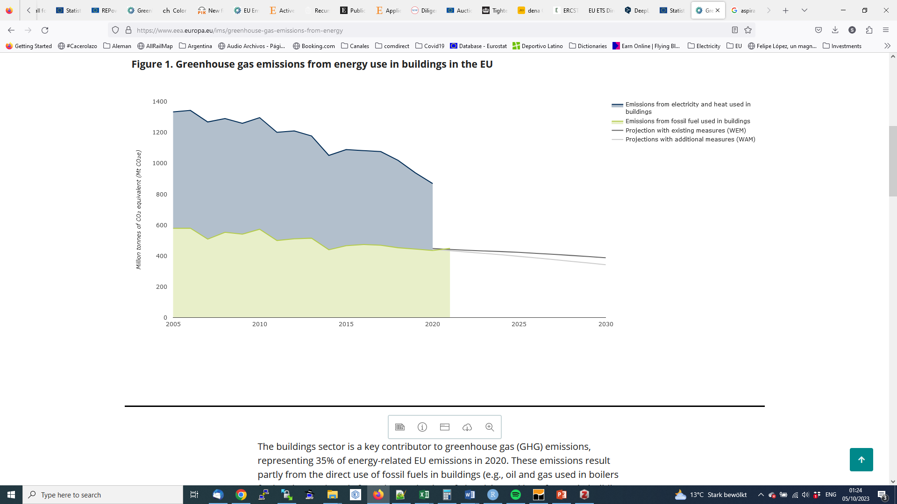
Greenhouse gas emissions from energy use in buildings in the EU
The building sector represented 35% of energy-related EU emissions in 2020
Projected decline not sufficient to meet the net 55% target (reduction of 60% in buildings)
755
35%
434
579
449
Source: EEA (2022)
Notes:
The decline in emissions observed in 2020 is partly related to the COVID-19 pandemic. Although estimates indicate a slight increase in emissions from fossil fuel use in buildings in 2021 compared to 2020, partly because of a colder winter and economic recovery, Member State projections suggest that the decreasing trend in emissions from buildings will continue.

Slide 6
A closer look to buildings [EU27]
Space heating, main use
Water heating tends to use lower-carbon sources
55%
39%
Source: Eurostat (2023a)

Slide 7
A closer look to heating [Residential, EU27]
Space heating, main use
Water heating tends to use lower-carbon sources
79%
54%
54%
Source: Eurostat (2023b)

Slide 8
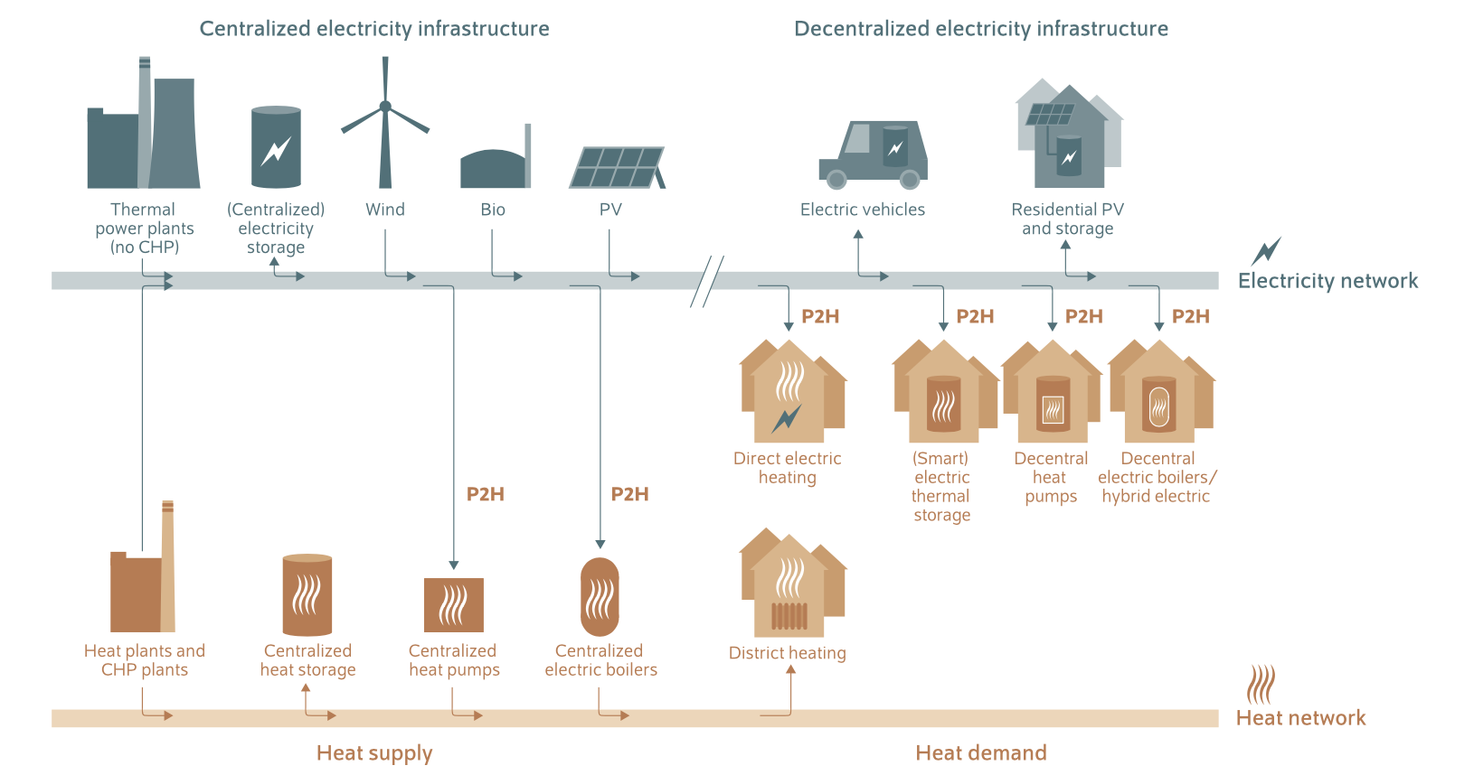
Heat supply
Heating can be supplied either in a centralized or a decentralized way:
Central heating: combined heat and power (CHP) and heat-only plants (HOP)
Decentral heating: boilers (oil, gas, electric), electric heating, solar thermal, etc
Source: Bloess et al. (2018)

Slide 9
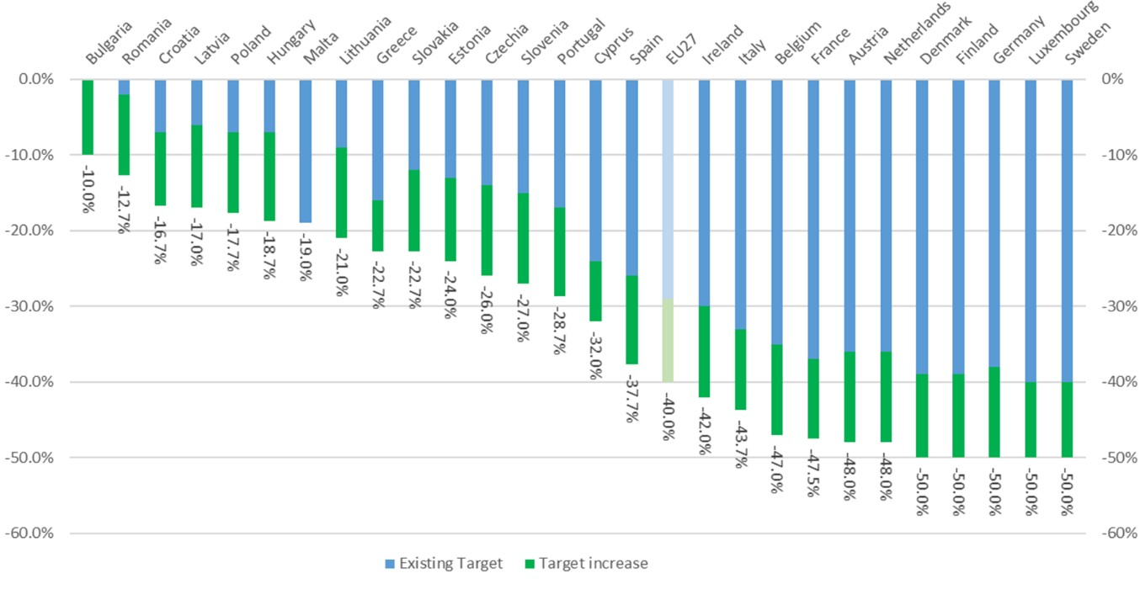
EU Green Deal targets: towards more stringency
Buildings: 42% of EU27 total energy consumption and 35% of carbon emissions in 2020
EU Green Deal:
  55% net emissions reduction by 2030 and climate neutrality by 2050
  EU ETS: from 43% to 62% by 2030
  ESR: from 29% to 40% by 2030
How to decarbonize the building sector?
Efficiency gains: Energy Efficiency First principle
  Energy Performance of Buildings Directive (EPBD) [‘Renovation wave’]
  Other relevant policies: the EU’s recovery plan, REPowerEU
  Energy switch -> District heating (DH) and power to heat (P2H)
Source: EC (2023)
Notes:
With the Energy Efficiency First principle at the core of the transformation of the buildings sector, the EGD enforces the revised Energy Performance of Buildings Directive (EPBD) and aims at triggering a ‘Renovation Wave’ with the aim of renovating Europe’s entire building stock by 2050 so that it becomes “nearly zero emissions”. However, what if it failed or substantially fell short of what is required? Then the electrification of decentralized heating and/or expansion of district heating would be necessary all the more
The Renovation Wave Initiative , and the EU’s recovery plan place a strong emphasis on reductions in GHG emissions and energy use from buildings. The REPowerEU plan published by the European Commission in May 2022 — which aims to end the EU’s dependence on Russian fossil fuels while tackling the climate crisis — calls for additional savings and energy efficiency gains in buildings through the Energy Performance of Buildings Directive.

Slide 10
Decarbonising the building sector
Options, ETS/ESR split, effects of building decarbonisation

Slide 11
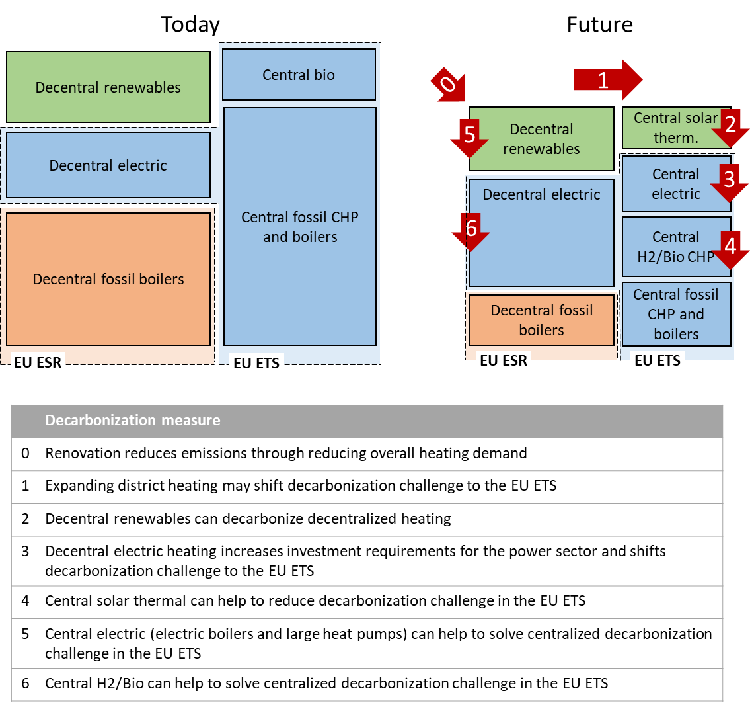
Options to decarbonise the building sector
Renovation: high potential but current figures far below requirements
DH: fossil-dominated, constrained to densely populated areas
Role of biomass? Priority for sectors difficult to decarbonise + local pollution
Heat electrification + DH expansion
-> de facto inclusion of buildings in EU ETS
Notes:
Renovation: 2/3 built before 1980; 75% of buildings has poor energy performance; current renovation figures do not invite to the optimism as average renovation only reaches 1%
DH: main option for countries with large networks already deployed (e.g., Nordics); 68% of DH still dominated by fossils; constrained to densely populated areas
Biomass: local pollution and priority to other sectors
The remaining decentralized technology, and eventually the only alternative for many households and businesses are heat pumps, and more generally electric heating.
The first option, as mentioned before, is energy demand reduction (measure 0). This has a large potential, considering that the lion’s share of buildings in Europe is old (two thirds of the EU building stock was built before 1980 (Bean et al., 2019)) and very inefficient (according to the European Commission (2020a) Impact assessment 75% of buildings has poor energy performance). However, historic dynamics invite to be cautious about future reductions of energy demandas as they have stalled in the last years. Currently, 11% of EU buildings undergoes some level of energy renovation each year, but this translates in a weighted annual energy renovation rate of a mere 1% (European Commission, 2020b). However, the average energy rate of renovation should be increased to at least 3% per year to ensure the renovation of the full building stock by mid-century (Vitali Roscini et al., 2020).
One of the main alternatives is expanding centralized district heating (DH). This might be the best option for countries with already high shares of DH (e.g., Nordic and Baltic countries). However, DH is still dominated by fossil fuels (68% in 2020 at EU level (Eurostat, 2022)) and relying on DH requires simultaneously expanding the networks which cover only 10% of the demand nowadays and decarbonising the supply, i.e., switching to biomass, large-scale heat pumps, solar thermal, excess heat and potentially hydrogen (measures 4-6 in Figure 1). Because of its capital-intensive structure and of the high network losses, DH expansion is however constrained to areas densely populated.

Slide 12
Effects of building sector decarbonisation
Heating electrification -> Increase in electricity demand
  Replacement of fossil-based boilers by heat pumps -> 526 TWh (26%) annual and increase in winter peak 20-70% (Kavvadias et al., 2019)
Enhanced sector coupling
  Flexibility and storage options -> contribute to RES integration (Ashfaq and Ianakiev, 2018; Bernath et al., 2019; Bloess et al., 2018; Ruhnau et al., 2020)
Power sector fit for heating electrification?
  National power systems could cope with higher heat-electrification rates, but only few could afford full electrification scenarios (Thomaßen et al., 2021)
  Renovation strongly triggered by the resulting seasonal electricity peak rather than by annual demand (Zeyen et al., 2021)
Tighter link through CHP
Impact on EU ETS?
  Emissions from heating accounted within the EU ETS -> Higher demand for EUA
  Climate neutrality -> buildings entirely integrated into the EU ETS

Slide 13
Research question
Impact of the buildings’ decarbonisation requirements on the EU ETS in light of more ambitious climate targets as proposed in the EU Green Deal
Estimate buildings’ heat demand that would be included in the ETS in order to reach the non-ETS targets under more stringent EU climate objectives
Identify the channels through which additional heat demand (due to limited renovation) poses pressure on the EUA prices

Slide 14
Methods
LIMES, building module, non-ETS targets, heat demand, additional assumptions

Slide 15
LIMES-EU in a nutshell
Linear optimization model
Temporal resolution:
  From 2010 to 2070 in 5-year steps
  6-10 representative days per year
  8 time-slices per day
  Perfect foresight
Geographical scope: Europe (29 model regions)
  EU (w/o MT and CY) + UK + CH + NO + aggregated Balkan
62 generation and storage technologies
EU ETS energy-intensive industry: MACC
Policy focus: EU ETS and MSR
Stylised representation of buildings: investment and dispatch decision for DH/P2H endogenous (heat demand profiles from When2Heat database [Ruhnau, 2019; Ruhnau et al., 2019; Ruhnau and Muessel, 2022])

Slide 16
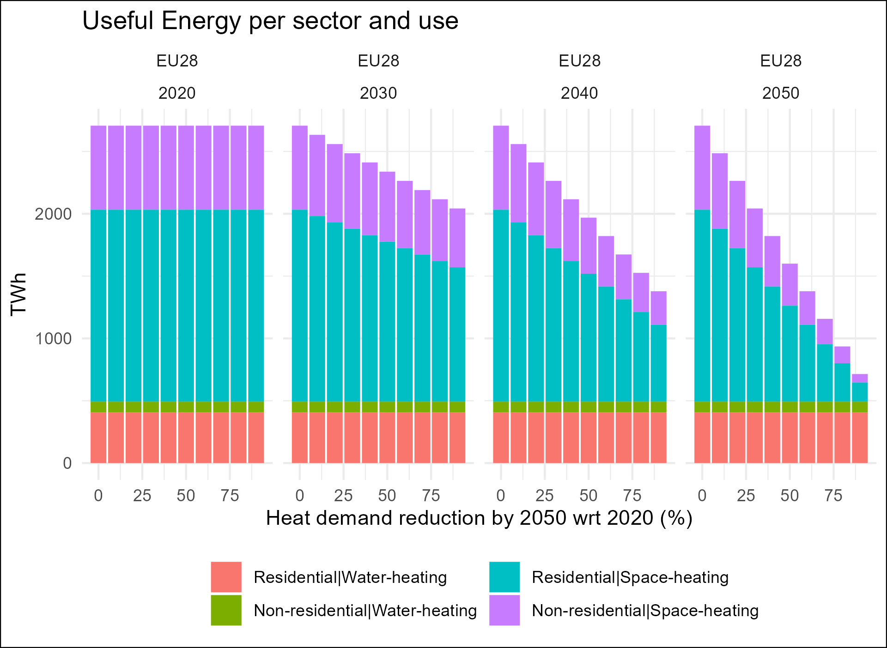
Buildings module
Derive emission targets for heating in 2030
Derive heat demand (useful energy)

Slide 17
Other assumptions
Electricity demand:
  Demand from heat electrification [Endogenous]
  Non-heat-related:
    EU Reference 2020
    Transport: 1 TWh in 2015 to 2000 TWh in 2050
    Hydrogen: 50 TWh in 2025 to 900 TWh in 2050 [assumed to be green]
Heat demand profiles, COP [When2Heat dataset] (Ruhnau, 2019; Ruhnau et al., 2019)

Slide 18
When2Heat
Profiles based on the German standard load profile methodology for the gas demand as a proxy for the heat demand in buildings (Ruhnau, 2019; Ruhnau et al., 2019)
Extension of dataset to all European countries by adapting the methodology to local building insulation characteristics according to heating threshold temperatures (Ruhnau and Muessel, 2022)

Slide 19
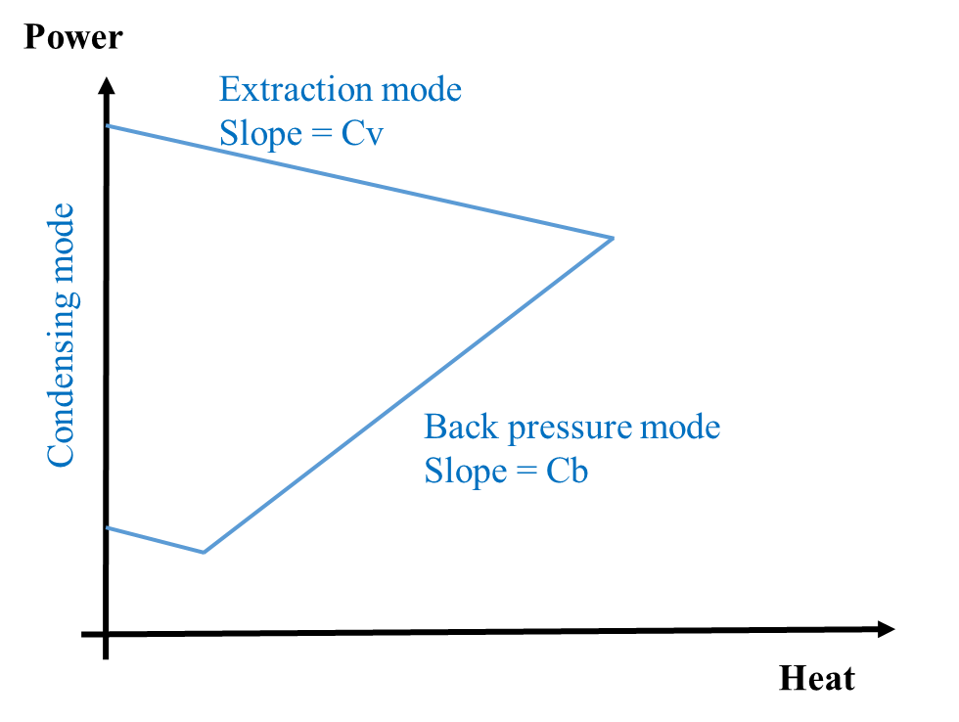
Interaction buildings module and EU ETS
Heat demand covered by ETS and ESR
  Heat_dem(ESR) + Heat_dem(ETS) = Heat_dem
Heat demand covered by ESR constrained by targets
  emi_fac * Heat_dem(ESR) ≤ cap_heating(ESR)
Other constraints
  CHP operation: most technologies allowed to operate with flexible power-to-heat ratio (i.e., endogenous total efficiency)
  Max potential for DH, for certain technologies (geothermal, solar thermal) [EUCalc, i.e., Codina Gironès et al., 2018]
  Min share for DH according to historic data
  Only central heat storage

Slide 20
Results
From ESR to ETS, challenges for power sector and DH, pressure on ETS prices

Slide 21
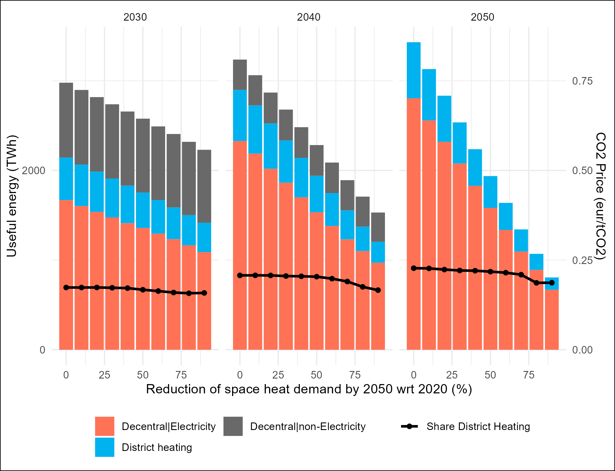
Evolution of heat-mix in buildings
Net zero target -> buildings completely decarbonised in 2050
Transformation would rely mainly on decentral P2H
DH: limited role (between 16-17% in 2030 to 19-23% in 2050), but large role when renovation is limited
Impact of renovation
  heat demand reductions in both DH and decentral P2H output up to 500 and 2150 TWh
Notes:
Although this appears to be a minor impact, the transformation required in the power sector is substantial.

Slide 22
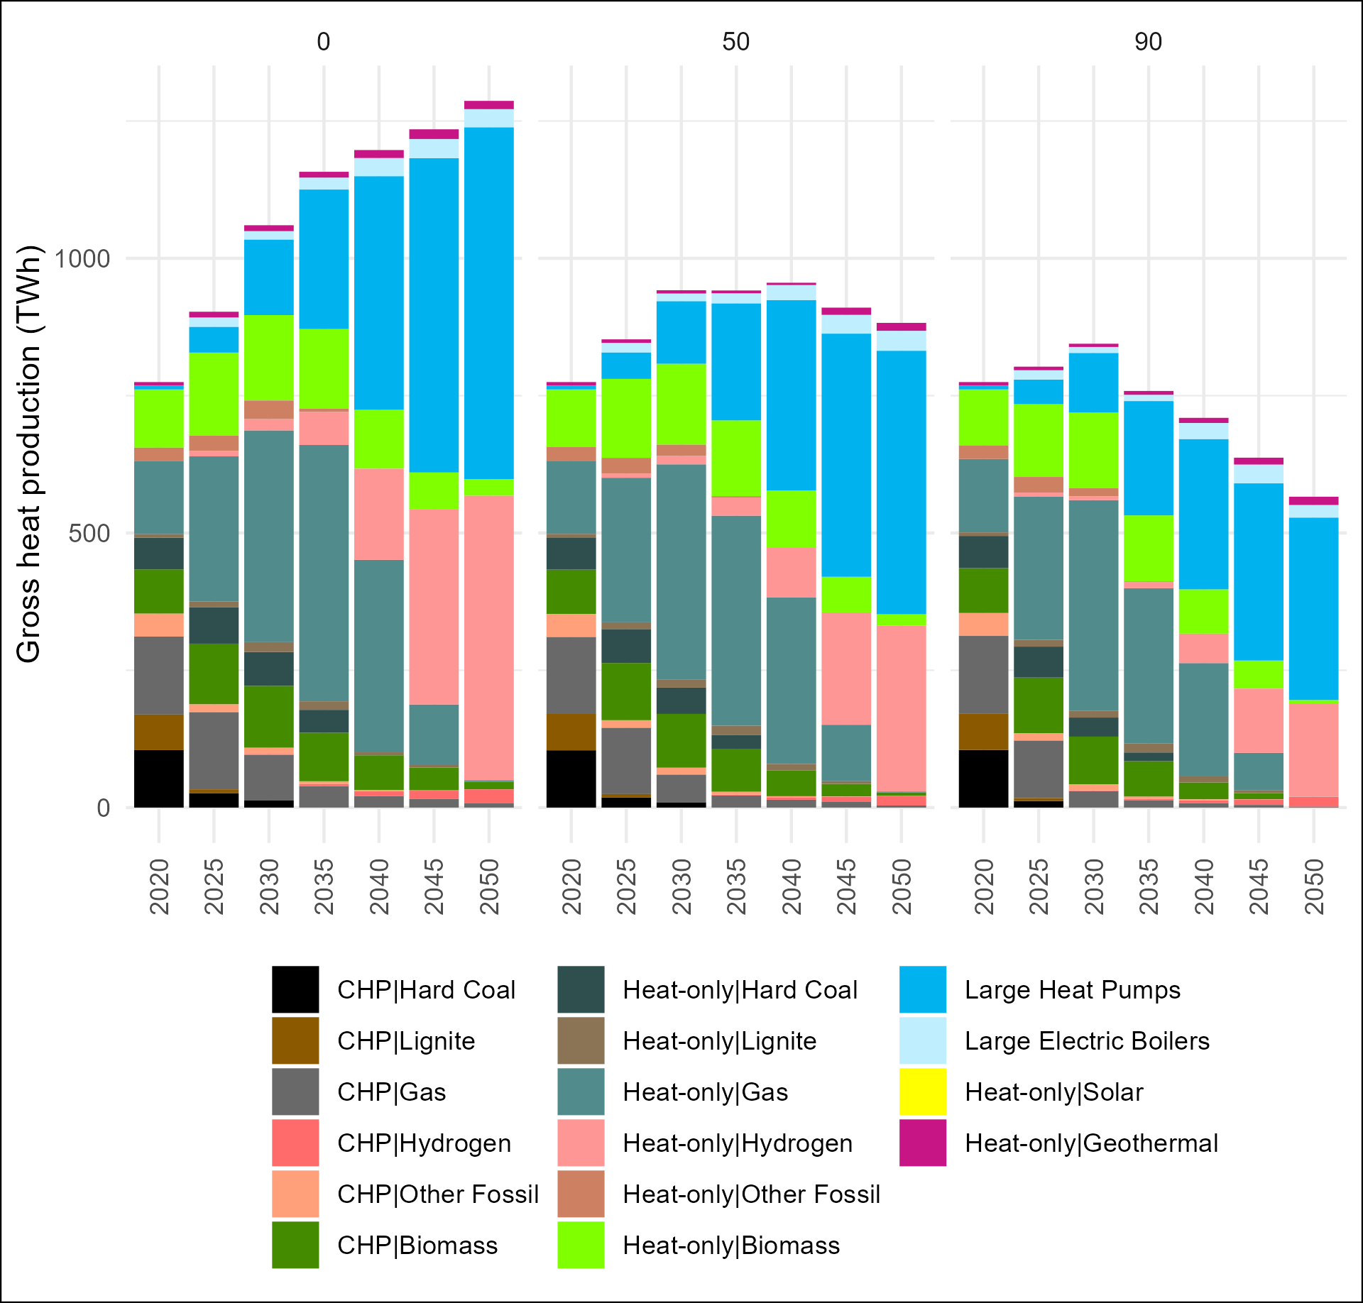
Evolution of DH generation-mix
Substantial transformation independently from renovation rates
2030: gas heat-only plants and biomass
2050: large HP and hydrogen heat-only plants main sources (>90%) -> 155 to 342 GW large HP required
Biomass and gas heat-only plants dominate 2030 but play only a transition role, only 1-3% by 2050
Bringing numbers down to earth:
  Large HP <1%; no hydrogen-fired plants
  Biggest HP (48 MW), larger system (Stockholm, 7 HP = 215 MW)
  Space requirements: 30-1000 m2/MW (vs. 20-30 m2 for CCGT)
Notes:
Although DH expansion remains limited, the transformation required is massive

Slide 23
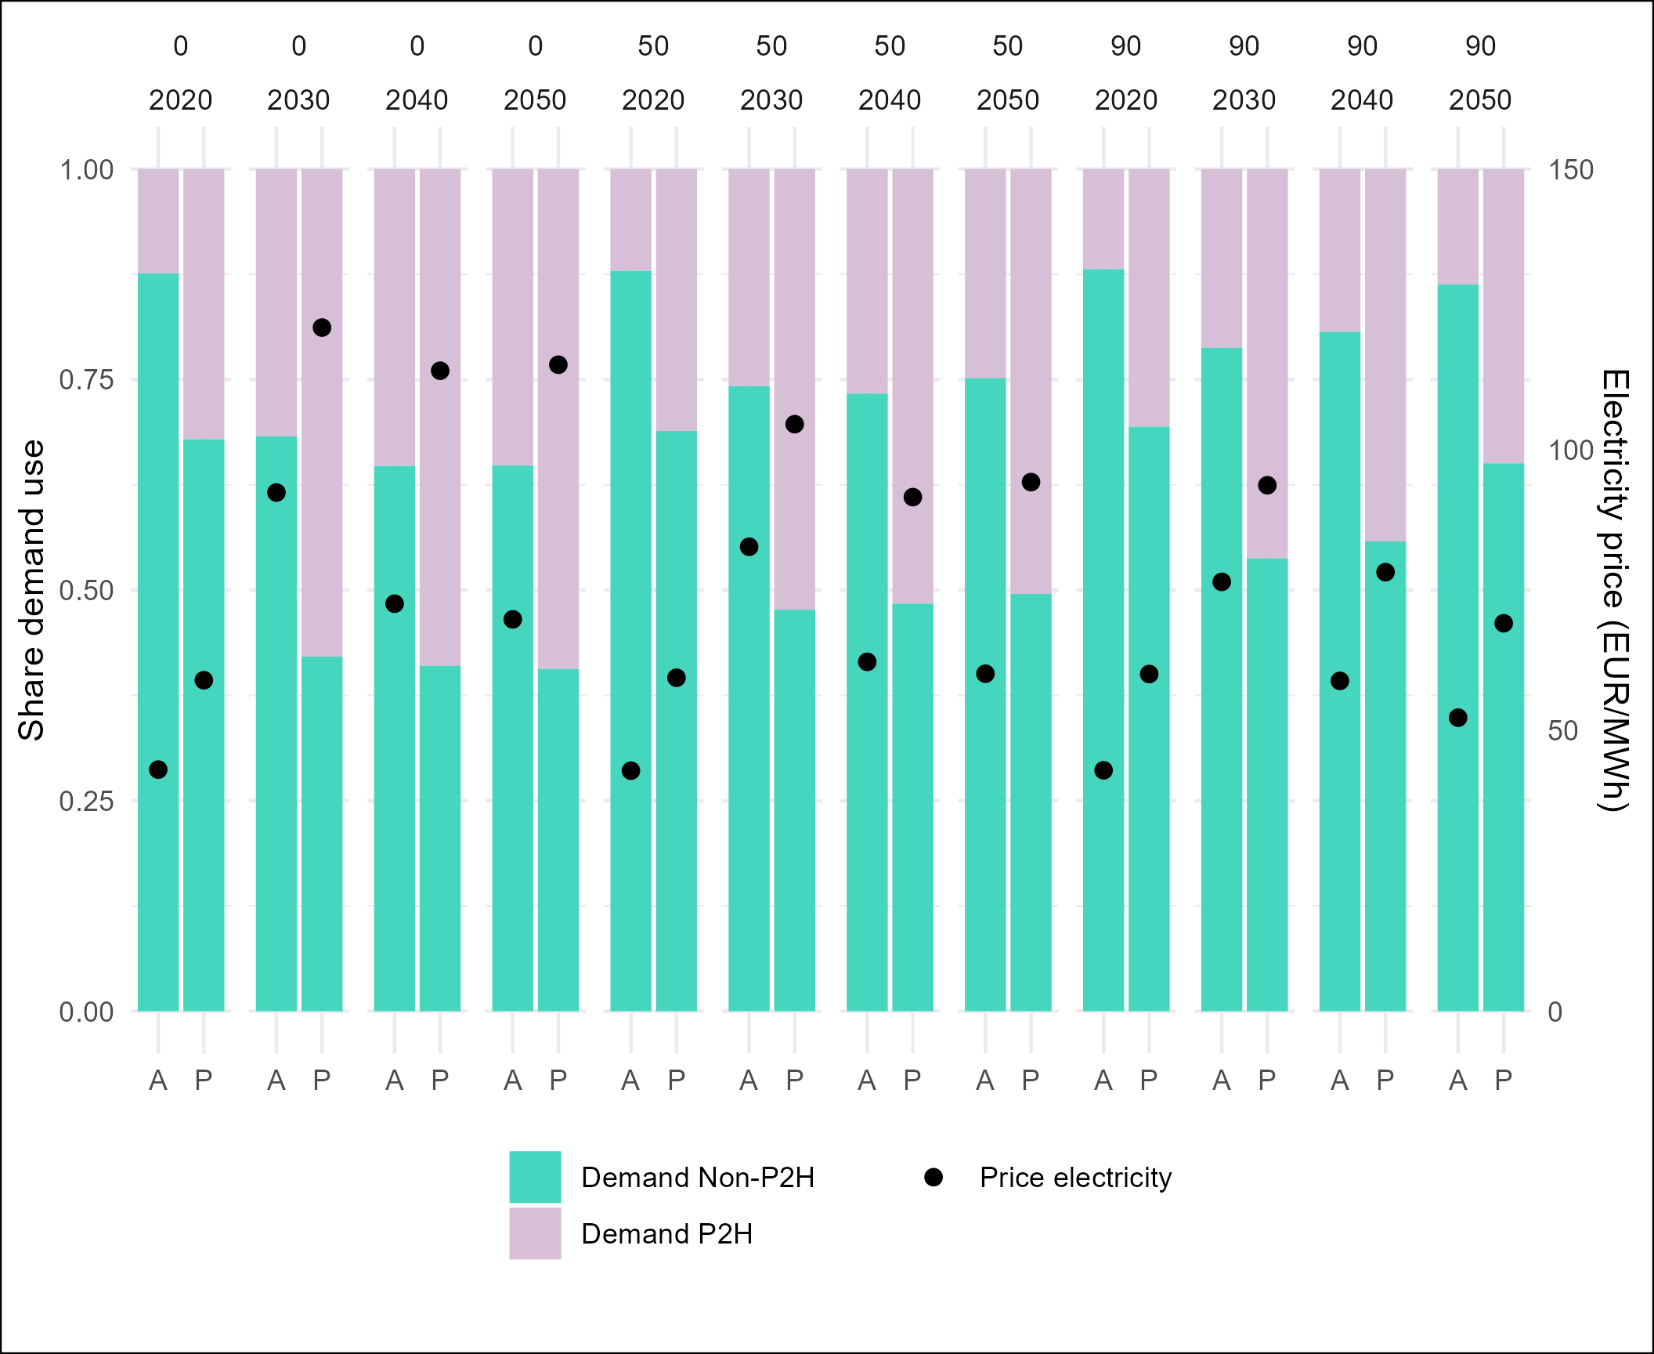
Impact of heat electrification on the power sector
Additional demand: 630-1080 TWh by 2030 and 500-1710 TWh by 2050
  Annual: 9 to 37%
  Peak: 30 to 60%
Renovation has a larger effect on peak prices than on average prices
  Annual: 21-62%
  Peak: 15-95%
  Wider gap between peak and average
Additional demand up to 1200 TWh (annual) and 350 GWh (peak) by 2050
  but the generation-mix dominated by renewables even at peak time
Notes:
It is already known from the literature that average demand is not a “problem”, but peak demand.

Slide 24
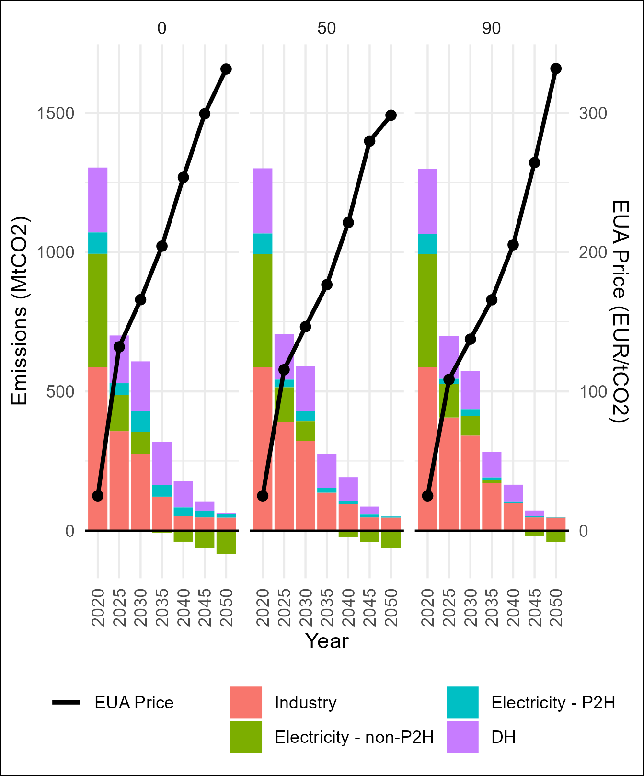
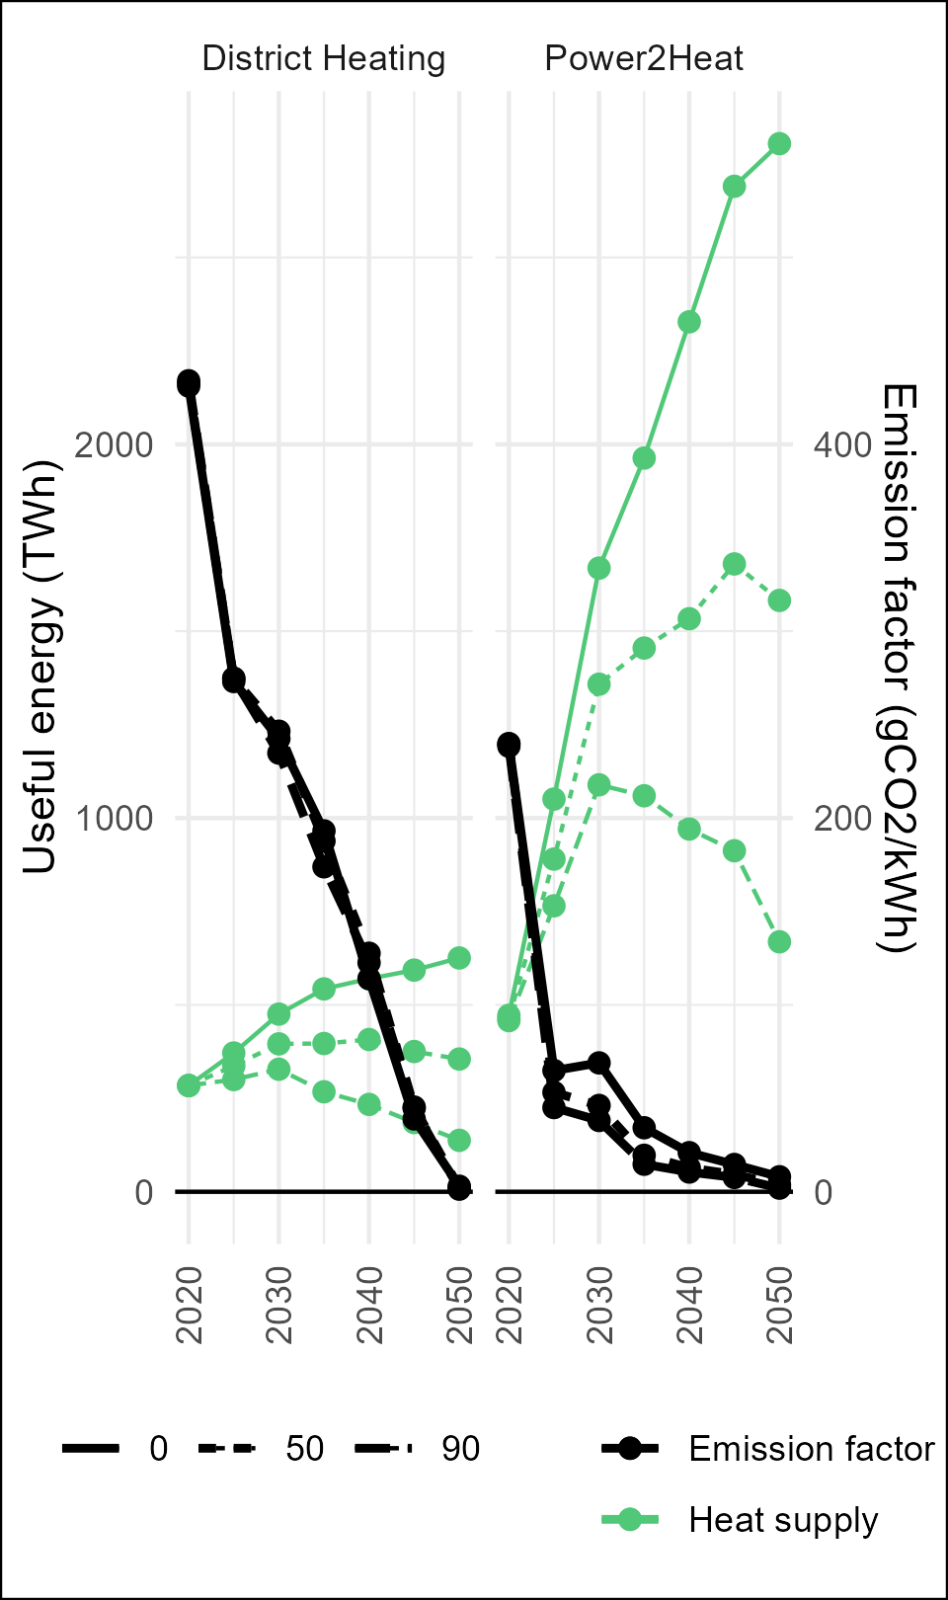
Carbon prices do not go through the roof
Carbon intensity of power sector and DH explains the limited impact of renovation rates on emissions
  Carbon prices: 137-166 EUR/tCO2 by 2030 and 300-331 EUR/tCO2 in 2050
Substantial changes in carbon intensity -> buildings are decarbonising faster than heat demand being transferred to the EU ETS
  DH: demand +35% while carbon intensity -30% (2020-2030)
  P2H: demand x3.4, carbon intensity /4 (2020-2030)
  Carbon intensity 2050 ~ 0 gCO2/kWh

Slide 25
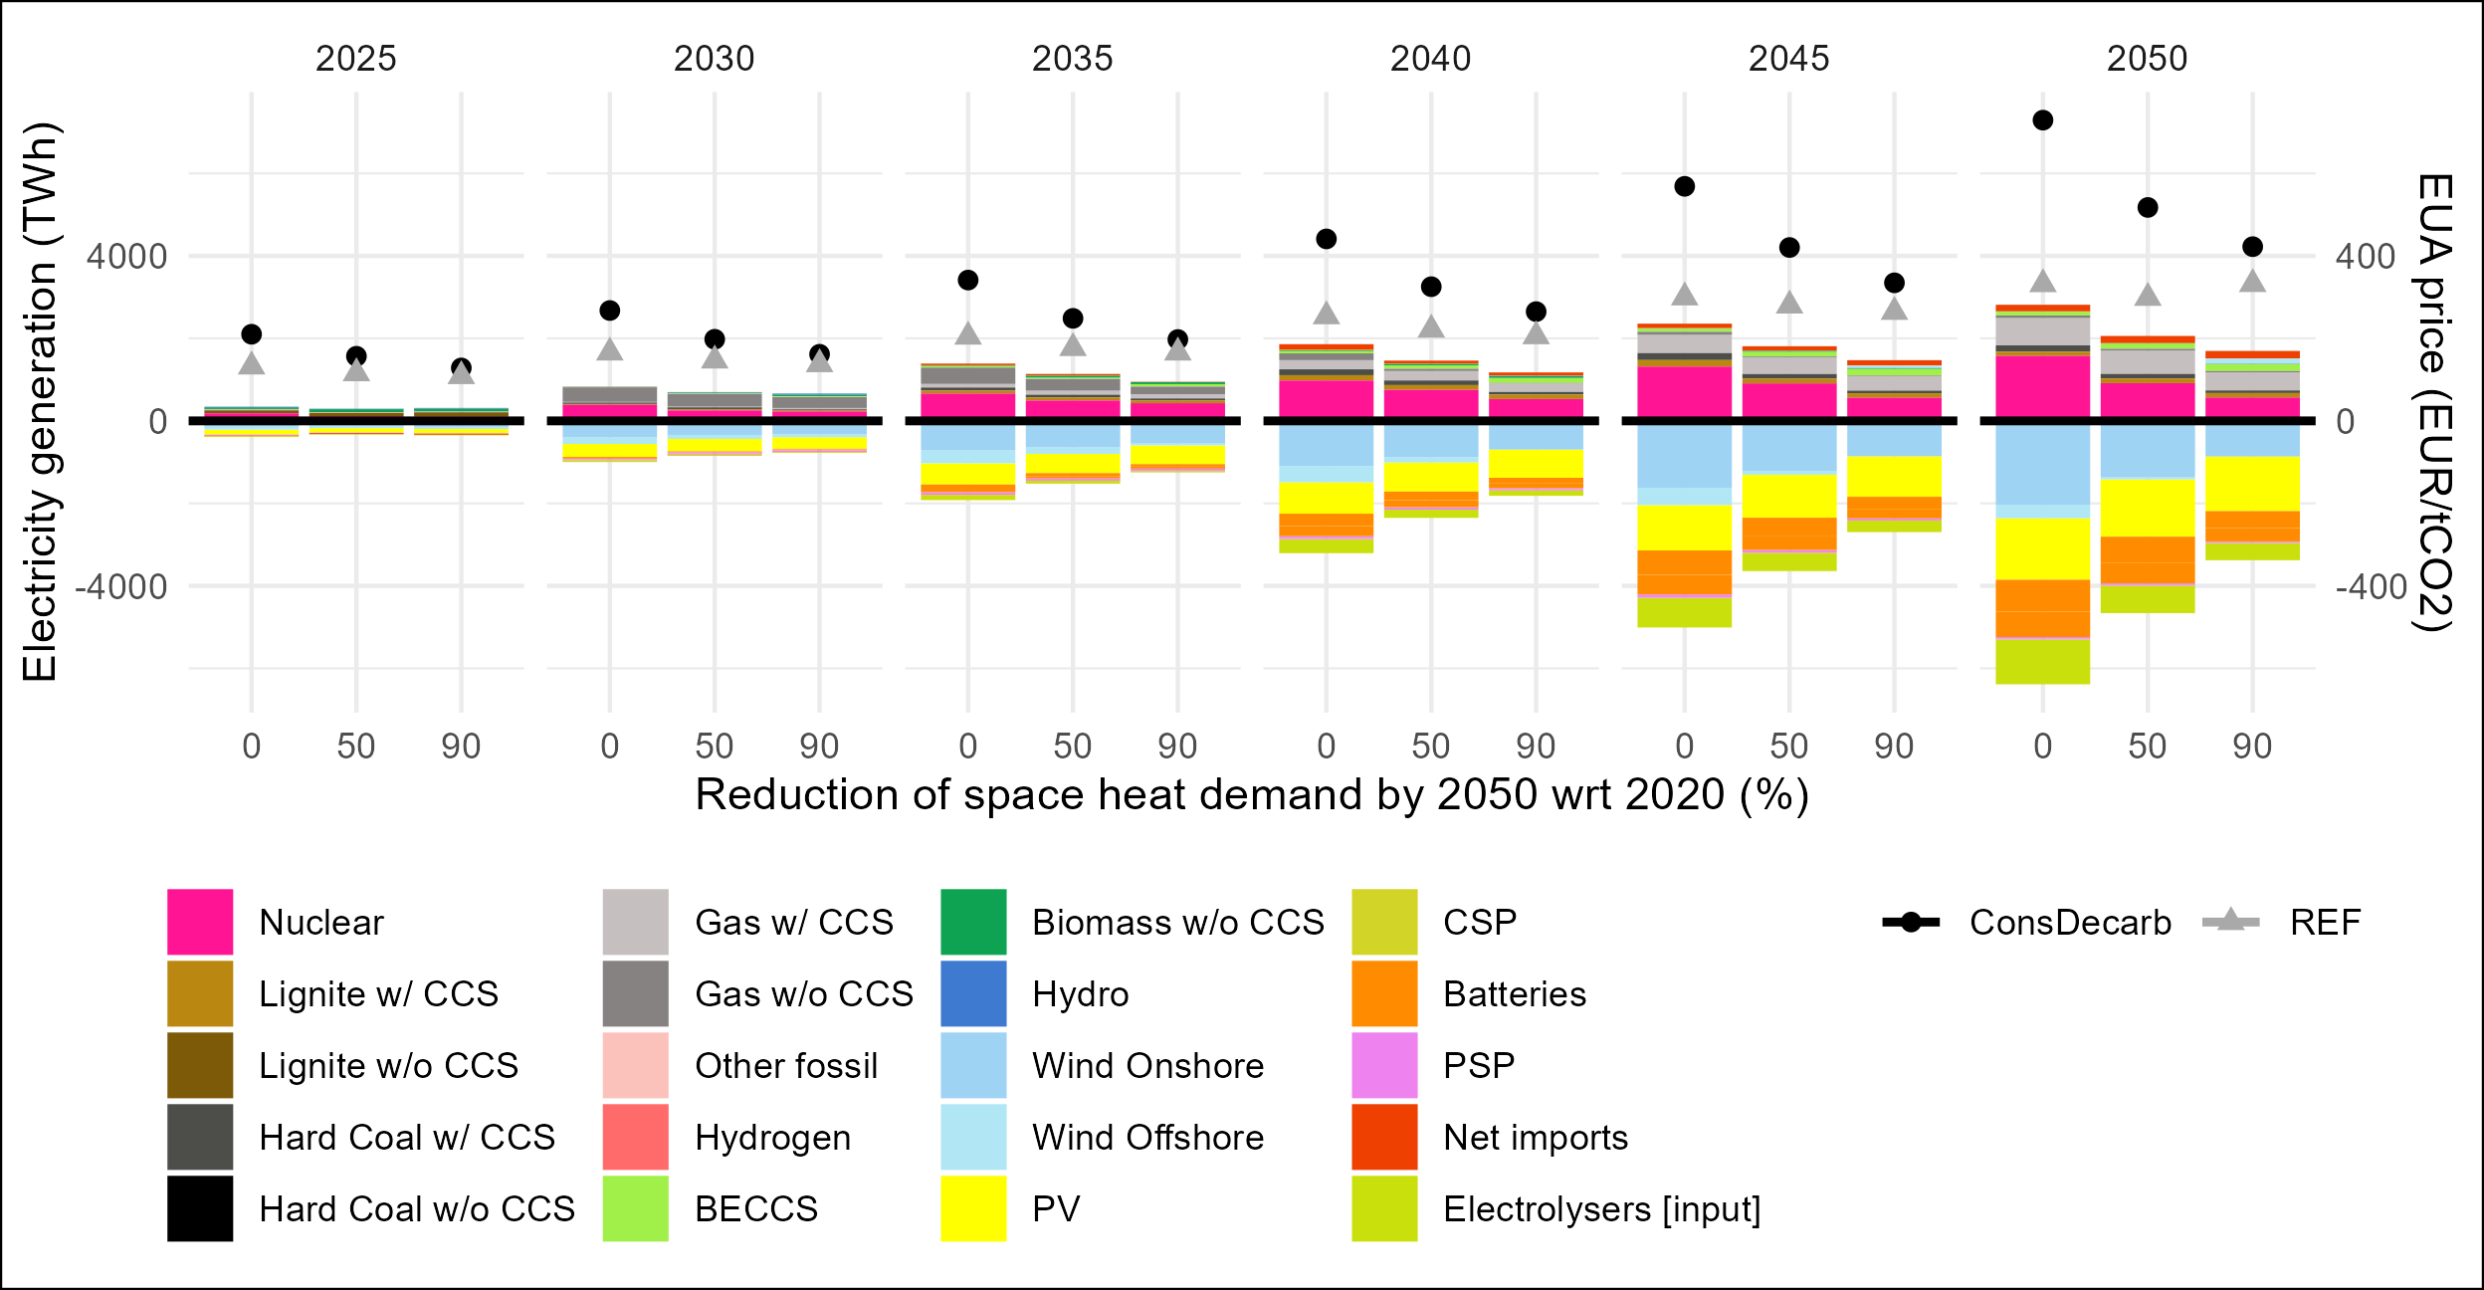
Only one concern: make sure decarbonisation options are available
Scenario ConsDecarb
(i) RES expansion is bounded by the maximum deployment rates between 2010 and 2020 , (ii) there are higher fuel prices , and (iii) that electrolysers need to pay additional fees included in the electricity tariffs
Gap between prices in ConsDecarb and REF increases over time and across scenarios
  21-49% higher between 2025 and 2045, and 55-85% higher in 2050
RES replaced with gas (without CCS) and nuclear in medium term (until 2035), and with gas (with CCS) and nuclear in the longer term (after 2035)
Notes:
From Figure 5, it is clear that heat supply is more difficult and expensive to decarbonise than the electricity supply. Figure 7 shows that there is a shift from CHP to HOP supply in DH networks. Remarkably, CHP plays only a marginal role in the long-term. This can be explained by the fact that biomass and gas do not play an important role in long-term decarbonisation of the electricity sector. Overall, given the lack of need to expand CHP to supply electricity, there is less incentive for CHP compared to HOP, whose heat efficiency is higher.

Slide 26
Conclusions
Renovation rates have moderate impact on ETS prices (<21%)
  Worth pursuing? Recovery funds (723 BnEUR)… renovation necessary?
Impact of renovation is more pronounced when decarbonisation options are constrained and costly
  What if EUA price is very high? Lack of incentives to further decarbonize buildings
  Interaction with ETS2? Very high prices in ETS might hamper heat electrification, need to limit price differences between the two systems
Role of renovation?
  From the ‘energy efficiency first principle’ to a ‘decarbonisation first principle’ (Levesque et al., 2023)
  Targeted renovations -> enabling role of efficiency
Electrification should be a priority
  Make sure power sector decarbonizes fast
  Setting a level playing field for HP
Notes:
As a result, one might question the extent to which renovations and energy demand reductions are worth pursuing. On the one hand, this highlights the need to evaluate carefully how EU funding is spent as efforts put into renovation might not actually pay off. This is more relevant now that improving energy efficiency in buildings is a key target of the 723 billion EUR allocated to recovery funds (European Commission, 2021b). On the other hand, we cannot assess in detail the cost-benefits of renovation given the model limitations. Renovations might be necessary (or at least cheaper) when substituting the heat source, e.g., installing a new heat pump. There are also certain cases in which renovation is absolutely necessary in order to improve air quality and health, and help alleviating energy poverty (European Commission, 2021a, 2020c).
Although our paper does not elaborate on which kind of policy might trigger such a heat pumps deployment, one of the first measures should focus on setting a level playing field for low-carbon heat technologies. Currently, the cost ratio between electricity-sourced and gas-sourced technologies is unfavourable in most European countries, part of the reason being higher taxes and levies on electricity (Rosenow, 2021). Rebalancing levies and taxes might complement national/EU plans and provide the right incentives to decarbonise the buildings sector.
At the same time, this would release some pressure on the EU ETS if power sector decarbonisation results costlier.

Slide 27

A bit of self promotion
Sebastian Osorio
sebastian.osorio@pik-potsdam.de
Potsdam Institute for Climate Impact Research

Slide 28
References (I)
Ashfaq, A., Ianakiev, A., 2018. Cost-minimised design of a highly renewable heating network for fossil-free future. Energy 152, 613–626. https://doi.org/10.1016/j.energy.2018.03.155
Bernath, C., Deac, G., Sensfuß, F., 2019. Influence of heat pumps on renewable electricity integration: Germany in a European context. Energy Strategy Rev. 26, 100389. https://doi.org/10.1016/j.esr.2019.100389
Bloess, A., 2019. Impacts of heat sector transformation on Germany’s power system through increased use of power-to-heat. Appl. Energy 239, 560–580. https://doi.org/10.1016/j.apenergy.2019.01.101
Bloess, A., Schill, W.-P., Zerrahn, A., 2018. Power-to-heat for renewable energy integration: A review of technologies, modeling approaches, and flexibility potentials. Appl. Energy 212, 1611–1626. https://doi.org/10.1016/j.apenergy.2017.12.073
Codina Gironès, V., Li, X., Maréchal, F., 2018. Data and model for the integration of district heating (No. D2.6).
EEA, 2022. Greenhouse gas emissions from energy use in buildings in Europe. https://www.eea.europa.eu/ims/greenhouse-gas-emissions-from-energy
European Commission, 2023. Effort sharing 2021-2030: targets and flexibilities. https://climate.ec.europa.eu/eu-action/effort-sharing-member-states-emission-targets/effort-sharing-2021-2030-targets-and-flexibilities_en
Eurostat, 2023a. Simplified energy balances (NRG_BAL_S). https://ec.europa.eu/eurostat/databrowser/view/nrg_bal_s/default/table?lang=en

Slide 29
References (II)
Eurostat, 2023b. Disaggregated final energy consumption in households – quantities (NRG_D_HHQ). https://ec.europa.eu/eurostat/databrowser/view/NRG_D_HHQ__custom_7681788/default/table?lang=en
Kavvadias, K., Jimenez Navarro, J., Thomassen, G., 2019. Decarbonising the EU heating sector: Integration of the power and heating sector (Technical Report No. EUR 29772 EN), Energy and transport. JRC, Luxembourg.
Levesque, A., Osorio, S., Herkel, S., Pahle, M., 2023. Rethinking the role of efficiency for the decarbonization of buildings is essential. Joule 7, 1087–1092. https://doi.org/10.1016/j.joule.2023.05.011
Ruhnau, O., Hirth, L., Praktiknjo, A., 2020. Heating with wind: Economics of heat pumps and variable renewables. Energy Econ. 92, 104967. https://doi.org/10.1016/j.eneco.2020.104967
Ruhnau, O., Hirth, L., Praktiknjo, A., 2019. Time series of heat demand and heat pump efficiency for energy system modeling. Sci. Data 6, 189. https://doi.org/10.1038/s41597-019-0199-y
Ruhnau, O., Muessel, J., 2022. Update and extension of the When2Heat dataset (Working Paper). Kiel, Hamburg: ZBW – Leibniz Information Centre for Economics.
Thomaßen, G., Kavvadias, K., Jiménez Navarro, J.P., 2021. The decarbonisation of the EU heating sector through electrification: A parametric analysis. Energy Policy 148, 111929. https://doi.org/10.1016/j.enpol.2020.111929
Zeyen, E., Hagenmeyer, V., Brown, T., 2021. Mitigating heat demand peaks in buildings in a highly renewable European energy system. Energy 231, 120784. https://doi.org/10.1016/j.energy.2021.120784

