Slide 1
Opportunities and Challenges of Emission Trading System in Japan
Kaitoh Hidano, Research Associate at the Energy Studies Institute, National University of Singapore
Date: November 28, 2023.

Slide 2
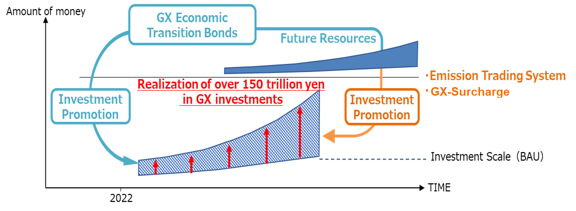
Position of the ETS in Japan’s strategy toward carbon neutral
October 2020 – Carbon neutral by 2050
October 2021 – NDC target of 46 % cut in GHGs in FY2030 from FY2013
April 2023 – ETS launched under the Basic Policy for the Realization of GX
20 trillon yen (USD 150 billion)
Source: Ministry of Economy, Trade and Industry

Slide 3
ETS at the prefectural level
In 1998, following the adoption of the Kyoto Protocol, the Law Concerning the Promotion of the Measures to Cope with Global Warming was enacted, requiring all local authorities to formulate plans for measures to control greenhouse gas emissions for their facilities to achieve the reduction targets.
Saitama Prefecture has adopted the Global warming countermeasure plan in 2010 and the ETS in 2011.
Global warming countermeasure plan
Company with energy use above 1,500 kL/yr
ETS
Facility with energy use above 1,500 kL/yr for three consecutive years.

Slide 4
ETS at the prefectural level
Base year x 1- (Target reduction rate) x Number of years > Total real emissions
Target reduction rate
Category of facilities | Phase 1 (2011-2014) | Phase 2 (2015-2019) | Phase 3 (2020-2024)
Commercial buildings, etc. | 8% | 15% | 22%
Factories, etc. | 6% | 13% | 20%
Base Target
2011 2012 2013 2014
Result of Phase 1 (2011-2014)
Category | Number of facilities | Targeted emissions | Emissions | Reduced emissions | Reduction rate | Achieved without trading | Achieved with trading | Total Achieved
Factories, etc. | 428 | 30.41 Mt | 23.73 Mt | 6.68 Mt | 22% | 371 | 50 | 421
Commercial buildings, etc. | 180 | 5.14 Mt | 4.02 Mt | 1.12 Mt | 22% | 162 | 16 | 178
Total | 608 | 35.55 Mt | 27.75 Mt | 7.8 Mt | 22% | 533 | 66 | 599
Source: Saitama Prefecture

Slide 5
ETS at the prefectural level
Dependent variable: Reduced CO2 emissions compared to base year
 | Facility level
Base_year Real emission in 2010 | - 0.1123*** (- 37.074)
ETS Dummy takes 1 if targeted | 1796*** (6.868)
Low_energy_comsumption Dummy takes 1 if less than 1,500 kL of oil equivalent of energy per year | 868.9*** (3.318)
Observation | 4525
Adjusted R | 0.2345
Note: Coverage time is 2011-2014, t-value is in parentheses and p-value denotes *** 1%, ** 5%, * 10%
Key findings:
The facilities that are covered by the ETS are more likely to reduce CO2 emissions than those that are not covered.
The facilities with larger CO2 emissions in the base year (FY2010) tend to reduce their emissions less than those with smaller emissions.
The facilities that use energy less than 1,500 kL per year are more likely to reduce CO2 emissions than those with energy use above 1,500 kL.

Slide 6
ETS at the prefectural level
Small facility --- energy use less than 1500 kL
Medium facility --- energy use above 1500 kL
Large facility --- energy use above 1500 kL for three consecutive years
Proportion of facility
Non-ETS facility
ETS facility
Reduction rate range in 2014

Slide 7
The Japanese government’s plan for the national ETS
By September 29, 2023: Participating companies submit goals
By end of December 2023: Publication of the above targets on the dashboard
By end of October 2024: Companies report on emission reductions achieved in FY2023
From October 2024: Trading of excess emission reduction allowances begins
2023
2026
2033
Phase 1
Phase 2
Phase 3
Voluntary
Implement measures to increase the participation
Voluntary
Formulate the guideline and validation of the pledged target from the third party
Voluntary
Strengthen the disciplines for the compliance through guidance and supervision
Participation
Gradual introduction of allowance auctions for the power sector
Target setting
Target achievement

Slide 8
Target achievement and emission allowance trading
Emission per year
Phase 1 Total emission
Emission
Emission
Target
Real emission
27.0%
NDC level
29.7%
32.4%
2013
2025
2024
2023

Slide 9
Target achievement and emission allowance trading
Emission per year
Phase 1 Total emission
Emission
Emission
Target
27.0%
NDC level
Real emission
29.7%
32.4%
Obtain
Credit
2013
2025
2024
2023

Slide 10
Target achievement and emission allowance trading
Emission per year
Phase 1 Total emission
Emission
Emission
27.0%
NDC level
Real emission
29.7%
Target
32.4%
Obtain
Credit
2013
2025
2024
2023

Slide 11
Target achievement and emission allowance trading
Emission per year
Phase 1 Total emission
Emission
Emission
27.0%
NDC level
Real emission
29.7%
32.4%
Obtain
Credit
Target
2013
2025
2024
2023

Slide 12
Target achievement and emission allowance trading
Emission per year
Phase 1 Total emission
Emission
Emission
Real emission
27.0%
Purchase
NDC level
29.7%
32.4%
Target
2013
2025
2024
2023

Slide 13
Target achievement and emission allowance trading
Emission per year
Phase 1 Total emission
Emission
Emission
Real emission
Target
Purchase
27.0%
NDC level
29.7%
32.4%
2013
2025
2024
2023

Slide 14
Corporate behaviors for emission reductions and mandatory scheme control
100%
Reduction rate
AT
RT = Real Target
AT = Achievable Target
MT = Mandatory Target
RTA
RTB
0%
Company A
Company B

Slide 15
Corporate behaviors for emission reductions and mandatory scheme control
100%
Reduction rate
AT
RT = Real Target
AT = Achievable Target
MT = Mandatory Target
RTB =
RTA
0%
Company A
Company B

Slide 16
Corporate behaviors for emission reductions and mandatory scheme control
100%
Reduction rate
RTA =
RT = Real Target
AT = Achievable Target
MT = Mandatory Target
RTB =
AT
0%
Company A
Company B

Slide 17
Corporate behaviors for emission reductions and mandatory scheme control
100%
Reduction rate
AT
RT = Real Target
AT = Achievable Target
MT = Mandatory Target
MT
Opportunity cost
RTA
RTB
0%
Company A
Company B

Slide 18
Corporate behaviors for emission reductions and mandatory scheme control
2 firms under voluntary scheme
Pattern: 10
Risk: 9

Slide 19
Corporate behaviors for emission reductions and mandatory scheme control
2 firms under mandatory scheme
Pattern: 10
Risk: 5

Slide 20
Corporate behaviors for emission reductions and mandatory scheme control
3 firms under voluntary scheme
Pattern: 20
Risk: 19

Slide 21
Corporate behaviors for emission reductions and mandatory scheme control
3 firms under mandatory scheme
Pattern: 20
Risk: 9

Slide 22
Corporate behaviors for emission reductions and mandatory scheme control
Risk disparity evolves between voluntary and mandatory target setting system
Number of participants | 1 | 2 | 3 | 4 | 5 | n
Pattern | 4 | 10 | 20 | 34 | 52 | 2(n²+1)
Risk under voluntary target | 3 | 9 | 19 | 33 | 51 | …
Risk under mandatory target | 2 | 5 | 9 | 13 | 20 | …

Slide 23
Summary
The current scheme focuses on removing the burden to join the ETS and to respond to their own targets, but the incentive that stimulates the voluntary contribution to reducing up to their achievable level is still limited.
The validation of self-pledged targets of emission reduction will be required in order to seek the most ambitious and achievable target to gain the highest utility.
If the scheme alleviates the criteria to get away from the allowance purchase obligation, the incentives for the companies to reduce as far as they can achieve could be weaken due to lack of buyers and return from their credits made.

Slide 24
Kaitoh Hidano
Energy Studies Institute
29 Heng Mui Keng Terrace
Singapore 119629
kaitoh.h@nus.edu.sg

