Slide 1
Time and frequency dynamics of connectedness between green bonds, clean energy markets and carbon prices
Presented by: Ingrid Emilie Flessum Ringstad
Paper by: Ingrid Emilie Flessum Ringstad & Kyriaki Tselika
FSR Climate Annual Conference, Firenze November 28th 2023

Slide 2
Overview
Brief motivation & introduction
Research question
Some relevant literature
Chosen methodology
Data
Results
Our contributions

Slide 3
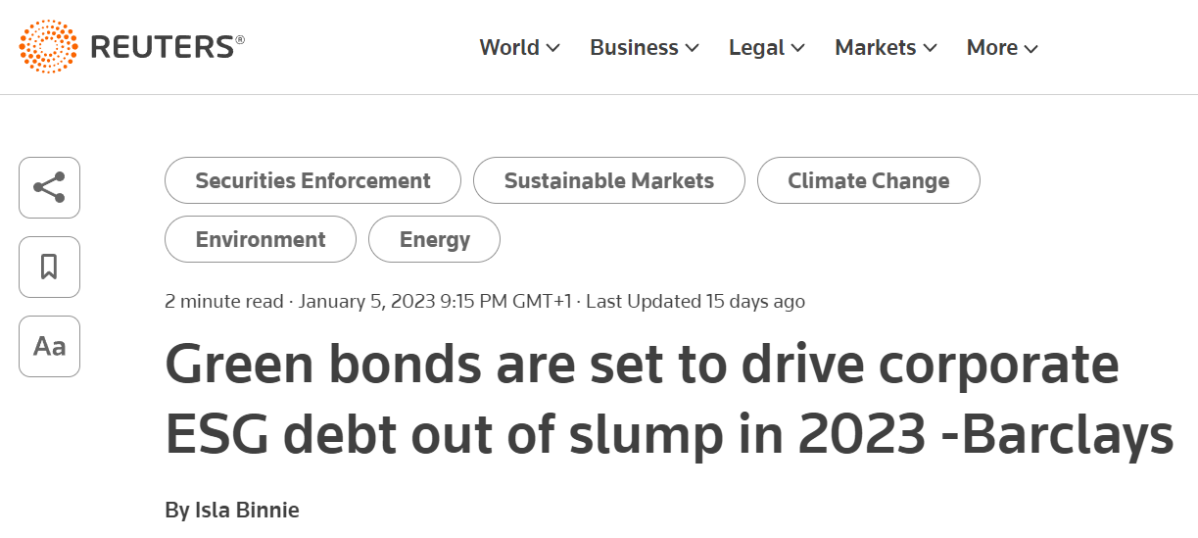
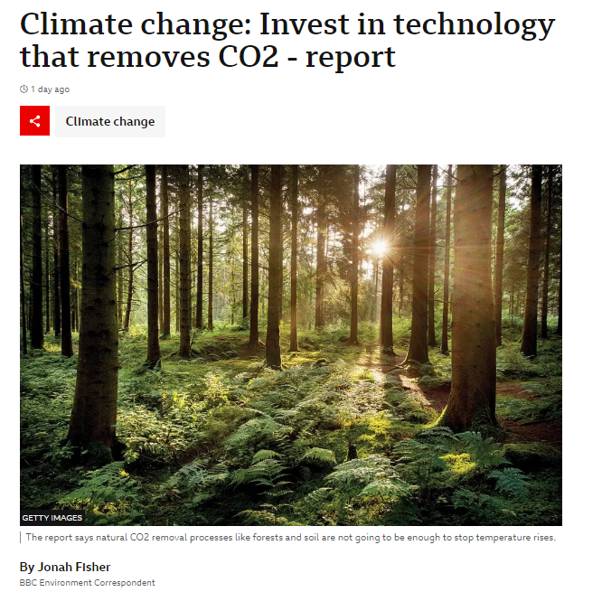
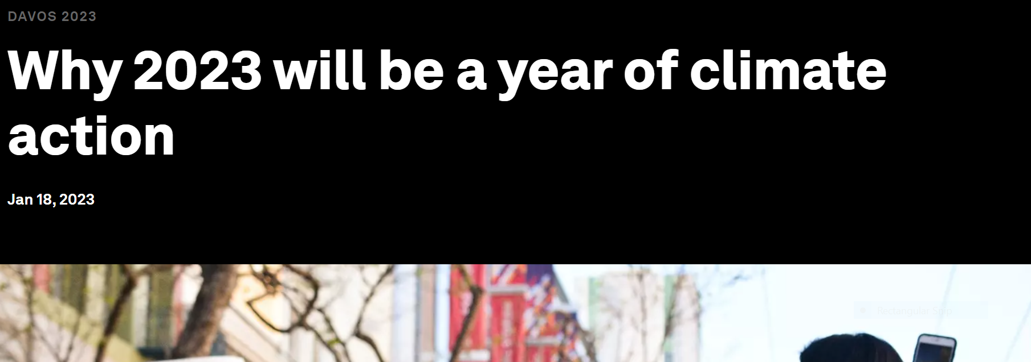
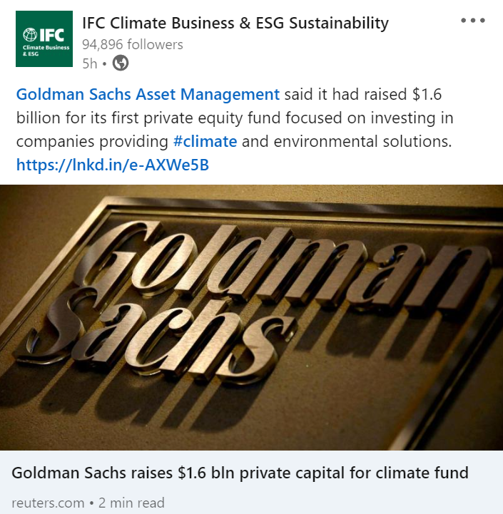
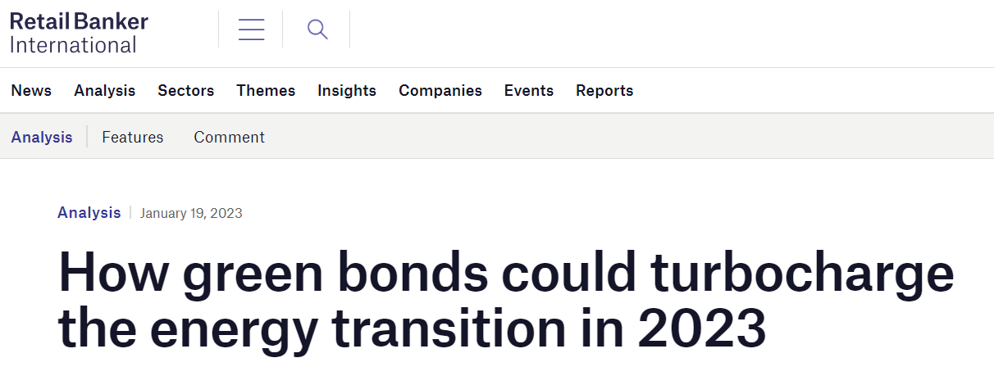
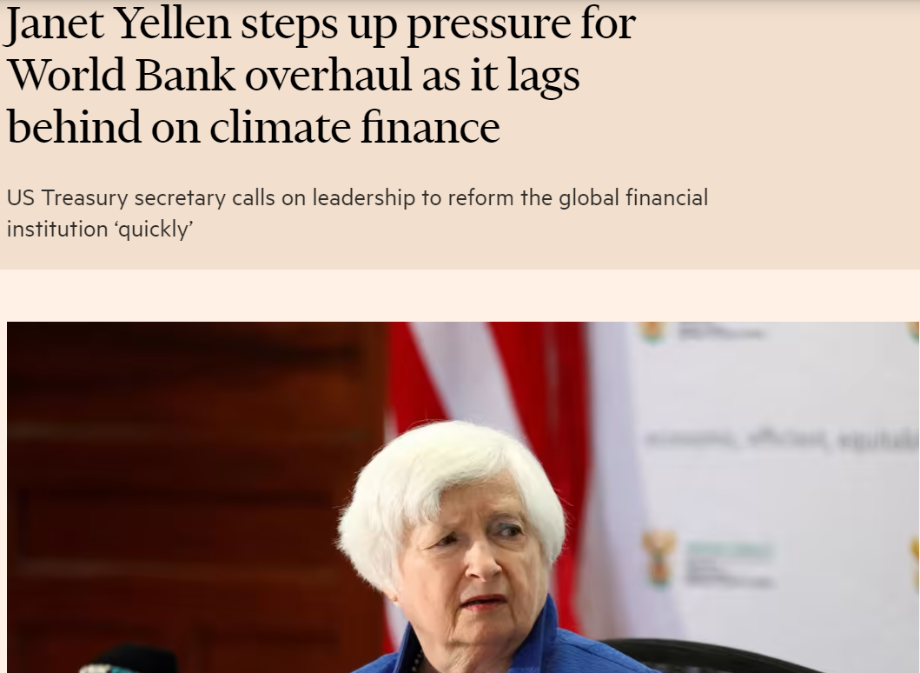
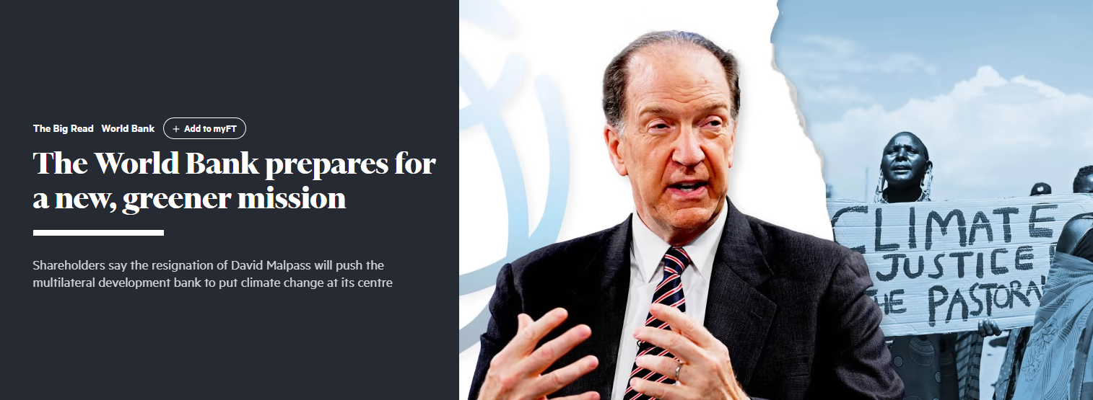
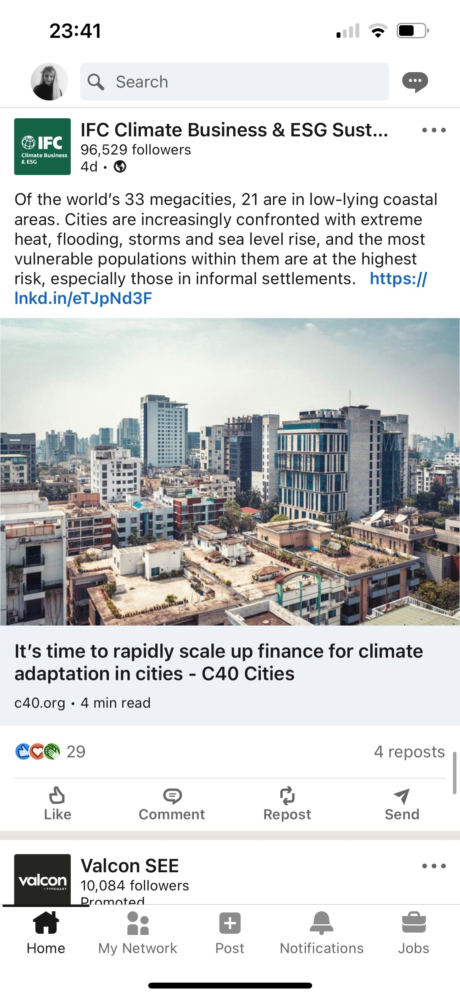
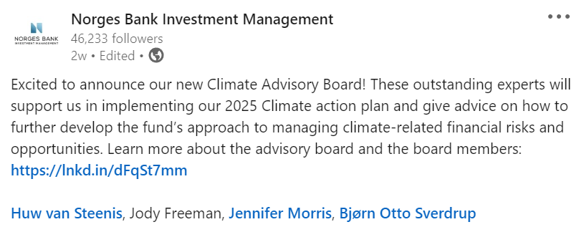
Motivation
Notes:
*https://www.weforum.org/agenda/2020/11/what-is-green-finance/

Slide 4
Introduction
Climate aligned finance, also called green finance, is an important matter mentioned and discussed in political, economic and environmental agendas around the world.
Green finance will be a key enabler for the green transition through investments aligned with the UN SDG’s and EU Fit for 55.
Channeling investments into clean energy and infrastructure markets is one of the most important priorities for a successful global green transition
Green Bonds can be an attractive and important market based tool in transitioning to low-carbon and potentially net-zero economies.
According to the World Economic Forum, by 2023 the green bond market could be worth 2.36$ trillion*
Green bonds definition: bonds whose proceeds are committed to finance environmental and climate-friendly projects, such as renewable energy, green buildings, or resource conservation
Notes:
*https://www.weforum.org/agenda/2020/11/what-is-green-finance/

Slide 5
Size of the green bond market
The green bond market compared to the bond market
Bond market
Green bond market
Notes:
With rounded numbers. GB total size by oct 2022 1,989 aka ca 2tr dollars. Global bond market end 2021 is 126,9 aka 127 tr dollars. 2/127 is about 1,5-1,6%. GB market end 2021 estimated at 509bn aka 0,51 tr dollars. Using these numbers GB market is about 0,4% of Global bonds market. Hard to find reliable data for late 2022.

Slide 6
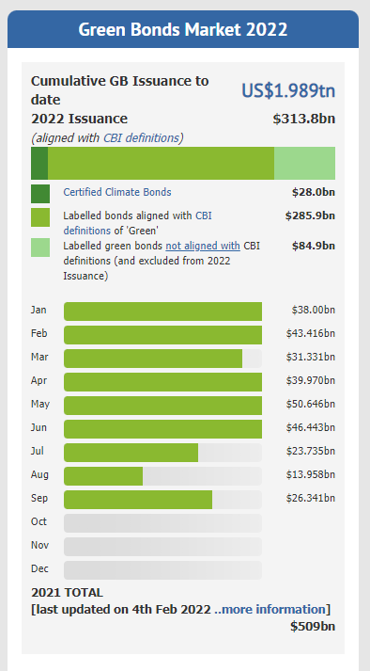
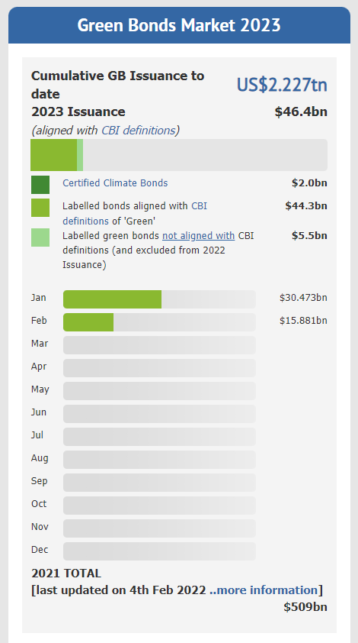
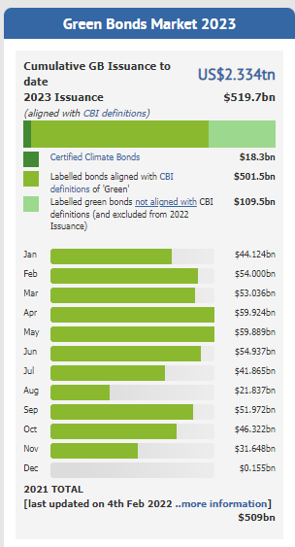
Green Bonds provide an alternative to investors that want to have more climate-aligned portfolios.
Moreover, governments and policy makers use fiscal tools such as carbon markets, taxation, etc. to regulate environmental damage. Thus, the carbon price is of interest for a variety of stakeholders.
Both immediate short-term action and a long-term perspective is important in order to reach a net-zero future.
Consequently, we find it interesting to investigate the connectedness between green bonds, clean energy markets and carbon prices at various investment horizons
Retreived Oct.2022
Retreived Feb.2023
Notes:
Figure from: https://www.climatebonds.net/

Slide 7
Our main research question:
What is the connectedness between green bonds, clean energy markets and carbon prices in the short-term and long-term?
Consequently, what are the diversification opportunities within a fully green financial market?
Notes:
(Take into consideration the short-term trader and the long term private/institutional investor)
- How can insights into this relationship aid policy makers in the quest for designing efficient policy regimes which foster green/climate positive investments? (Could this be used to minimize/reduce systemic risk in the emerging green finance market)
Is there a significant and growing connection between environmental policy uncertainty and green bond markets?
Possible extension.

Slide 8
So how is connectedness defined?
System connectedness can be characterized through variance decompositions from a vector auto-regression approximating model. Variance decompositions provide useful information about how much of future uncertainty of variable j is due to shocks in variable k.”. More detailed “Connectedness measure denotes the contribution of the jth variable to the variance of the forecast error of the variable kth at the horizon H”.
- Barunik and Křehlík (2018)
Notes:
(Take into consideration the short-term trader and the long term private/institutional investor)
- How can insights into this relationship aid policy makers in the quest for designing efficient policy regimes which foster green/climate positive investments? (Could this be used to minimize/reduce systemic risk in the emerging green finance market)
Is there a significant and growing connection between environmental policy uncertainty and green bond markets?
Possible extension.

Slide 9
Why our research question is important
By examining the relationship between green bonds, the carbon market and clean energy stocks we can investigate the transmission risk between three markets, which can be associated with financial contagion and diversification opportunities.
A large share of the proceeds from green bonds are invested in clean energy-renewables and clean infrastructure.
Extended investigation of the carbon market is important to understand its role in the green financial transition.
Governments use carbon pricing as an incentive for investing in clean energy.
Assessing the risk and diversification features of our chosen assets can be important when designing climate-aligned portfolios, and to shape financial incentives aimed at boosting interest in allocating resources to activities consistent with low-carbon economies.
No other paper has investigated the connectedness in our three markets using the time-frequency framework
Notes:
Possible extension: Understanding the relationship between green bonds, clean energy stocks and environmental policy uncertainty could aid policy makers in designing efficient policies to reach the climate goals.

Slide 10
Key takeaways from the literature
A large focus on relationship between green bonds and general financial markets; Tiwari et al., 2022; Reboredo et al., 2022; Lui et al., 2021; Leitao et al., 2021; Reboredo et al., 2020; Reboredo, 2018
Literature finds strong connectedness between green bonds and treasury and corporate bonds in the short and long run. Green bonds are also found to be a receiver of connectedness; Reboredo and Ugolini (2019)
Extreme movements in CE stock market have spillover effects on the GB market, and vice versa. Relationship is asymmetric; Liu et al. (2021)
The time and frequency framework have been used to investigate the connectedness between renewable energy and other markets such as carbon, oil price and materials. Most connectedness are generated in the short-term; Ferrer et al., (2018); Jiang and Chen., (2021)
Tiwari et al (2022) use similar data as we do in their paper, investigating dynamic spillover effects between green bonds and renewable energy stocks as well as carbon markets using a TVP-VAR approach. They also investigate hedging and portfolio design. However, they do not consider the frequency dimension, thus ignoring various short-term and long-term dynamics in their data.
In their paper Liu et al. (2021) remarke that future research should consider a framework that can model systemic risk between multiple variables from both time and frequency perspectives
Notes:
There is a large part of the literature that investigates if companies issuing green bonds receive a green premium: Gianfrate and Peri, 2019; Kapraun and Scheins, 2019; Baker et al., 2018; Ehlers and Packer, 2017.

Slide 11
System connectedness
Methodologies
Frequency dynamics of connectedness
Diebold and Yilmaz (2012) – DY12
Barunik and Křehlík (2018) – BK18
They measure directional spillovers in a generalized VAR framework. It can be used to measure the spillovers in returns or return volatilities across individual assets, asset portfolios, asset markets, etc. revealing spillover trends, cycles, bursts, etc.
Given the financial turbulence that exists, it is unlikely that any single fixed parameter model would be appropriate. Thus, they estimate spillovers using rolling samples and assess the extent and nature of the spillover variation over time.
They also estimate directional spillovers, net spillovers and net pairwise volatility spillovers which help in understanding the connections between markets.
In order to understand the sources of connectedness in an economic system, it is crucial to understand the frequency dynamics of the connectedness as shocks to economic activity impact variables at various frequencies with various strengths.
Investors operate on different investment horizons due to the heterogeneity of their preferences.
It is important to investigate the connectedness between financial systems in short/long-term.

Slide 12
System connectedness
Diebold and Yilmaz (2012) – DY12
They measure directional spillovers in a generalized VAR framework by computing its forecast error variance decomposition (FEVD) at horizon H.
It can be used to measure the spillovers in returns or return volatilities across individual assets, asset portfolios, asset markets, etc. revealing spillover trends, cycles, bursts, etc.
Given the financial turbulence, it is unlikely that any single fixed parameter model would be appropriate. Thus, they estimate spillovers using rolling samples and assess the extent and nature of the spillover variation over time.
They also estimate directional spillovers, net spillovers and net pairwise volatility spillovers which help in understanding the connections between markets.
Notes:
Their method measures spillovers based on the generalized vector autoregressive (VAR) framework by computing its forecast error variance decomposition (FEVD) at horizon H

Slide 13
Frequency dynamics of connectedness
Barunik and Křehlík (2018) – BK18
In order to understand the sources of connectedness in an economic system, it is crucial to understand the frequency dynamics of the connectedness, as shocks to economic activity impact variables at various frequencies with various strengths.
Investors operate on different investment horizons due to the heterogeneity of their preferences. Think short-term oriented VS long-term oriented investors
It is important to investigate the connectedness between financial systems in short/long-term, in other words at the high frequency band and low frequency band.

Slide 14
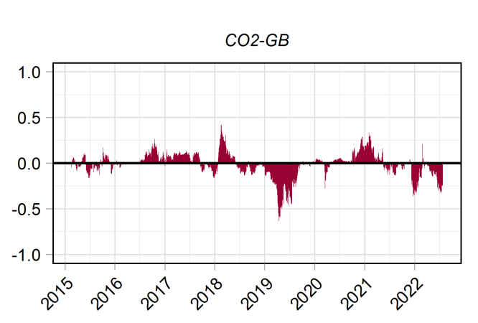
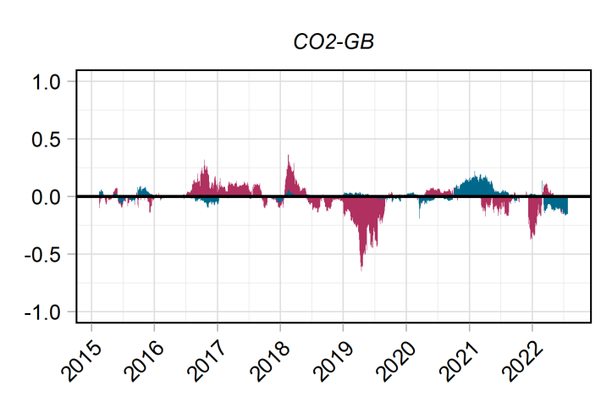
Illustrative example
DY12 framework
BK18 framework
Notes:
Pink is short –term, blue is long-term

Slide 15
Our methodological choices
We use two frequency bands – Short-term and long-term
Short-term (high frequency band) = 1-5 days
Long-term (low frequency band) = 6-200 days
Time period 2014 – mid 2022
We choose a 200-day rolling window and 100-day forecast horizon
Choose our optimal number of lags using SIC (Schwarz Information Criterion)
We run both frameworks DY12 and BK18
Focus on BK18
We assume our variables represent a fully green financial market

Slide 16
Data
Data is retrieved from Bloomberg and Refinitiv
CO2 Emissions Quota Prices (CO2) – Based on EU ETS, source from Refinitiv
S&P Green Bond Index (GB): represents the global green bond market and includes only those bonds whose proceeds are used to fund environmentally friendly projects. Only include labeled-green bonds in compliance with the Green Bonds Principles, from independent certifiers. Public and corporate issuers.
S&P Global Energy Index (SP_Clean): includes stocks that are related to clean energy production or technologies. Includes both developed and developing markets, target count of 100 firms.
World Renewable Energy Index (RENIXX): includes companies that earn more than half of their revenues from the renewable energy sector. The international stocks with the 30 highest free-float market capitalisations form the RENIXX World
WilderHill Clean Energy Index (ECO): Started following US firms, the first in the US to focus on renewable energy sector.
ISE Global Wind Energy Index (ISE_WIND): tracks the performance of companies that are primarily engaged and involved in the wind energy industry based on analysis of the products and services offered by those companies.
MAC Global Solar Energy Stock Index (MAC_SOLAR): tracks the performance of companies in global solar energy businesses.
S&P TSX Renewable Energy and Clean Technology Index (TSX): includes a range of non-renewable clean energy technologies (smart grid, energy storage, etc.).
Notes:
S&P Green Bond Index: represents the global green bond market and includes only those bonds whose proceeds are used to fund environmentally friendly projects.
CO2 Emissions Prices
S&P Global Energy Index: includes stocks that are related to clean energy production or technologies.
World Renewable Energy Index (RENIXX): includes companies that earn more than half of their revenues from the renewable energy sector.
ISE Global Wind Energy Index: tracks the performance of companies that are primarily engaged and involved in the wind energy industry based on analysis of the products and services offered by those companies.
MAC Global Solar Energy Stock Index: tracks the performance of companies in global solar energy businesses.
Global Energy Smart Technologies Index: includes a range of non-renewable clean energy technologies (smart grid, energy storage, etc.).

Slide 17
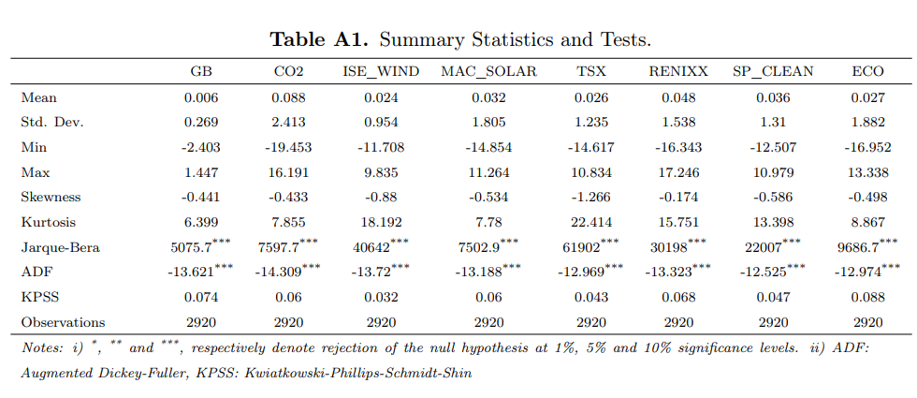
Some descriptive data
Overview of the summary statistics or our daily returns, and tests that we have run for our data
Graphic illustration of our data coming up…
Notes:
Following Liu et al., 2021, we calculate GB yields and Clean Energy stocks returns as follows: [ln (pit)−ln (pi,t−1)]×100
S&P Green Bond Index: represents the global green bond market and includes only those bonds whose proceeds are used to fund environmentally friendly projects.
CO2 Emissions Prices
S&P Global Energy Index: includes stocks that are related to clean energy production or technologies.
World Renewable Energy Index (RENIXX): includes companies that earn more than half of their revenues from the renewable energy sector.
ISE Global Wind Energy Index: tracks the performance of companies that are primarily engaged and involved in the wind energy industry based on analysis of the products and services offered by those companies.
MAC Global Solar Energy Stock Index: tracks the performance of companies in global solar energy businesses.
Global Energy Smart Technologies Index: includes a range of non-renewable clean energy technologies (smart grid, energy storage, etc.).

Slide 18
Graphical summary
Green bonds are measure on the left side y-axis
Green bonds show a clearly different pattern that the other markets
CO2 peaks after the clean markets
Clean energy markets all peak around end-2020
Notes:
S&P Green Bond Index: represents the global green bond market and includes only those bonds whose proceeds are used to fund environmentally friendly projects.
CO2 Emissions Prices
S&P Global Energy Index: includes stocks that are related to clean energy production or technologies.
World Renewable Energy Index (RENIXX): includes companies that earn more than half of their revenues from the renewable energy sector.
ISE Global Wind Energy Index: tracks the performance of companies that are primarily engaged and involved in the wind energy industry based on analysis of the products and services offered by those companies.
MAC Global Solar Energy Stock Index: tracks the performance of companies in global solar energy businesses.
Global Energy Smart Technologies Index: includes a range of non-renewable clean energy technologies (smart grid, energy storage, etc.).

Slide 19
Results
Current results from our analysis
Total return connectedness
Net directional return connectedness
Pairwise directional return connectedness
Notes:
(Potentially indices on Economic Policy Uncertainty (EPU) and Environmental Policy Uncertainty (EnvPU))

Slide 20
Total Return Connectedness
Results using both DY12 and BK18 frameworks

Slide 21
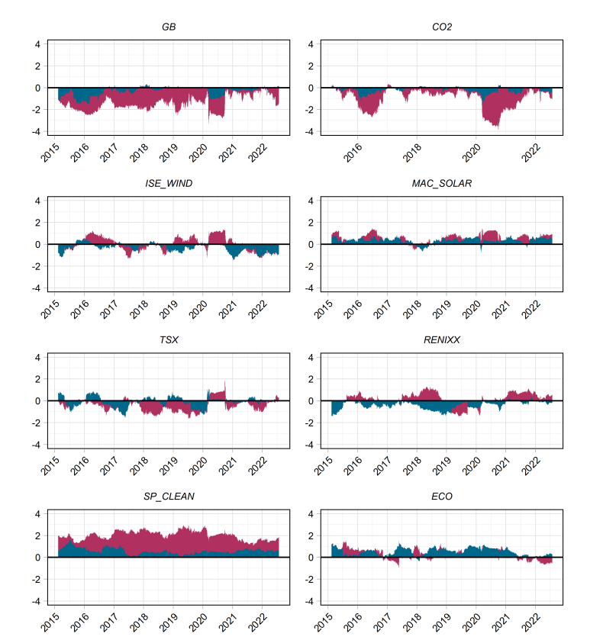
Net directional return connectedness
Results from BK18 framework
Green bonds and CO2 are clear net receivers across frequencies.
SP_Clean and ECO are the two most clear net transmitters
The other clean energy markets switches and the net directional transmission is both time and frequency dependent.
Typically, periods of high political and economic volatility drives return spillovers.
ECO is the one that seems to be mostly driven by the long-term (low frequency)
Generally, there seems to be relatively lower connectedness among the clean energy markets

Slide 22
Pairwise directional return connectedness
One static and one dynamic example
Including the static as an overview for intuition see next slides for GB-pair and CO2-pair

Slide 23
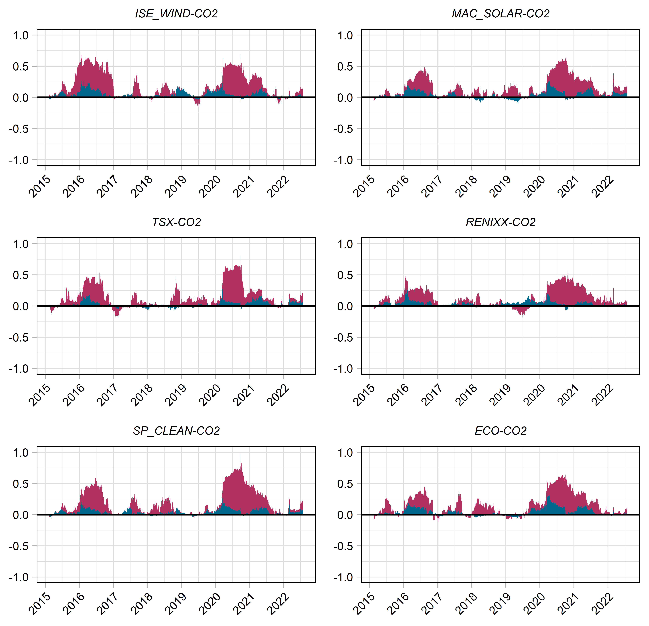

Slide 24
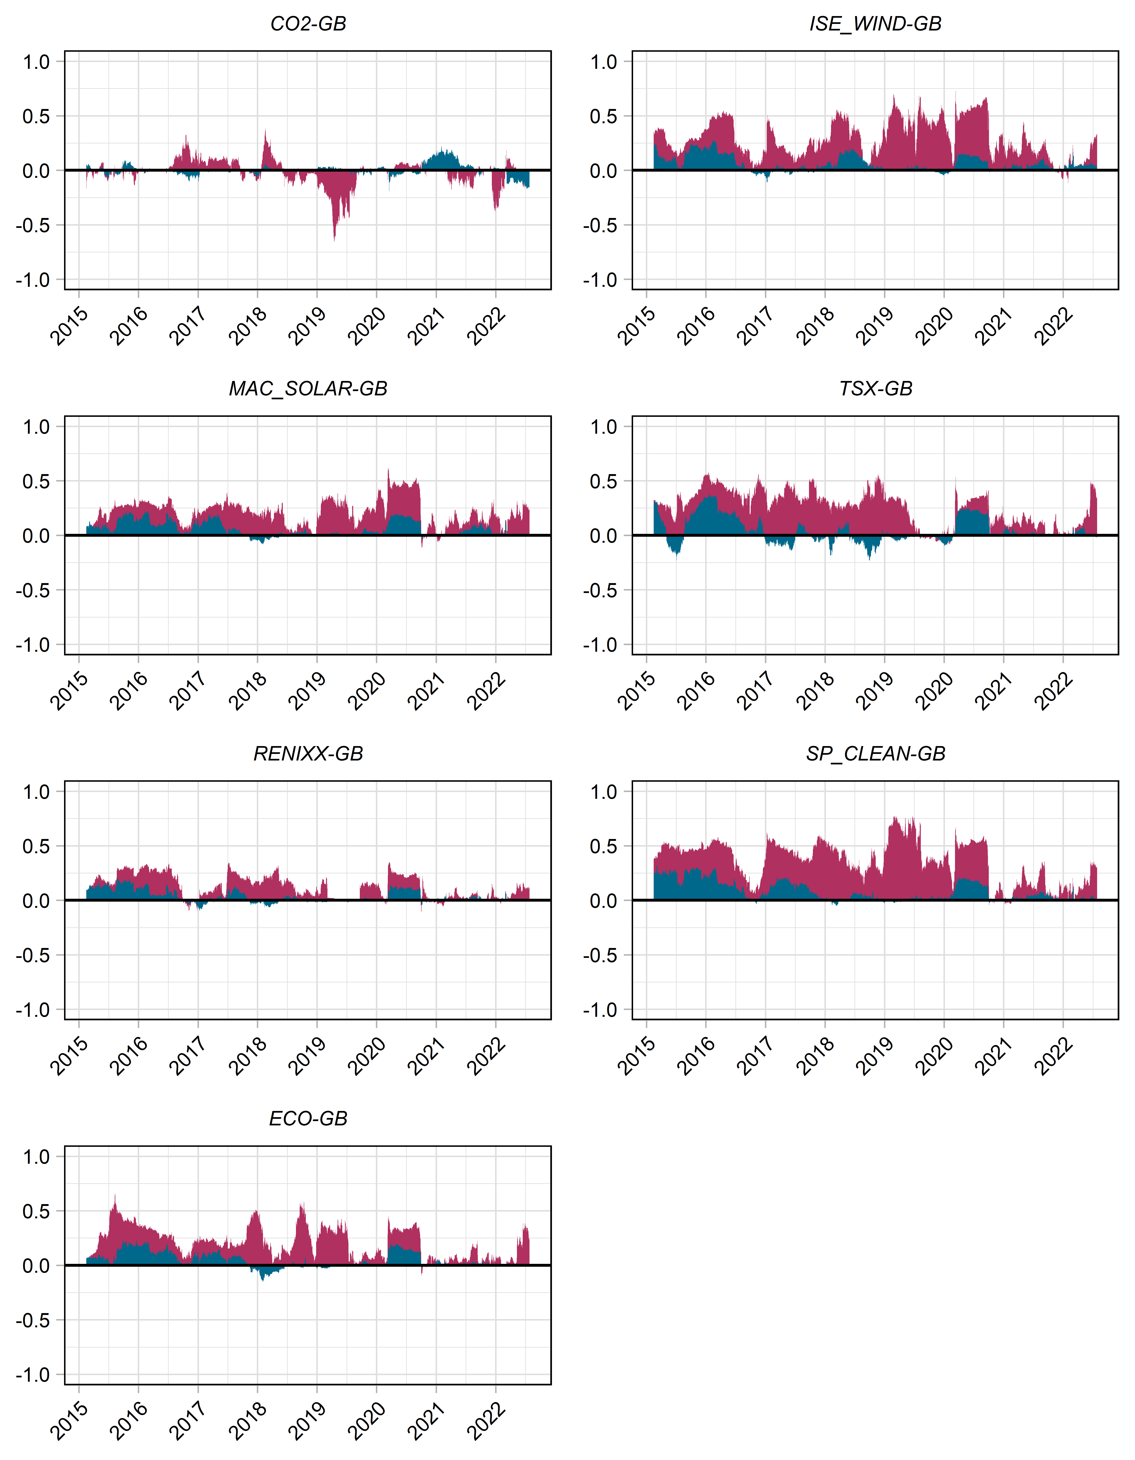

Slide 25
Contribution & conclusion
We investigate the dynamic connectedness between green bonds and clean-renewable energy markets using a time and frequency dynamics approach. There is literature on green bonds and clean-renewable markets but they do not consider the frequency dynamics, we do.
We find interesting diversification options for the «green investor», especially linked to carbon markets at both frequencies
We show that green bonds have interesting diversification possibilities in the green financial market, especially at the low-frequency (long-term)
We show that most return spillovers in the green market is driven by the high frequency, so it is similar to the general financial market
Contribute to enhancing investor’s and policy maker’s understanding of connectedness between green assets and carbon prices.
We provide more research based arguments for investors to go green, which is needed for a successful and just green transition for society

Slide 26
Thank you for your attention
Contact: ingrid.flessum@nhh.no

Slide 27
Literature – Key takeaways is coming up
A variety of research has focused on the connection between the green bond market and other financial markets: Pham and Nguyen, 2022; Tiwari et al., 2022; Reboredo et al., 2022; Lui et al., 2021; Leitao et al., 2021; Reboredo et al., 2020; Reboredo and Ugolini, 2019; Reboredo, 2018.
Reboredo and Ugolini (2019) use the value-at-risk model to study the price correlation between green bonds and financial markets in the EU and USA. Results reveal strong connectedness between green bonds and treasury and corporate bonds in the short and long run, with green bonds receiving sizeable spillovers from treasury and corporate bond prices and transmitting negligible effects.
Liu et al. (2021): Examine the dynamic dependence structure between green bonds and clean energy markets using several time-variant and time-varying copula approaches. They note that future research should consider a framework that can model systemic risk between multiple variables from both time and frequency perspectives
Tiwari et al., (2022) also investigate dynamic spillover effects between green bonds and renewable energy stocks as well as carbon markets using a TVP-VAR approach. They also investigate hedging and portfolio design.
Ferrer et al., (2018) and Jiang and Chen., (2021) both exploit a new framework on time and frequency dynamics to investigate the connectedness between renewable energy and other markets such as carbon, oil price and materials. Both find that most connectedness are generated in the short-term.
Notes:
Maybe reduce this slide a bit. There is a large part of the literature that investigates if companies issuing green bonds receive a green premium: Gianfrate and Peri, 2019; Kapraun and Scheins, 2019; Baker et al., 2018; Ehlers and Packer, 2017.
Tiwari et al., 2022 also investigate dynamic spillover effects between green bonds and renewable energy stocks as well as carbon markets using a TVP-VAR approach.

