Slide 1
TECHNOLOGY DIFFUSION IN CARBON MARKETS: Evidence from Aviation
Xavier Fageda
Jordi J. Teixidó
Department of Applied Economics
University of Barcelona

Slide 2
INTRODUCTION
SOURCE OF EMISSIONS: Direct CO2 emissions from aviation account for about 3% of the EU total emissions.
MOST CLIMATE INTENSIVE MODE OF TRANSPORT: (multiplier of ≈2 for CO2 emissions) (Azar and Johansson, 2012)
PROJECTED GROWTH: IATA forecasts that by 2050, they could grow by a further 20-70% in comparison to 2019 levels.
PARIS AGREEMENT: No explicit mention and yet -41% to 96% reduction in comparison to 2005 needed for 2050 for 2ºC threshold (Cames et al., 2015).
EU ETS: Aviation emissions included in 2012. We examine technology adoption in response to carbon pricing

Slide 3
BACKGROUND
TECHNOLOGICAL CHANGE (Schumpeter, 1942): Invention/Innovation/Diffusion
INDUCED-DIFFUSION HYPOTHESIS with command-and-control measures (Kerr & Newell, 2003; Popp, 2010)
EU ETS: Evidence that has provided more innovation than adoption (Teixidó et al., 2019; Calel, 2020; Calel & Dechezleprêtre, 2016).
EU ETS: No evidence of changes in emission intensities (Calel, 2020; Jaraite & di Maria, 2016; Klemetsen et al., 2020; Löfgren et al., 2014).

Slide 4
BACKGROUND
We investigate the effect of the EU ETS on actual technology diffusion using reliable, comparable metrics of technology change.
To do so, we analyze how the EU ETS affects actual emission intensity (kg of CO₂ per seat-km), aircraft model choice and aircraft retrofit decisions (winglets).
Fageda and Teixidó (2022) and Kang et al. (2022) report evidence of the short-run effect of the EU ETS in reducing the number of flights in response to carbon costs.
- To date, the supply effect is the strongest channel of emission reduction in the sector.
We identify the onset of a long-run response, which is better characterized by retrofitting actions and earlier technology upgrades.

Slide 5
INNOVATION, DIFFUSION AND AVIATION
Some potentially applicable disruptive technologies (laminar flow control, open-rotor propulsion, and double-bubble designs) have still to overcome major technical and economic obstacles (Graham et al., 2014).
The use of green hydrogen is a long way from being technically feasible.
Two main channels for reducing aircraft emission intensity over the next few years:
- Use of biofuels. Some challenges: costs, infrastructure, feedstock
Improvements in aircraft technology
1. Retrofitting options: Winglets (Invention:1897, First Boeing/Airbus in 1985, modest presence in 2010)
2. New aircrafts: More efficient but still depend on petroleum-based fuels (e.g. A320neo)

Slide 6
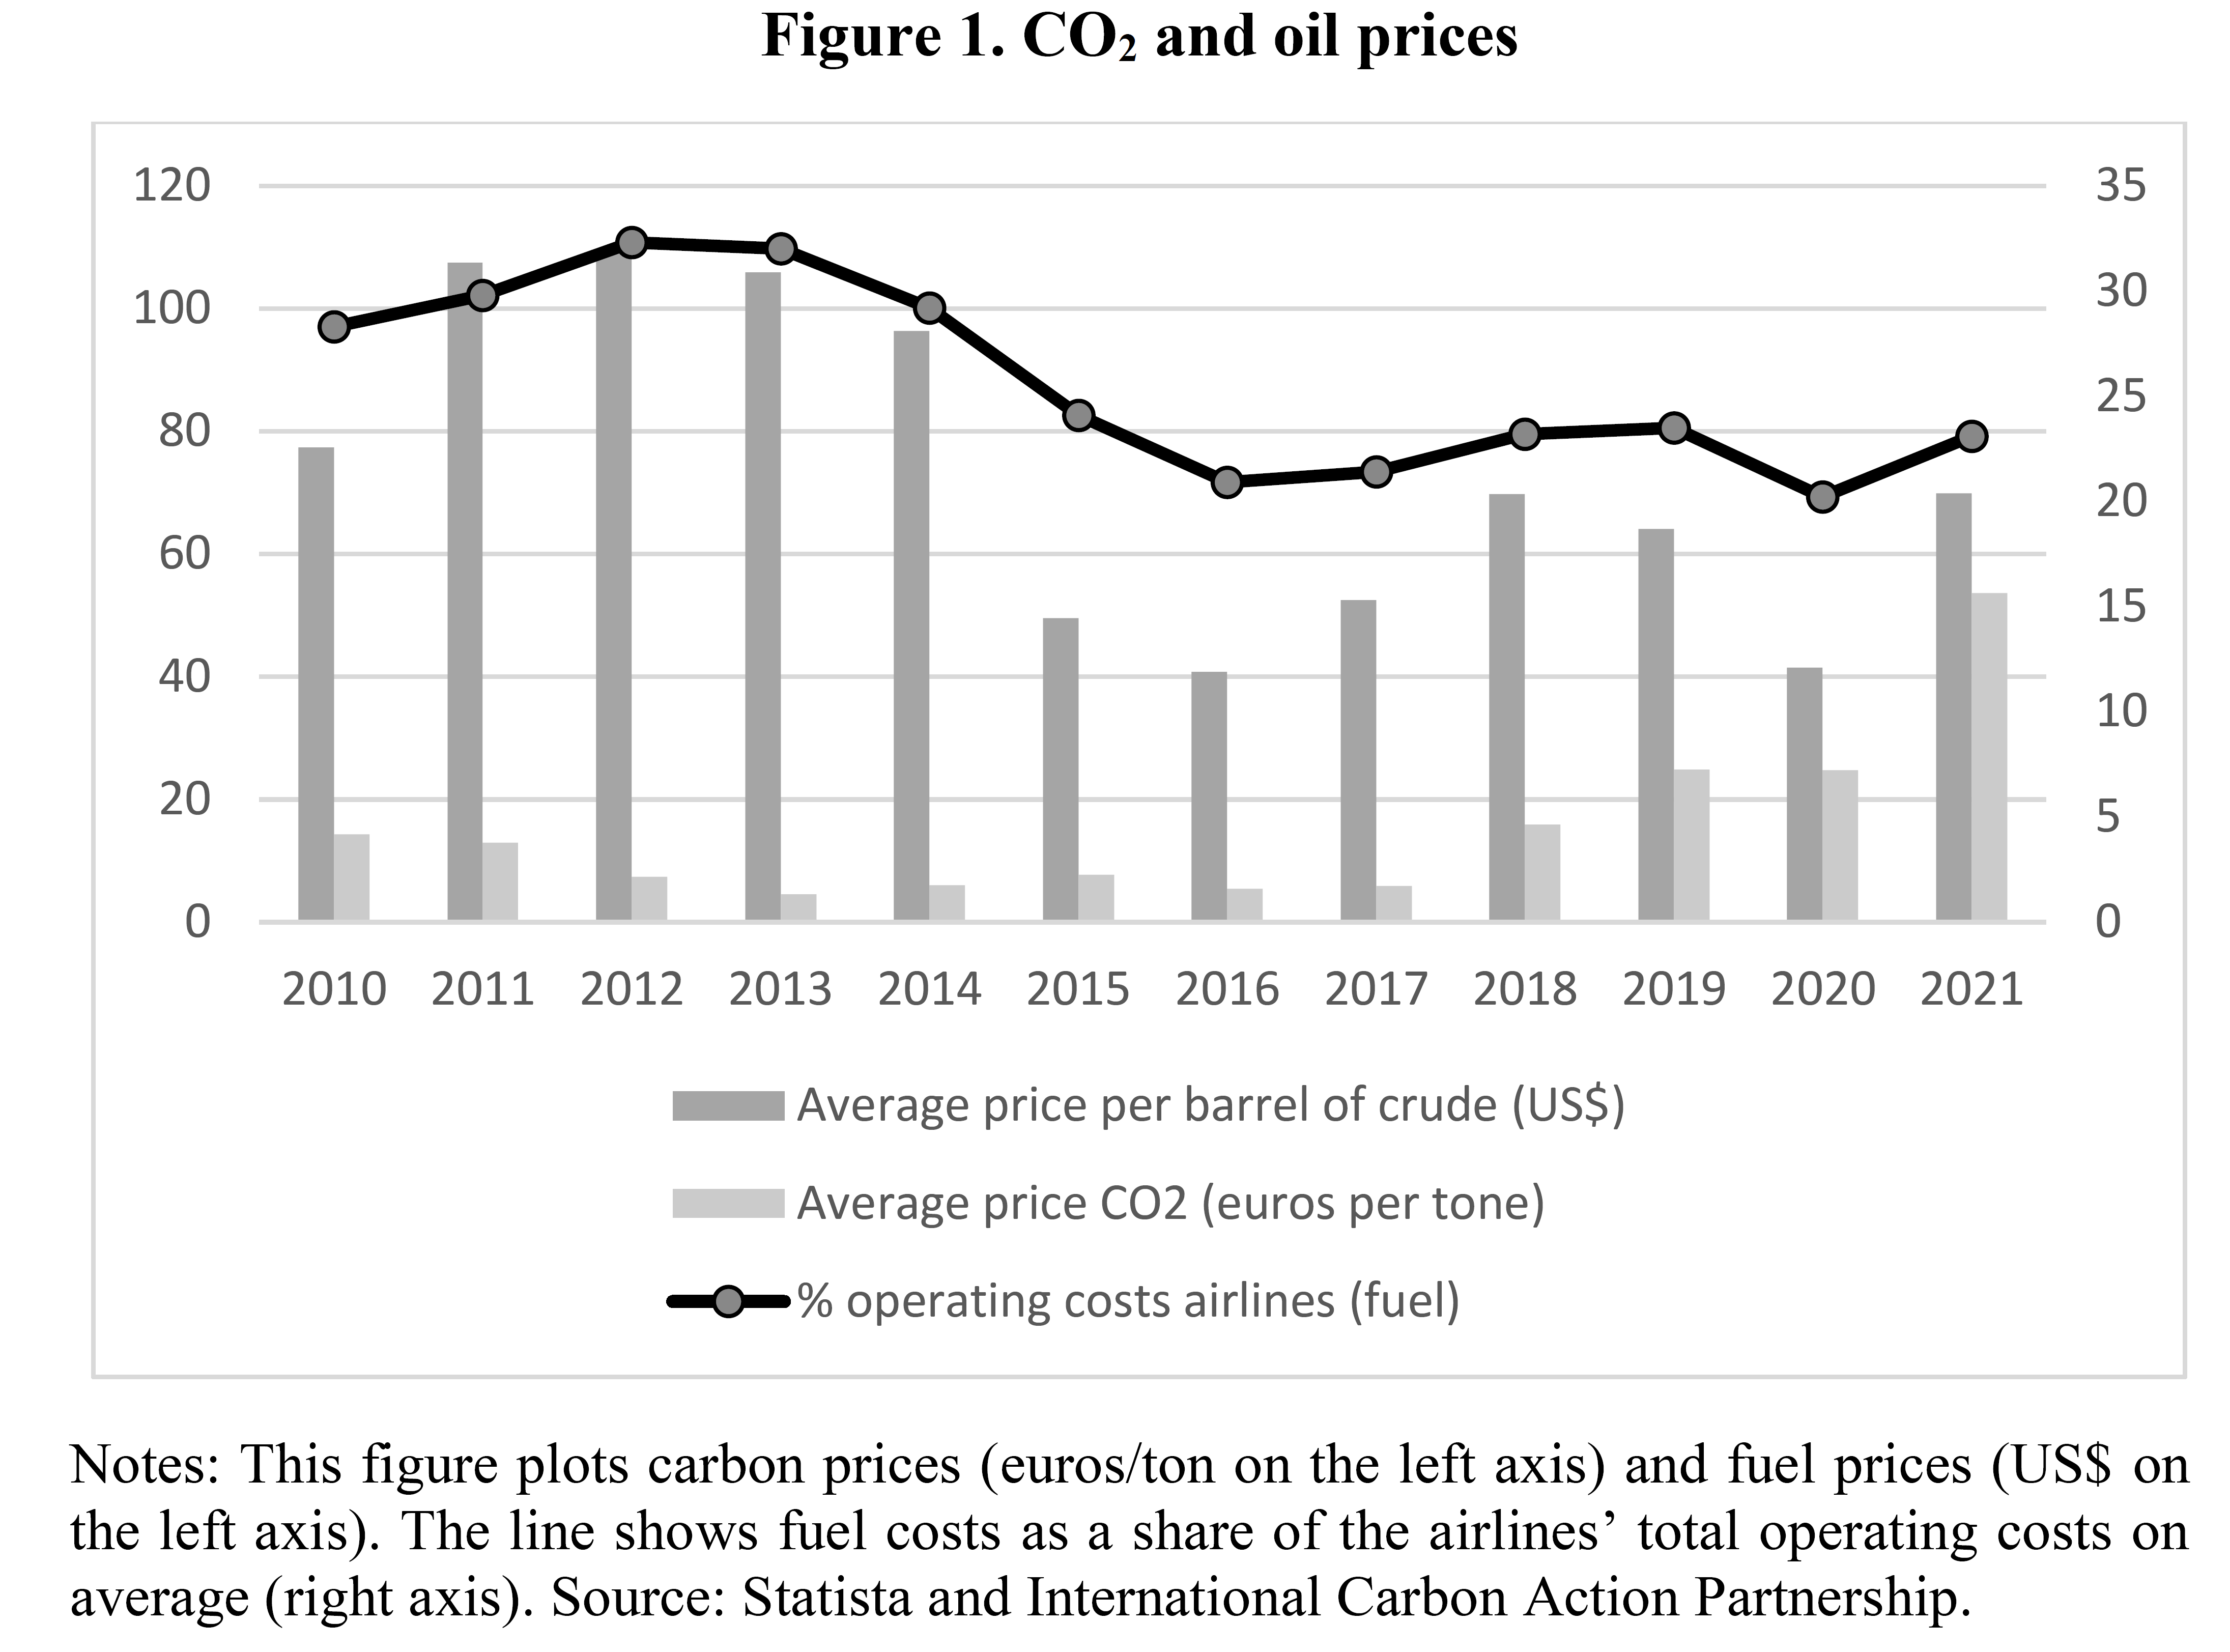

Slide 7
A single aircraft in this distance range usually makes around 3,000 flights
per year

Slide 8
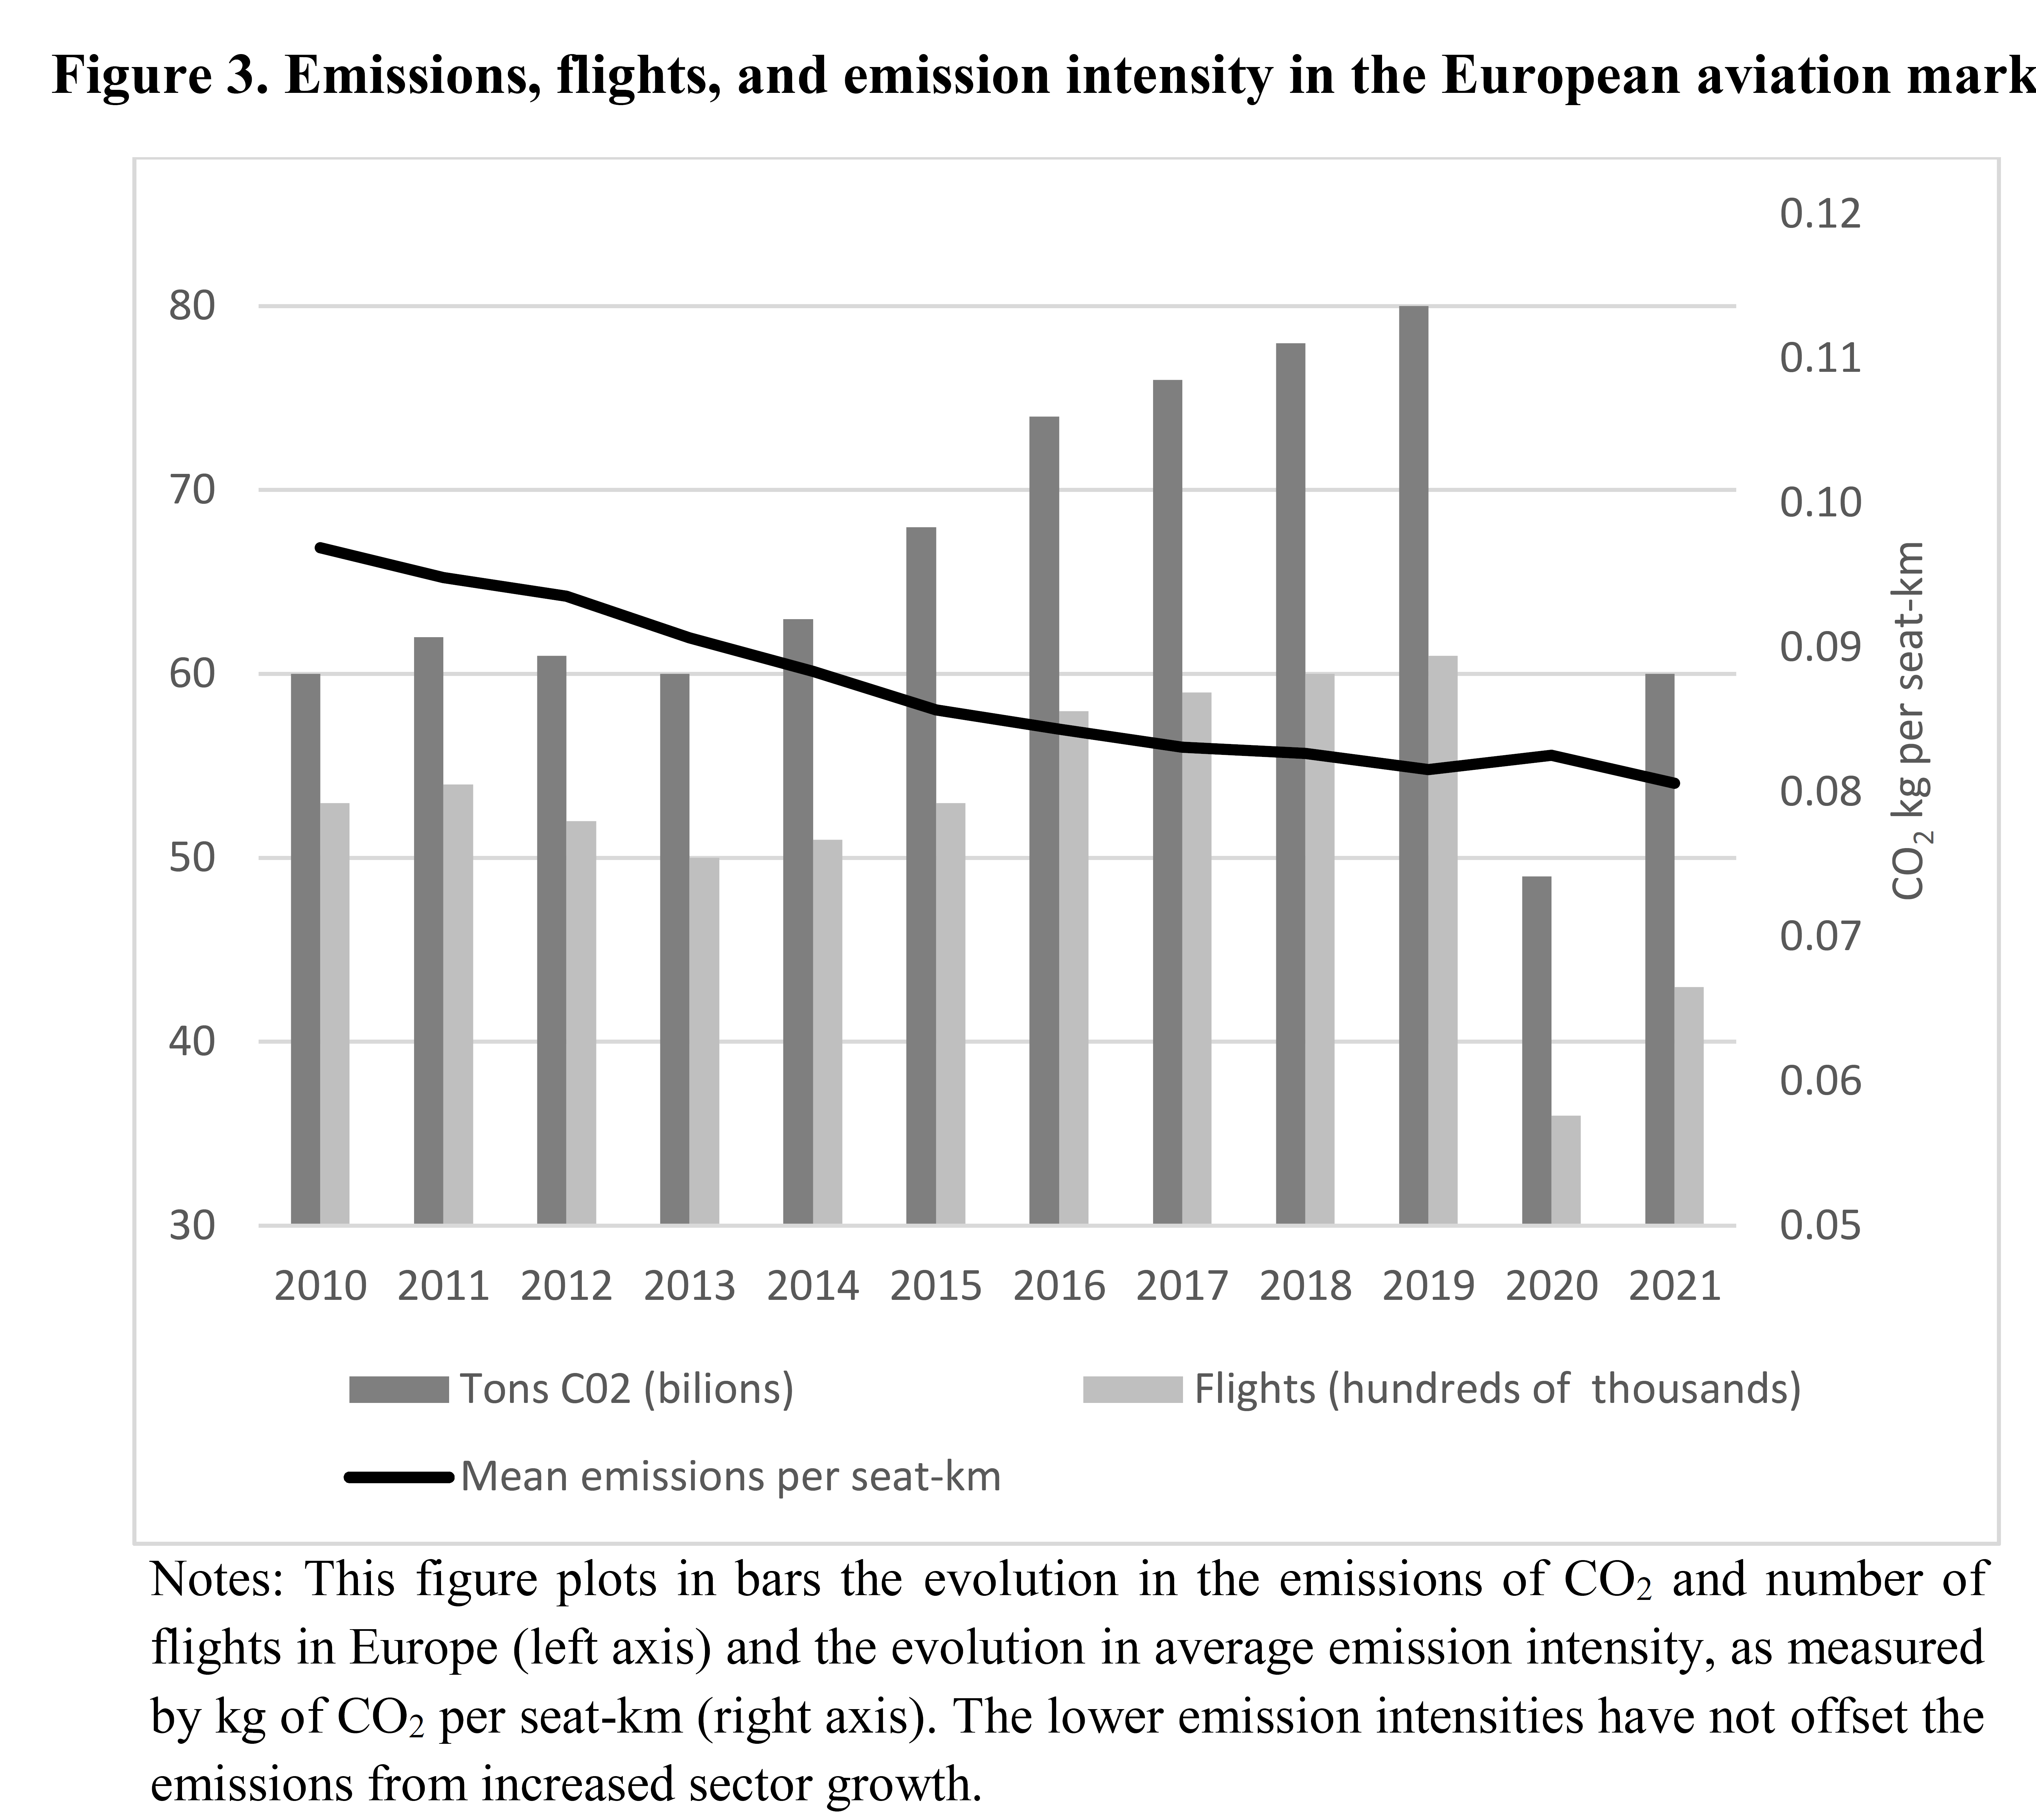

Slide 9
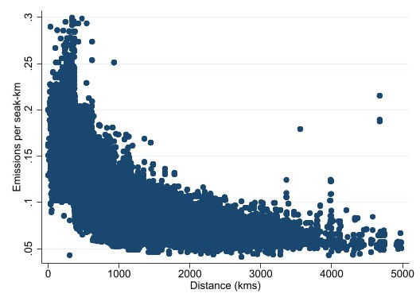
Emission intensity (CO₂ per seat-kms vs distance)

Slide 11
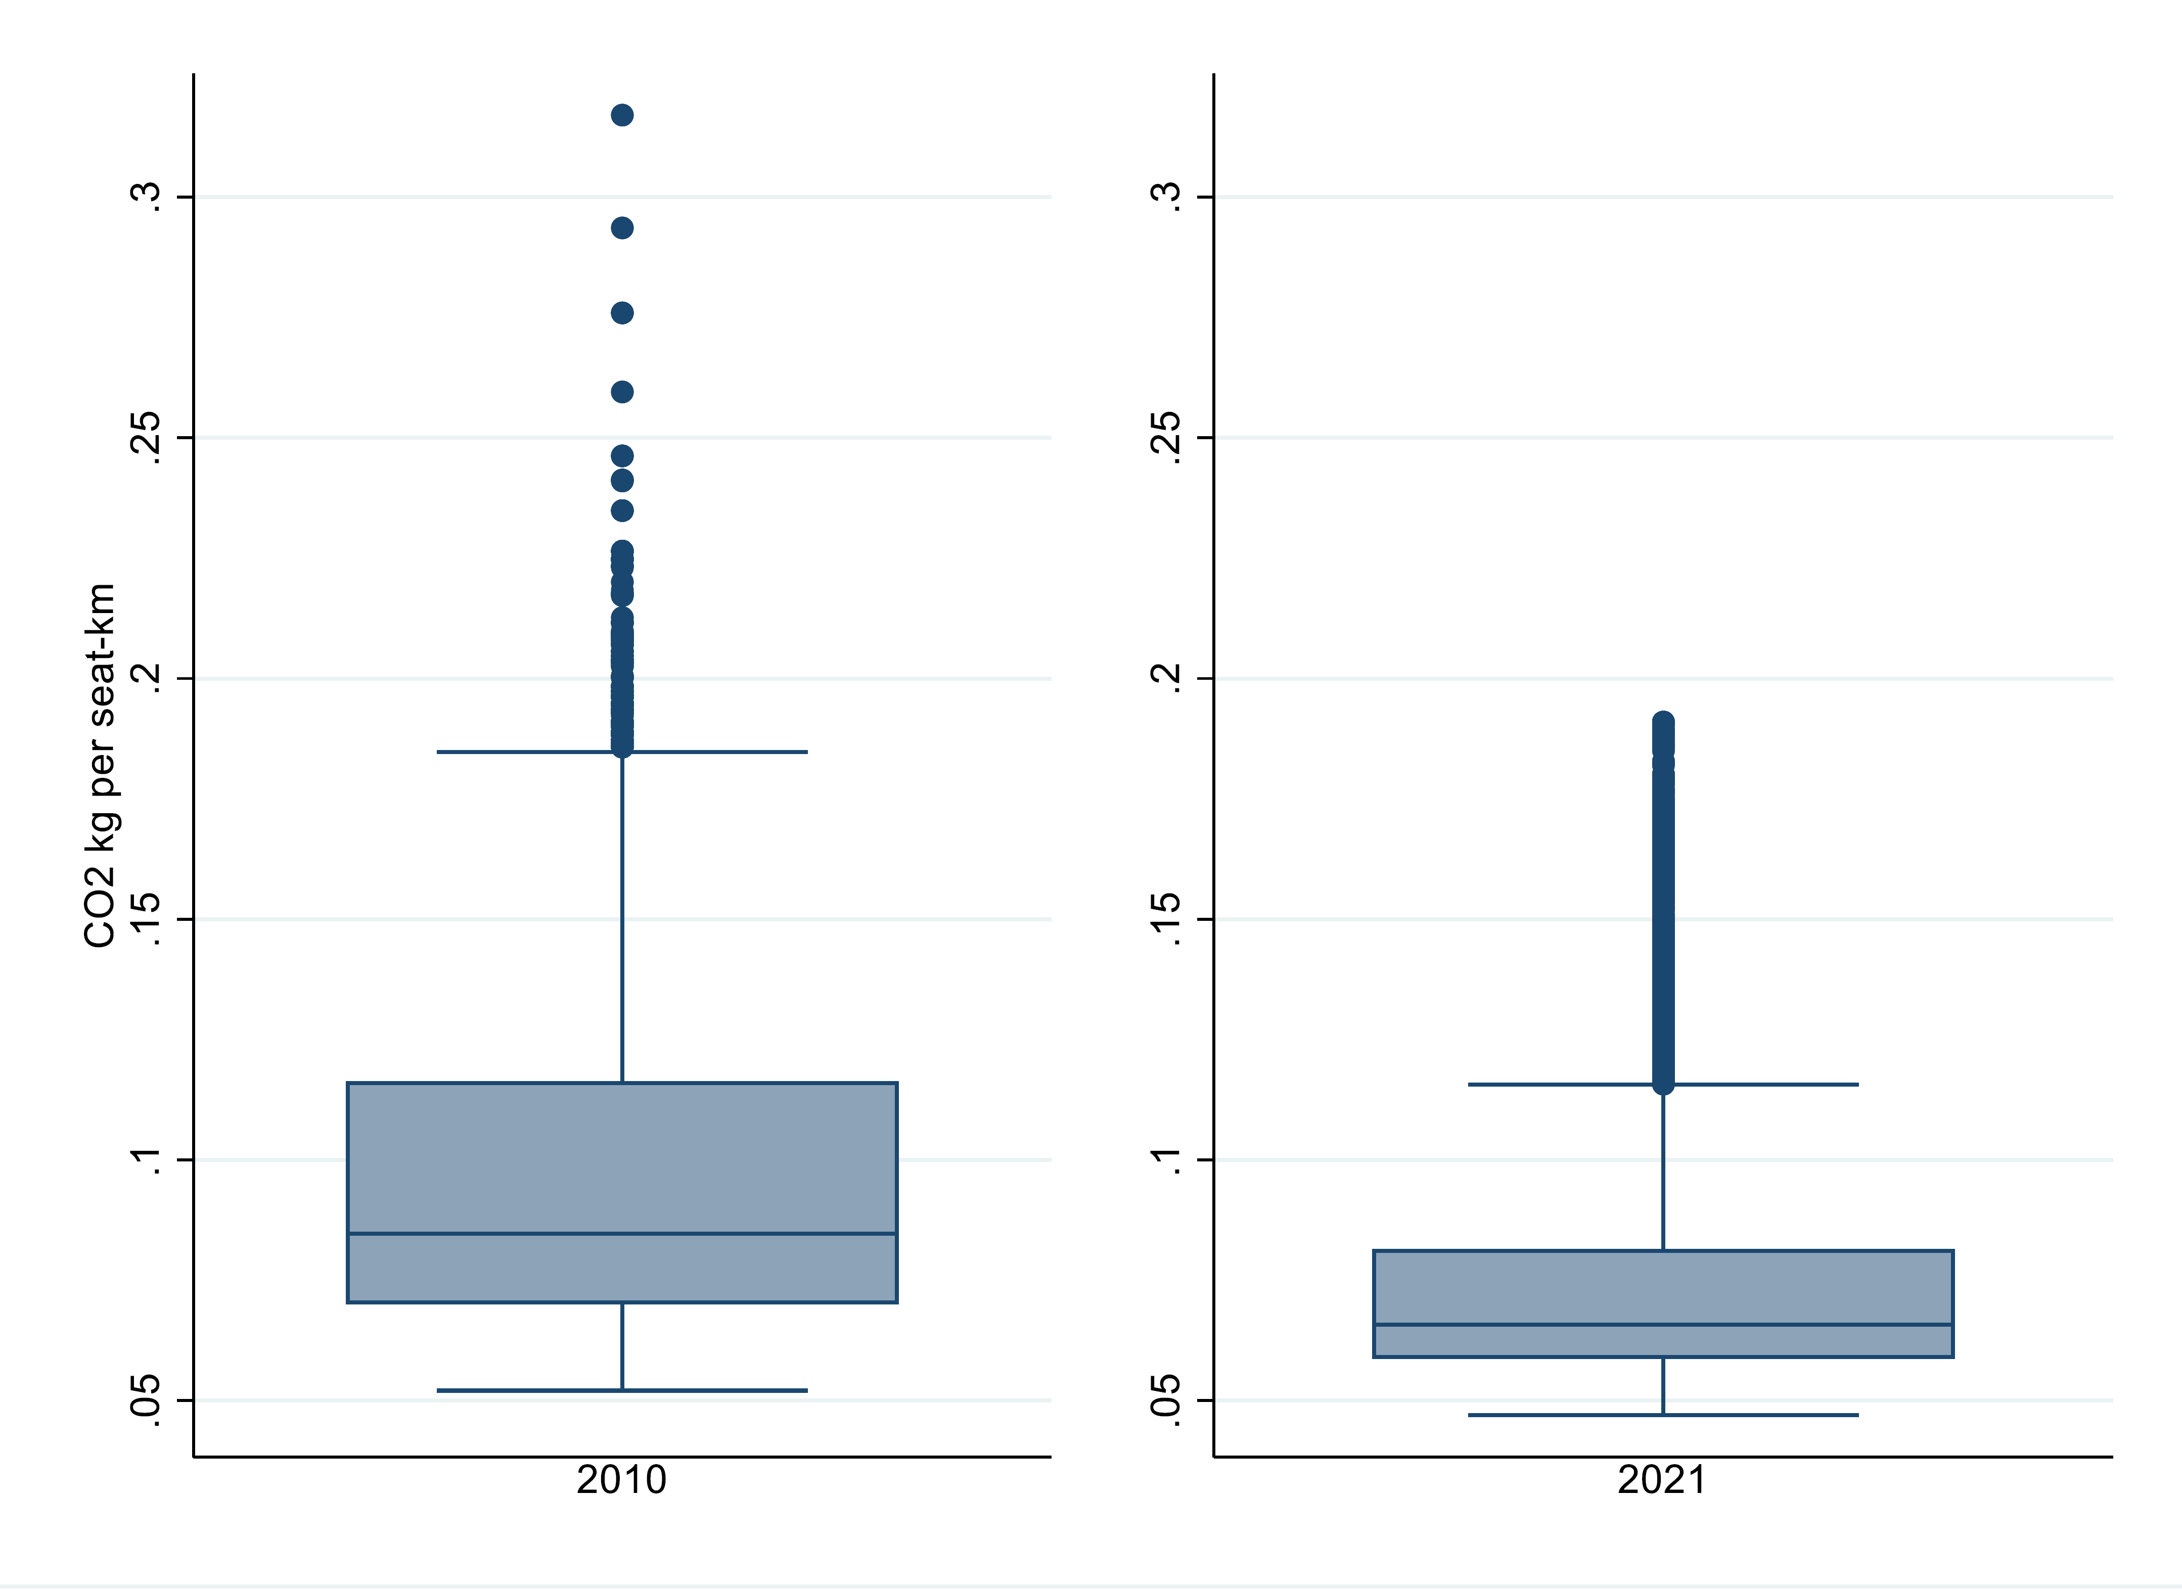
Emissions per seat-km

Slide 12
Determinants of aircraft emission intensity (emissions per seat-km)
VARIABLES | (1) | (2) | (3)
ln(Distance) | -0.274*** | -0.265*** | -0.289***
 | (0.00267) | (0.00235) | (0.00223)
ln(Aircraft size) | -0.185*** | -0.144*** | -0.684***
 | (0.00442) | (0.00359) | (0.00295)
Network Airlines | 0.0499*** | 0.0312*** | 0.0117***
 | (0.00215) | (0.00192) | (0.00173)
Low-cost Airlines | -0.0600*** | -0.0419*** | -0.0349***
 | (0.00151) | (0.00124) | (0.00115)
Narrowbody Aircraft | -0.0792*** (0.00331)
Fuel efficient aircraft |  | -0.206*** (0.00186)
Winglets |  |  | -0.0691***
 |  |  | (0.000708)
Constant | 0.473*** | 0.263*** | 3.030***
 | (0.0178) | (0.0147) | (0.0194)
Observations | 530,281 | 530,281 | 409,504
R-squared | 0.760 | 0.837 | 0.909
Sample | All | All | Popular Aircrafts

Slide 13
Coefficient estimates of the year variables

Slide 14
INNOVATION & DIFFUSION in AVIATION
Two main channels for reducing aircraft emission intensity over the next few years:
Biofuels
The abatement cost ranges from $46 to $652/t CO₂ (Winchester et al., 2015) and this is without considering such challenges as prices rising higher than those of jet fuel, a lack of sufficient feedstock and the need for major capital investment in bio-refining infrastructure (Staples et al., 2018).
Biofuels represent less than 0.1% of total aviation fuel consumption.
Improvements in aircraft technology
Retrofitting options: Winglets
New aircrafts: More efficient but still depend on petroleum-based fuels
Notes:
Despite its magnitude, international shipping and aviation have traditionally been left out in global climate policy initiatives.
Some potentially applicable disruptive technologies (laminar flow control, open-rotor propulsion, and double-bubble designs) have still to overcome major technical and economic obstacles (Graham et al., 2014).
The use of green hydrogen is a long way from being technically feasible.

Slide 15
IDENTIFICATION
The EU ETS:
More than 12,000 installations covered, 45% of EU’s GHG. Sectors included:
  Power and heat generation
  Energy intensive industry (Refineries, Iron and steel, aluminium, metals, cement, lime, glass, ceramics, pulp, paper, cardboard, acids and bulk organic chemicals)
  Commercial Aviation (until 31 December 2023 the EU ETS will apply only to flights between airports located in the European Economic Area (EEA))
Notes:
Cap-and-trade system:
Reducing cap
Tradable Emission Allowances (EUAs)
Static Efficiency (i.e., cost-effectiveness)
Dynamic efficiency (i.e., innovation)
Running since 2005 across 31 countries
More than 12,000 installations covered, 45% of EU’s GHG. Sectors included:
Power and heat generation
Energy intensive industry (Refineries, Iron and steel, aluminium, metals, cement, lime, glass, ceramics, pulp, paper, cardboard, acids and bulk organic chemicals)
Commercial Aviation (until 31 December 2023 the EU ETS will apply only to flights between airports located in the European Economic Area (EEA))

Slide 16
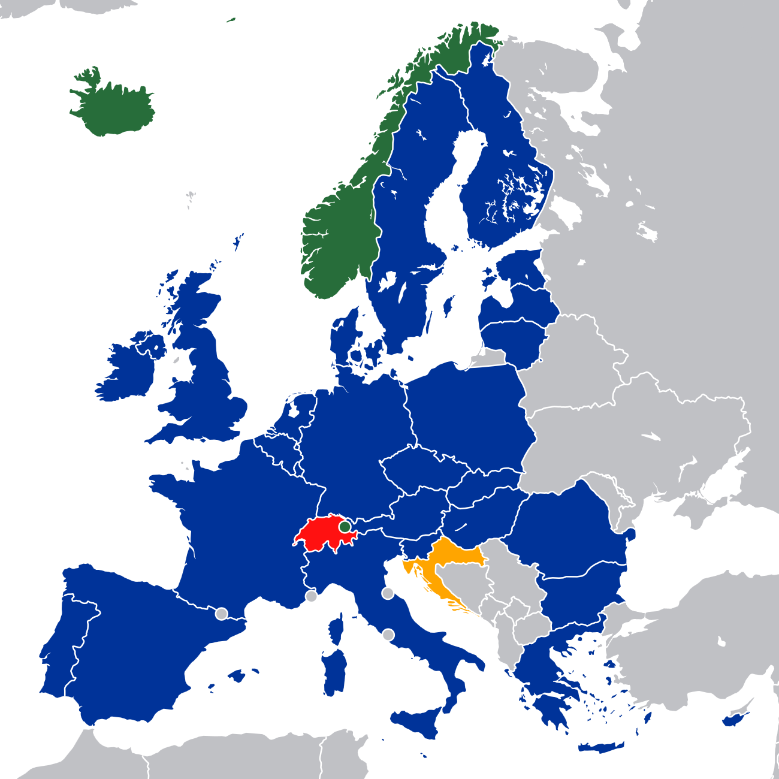
IDENTIFICATION
The quasi-experiment: STOP-THE-CLOCK
2012: All flights arriving and departing from Community airports [full scope].
2013: the European Commission “stops the clock” and reduces scope from 2013 to intra EEA flights [reduced scope].
EU and EEA member state
EFTA and EEA member state
EU and EEA future MS
EFTA member state (Switzerland)
The STOP-THE-CLOCK law in the EU ETS regulation provides a unique opportunity to measure the impact of carbon pricing on aviation

Slide 17
IDENTIFICATION
3rd Countries
EEA countries
3rd Countries include:
Albania,
Armenia.
Azerbaijan,
Belarus,
Bosnia and Herzegovina,
Georgia,
Macedonia (FAROM),
Montenegro, Moldova,
Serbia,
Switzerland,
Turkey,
Ukraine.
EEA countries include
EU28,
Norway
Iceland.
EU28+
Treated group
Control group
Flights within Europe in 2010-2021 with at least one flight per week
80,698 airline–route pairs with two datasets: aircraft–airline–route level, airline-route-level

Slide 18
DiD
$${log⁡(Y)}_{ait}=α+β{ETS}_{it}+λX_{it}+γ_{i}+η_{t}+ε_{ait}$$
Variables
Dependent variable: emission intensity, aircraft choice or winglet installation. Source: RDC aviation, Eurocontrol
Main variable
ETS: Dummy that takes the value 1 for within-EEA flights from 2013 (DiD)
EEA x year: Interaction of dummy for within- EEA flights (Treated) and dummies for years
Control variables:
Income: Mean gross domestic product per capita of origin and destination countries of the route. Source: World Bank
Population: Mean population of origin and destination regions of the route. Source: Eurostat, UN,
HHI. Source: RDC Aviation
Dummy for High-speed rail. Source: UIC
Average aircraft size (only when emissions per seat-km as dependent)
Airline-route, and year fixed effects
Standard errors are robust to heteroscedasticity and clustered at the route level.
We apply weights based on the number of flights for each aircraft–airline–route or route–airline combination

Slide 19
DiD - Evolution of emission intensities and shares of aircraft used

Slide 20
EU ETS and emission intensity (emissions per seat-km)
VARIABLES | (1) | (2) | (3) | (4)
EU ETS | -0.0239*** | -0.0260*** | -0.0219*** | -0.0229***
 | (0.00331) | (0.00369) | (0.00326) | (0.00356)
Constant | 1.600*** | 1.585*** | 0.481 | 0.366
 | (0.476) | (0.488) | (0.464) | (0.483)
Observations | 158,891 | 146,765 | 131,807 | 119,681
R-squared | 0.972 | 0.973 | 0.977 | 0.978
Route-airline FE | YES | YES | YES | YES
Year FE | YES | YES | YES | YES
Sample | All | All | All | All
Period | 2010-2021 | 2010-2021 | 2010-2019 | 2010-2019
Year 2012 | YES | NO | YES | NO
Clusters | Route | Route | Route | Route
Controls | All | All | All | All

Slide 21
Event-study estimates of the EU ETS effect on flight emission intensity

Slide 22
EU ETS effect on emission intensity (emissions per seat-km) by distance
 | (1) | (2) | (3)
VARIABLES | Short-haul | Medium-haul | Long-haul
EU ETS | -0.0263*** | -0.0187*** | 0.0332
 | (0.00485) | (0.00376) | (0.0295)
Constant | 4.000*** | -1.891*** | 5.245***
 | (0.704) | (0.456) | (1.741)
Observations | 65,329 | 85,687 | 7,584
R-squared | 0.953 | 0.939 | 0.818
Route-Airline FE | YES | YES | YES
Year FE | YES | YES | YES
Sample | <1000 kms | 1000-2000 kms | >3000 kms
Clusters | Route | Route | Route
Controls | All | All | All

Slide 23
Figure 11. Event-study estimates of the effect of EU ETS on flight emission intensities by distance

Slide 24
EU ETS on aircraft choice
 | (1) | (2) | (3)
VARIABLES | Narrowbody aircraft | Per year-distance fuel efficient aircrafts | Winglets in aircraft
EU ETS | 0.0368*** | 0.0539*** | 0.0798***
 | (0.00552) | (0.0126) | (0.00815)
Constant | 4.623*** | -2.179* | 0.967
 | (0.619) | (1.217) | (1.568)
Observations | 530,162 | 530,162 | 409,513
R-squared | 0.803 | 0.691 | 0.610
Year FE | YES | YES | YES
Sample | All | All | Popular aircrafts
Airlines | All | All | All
Clusters | Route | Route | Route
Controls | All | All | All
Note: This table shows difference-in-difference coefficients using as our outcome variable dummies for the type of aircraft used. In column 1, we consider a dummy variable for narrowbody aircrafts, in column 2 for the most fuel-efficient aircraft in a given year and over a given distance, and in column 3 for winglet fittings. Robust standard errors (in parentheses) are clustered at the route level.

Slide 25
Event-study estimates for aircraft choice

Slide 26
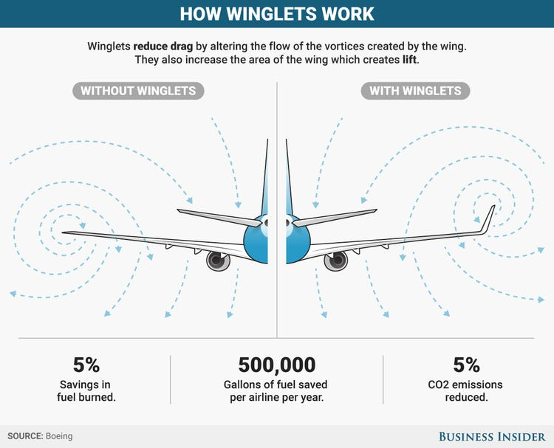
WINGLETS:
The concept was first devised in 1897.
First Boeing and Airbus winglet models would not be employed until 1985
In 2010 → about 10% of narrowbody planes in Europe use winglets
by 2019 → above 30%.

Slide 28
CONCLUSIONS
We report some evidence of low-carbon technology diffusion in response to the EU ETS. However, the impact is small.
From a policy perspective, the emission reductions achieved to date fall well short of climate targets in this sector.
The EU ETS has only moderated emission growth by reducing supply and, to a lesser extent, as we show, by spurring adoption of low-carbon technology.
The retrofitting of winglets is the main adoption practice identified here as being of any great magnitude, especially after 2015, that is, after carbon emissions started being priced in the sector.
Even though higher carbon prices may trigger higher levels of low-carbon technology adoption, carbon pricing could be complemented with the regulation of technology standards

