Slide 1
Memory effect of appliance rebate programme: evidence from a lab experiment
María del Mar Solà, Amaia de Ayala, Ibon Galarraga, Marta Escapa
Department of Quantitative Methods, University of the Basque Country (UPV-EHU)
Basque Centre for Climate Change
FSR Climate Annual Conference 2023
27 - 28 November 2023

Slide 2
Introduction
Human action has warmed the atmosphere, ocean and land due to GHG (IPCC, 2021)
Global surface temperature will continue to increase until at least mid-century under all emissions scenario considered (IPCC, 2021) unless GHG emissions are reduced dramatically.
Two ways of reducing GHG associated to energy consumption:
Renewable energies
Reduction in energy demand
Household energy consumption: 17% of global GHG

Slide 3
Introduction
Energy efficiency plays a significant role for reducing GHG associated to energy consumption
Energy efficiency (EE), defined as improvements in the efficiency with which energy is used to provide a service (Linares and Labandeira, 2010)
EE can lead to multiple benefits for individuals and industry:
Energy-efficiency gap: Invest less than what may be economically rational
The EE gap has been explained through: market failures, behavioural failures and other factors

Slide 4
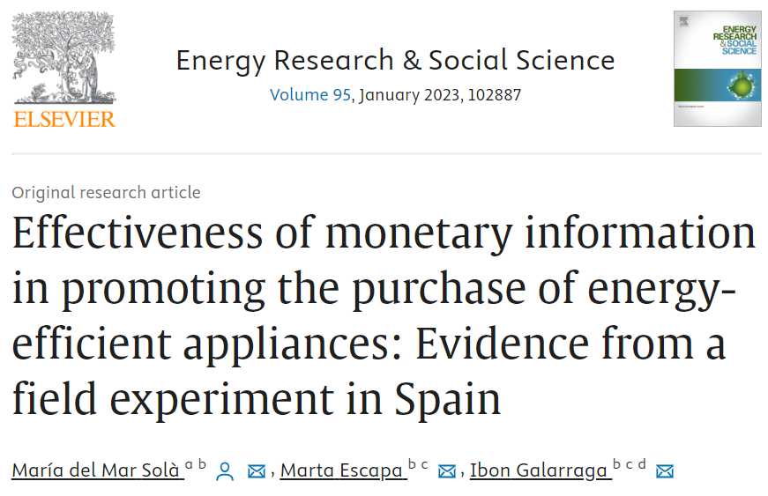
Introduction
New effect: memory effect of the RENOVE…
RENOVE – Rebate programme for appliances, run by regional governments – most efficient alternatives
…in those places where a RENOVE programme was running before the experiment, the effect of the RENOVE lasted after the end of the programme.
Objective: to analyse in a controlled environment – lab experiment – whether there is a memory effect and what factors that nudge consumers’ towards energy-efficient appliances.
Solà et al. (2023) – Energy Research and Social Science https://doi.org/10.1016/j.erss.2022.102887

Slide 5
Effectiveness of rebate programmes
Studies have focused only on analysing the policy during the implementation period
Article | Rebate program analysed | Country | Product category | Effect found
Datta and Filippini (2016) | Energy Star | USA | Washing machine, dishwasher, fridge, air conditioner
Chuang et al. (2018) | Residential energy efficiency program | USA | Pool pumps, fridge
Houde and Aldy (2017) | State Energy Efficient Appliance Rebate Programmes | USA | Appliances
Galarraga et al. (2013) | RENOVE rebate program | Spain | Dishwashers
Olsthoorn et al. (2017) | Rebate programmes | 8 EU Member States | Appliances | .

Slide 6
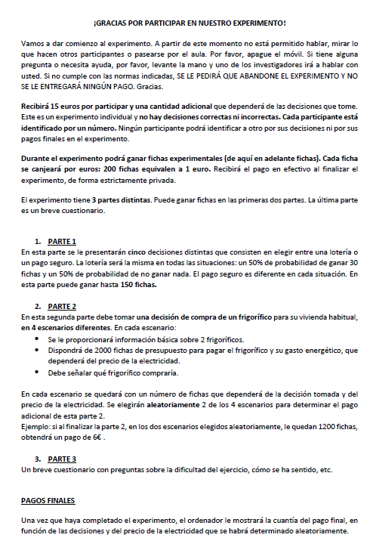
Design of the lab experiment
Laboratory of Experimental Analysis (Bilbao-Labean) at the University of the Basque Country in March 2022.
166 subjects took part in the experiment
Recruited by CPS (a company located in Bilbao)
At the beginning: instructions were provided and read aloud to ensure that participants understood the game.

Slide 7
…structure of the lab experiment
Different parts:
a role-playing exercise to analyse whether there is a memory effect in the purchasing decision for a fridge;
For the role playing game: price in tokens, kWh/year in electros per year, €/kWh in tokens per electro.
SCENARIO 1
Business as usual
A: Inefficient fridge (INEF)
B: Efficient fridge (EF)

Slide 8
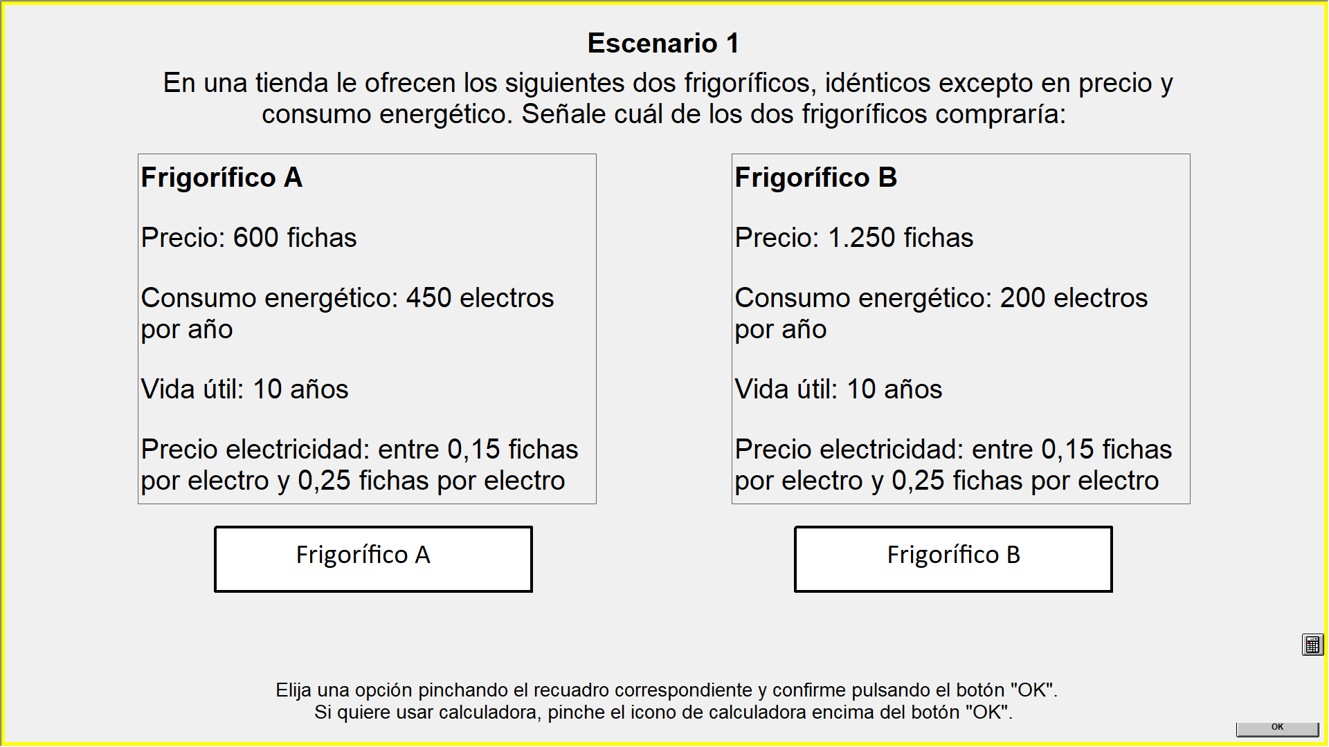
… interface of the lab
BUDGET: 2000 tokens (Price and the cost associated)
Scenario 1 A shop offers the following two fridges, which are identical except for their prices and energy consumption. Please indicate which you would purchase:
Fridge A Price: 600 tokens Energy consumption: 450 electros per year Useful lifetime: 10 years Electricity price: between 0.15 and 0.25 tokens per electro | Fridge B Price: 1250 tokens Energy consumption: 200 electros per year Useful lifetime: 10 years Electricity price: between 0.15 and 0.25 tokens per electro
Fridge A - INEF | Fridge B - EF
Choose an option by clicking on the appropriate box and confirm by clicking OK. If you wish to use a calculator, click on the calculator button above the OK button.

Slide 9
…structure of the lab experiment
Different parts:
a role-playing exercise
We also asked about the main criterion underlying each choice in each scenario (e.g. the price of the two options, on energy consumption, on lifetime energy cost or on a random decision).
Once all subjects had finished: final payments were shown on the screen.
SCENARIO 1
SCENARIO 2
SCENARIO 3
SCENARIO 4
RENOVE
But…
… money from the RENOVE is no longer available
Business as usual
LEC information is provided
A: Inefficient fridge (INEF)
B: Efficient fridge (EF)
A: Inefficient fridge (INEF)
B: Efficient fridge (EF)
A: Inefficient fridge (INEF)
B: Efficient fridge (EF)
A: Inefficient fridge (INEF)
B: Efficient fridge (EF)

Slide 10
…structure of the lab experiment
Different parts:
a role-playing exercise to analyse whether there is a memory effect in the purchasing decision for a fridge;
a post-experiment survey to control personal characteristics (e.g. socio-economic variables)
Difficulty of the lab experiment;
Personal experience regarding EE and the RENOVE rebate programme;
Attitudes towards the environment;
Socio-economic characteristics.

Slide 11
Data
Share of energy-efficient choices:
% subjects who chose efficient fridges per Scenario | %
Scenario 1 – Business as usual | 75.90%
Scenario 2 – Lifetime energy cost information is provided | 60.24%
Scenario 3 – Renove | 89.75%
Scenario 4 – Renove is over | 66.86%

Slide 12
Data
Choice made by participants by Scenario and potential interpretations
Purchasing decision per Scenario |  |  |  | Interpretation | %
Scenario 1 | Scenario 2 | Scenario 3 | Scenario 4
EF/INEF | INEF | EF | EF | Memory effect (1) | 13.25%
INEF | INEF | EF | INEF | RENOVE (2) | 12.65%
EF | EF | EF | EF | AlwaysEfficient (3) | 51.20%
INEF | INEF | INEF | INEF | AlwaysInefficient (4) | 6.02%

Slide 13
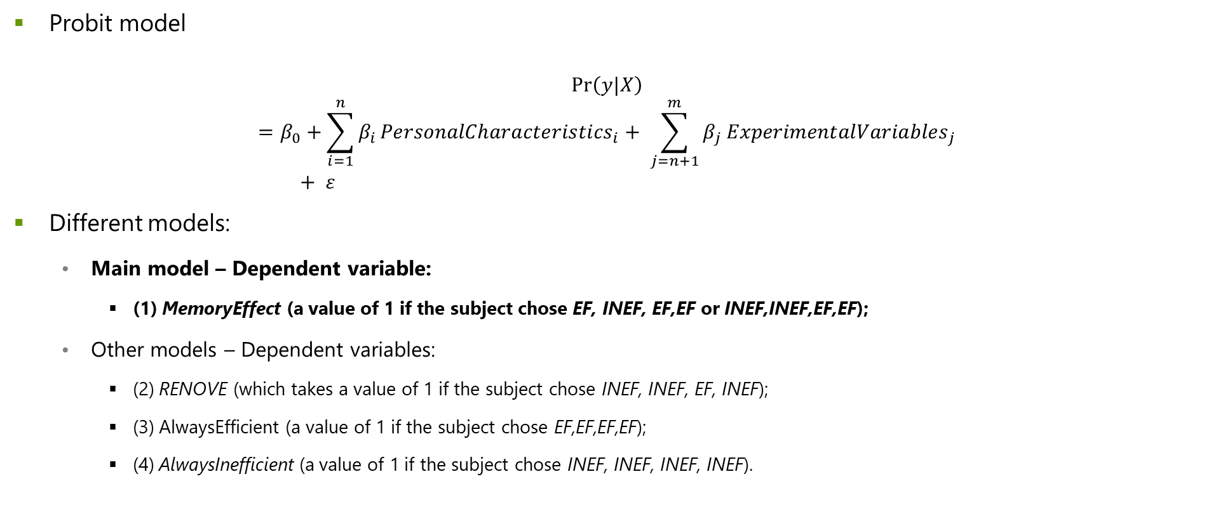
Model specification
Probit model
$$\operatorname{Pr}\left(y|X\right)=β_{0}+\sum_{i=1}^{n}{β_{i}}{PersonalCharacteristics}_{i}+ \sum_{j=n+1}^{m}{β_{j}}{ExperimentalVariables}_{j}+ ε$$
Different models:
Main model – Dependent variable:
(1) MemoryEffect (a value of 1 if the subject chose EF, INEF, EF,EF or INEF,INEF,EF,EF);
Other models – Dependent variables:
(2) RENOVE (which takes a value of 1 if the subject chose INEF, INEF, EF, INEF);
(3) AlwaysEfficient (a value of 1 if the subject chose EF,EF,EF,EF);
(4) AlwaysInefficient (a value of 1 if the subject chose INEF, INEF, INEF, INEF).

Slide 14
Results of the lab experiment
Variables |  | Model 1- Memory effect | Model 2 - RENOVE | Model 3 - Purchase of an efficient appliance | Model 4 - Purchase of an inefficient appliance
Gender |  |  |  |  | ↑
Age |  |  | ↓ | ↑
Education |  | ↑
Social class | Middle |  |  | ↑
 | Lower middle | ↓
Environmental concern |  | ↑
Recent purchase of an appliance |  |  | ↓
Decision criteria | Energy consumption criteria | ↓ |  | ↑
 | Lifetime energy cost criteria |  | ↑ |  | ↑
 | Random criteria |  |  |  | ↑
TIME – average time response
LEARNING – if the consumer has a learning effect

Slide 15
Conclusions (prelim) of this lab experiment
Results show that different personal characteristics could affect consumers' choices.
The probability of having a memory effect :
Increases: with high education level and high levels of environmental concern
Decreases: with low social class and which the main criteria was the energy consumption
51.20% of the subjects always choose efficient alternatives; 13.25% of subjects represent the memory effect
This effect opens a new space for debate concerning the effectiveness of rebate programmes for appliances (unexpected and positive impact of rebate programmes)

Slide 16
Memory effect of the RENOVE: lab + field
Memory effect found in field experiment in El Corte Inglés
Lab experiment: the memory effect (13.25%)
FIELD + LAB: helped to enrich and encompass the evidence of rebate programmes:
The RENOVE is effective for a segment although…
… 51.20% of the population always buy efficient options
Main barrier for EE – difference on price between A+++ and A++ appliances
Redesign of RENOVE: not providing the subsidy directly to everyone, or analyse the use of other price instruments
Co-benefit of rebate programmes for appliances
Controlled environment of the lab exp:
Socio-demographic characteristics
Decision criteria

Slide 17
Thank you! Eskerrik asko!

Slide 18
Acknowledgements - Funding
This research was financed by the Spanish State Research Agency through María de Maeztu Excellence Unit accreditation 2018-2022 (Ref. MDM-2017-0714) funded by MCIN/AEI/10.13039/501100011033/ and by the Basque Government (Spain) through the BERC 2018-2021 programme.
It was also supported by the project ENERPOLIS funded by ‘la Caixa’ Foundation with the code SR0435 and by Fundación Ramon Areces under XVIII Concurso Nacional para la Adjudicación de Ayudas a la Investigación en Ciencias Sociales with the project “La toma de decisiones de los hogares en eficiencia energética: determinantes y diseño de políticas”.

Slide 19
Supplementary information

Slide 20
Final payments
Real gains: Risk elicitation task (max 150 tokens) + Role-playing exercise (RPE)
RPE: to choose between two fridges (budget: 2000 tokens) and
Final payments depended:
the decision made in each scenario;
the scenarios chosen for the payment; and
the final energy price.
Two scenarios and energy prices were randomly selected in each session, and were the same for the subjects in each session.
MIN: 17.65€ MAX: 23€

Slide 21
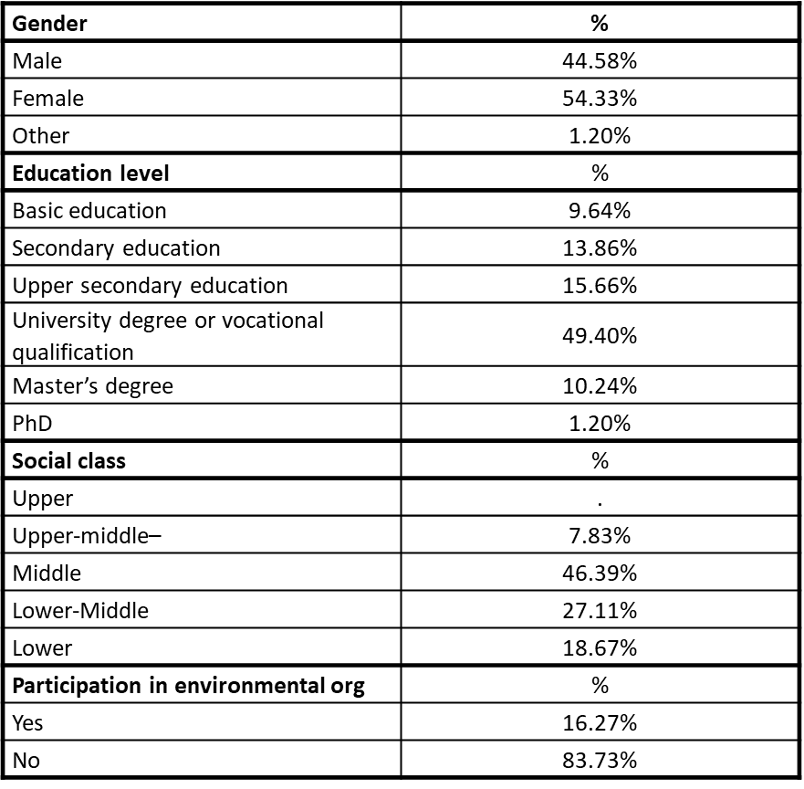
Participants of the lab experiment

Slide 22
Tokens subsidized in the different group of decisions
Purchasing decision per Scenario |  |  |  | Interpretation | % | Subsidy
Scenario 1 | Scenario 2 | Scenario 3 | Scenario 4
EF/INEF | INEF | EF | EF | Memory effect (1) | 13.23% | 3,300 tokens
INEF | INEF | EF | INEF | RENOVE (2) | 12.65% | 3,150 tokens
EF | EF | EF | EF | AlwaysEfficient (3) | 51.20% | 12,750 tokens
INEF | INEF | INEF | INEF | AlwaysInefficient (4) | 6.02% | X

Slide 23
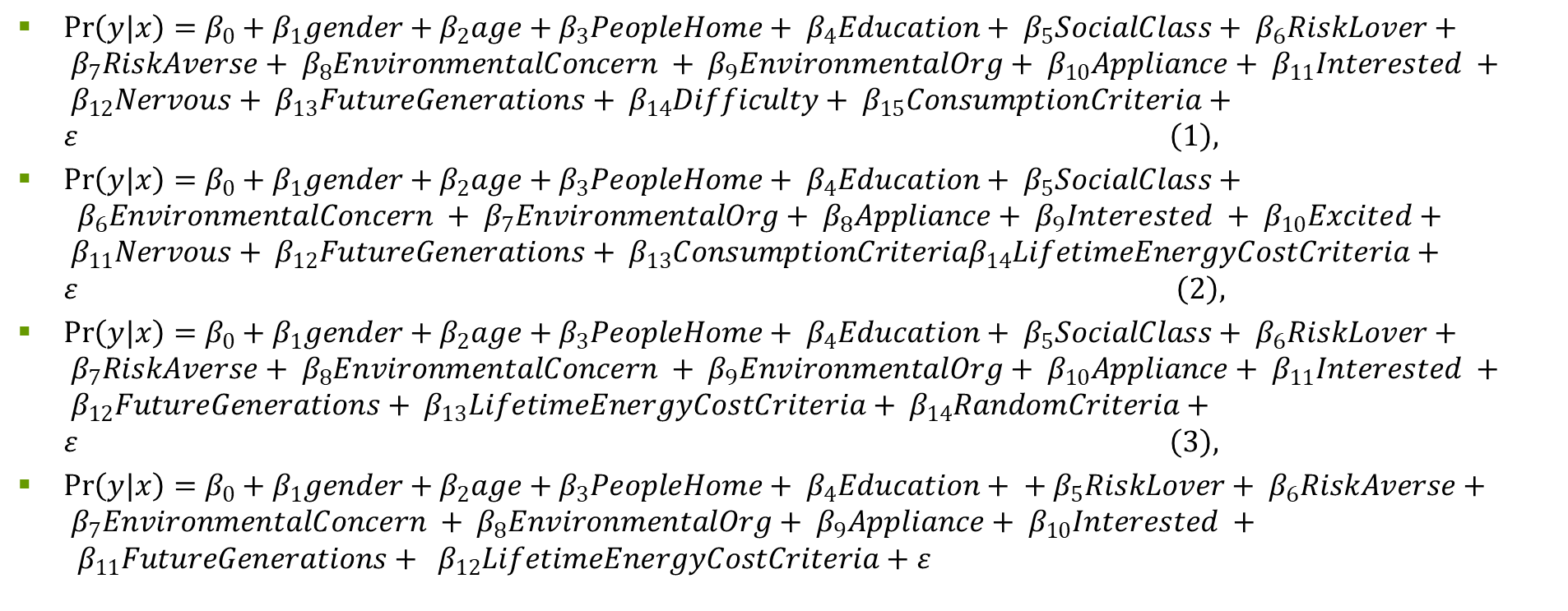
Models run in the lab experiment
$\operatorname{Pr}\left(y|x\right)=β_{0}+β_{1}gender+β_{2}age+β_{3}PeopleHome+ β_{4}Education+ β_{5}SocialClass+ β_{6}RiskLover+ β_{7}RiskAverse+ β_{8}EnvironmentalConcern + β_{9}EnvironmentalOrg+ β_{10}Appliance+ β_{11}Interested + β_{12}Nervous+ β_{13}FutureGenerations+ β_{14}Difficulty+ β_{15}ConsumptionCriteria+ε \left(1\right),$
$\operatorname{Pr}\left(y|x\right)=β_{0}+β_{1}gender+β_{2}age+β_{3}PeopleHome+ β_{4}Education+ β_{5}SocialClass+ β_{6}EnvironmentalConcern + β_{7}EnvironmentalOrg+ β_{8}Appliance+ β_{9}Interested + β_{10}Excited+ β_{11}Nervous+ β_{12}FutureGenerations+ β_{13}ConsumptionCriteriaβ_{14}LifetimeEnergyCostCriteria+ε \left(2\right),$
$\operatorname{Pr}\left(y|x\right)=β_{0}+β_{1}gender+β_{2}age+β_{3}PeopleHome+ β_{4}Education+ β_{5}SocialClass+ β_{6}RiskLover+ β_{7}RiskAverse+ β_{8}EnvironmentalConcern + β_{9}EnvironmentalOrg+ β_{10}Appliance+ β_{11}Interested + β_{12}FutureGenerations+ β_{13}LifetimeEnergyCostCriteria+ β_{14}RandomCriteria+ε \left(3\right),$
$\operatorname{Pr}\left(y|x\right)=β_{0}+β_{1}gender+β_{2}age+β_{3}PeopleHome+ β_{4}Education+ + β_{5}RiskLover+ β_{6}RiskAverse+ β_{7}EnvironmentalConcern + β_{8}EnvironmentalOrg+ β_{9}Appliance+ β_{10}Interested + β_{11}FutureGenerations+ β_{12}LifetimeEnergyCostCriteria+ε$

Slide 24
Results of the lab experiment (Model 1 and 2)
Variables | MODEL 1- RENOVE |  | MODEL 2 – Memory effect
 | Marginal effects | z | Marginal effects | z
Gender (=1 if the subject is male) | 0.0374435 (0.0271603) | 1.38 | -0.0346063 (0.0528432) | -0.65
Age | -0.00239* (0.0013791) | -1.73 | 0.0015412 (0.0022308) | 0.69
PeopleHome | 0.0206309 (0.0155058) | 1.33 | -0.0348844 (0.0263735) | -1.32
Education (=1 if the subject holds a Bacelor’s , Master’s or PhD degree) | -0.0127729 (0.0312079) | -0.41 | 0.1169006* (0.0620943) | 1.88
SocialClass
Lower middle | 0.0567254 (0.038046) | 1.49 | -0.1611262** (0.0805291) | -2.00
Middle | 0.0292781 (0.0238578) | 1.23 | -0.0856762 (0.0829525) | -1.03
Upper middle | 0.057572 (0.07919) | 0.73 | -0.0983892 (0.1104725) | -0.89
RiskLover (=1 if the subject is a risk lover) | -0.0149361 (0.0329894) | -0.45
RiskAverse (=1 if the subject is risk-averse) | 0.0186073 (0.034607) | 0.54
EnvironmentalConcern (=1 if the subject is highly concerned about the environment) | -0.0592757 (0.041676) | -1.42 | 0.1547471** (0.0756408) | 2.05
EnvironmentalOrg (=1 if the subject takes part in an environmental organisation) | -0.0042434 (0.032657) | -0.13 | -0.0727788 (0.0710509) | -1.02
Appliance (=1 if the subject has bought an appliance in the last 4 years) | -0.0527857* (0.0300081) | -1.76 | -0.0391263 (0.0552374) | -0.71
Interested (=1 if the subject feels interested in the experiment) | 0.0748845* (0.0422676) | 1.77 | -0.1114408* (0.062918) | -1.77
Excited (=1 if the subject feels excited about the experiment) |  |  | 0.0372578 (0.0588423) | 0.63
Nervous (=1 if the subject feels nervous about the experiment) |  |  | -0.167776 (0.1139745) | -1.47
FutureGenerations (=1 if the subject agrees with the statement “Future generations will be the ones who will have to deal with environmental problems”) | -0.0352842 (0.0393579) | -0.90 | 0.1492746*** (0.0568914) | 2.62
Difficulty (=1 if the subjects think that the experiment was difficult or very difficult)
ConsumptionCriteria (=1 if subjects make choices during the scenarios considering mainly the energy consumption criteria) |  |  | -0.1337564** (0.0680757) | -1.96
LifetimeEnergyCostCriteria (=1 if subjects make choices during the scenarios considering mainly lifetime energy cost criteria) | 0.0985732** (0.0411898) | 2.39 | 0.0025567 (0.0627744) | 0.04
RandomCriteria (=1 if subjects make choices during the scenarios considering mainly random criteria)
 | Number of obs = 164 LR chi2(15) =42.72 Prob > chi2 =0.0002 Log likelihood = -39.450006 Pseudo R2=0.3513 |  | Number of obs=164 LR chi2(16) =28.04 Prob > chi2= 0.0313 Log likelihood = -48.737591 Pseudo R2=0.2234

Slide 25
Results of the lab experiment (Model 3 and 4)
Variables | MODEL 3 – always efficient |  | MODEL 4 – always inefficient
 | Marginal effects | z | Marginal effects | z
Gender (=1 if the subject is male) | -0.0505469 (0.0927407) | -0.55 | 0.0401826* (0.0237633) | 1.69
Age | 0.0077615* (0.004124) | 1.88 | -0.0010658 (0.0010186) | -1.05
PeopleHome | -0.0027961 (0.0453796) | -0.06 | -0.0093976 (0.0111091) | -0.85
Education (=1 if the subject holds a Bacelor’s , Master’s or PhD degree) | -0.0998195 (0.1011883) | -0.99 | -0.0181992 (0.0212454) | -0.86
SocialClass
Lower middle | 0.075307 (0.1357736) | 0.55
Middle | 0.2327231* (0.1264877) | 1.84
Upper middle | 0.0353253 (0.2034611) | 0.17
RiskLover (=1 if the subject is a risk lover) | 0.0013197 (0.1091984) | 0.01 | 0.0300463 (0.0251705) | 1.19
RiskAverse (=1 if the subject is risk-averse) | 0.1203321 (0.1098915) | 1.10 | 0.0106162 (0.0261606) | 0.41
EnvironmentalConcern (=1 if the subject is highly concerned about the environment) | 0.0853811 (0.1226522) | 0.70 | -0.0126063 (0.0272957) | -0.46
EnvironmentalOrg (=1 if the subject takes part in an environmental organisation) | -0.0200911 (0.1257927) | -0.16 | -0.0143196 (0.0270963) | -0.53
Appliance (=1 if the subject has bought an appliance in the last 4 years) | 0.1322801 (0.1022206) | 1.29 | -0.0273449 (0.022984) | -1.19
Interested (=1 if the subject feels interested in the experiment) | 0.0602908 (0.1056415) | 0.57 | -0.0423164 (0.028063) | -1.51
Excited (=1 if the subject feels excited about the experiment)
Nervous (=1 if the subject feels nervous about the experiment) | 0.0893981 (0.1810481) | 0.49
FutureGenerations (=1 if the subject agrees with the statement “Future generations will be the ones who will have to deal with environmental problems”) | 0.0185457 (0.1144941) | 0.16 | -0.0305531 (0.029616) | -1.03
Difficulty (=1 if the subjects think that the experiment was difficult or very difficult) | -0.0380307 (0.09834) | -0.39
ConsumptionCriteria (=1 if subjects make choices during the scenarios considering mainly the energy consumption criteria) | 0.4704775*** (0.099288) | 4.74
LifetimeEnergyCostCriteria (=1 if subjects make choices during the scenarios considering mainly lifetime energy cost criteria) |  |  | 0.0550345* (0.0288591) | 1.91
RandomCriteria (=1 if subjects make choices during the scenarios considering mainly random criteria) |  |  | 0.1389705* (0.0727298) | 1.91
 | Number of obs=164 LR chi2(17) =50.28 Prob > chi2= 0.0000 Log likelihood =-88.42531 Pseudo R2=0.2214 |  | Number of obs=164 LR chi2(13) =18.12 Prob > chi2=0.1530 Log likelihood = -28.601451 Pseudo R2= 0.2406

Slide 26
Structure
Objective 2: Test the effectiveness of monetary information.
Energy Consumption → Savings (€)
Objective 1: study the effectiveness of EE policies
Chapter 2
Introduction
Chapter 1
Conclusions and policy recommendations
Chapter 3
Chapter 4
Objective 3: Test the effectiveness of monetary information.
Energy Consumption → Cost (€)
Objective 4: test the existence of the memory effect of the RENOVE

