Slide 1
4 waves of Regulation’s… facts & challenges…
Montevideo, 12 December 2018
Jean-Michel Glachant
Directeur Florence School of Regulation
Institut Universitaire Européen (Florence, Italy)

Slide 2
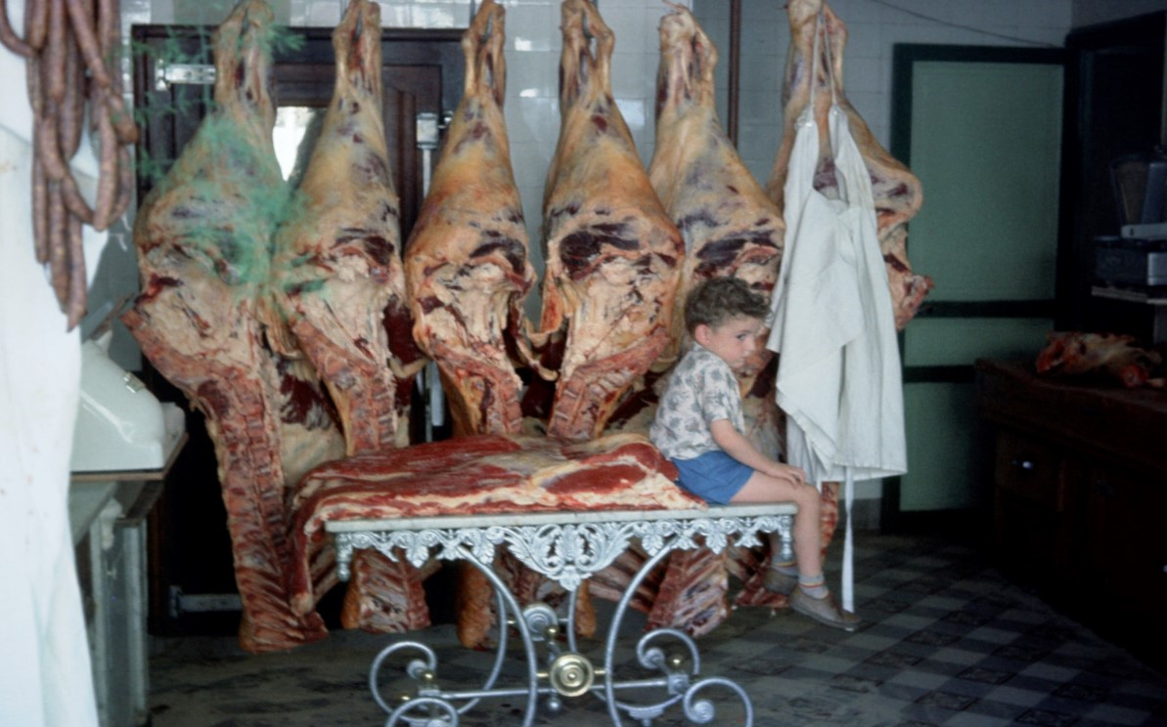
To stay young… for ever!

Slide 3
Regulation: a Lego to play…
Two Big Classics of Public Regulation -- -- -- --
1st Layer: To submit (Natural Monopolies) to Social Welfare
2nd Layer: To implement Political Economy of (Universal Service)
Two Revolutions of Public Regulation: Industry Structure, Technology, Market Arrangements -- -- -- --
3nd Layer: To coordinate (Unbundled Grids) & (Market Design)
4th Layer: To innovate with (Decentralization) + (Digitalization)

Slide 4
Decentralization opens by streams of changes
1- Distributed Generation (Wind, solar)
Size: Old 2GW or 600MW > 10MW, 2MW > 2kW = /1k to 1m
Location: TRSM grid > Dstrb Grid
2- Demand Response (Aggregators, Platforms, etc)
Size: Old 1MW > 1 kW = /1k
Location: Behind the Meter
3- More to come (Storage, El.cars, Smart Buildings)
Size: ? (Tesla Australie – Tesla Home); Fleets: El.cars; Smart Buildings
Location: All Behind the Meter

Slide 5
1/ Decentralization has two children
*1*End of single centralized Utilities
substituting multiple players, all along the value chain
**2**End of single centralized System Operation
substituting multiple levels of control & optimization
(micro-grids; distribution grids; transmission grids)

Slide 6
Digitalization favoring two streams of changes
1/ Playing from outside Traditional Sector:
Fleets of “Behind the Meter devices” can be gathered & controlled to be managed as system smart assets
> electric car fleets; “zero net consumption” buildings
2/ New ways of coordinating small decentralized units:
thanks to Agregators & Platforms P2P
down to Blockchain networks
>Blockchain network is P2P with NO intermediary, NO UBER between Peer-2-Peer
3/ BUT, but, BUT…

Slide 7
Digitalization favors two streams of changes
1/ Playing from outside Traditional Sector
2/ New ways of coordinating all decentralized units
3/ BUT, but, BUT WITHIN “Amazon Delivery Loop constraint”
> the needed / desired “Distribution Grid Platform”
> “Utility of the Future” Ignacio Perez-Arriaga
when perfectly set up (his MIT Report 2016)
>>New York “Distribution Platform” project
if implemented (Sioshansi Fereidoon books 2017; 2019)

Slide 8
Decentralization & Digitalization can only strongly interact
1/ Because they have similar wings of change
Decentralization, more playuers, smaller units
“Behind the Meter” targets of “smart assets”
Aggregators & Platforms P2P offering ways of entry into the “El. Amazon Loop” delivery constraint
2/ Because both 2Ds (Decentralization & Digitalization)
touch upon the same: tasks, assets, operation, apps, integrators, platforms
> Up to Governance
with new types of players going to play, as
*Communities of Peers
**Clubs of Partners
***Smart Local Authorities

Slide 9
Conclusions : challenges for … regulators
1> New Coordination Tasks:
Beyond “Utilility”+ “Behind the Meter” + interactions Transmission – Distribution – ‘Mini Grids’
2> New Incentive Regulation:
To favour structural business innovations & new business models <through> incentive Regulatory Frames
3> New Protections needed: a) individual privacy - from abuse of digital power (typical: EU new regulation; but) b) all industry chain software - from piracy & org. crime c) system hardware - from extreme natural events, as forest fire, flood, tornado…

Slide 10
Do you want to know more about Digitalisation?
Please read my policy brief:
http://fsr.eui.eu/publications/the-digital-world-knocks-at-electricitys-door-six-building-blocks-to-understand-why/

Slide 11
Muchas Gracias! Muito obrigado!
Email : jean-michel.glachant@eui.eu
Tweeting no Twitter: @JMGlachant ~46 000 tweets
Web site: http://fsr.eui.eu/

