Slide 1
EU Electricity Regulation - Present & Future
Jean-Michel Glachant, Director FSR
IIT Kanpur – Center for Energy Regulation
10 October 2018

Slide 2
Table of content
EU Electricity Wholesale Market Design (Regulation)
[1] El. Day-Ahead Energy Markets & European Coupling
[2] Network codes as EU Market Design
EU Electricity System Long Term (Analysis)
[3] Mid term generation adequacy forecast 2017
[4] Ten Year Network Development Plan 2018
EU Electricity Transition – very long term (Vision)
[5] How to surf on innovation waves… >> Tomorrow

Slide 3
What a mess? Or what a chess?
Balancing market
Day-ahead market
Bilateral / OTC
Market coupling
Intraday markets
Reserves/ ancillary services markets
Peak load product
Flexibility market
Market splitting
Explicit auctions for transmission capacity
Base load product
Capacity markets
Congestion management
Long term contracts
Implicit auctions

Slide 4
[1] El. Day-Ahead Energy Markets & European Coupling

Slide 5
The case of Europe
Are the European markets coupled or national?
Country B
Day ahead
Market
(energy B)
Intraday
market
(energy B)
Balancing
Mechanism
(Power B)
‘’Gate
Closure’’
Day ahead
Market
(transmission A-B)
Intraday
market
(transmission A-B)
Balancing
mechanism
(transmission A-B)
Interconnection
capacity
Country A
Day ahead
Market
(energy A)
Intraday
Markets
(energy A)
Balancing
Mechanism
(Power A)

Slide 6
What El. Wholesale markets to integrate? How EU does it ?
Space
Country B
Day ahead
Market
(energy B)
Intraday
market
(energy B)
Balancing
Mechanism
(energy B)
Day ahead
Market
(transmission A-B)
Intraday
market
(transmission A-B)
Balancing
mechanism
(transmission A-B)
Interconnection
capacity
Country A
Day ahead
Market
(energy A)
Intraday
Markets
(energy A)
Balancing
Mechanism
(energy A)
Time

Slide 7
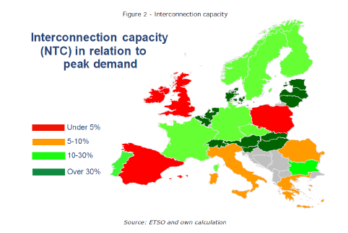
Given transmission limited capacity, national energy markets cannot be perfectly coupled 8760h every year
Why to split EU D-A energy market?
EU market is split when transmission capacity is constrained (i.e., when there is a congestion)
Cross-border congestion management calls for coordination (coupling/decoupling) of D-A energy markets

Slide 8
2 options to coupling/decoupling D-A EU el. energy markets?
Explicit auctions
Cross-border transmission capacity is a separate market
Cross-border integration of energy markets is left to the ability of arbitrageurs
Implicit auctions (market coupling or market splitting)
Algorithm common to Power Exchanges & TSOs allocates cross-border capacity according to energy bids’ merit order
Implicit auctions
Explicit auctions
Country B
Day-ahead
Markets
of both countries
(energy A + B)
Matching
Algorithm
Allocates
transmission
capacity A to B
to best A+B
energy bids
Day-ahead
Market
(energy B)
Day-ahead
Market
(transmission A-B)
Country A
Day-ahead
Market
(energy A)

Slide 9
A landmark: EU Day-ahead market coupling
MRC= Multi regional coupling
MC= Market coupling
Coupled DA-markets in the EU (ENTSO-E, 2017)

Slide 10
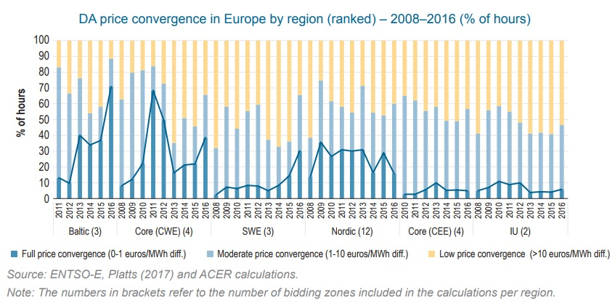
How integrated are EU Day-Ahead energy markets within Market Coupling?

Slide 11
The complete set of EU wholesale el. markets
Sequence of wholesale el. markets
Electricity component
Scope
Real time /
Balancing
Mechanism
(centralised
by the TSO)
Long-term Energy markets
Short-term Energy markets
Energy
Energy
Long-term Transmission markets
Short term Transmission markets
Transmission
Transmission
Long-term
Reserves/
flexibility markets
Short term
Reserves/
flexibility markets
Flexibility Reserves
Reserves / flexibility
T-~2h
Delivery by injection
T-~months/years
T-~24h
T
Time
NB: markets for flexibility are often called “reserves” because the TSO reserves some flexible capacity (power station or demand response) to ensure enough flexibility in real time

Slide 12
[2] Network Codes as EU Market Design

Slide 13
What is a EU network (code or guideline)?
1
A set of practical rules applied to cross-border & market integration issue
2
Developed by gathering of NRAs into ACER, of TSOs into ENTSO-E + Control by the European Commission (under Art. 8 of Electricity Directive 2009)
3
Going through a EU law-making process called ‘Comitology’
Adoption transforms network codes & guidelines proposals into binding “EU laws” as “Regulations” to be implemented in all EU countries by all NRAs & TSOs
4

Slide 14
Which EU electricity network codes?
How to integrate power markets?
Market codes
Forward Capacity Allocation (FCA GL)
Capacity Allocation and Congestion Management (CACM GL)
How to harmonize grid connection rules?
Grid connection codes
Demand Connection Code (DCC NC)
Requirements for Generators (RfG NC)
How to seamlessly operate a power system?
System operation codes
System Operations (SO GL)
Emergency and Restoration (ER NC)
Electricity Balancing (EB GL)
HVDC Connections (HVDC NC)

Slide 15
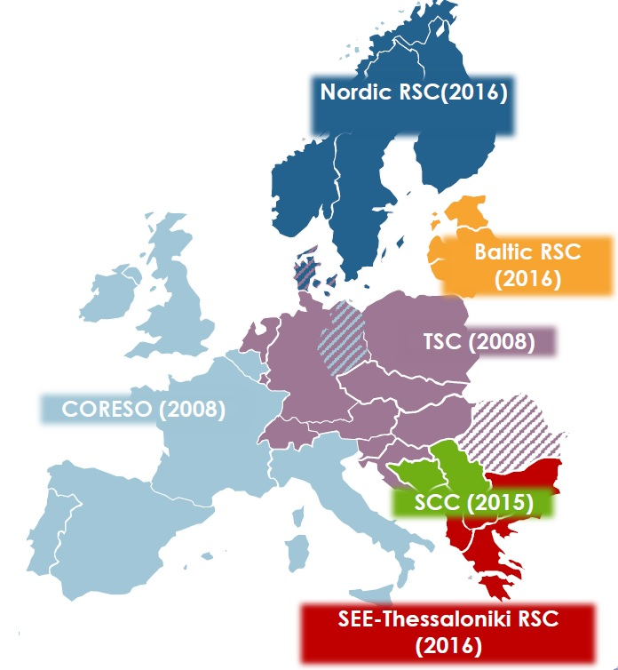
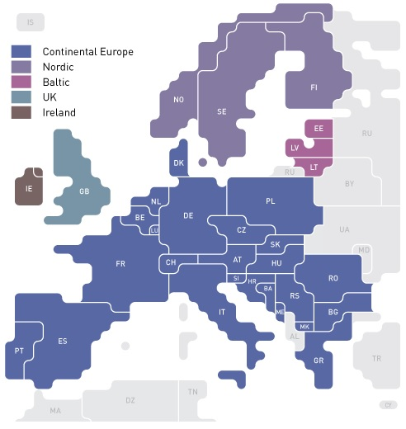
Operations codes: e.g. towards regional operation?
Synchronous zones in the EU (ENTSO-E, 2017)
Regional Security Centres (ENTSO-E, 2017)

Slide 16
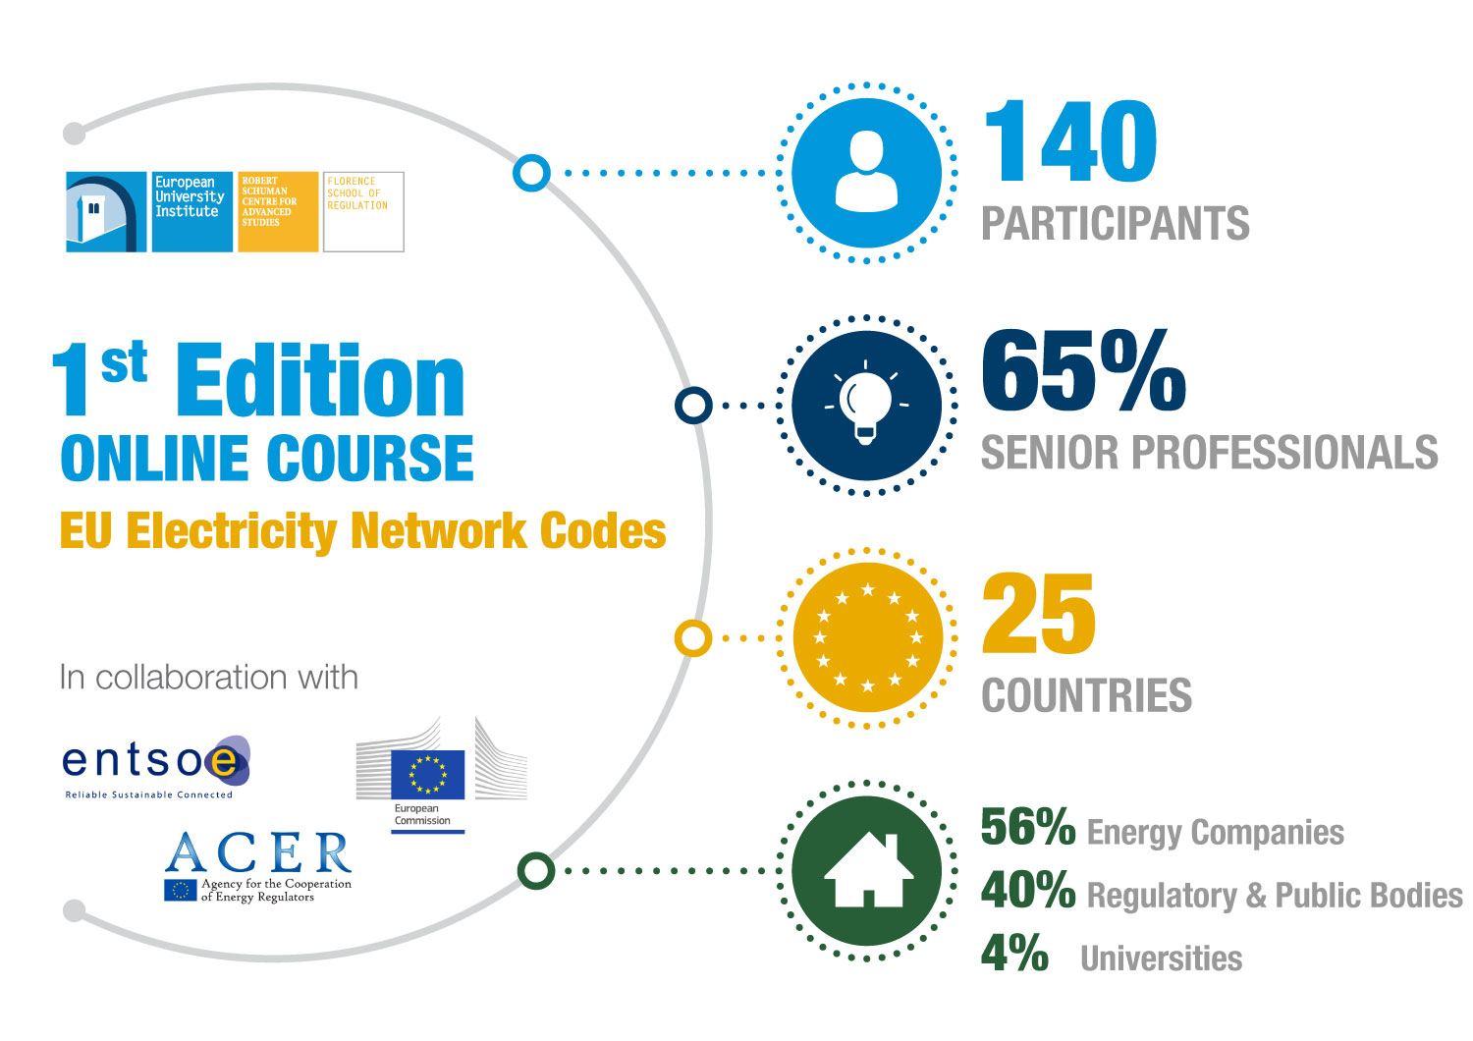
Notes:
LEO

Slide 17
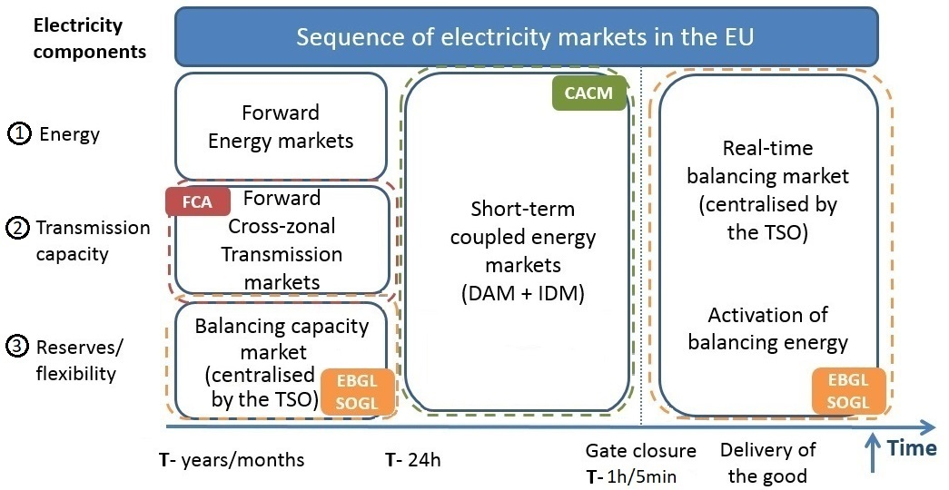
Network codes course at Florence School (Content)

Slide 18
[3] Mid term EU generation adequacy forecast 2017

Slide 19
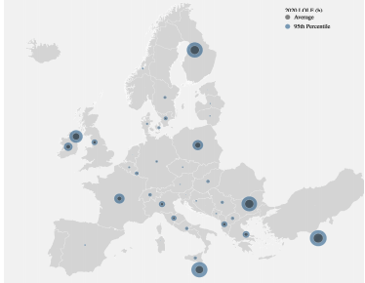
2020 Loss of load expectations (LOLE) – base case
Loss Of Load Expectation (h/y) LOLE is the number of hours in a given period (year) in which the available generation plus import cannot cover the load in an area
Main risk of resource scarcity:
• Islands
(e.g. Cyprus, Malta, Ireland and Northern Ireland)
• periphery*
(e.g. Albania, Bulgaria, Greece and Finland)
* Periphery to simulated countries of continental Europe

Slide 20
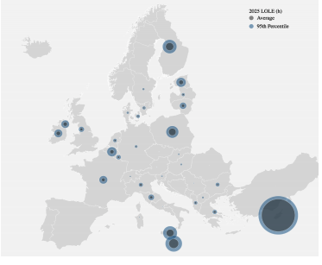
2025 Loss of load expectations (LOLE) – base case
Island/ periphery risk confirmed
Belgium and Baltics risk appear

Slide 21
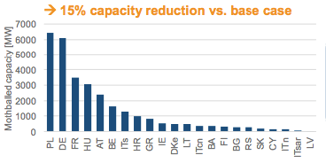
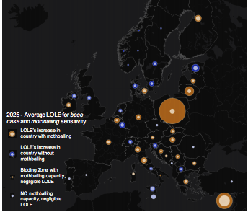
Mothballing sensitivity leads to large uncertainty and thereby strong interdependency
Mothballing in 45% of the countries significantly impacts adequacy in 82% of the countries
Importance to have reliable generation plan from utility (min 3-5 years)
Crucial to get a clear picture
Significant impact on adequacy in a larger region
Coordinated studies needed
Notes:
Substantial capacities at risk of being mothballed, with far-reaching consequences for adequacy: In our data collection, 45% of the countries reported generation capacities at risk of being mothballed, representing a reduction of thermal generation capacity by 15% compared to the base case (best estimate). In a sensitivity simulation analysing adequacy in Europe without these capacities, significant impacts are observed. In fact, these mothballing activities would imply tightened adequacy margins in 82% of the countries, thus having a substantial effect far beyond national borders. It will therefore be crucial to monitor mothballing activities on a broader European scale.

Slide 22
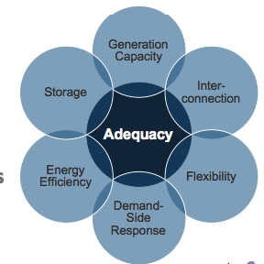
Proposal new EU energy law (“Package”)
Clean Energy Package:
“Where the European resource adequacy assessment identifies a resource adequacy concern; Member States shall identify any regulatory distortions that caused or contributed to the emergence of the concern”
Strong Pan-European and technological interdependencies.
Need to coordinate and align activities

Slide 23
[4] Ten Year Network Development Plan

Slide 24
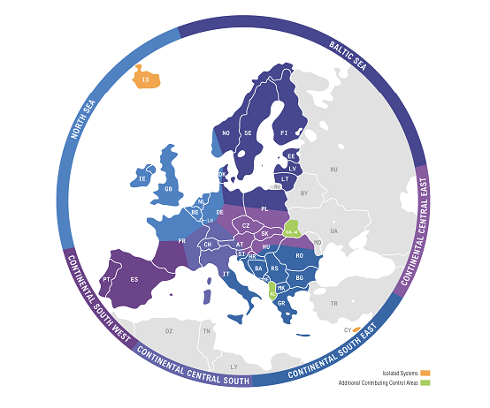
Ten Year Network Development Plan (TYNDP)
Long-term network development plan is one of the core missions of any transmission system operator (TSO).
It allows them to tailor grids to the evolution of demand and generation, securing an affordable supply of energy for customers in the next decades.
Having a European approach to grid planning ensures consistency and cost-efficiency.
The TYNDP is thus key to many of Europe’s economic, climate and energy objectives.

Slide 25
Ten year network development plan
ENTSOs for electricity & gas pooled their efforts and expertise to provide a joint set of scenarios, allowing for assessments of future investment decisions in Europe to be based on comparable analysis between the sectors. Together, we described three markedly different and ambitious paths towards delivering the future European emission targets
Scenarios
Short term and medium term
2020
2025 Coal Before Gas (CBG) and 2025 Gas Before Coal (GBC).
Long terms :
Sustainable Transition (ST) Targets reached through national regulation, emission trading schemes and subsidies, maximising the use of existing infrastructure.
Distributed Generation (DG) Prosumers at the centre – small-scale generation, batteries and fuel switching society engaged and empowered.
Global Climate Action (GCA) Full speed global decarbonisation, large-scale renewables development in both electricity and gas sectors.
External Scenario: Based On EUCO 30 EUCO 30 is a core policy scenario produced by the European Commission. The scenario models the achievement of the 2030 climate and energy targets as agreed by the European Council in 2014, but including an energy efficiency target of 30%. The ENTSOs both welcome this new collaboration with the European Commission and welcome further cooperation.

Slide 26
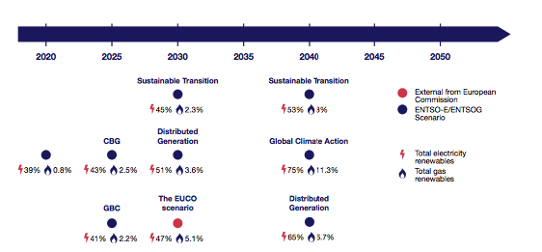
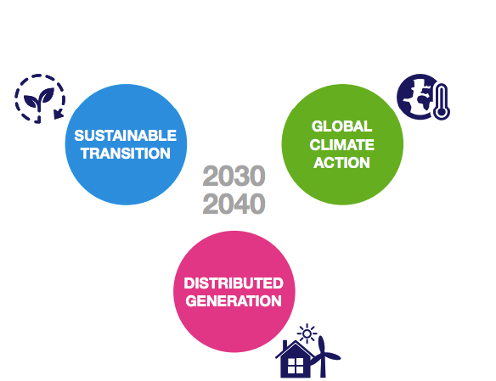
Ten year network development plan

Slide 27
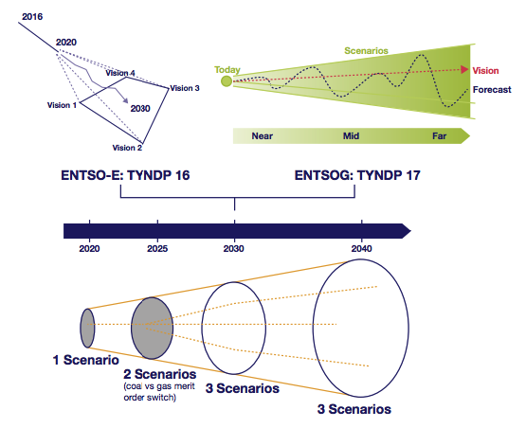
Ten year network development plan

Slide 28
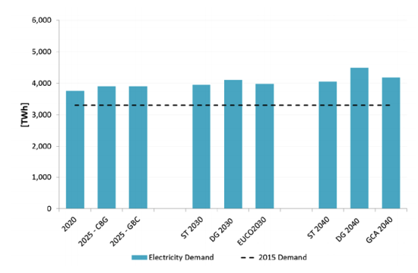
TYNDP 2018– Scenario results- electricity demand

Slide 29
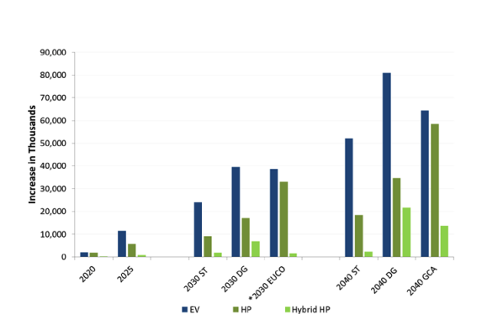
TYNDP 2018– Scenario results- electricity demand

Slide 30
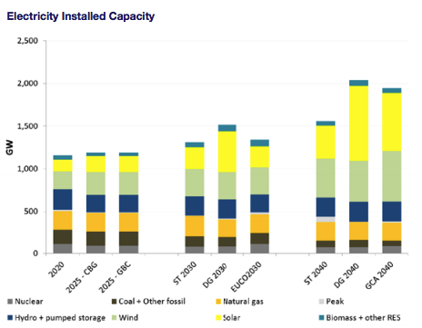
TYNDP 2018– Scenario results- electricity supply

Slide 31
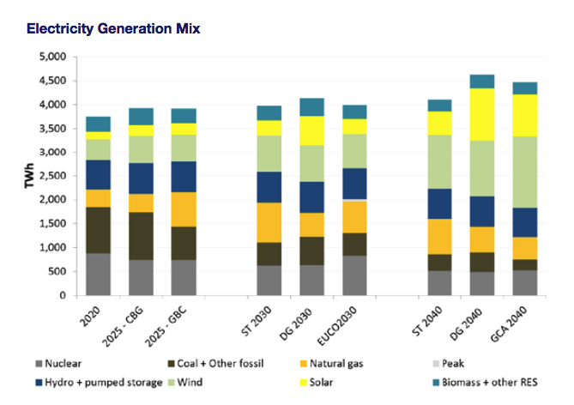
TYNDP 2018– Scenario results- electricity supply

Slide 32
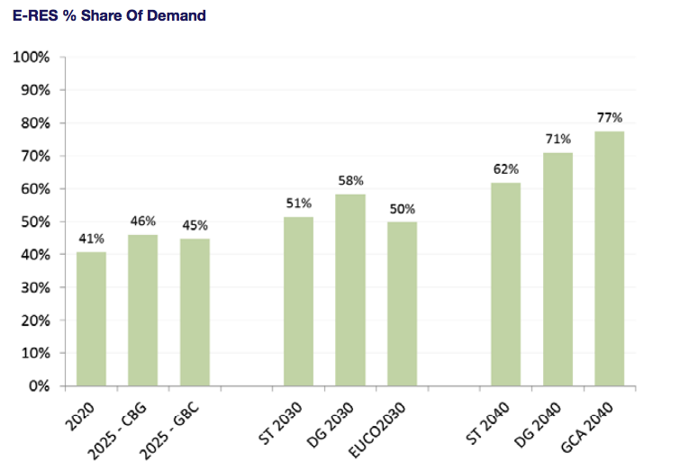
TYNDP 2018– Scenario results- Increase in RES

Slide 33
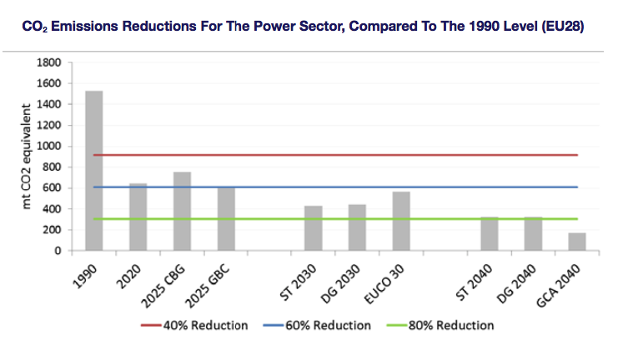
TYNDP 2018– Scenario results- emission reductions

Slide 34
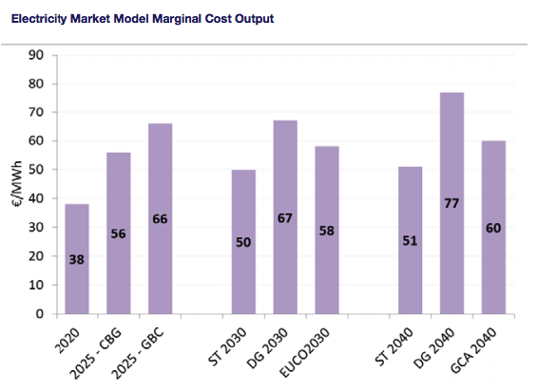
TYNDP 2018– Scenario results- marginal cost

Slide 35
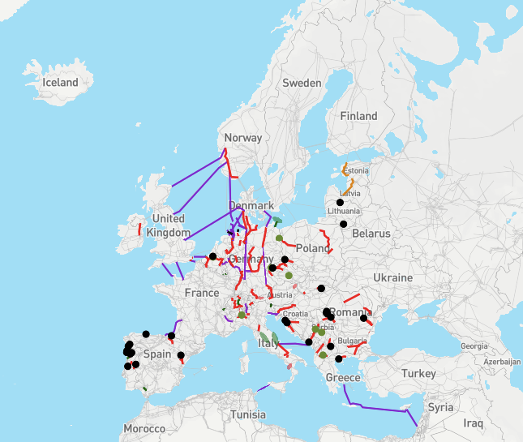
TYNDP 2018– Projects – Mid term

Slide 36
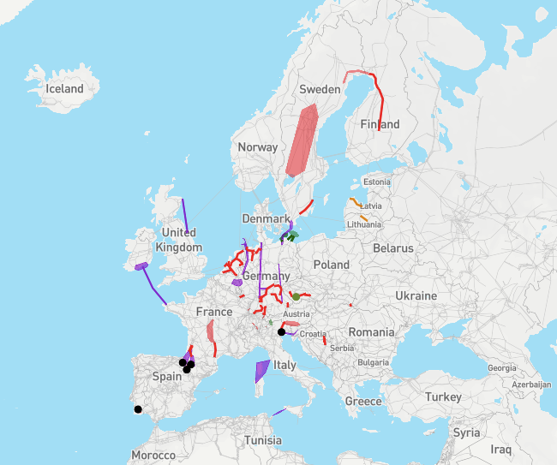
TYNDP 2018– Projects – Long term

Slide 37
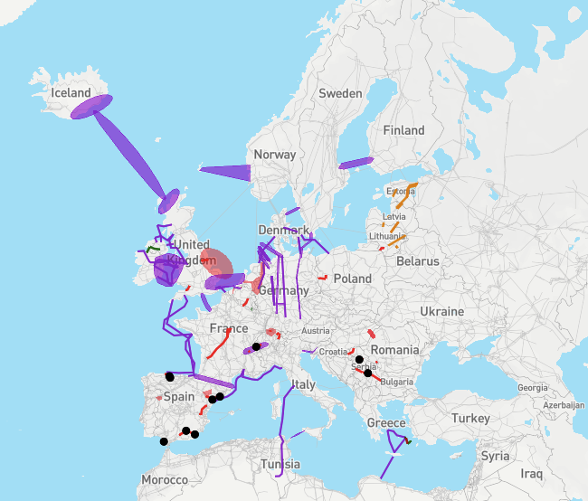
TYNDP 2018– Projects – Future

Slide 38
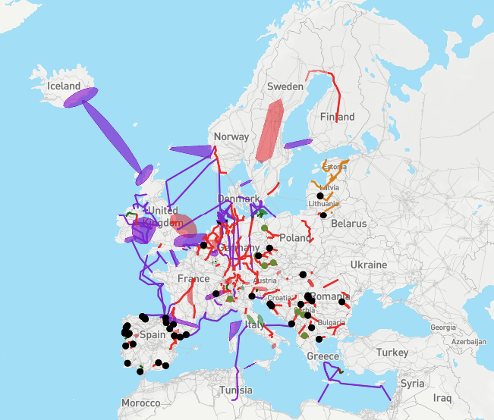
TYNDP 2018– Projects – All projects

Slide 39
[5] Other Changes are coming: Tomorrow ☺

Slide 40
Many thanks for your patience!

Slide 41
Dhanyavad!
Email : jean-michel.glachant@eui.eu
Tweeting no Twitter: @JMGlachant >44 000 tweets
Web site: http://fsr.eui.eu/

