Slide 1
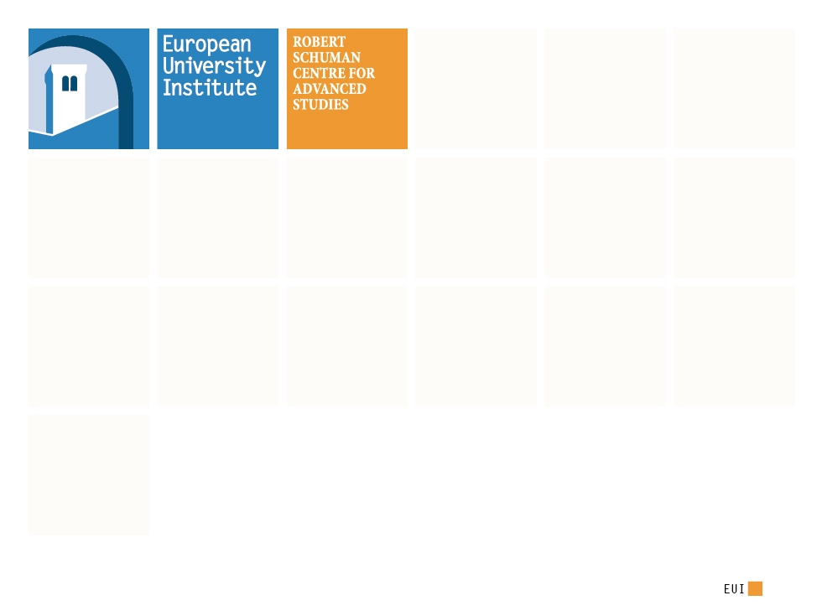
32nd Florence Forum Florence School “Pillars & Roadblocks” towards EU seamless Transmission System
Jean – Michel Glachant
Director Florence School of Regulation

Slide 2
Florence School Vision
Seamless EU Transm System
Pillar 1
Coordination
Decisions & Actions
Pillar 2
Sharing
Costs & Benefits
Pillar 3
Solidarity
> Costs & Benefits
Common foundations
Power Target Model & Network Codes
Our Analytical Framework
Notes:
2

Slide 3
Roadblock 1
Dealing with Redispatching Actions
Seamless EU Transm System
Pillar 1 Coordination
Decisions & Actions
Pillar 2
Sharing
Costs & Benefits
Pillar 1 Coordinating
Actions & Decisions
Pillar 2
Sharing
Costs & Benefits
Pillar 3
Solidarity
> Costs & Benefits
R2: Review of the bidding zones for DA and ID markets.
R1: Common methodology for costs & benefits calculation and costs allocation.
----- Long Term -----
R3: Common regulatory principles for the adoption of the results of the bidding zones review.
R2: Review of bidding zones for DA and ID markets.
R1: Adoption of a common methodology for costs calculation.
Common foundations
Power Target Model & Network Codes
Common foundations
Power Target Model & Network Codes
Our Vision
Notes:
3

Slide 4
Roadblock 2
Capacity Adequacy and Crisis Management
Seamless EU Transm System
Pillar 1 Coordination
Decisions & Actions
Pillar 2
Sharing
Costs & Benefits
Pillar 3
Solidarity
> Costs & Benefits
R1: TSO common methodology to assess capacity adequacy & value it cross-border.
R2: EU & MS common methodology for assessing the need of CRMs.
R3: Full access to neighbouring resources under market conditions when crisis affects a single MS.
R4: TSO driven coordination and sharing of scarce available resources during multilateral crises.
Common foundations
Power Target Model & Network Codes
Our Vision
Notes:
4

Slide 5
Thank you for your attention
For more information, read corresponding
FSR Policy Brief
FSR Research Report

Slide 6
(Thank you)2 for your attention
Email contact: jean-michel.glachant@eui.eu
Follow me on Twitter: @JMGlachant already 28 000+ tweets
My web site: http://www.florence-school.eu

Slide 7
Our lesson = our vision
One Analytical Framework
# EU already has foundations
# We check three Pillars for a seamless Transmission System
Two Illustrations
# Roadblock 1: Dealing with Redispatching Actions
# Roadblock 2: Capacity Adequacy & Crisis Management

Slide 8
Analytical Framework: Three Pillars for a Seamless Transmission System (1)
Integration of the European electricity systems began in the 1990s and was addressed by successive Energy Packages.
Nevertheless, the completion of the IEM is not yet achieved and the energy transition is creating new challenges.
Several, often basic, questions were not properly dealt with in the past decades.
The EU is needing at least three core pillars:
Comprehensive set of coordination tools;
Working principles for sharing costs & benefits;
Solidarity beyond costs & benefits.

Slide 9
Analytical Framework: Three Pillars for a Seamless Transmission System (2)
Around 35 TSOs from 30 countries are there in Europe (EU + Norway &Switzerland). Coordination among such a large number of entities is key to have a seamless operation of the interconnected system, ensuring service delivery and a level playing field.
The operation and expansion of the electric system crosses several political borders. Fair and efficient sharing of the costs and benefits is essential to enable coordination and cooperation between actors with different “shareholders”.
During emergency conditions markets are not always able to take the necessary swift decisions. In these moments, solidarity beyond narrow costs & benefits calculation must be displayed in order to guarantee continuity of supply and the protection of the most vulnerable customers.

Slide 10
Roadblock 1: Dealing with Redispatching Actions
The growing share of variable RES in the generation mix and the surge in cross-border trade have increased the need for TSOs to re-dispatch power plants after market closure. Costs have gone up.
Redispatching actions call for cross-border coordination in system and market operation, in order to minimise overall costs, take into account spill-over effects and ensure security.
Redispatching actions call for identification of costs and benefits and their sharing among interconnected systems.

Slide 11
Roadblock 2: Capacity Adequacy and Crisis Management
The break-up of old monopolies, the increasing interconnection of neighbouring grids and the deployment of variable RES make capacity adequacy difficult to assess and inefficient to promote at the national level.
Interdependence between national systems makes electricity crisis management at the national level expensive and often ineffective.
Capacity adequacy calls for coordination in its assessment at the regional and European level. Equally, policies that promote it shall be coordinated beyond national borders.
Crisis management calls for cross-border sharing of costs at market prices when scarcity affects one country and for solidarity among countries when scarcity is multilateral and markets do not work properly anymore.

