Slide 1

EU
Electricity (& Gas)
Markets
Jean-Michel Glachant
Director Florence School of Regulation
European University Institute (Florence, Italy)
FSR.EUI.EU

Slide 2
2- Why EU?
3- Why Electricity? as Gas?
1- Why Markets?
Jean-Michel Glachant
Director Florence School of Regulation
European University Institute (Florence, Italy)
FSR.EUI.EU

Slide 3
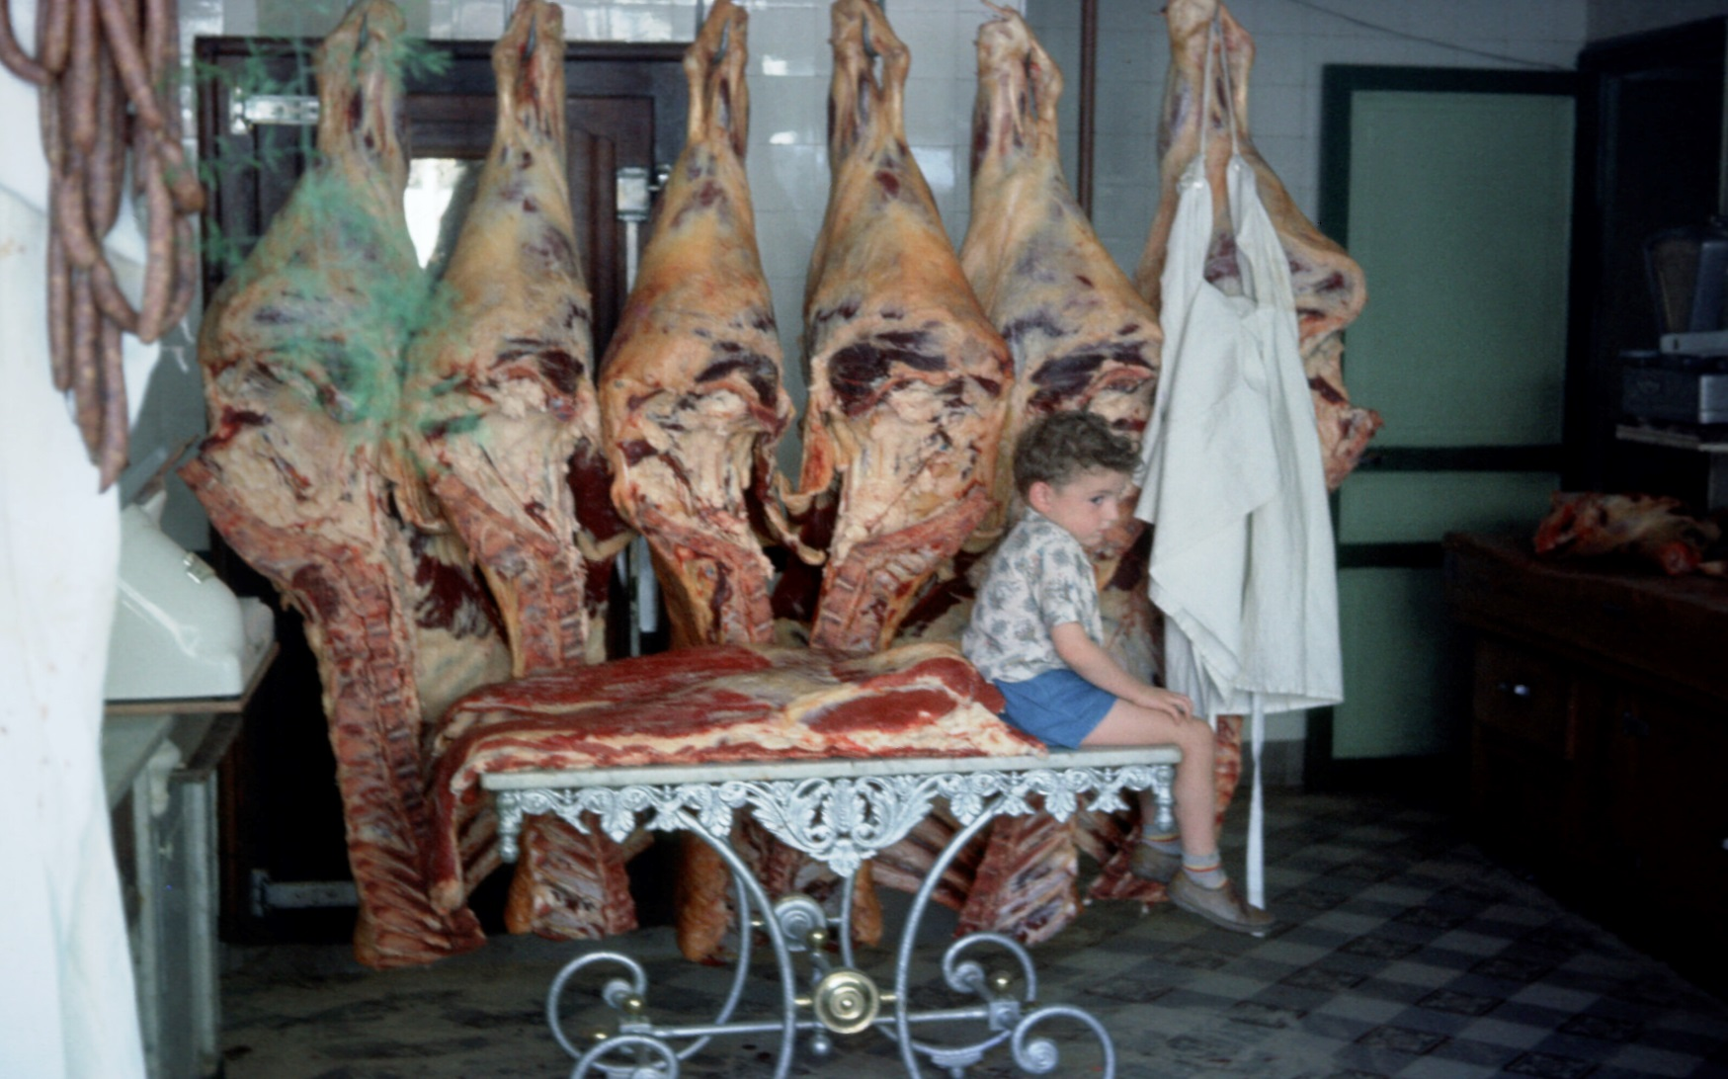
First step with markets: a case study

Slide 4
First Poll: a market
Is this boy sitting in a market?
Would you say that his father was buying electricity in a market?
At what age will this boy discover that electricity could be sold in a market?
Yes / No / Maybe
Yes / No / Maybe
Next day / 36 years later / Still waiting 60 years later

Slide 5
Everything for more xy’
Everything you would like to be told about my discovery of energy markets since April 1994 (Just ask)
Everything you wouldn’t like to be told about it (Don’t ask – I will do by myself)

Slide 6
Second market step
Snapshots from Gjm in 2002-2006
So long ago… so far so good?

Slide 7

ESNIE @ MIT - Cambridge (Mass.)
September 29th 2002
Jean-Michel Glachant & Virginie Pignon
Universities Paris XI & Paris I
Nordic Congestion’s Arrangement
as a Model for EU El. Market:
More Liquidity for EU El. Market… or…
More Money for EU Transmission S.O.s?

Slide 8
A Core Issue of El. Reforms:
Coordinating Competitive Markets & Network Constraints
UK (1990-2001)
Single Wholesale El. Market sets a single Energy Price
At Congestion Time:
The Network Operator adds to this a Congestion Uplift
NORDIC Countries (1996-)
At Congestion Time:
Splited Wholesale El. Markets setting separated Energy Prices who valuate the Congestion
>Pionnering European Model
for Internal Coordination
in a ‘Single Country’
>Pionnering European Model
for International Coordination
between 2 to 4 Countries (Norway, Sweden,etc.)
>Is that Nordic Model the Best solution for the whole EUROPEAN UNION?

Slide 9
Second Poll: a market?
Is this 2nd story more about market?
Is this 2nd story more about network?
Is this 2nd story more about regulation?
Yes / No / Maybe
Yes / No / Maybe
Yes / No / Maybe

Slide 10
EURELECTRIC
15th JUNE 2004
Jean-Michel Glachant
University Paris XI www.grjm.net
Electricity Regulatory Governance Models:
Do turkeys vote for Christmas?

Slide 11
Electricity Turkeys’ Governance seen through Academic Eyes
‘Foie Gras’ of El. Turkeys is made of Wholesale Market + Transmission Services
Academic Eyes on Regulatory Governance:
Who rules what when the reform starts?
+ Acheaving what ends?
5 Models of El. Turkeys’ Governance:
3 Reform Pioneers
  ( GB 1989; California 1996; Sweden 1994)
  + 2 EU Heavyweights
  (Germany 1998; France 2000)

Slide 12
El. Turkey Recipe N°1: ‘au whisky’
British Wholesale Features (1990-1994)
1°Day Ahead Wholesale Market (Electricity Pool) mandatory for generators and suppliers and both vertically unbundled
2°Pool a ‘non profit’ organization governed by generators and suppliers
3°TSO operating Pool & TRSM services under supervision of generators and suppliers

Slide 13
Third Poll: Governance
Is governance anymore a market issue?
Is congestion governance about (market) or (network) issue?
Should market or network governance be set by (market players)?
Yes / No / Maybe
Yes / No / Maybe
Yes / No / Maybe

Slide 14


www.grjm.net
Jean-Michel Glachant
(Univ. Paris Sud)
Brussels, 9th March 2006
SESSA research…
Acheiving the Internal Market in 2009?
www.sessa.eu.com

Slide 15
20 priorities derived from SESSA
Research Programme
Premises
  Making progress towards a competitive and integrated EU market
  Feasible priorities for 2006-2009
  Without new pieces of legislation (i.e., no third package)
  Driving forces: EU law enforcement (2d Directive and companion Regulations, Regulation 1/2003, ECMR, …) + regional cooperation (between TSOs, NRAs, PXs…)
Notes:
Definition: A cartel is essentially an agreement to limit output with the objective of increasing prices and profits. In practice this is generally done by means of price-fixing, allocation of production quotas or sharing of geographic markets or product markets.
A cartel agreement is generally viewed as an infringement of a very high level of gravity. George Stigler, the Chicagoan economist has used the term of industrial incest to designate such a firm’s behavior.
The basic reason is that one can see no countervailing benefits. In comparison to a merger for instance where the integration of firms may result lower costs or better products that may counterbalance in terms of social welfare their increase in market power.
Such an absence of benefits from cartels is not, however, systematic. It is a good rule of thumb. But one may find sometimes some economic interest in collective action from firms. For instance in the chemical sector a cartel may ensure fixed costs recovery and therefore is a guarantee that long term investment will be made.
Anyway, taking aside this exceptional circumstances, cartels are very harmful to society and, therefore, must be fought and condemned without pity.
Priority because the aim of the EU competition law reform is to have more time, to dedicate more resources to serious infringement
Monti: In fact the very aim of the reform is to strengthen the enforcement of the Community rules in the field of cartels and other serious infringements

Slide 16

20 priorities derived from SESSA
Research Programme
6 months latter…
Premises
  Making progress towards a competitive and integrated EU market
  Feasible priorities for 2006-2009
  Without new pieces of legislation (i.e., no third package)
  Driving forces: EU law enforcement (2d Directive and companion Regulations, Regulation 1/2003, ECMR, …) + regional cooperation (between TSOs, NRAs, PXs…)
  Feasible priorities for 2006-2009 >> EURELECTRIC, ETSO, CEER & ERGEG competing with initiatives to achieve Internal Market
  Without new pieces of legislation (i.e., no third package) >> To be seen >> 2++ Package
  Driving forces: EU law enforcement (2d Directive and companion Regulations, Regulation 1/2003, ECMR, …) + regional cooperation (between TSOs, NRAs, PXs…) >> + DG COMP adding “incentives” + M&As Frenzy
Notes:
Definition: A cartel is essentially an agreement to limit output with the objective of increasing prices and profits. In practice this is generally done by means of price-fixing, allocation of production quotas or sharing of geographic markets or product markets.
A cartel agreement is generally viewed as an infringement of a very high level of gravity. George Stigler, the Chicagoan economist has used the term of industrial incest to designate such a firm’s behavior.
The basic reason is that one can see no countervailing benefits. In comparison to a merger for instance where the integration of firms may result lower costs or better products that may counterbalance in terms of social welfare their increase in market power.
Such an absence of benefits from cartels is not, however, systematic. It is a good rule of thumb. But one may find sometimes some economic interest in collective action from firms. For instance in the chemical sector a cartel may ensure fixed costs recovery and therefore is a guarantee that long term investment will be made.
Anyway, taking aside this exceptional circumstances, cartels are very harmful to society and, therefore, must be fought and condemned without pity.
Priority because the aim of the EU competition law reform is to have more time, to dedicate more resources to serious infringement
Monti: In fact the very aim of the reform is to strengthen the enforcement of the Community rules in the field of cartels and other serious infringements

Slide 17
Fourth Poll: EU market achievement
March 2006 dominant mood’s EU achievement in 2009 with NO new legislation?
September 2006 dominant mood’s EU achievement
November 2016 dominant mood’s
EU Law enforcement /or Regional Cooperation / or?
DG Comp / or 2++ Package / or 3d Package
DG Comp / or Regional Cooperation / or 3++ or 4th Package

Slide 18
Why a European market?
1-Because we are Europeans? As Bread & bakery? TV Channels? Telephone?
2-Because the scale of industry is as big as the EU? Electricity? Gas? Bank? Insurance?
3-Because competition expected from one national (monopoly) champion vs the other?
4-Because governments were OK to have the bad cop in Brussels?
5- Simply because & because?

Slide 19
5th & Last Poll: Why EU markets?
1- Because we are Europeans
2- Because Large Scale of this Industry
3- Because we need Nat.Champions to compete another Nat.Champions
4- Because MS prefer 2put Bad Cop in Brussels
5- Because it is like that, you know

Slide 20
Why electricity as gas?
Is there so many large countries in the world having open continental markets for electricity or/ and for gas?
Do they build markets similar to the EU for electricity and/or for gas?
Why should an electricity open market should be like a gas market and not like a telecom market, a train transportation market or a postal service market?

Slide 21

EU Energy Markets « à la carte »
www.grjm.net

Slide 22

Thank you for your attention
Email contact: jean-michel.glachant@eui.eu
Follow me on Twitter: @JMGlachant (>25K tweets)
My web site: fsr.eui.eu

