Slide 1

Clean Energy for all Europeans
Prof Jean-Michel Glachant & Prof Leonardo Meeus
Budapest, 21st of February

Slide 2
Winter package topics for this workshop
Regional Operation Centres
Regional balancing pilots
Capacity adequacy & load shedding
TSO-DSO coordination

Slide 3

www.kahoot.it
FSR introduces a statement
Polling to know what the room thinks
Group discussion
FSR concludes

Slide 4

My top 5 nicknames
Winter
2030
4rth
Jumbo
New deal

Slide 5
What is your nickname for this package
2030
4th liberalization
New deal
Bad deal

Slide 6
Regional Operation Centres

Slide 7
ROCSs (a new proposal) vs RSCs (the existing)
Regional Operational Centers
Regional Security Coordinators
New proposal made by European Commission in “Winter Package” (November 2016).
Set up by TSOs since 2008; and covering the whole EU next year (2018).

Slide 8
RSCs: “Regional Security Coordinators” replacing RSCIs next year
Regional Security Coordinators
Regional Security Coordination Initiatives
(a) mandatory according to EU common “System Operation Guidelines”;
(b) covering the whole EU next year (2018); (c) with the same 5 tasks:
  Short Term Security Analysis: risks & remedial actions for day & hours ahead
  Coordinating Grid outages,
  Coordinating cross-border capacity calculation,
  Studying Adequacy Generation, Consumption & Grid 1 week ahead,
  Creating common grid model & data feed: hours ahead to year ahead;
(d) don’t take decisions which stay with existing national TSOs.
a) voluntary initiatives by some TSOs since 2008 (Coreso, TSC);
b) not covering the whole EU;
c) not same Coreso study TSC platform;
d) don’t take decisions which stay with existing national TSOs.

Slide 9
ROCs: “Regional Operational Centers”
New proposal made by the European Commission in “Winter Package” (November 2016): more functions put in common into Regional Centers // don’t take decisions which stay with existing national TSOs
3 more If & when Entso-e agrees
4 Basics
Identifying risk scenarios and proposing to countries preparation plans;
Complement Entso-e EU outlooks with regional adequacy assessments;
Organizing training and certification for TSOs staff – up to regional simulators.
At generation shortage: to increase transmission capacity towards the country suffering the shortages;
Calculating daily balancing reserves at regional level; creating a regional platform offering these balancing reserves to all countries needing them;
Doing independent ex-post analysis of countries’ system incidents;
Managing flows of money between TSOs for X-B congestion rent & cost sharing;
1 more If & when NRAs & MS agree; or with a new voted EU Regulation
Decision-making powers (as for remedial actions or capacity calculation) might be transferred to ROCs.

Slide 10
Pick a statement that fits you best
No to RSCs and no to ROCs
Yes to RSCs, no to ROCs
YES to RSCs, and maybe ROCs in next step
ROCs asap

Slide 11
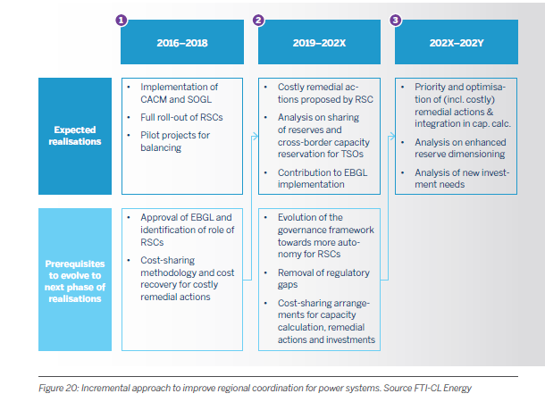
Fti Report approved by Entso-E (December 2016)
“Adoption of a gradual and modular process for the implementation of ERC”
(Page 73): What is different from the Winter Package??

Slide 12
Regional Balancing Pilots

Slide 13
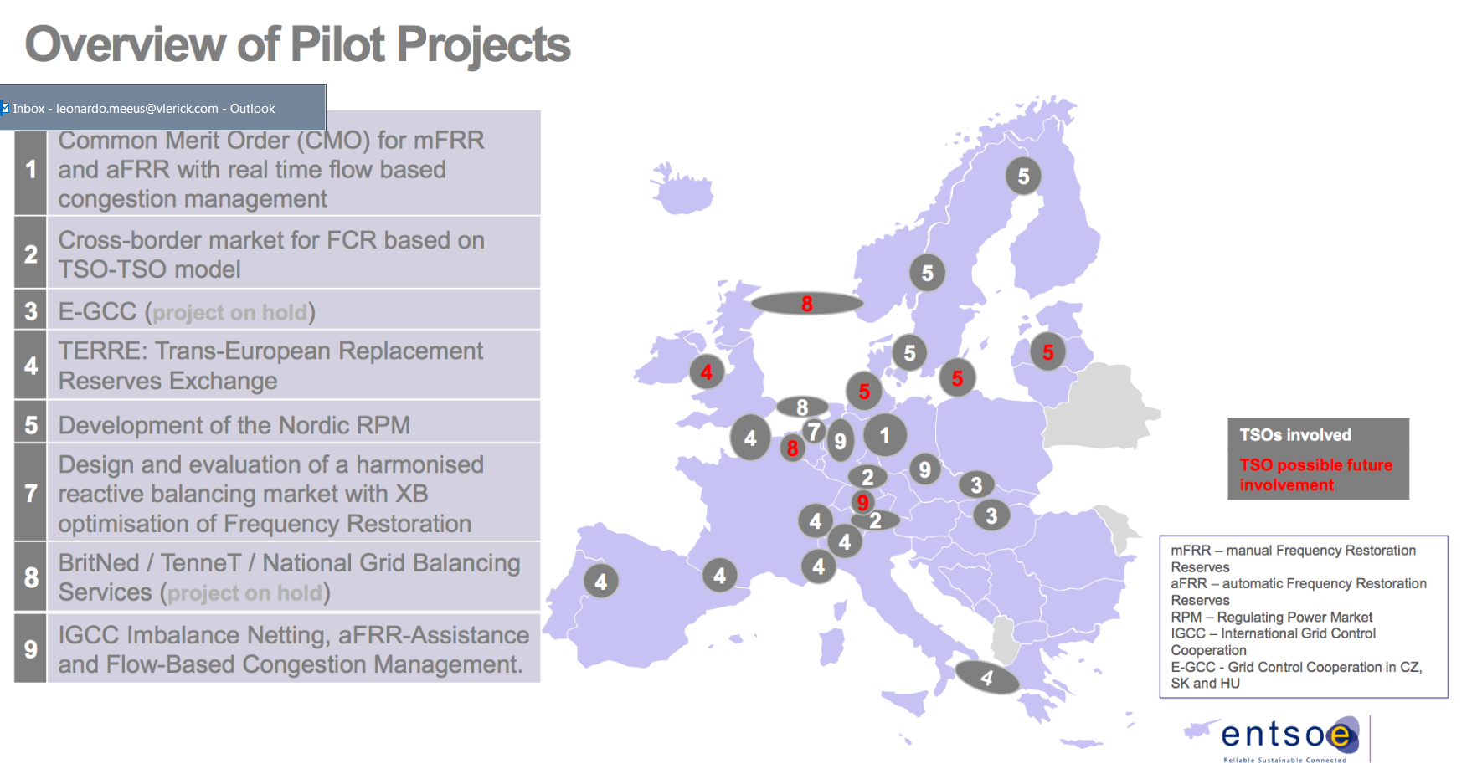
Overview of pilot projects

Slide 14
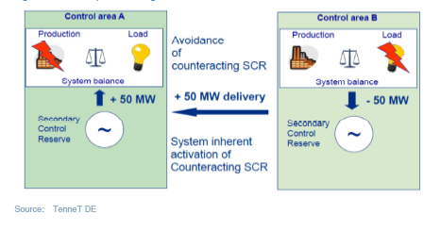
Introduction to « netting »
Imbalance netting cooperation (INC)
Austria (APG)
Slovenia (ELES)
Source: ACER (2014)

Slide 15
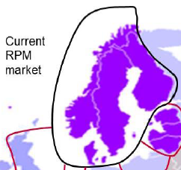
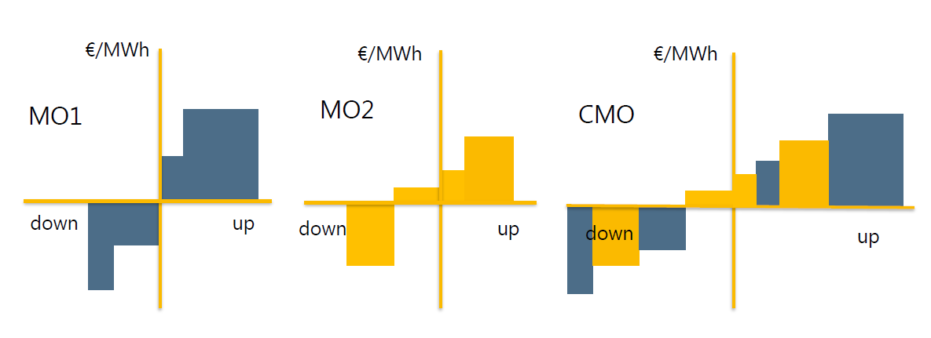
Introduction to « joint procurement »
Source: E-Bridge (2013)

Slide 16
Benefits of balancing market integration are biggest for
Netting
Joint procurement

Slide 17
Benefits of netting, e.g. imbalance netting cooperation
Austria APG
Slovenia ELES
From May 2013 until the end of 2013, 19% (11%) of upward (downward) secondary reserve needs in the APG area were met by applying imbalance netting
reduction of 9% in the costs of secondary reserve in the control area of APG
In the same period, ELES’ needs for upward (downward) secondary reserve were reduced by 29% (33%) due to imbalance netting
Source: ACER (2014)

Slide 18
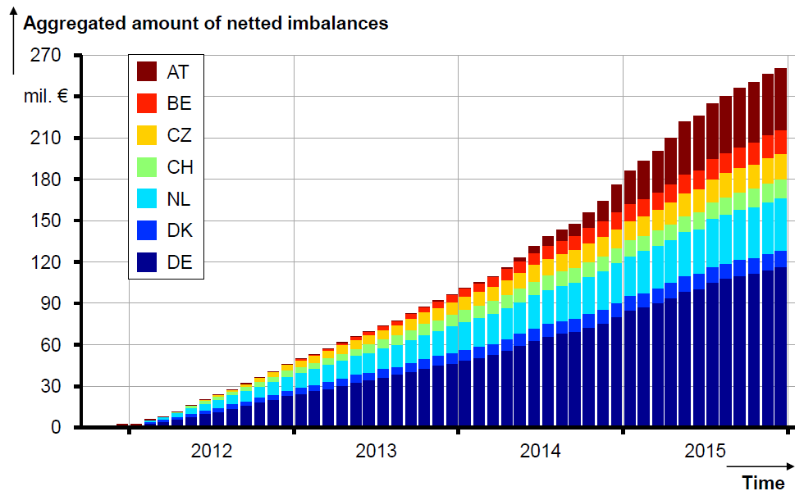
Benefits of netting, e.g. IGCC (25 euro/MWh)
ENTSO-E (2016), p 19

Slide 19
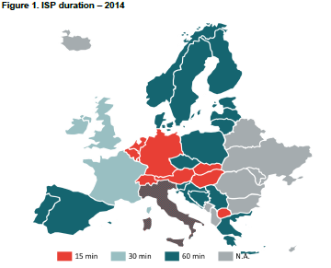
Also costs involved because starting point is non-harmonized, e.g. settlement period
Source: Frontier Eocnomics (2015)

Slide 20
  Benefits of joint procurement, e.g. Nordics
Regulating Power Market (RPM)
➔ Nordic mFRR (manual Frequency Reserve Restoration)
➔ Multinational market with Common Merit Order (CMO)
Results Jan 2013 – Feb 2014
In 14 months, the benefit of CMO amounts to EUR 230 mil.
Hydro has the largest share in RPM – over 80%
Source: Jensen (2014)

Slide 21
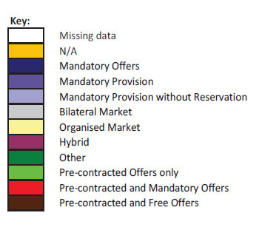
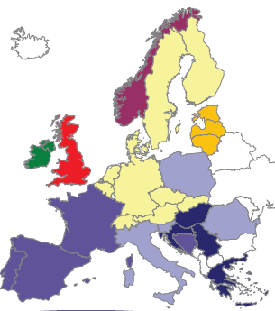
Also costs involved because starting point is non-harmonized, e.g. what and how to procure
E.g. Frequency containment reserve - capacity
Source: ENTSOE (2015)

Slide 22
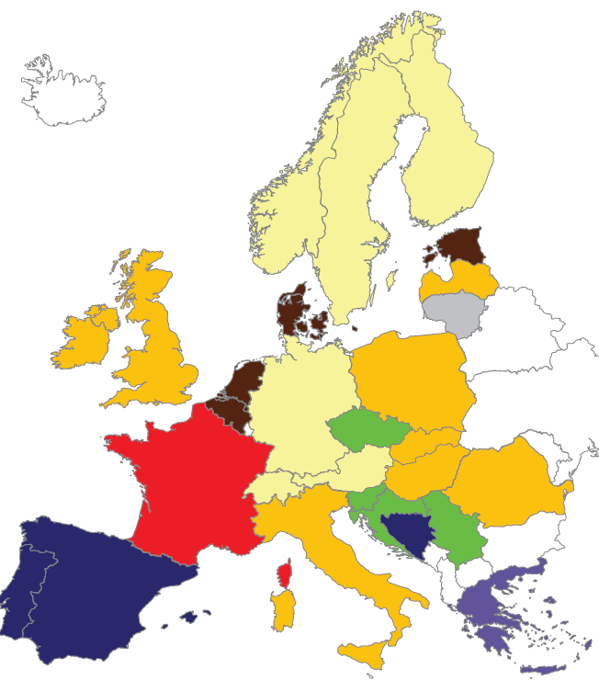
Also costs involved because starting point is non-harmonized, e.g. what and how to procure
E.g. Frequency restoration reserve (manual) - energy
Source: ENTSOE (2015)

Slide 23
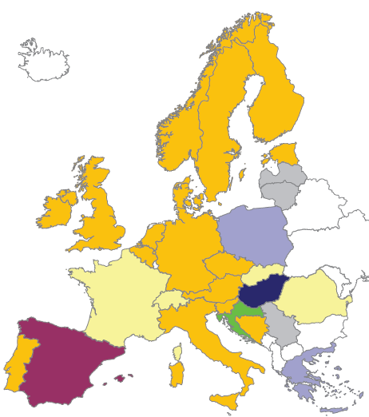
Also costs involved because starting point is non-harmonized, e.g. what and how to procure
E.g. Frequency replacement reserve - capacity
Source: ENTSOE (2015)

Slide 24
Capacity Adequacy
& Load Shedding

Slide 25
Capacity adequacy and load shedding are national security of supply
Capacity adequacy
Load shedding
Development of national capacity mechanisms as a response to growing concerns about system adequacy and reliability in the context of low wholesale prices and growing RES deployment.
Each country has its own national system concern (gen + load + grid). Each country has its own capacity adequacy approach.
Rules for load shedding are national because both system concern (gen + load + grid) &“willingness to pay & socialize” are national.
+ Uncertainty on potential cross-border availability in case of power shortage: can neighbors be trusted? We are better off if we don’t trust?

Slide 26
Capacity adequacy and load shedding are European market issue
Capacity adequacy
Load shedding
1- If generators build plants in country X with country X capacity market payments & sell energy everywhere in the EU with EU energy market payments, competition is distorted.
Capacity mechanisms are possibly used to subsidy national generation in the current context of low energy prices.
2- When a system goes to load shedding in a country, it stops running power market as “neutral decision maker” managing scarcity between buyers & sellers.
The “trigger” to close EU market functioning & come back to Gosplan orders should be defined by an EU set of rules

Slide 27
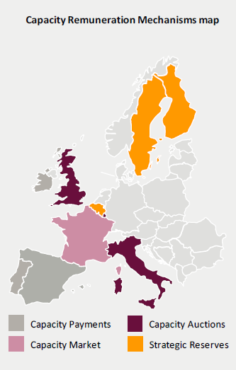
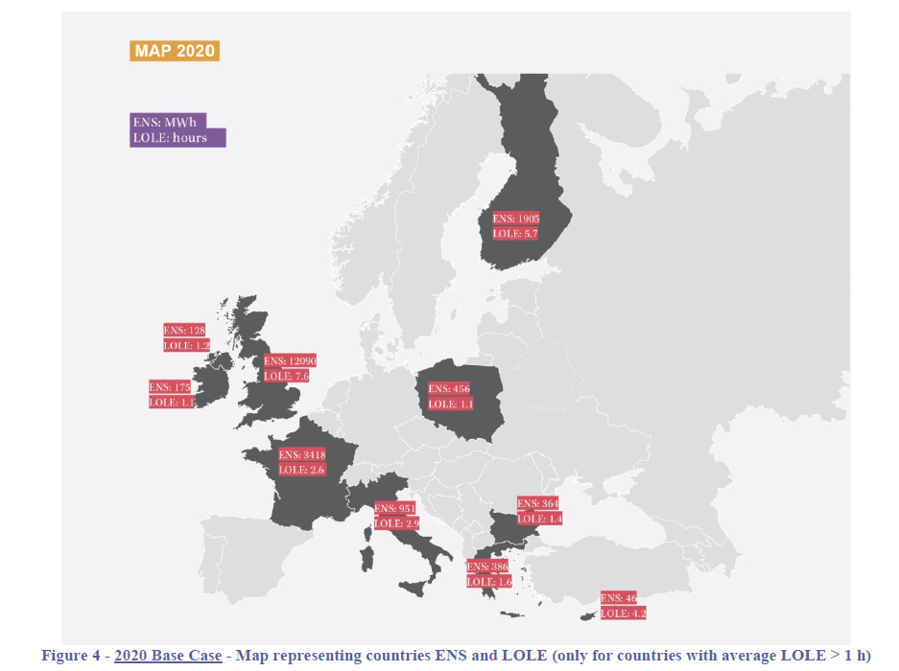
Non-harmonized national practices

Slide 28
What approach would you suggest for capacity adequacy & load shedding
Purely national
National with a bit of EU
EU with a bit of national
Purely EU

Slide 29
Could Capacity adequacy and load shedding become European Security of Supply?
Capacity adequacy
Load shedding
1- Entso-e could define common EU methodology to assess adequacy of individual power systems & to pencil common “XB access” adequacy schemes at the regional level
Can’t each country get help from neighboring countries from XB exchange? Is clarity helping trust?
2- Entso-e could define common EU methodology of “system stress alarms” & Governments (+NRAS, TSOs) at regional level agree on “regional stress triggers”
Rules of cross-border curtailment in case of single country or multi country capacity shortage can then be defined at regional level
Can’t each country get any help from any neighbor? Is clarity helping trust?

Slide 30
TSO-DSO Coordination

Slide 31
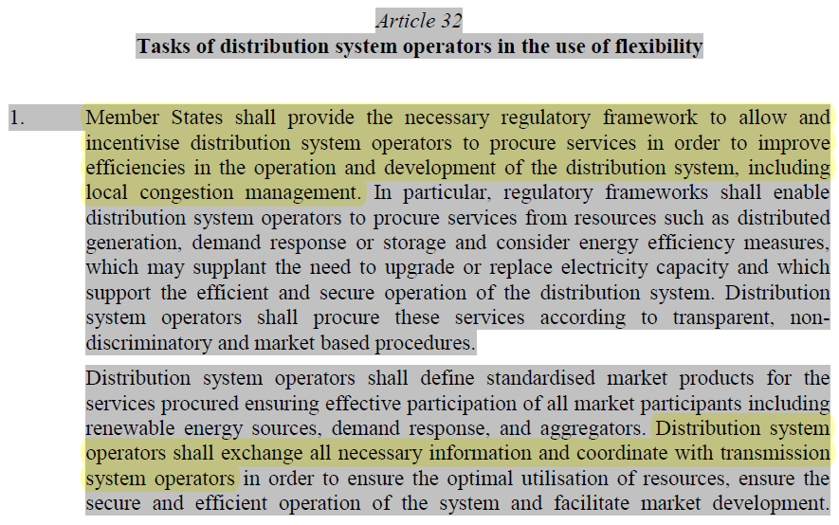
Winter package assigns a role to DSOs for local congestion management, but not for balancing
EC (2016) Proposal for a DIRECTIVE OF THE EUROPEAN PARLIAMENT AND OF THE COUNCIL on common rules for the internal market in electricity

Slide 32
Do you agree with winter package on role of DSOs in local congestion management?
No, DSOs should not have such a role in local congestion management
Yes, DSOs should have such an role in local congestion management
Yes, but DSOs should also have a role in system balancing

Slide 33
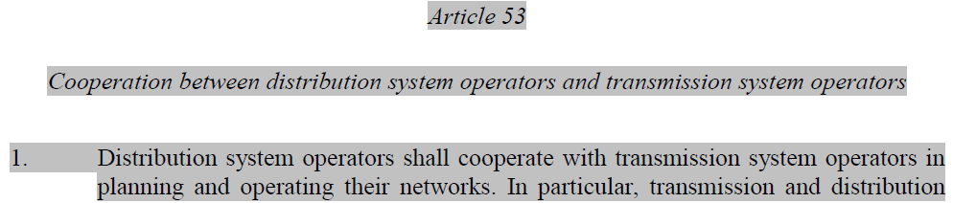
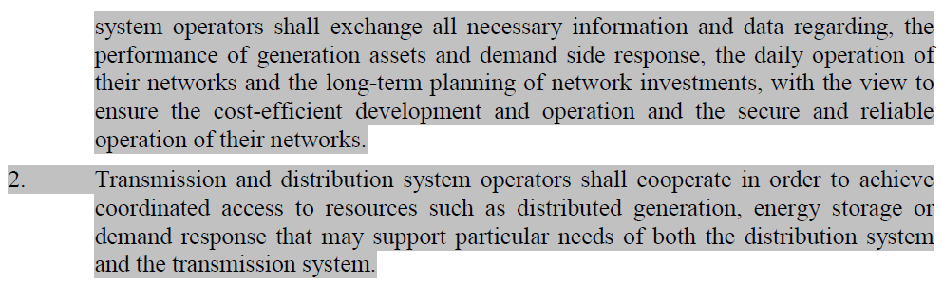
DSOs and TSOs shall cooperate for daily operation of their networks, but how?
EC (2016) Regulation on the internal market for electricity

Slide 34
Do you agree or disagree? We need
Standardized ancillary services for DSOs and TSOs
Jointly procurement of ancillary services by DSOs and TSOs
Coordinated activation of ancillary services in real time by DSOs and TSOs

Slide 35
Distribution grid congestion management
Different approaches
  Long term action: manage demand and supply of distribution grid capacity
    Supply: invest in more distribution grid capacity
    Demand: non-firm connections + non firm access by TSOs to distributed energy resources
  Short term action: manage congestion if there can be scarcity
    Ex-ante: constraints internalized in the market design
    Ex-post: adjustment to the market outcome
No perfect approach, each has its issues
  TSO-DSO coordination
  Market power
  Market risk
  Feasibility
Than can be at least partly remedied with regulatory measures

Slide 36



